Slide 1
OCB for 60 GHz V2X
Date: 2019-7-15
Authors:

Slide 2
Abstract
In this submission we propose an OCB mode for 60GHz STAs to 11bd to enable high data rate V2V applications proposed in [1].
The submission discusses possible spec changes to define OCB mode for 60 GHz.
[1] 11-19/0840r0 Use Cases for 11bd using High Data Rate

Slide 3
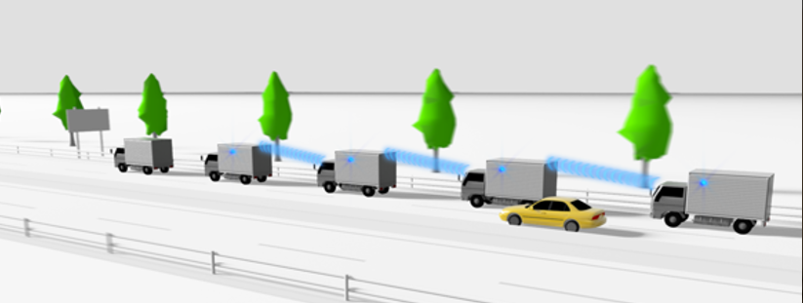
V2V scenario using 60GHz
The submission [1] proposes V2V See-through usage scenario that can be realized by using high data rate of 60 GHz band.
Also for 60 GHz band V2V, we think OCB is a suitable choice.
  In V2V scenario, peer STAs within the communication range may be changed rapidly. Handover signaling cost may be large if we employ BSS.
  It is expected that the 60 GHz band V2V is used as complement of 5.9 GHz V2V (11p/NGV). It transfers high volume data, while 5.9 GHz band provides more reliable link. Sharing upper layer should reduce signaling costs, and enable extension of DSRC/WAVE applications.
We propose to consider OCB for 60GHz band

Slide 4

Topology consideration
Scenario 1: each vehicle has single STA with 360-degree coverage with beamforming (and possibly multi-DMG antennas (antenna arrays))
Scenario 2: each vehicle may have multiple STA to cover 360 degrees.
OCB is suitable to handle multi-V2V topology including scenario 1 and scenario 2 since it doesn’t need to decide who’ll be an AP/PCP.
each STA has 360-degree
horizontal scan coverage
with beamforming
No available link
No available link
beam
(sector)
STA1
STA2
STA3
STA4
STA11
STA12
STA31
STA32
each STA has 180-degree
horizontal scan coverage
with beamforming
Lane#1
beam
(sector)
No available link
Lane#2
No available link
STA21
STA22
STA41
STA42

Slide 5
OCB for 60GHz band
PHY and lower MAC are reused from 11ad/11ay
In 60 GHz OCB mode, synchronization, authentication, association or security defined in .11 are not used.
The BSSID field in OCB mode frames are set to the wildcard BSSID value.

Slide 6
Expected spec changes from 11ad/ay(pt.1)
Discovery beacon
  In 11ad/ay, discovery beacons are used by non-AP/PCP STAs to perform active scanning and initial beamforming as defined in 11.1.4.3.3(Active scanning procedure for a DMG STA) of 802.11-2016 [2].
  For OCB, Discovery beacons will be used by OCB DMG STAs to discover MAC addresses of peer STAs.
    DMG beacon frame may include a field to indicate OCB mode.
    An MLME primitive to request discovery for OCB should be defined.
    An OCB DMG STA shall follow rules in 11.1.3.4 (DMG beacon generation before establishment of a BSS). The random Beacon Interval rule specified in that subclause may need to be optimized for mobility scenarios.
BTI of OCB STA
A-BFT slot #1
A-BFT slot #2
OCB STA
Discovery Mode = 1
DBcn
DBcn
DBcn
DBcn
SSW-FB
SSW-FB
transmitting 10s (or more) of DBcn frames with
changing (sweeping) sectors (beam direction)
SSW
SSW
DBcn : DMG Beacon frame
SSW: Sector Sweep frame
SSW-FB: Sector Sweep Feedback frame
Peer OCB STA1
SSW
SSW
Peer OCB STA2
time

Slide 7
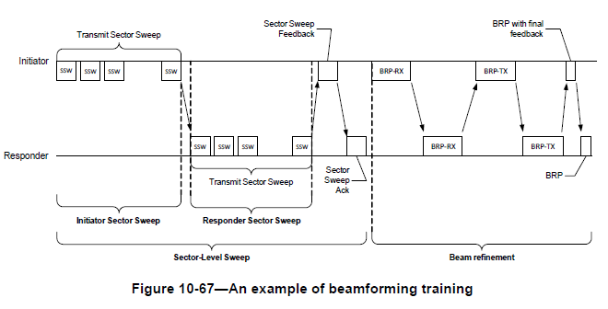
Expected spec changes from 11ad/ay (pt.2)
Beamforming training(BFT)
  11ad/ay BFT is re-used for 60 GHz OCB (if peer’s MAC address is known). Shorter training delay than Discovery beacon is expected.
  To enable performing BFT before/without SCAN or JOIN, a parameter needs to be added to the MLME-BF-TRAINING.request primitive to indicate the channel number over which the STA performs a BFT.

Slide 8
Expected spec changes from 11ad/ay (pt.3)
A MIB variable is defined to indicate “OCB DMG STA”
  “dot11OCBActivated” defined in 11p can be referred
  Similar to 5.9GHz OCB, the following will be specified for the case of dot11OCBActivated is true (See 11.21 STAs communicating Data frames outside the context of a BSS in IEEE802.11-2016[2] (or REVmd))
  Synchronization, authentication, association, and frame classes as defined in 11.1 (Synchronization) and 11.3 (STA authentication and association) are not used. Data confidentiality as defined in Clause 12 (Security) is not used. The STA may send Action and, if the STA maintains a TSF Timer, Timing Advertisement frames. If the STA is a DMG STA, the STA may send DMG Beacon frames with discovery mode field set to one.
  The STA may send Control frames, except those of subtype PS-Poll, CF-End, and CF-End +CFAck, Poll, SPR, Grant and Grant Ack.
  The STA may send Data frames of subtype Data, Null, QoS Data, and QoS Null.
  The STA shall set the BSSID field in all Management and Data frames to the wildcard BSSID value.
  [Note: Redline shows difference from 5.9GHz OCB]

Slide 9
Expected spec changes from 11ad/ay (pt.4) (cont’d)
default EDCA parameter set
  5.9 GHz STAs have the dedicated default EDCA parameter set that is different from non-OCB OFDM STAs.
  For 60 GHz OCB, the default EDCA parameter set may be the same as 11ad/11ay (i.e. single AC)
    Need further study

Slide 10
Conclusion
In this submission, we propose to define an OCB mode for 60GHz/DMG STAs. Expected spec changes from 11ad/ay were discussed.

Slide 11
References
[1] 11-19/0840r0 Use Cases for 11bd using High Data Rate
[2] IEEE802.11-2016

Slide 12
Straw Poll
Do you support to add the following text to Section 4 of SFD
  “11bd defines MAC sublayer functions and MLME extensions for DMG STAs in which dot11OCBActivated is true.”
Y /N /A

