Slide 1
Compressed Midamble in NGV
Date: 2019-09-15
Authors:
Name | Affiliation | Address | Phone | Email
Yujin Noh | Newracom |  |  | yujin.noh at newracom.com
Sichan Noh | Newratek |  |  | sc.noh at newratek.com

Slide 2
Background 1/2
11bd PPDU format is under discussion.
  FRD&SFD Motion #10 as below [1]
    “11bd PPDU design shall support Midamble(s) in Data field.
    Midamble is composed by long training field, with design TBD.
    Midamble periodicity is TBD.”
  Different aspects upon Midamble structure suggested
    Compressed Midamble [2]
    Midamble periodicity [3], [4]
FRD&SFD Motion #11 passed with “11bd devices shall support 256 QAM. The 256 QAM constellation mapping is the same as that defined in 21.3.10.9 (Constellation mapping)” [1]
  Considering OCB mode, it becomes mandatory
  Already accepted, it is important to make sure how to use it well for different circumstances as much as possible to achieve high throughput

Slide 3
Background 2/2
In this contribution, with additional simulation results, two topics below are intensely taken into account to help the group make a progress this meeting.
  Midamble types and its overhead
    Option 1) Noncompressed midamble (NCMA)
    Option 2) 2x Compressed midamble (CMA)
    Option 3) Repeated 2x Compressed midamble (RCMA)
  Given different midamble types, the number of Midamble periodicity and its values

Slide 4

Midamble Structure
Different from 11ax channel circumstance, since NGV considers high Doppler effect more seriously, the impact of this final touch needs to be verified based on simulation results. [5]
All simulations are based on the way not to ignore Doppler impact onto the very last one data symbol
  The number of Midamble period,
$$N_{MA}=\left\lfloor \left(N_{SYM}−1\right)/M\right\rfloor$$
last midamble period
(End of NGV PPDU with M=4)
…
MA
DATA1
DATA2
DATA3
DATA4
MA
DATA5

Slide 5
Compressed Midamble
(2x compressed MA)
Good approach to reduce Midamble overhead.
  Reduce the midamble per symbol duration to ½, by sampling every 2 tones in NGV-LTF.
  Taking half of the waveform in time-domain.
    After IFFT, the time domain has 2 periods per symbol, then transmit 1 period
  Same GI duration as normal NGV-LTF prepended to resolve channel delay spread
  With Repeated 2x compressed MA, it could even provide channel estimation gain like L-LTF

Slide 6
Simulation Configuration 1/3
General configuration:
  1 TX, 1 RX, 1 SS
# of channel realizations: 5,000
C2C Channel Model (including Enhanced C2C channel Model)
  12.5ns sampling rate, tapped delay line with Doppler shift
  channel power distribution with the total power normalized to 1.
Impairments
  PA Non-linearity : RAPP PA model with p = 3.
  Carrier Frequency Offset : fixed 20 ppm
  Phase noise with a pole-zero model
    PSD(0) = -100 dBc/Hz
    Pole frequency fp = 250 kHz
    Zero frequency fz = 7905.7 kHz
Rx processing:
  Ideal timing and Ideal PPDU detection
  CFO estimation and compensation in preamble portion

Slide 7
Simulation Configuration 2/3
11ac 20MHz DC2 with LDPC
Midamble structure protecting to the last data symbol
  Option 1) Noncompressed MA (NCMA)
  Option 2) 2x Compressed MA (CMA)
  Option 3) Repeated 2x Compressed MA (RCMA)
…
…
NGV-LTF
DATA1
DATA1
DATA1
DATA1
MA
DATA5
…
…
NGV-LTF
DATA1
DATA1
DATA1
DATA1
2x MA
DATA5
…
…
NGV-LTF
DATA1
DATA1
DATA1
DATA1
Repeated 2x MA
DATA5

Slide 8
Simulation Configuration 3/3
M = 4
Payload = 310 Bytes and 900 Bytes
MCS = MCS0, MCS2, MCS4, MCS6 and MCS8
Receiver channel interpolation
  Channel on even tones can be directly estimated using Midamble.
  Channel on odd tones needs to be interpolated,
New pilot locations
  [-21, -7, 7, 21] ➔ [-22, -8, 8, 22] only for simulation

Slide 9
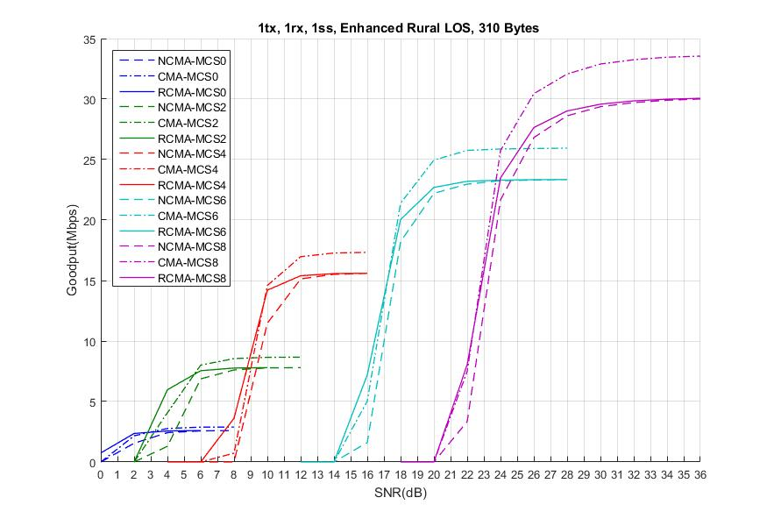
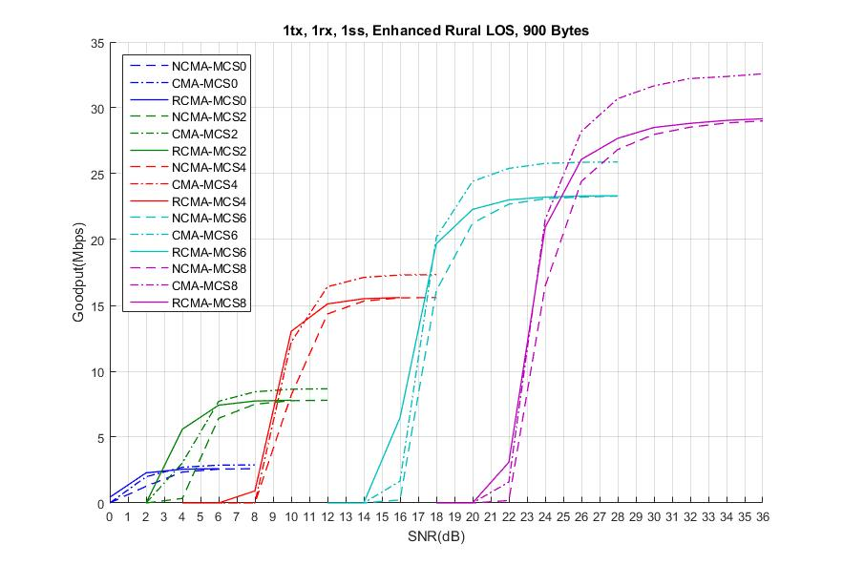
Enhanced Rural LOS
PER curve in Appendix 1
For most SNR range of each MCS, Compressed MA (CMA) shows good throughput for 310 bytes and 900 bytes
For most SNR range of each MCS, Repeated CMA does not make a meaningful throughput improvement comparing to Noncompressed MA (NCMA) for 310 bytes and 900 bytes.
  For low MCS (MCS0 and MCS2), RCMA provides better performance with channel estimation gain at limited SNR range

Slide 10
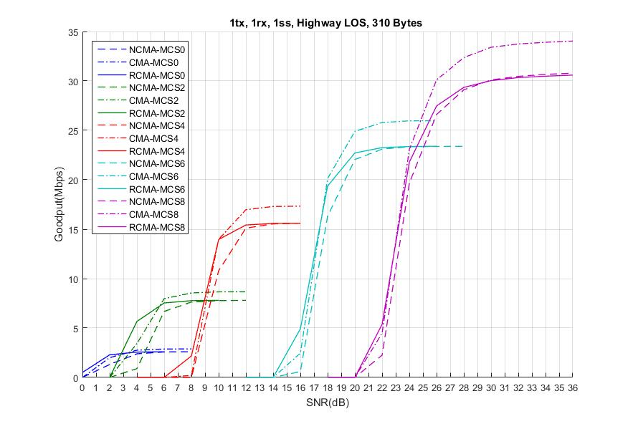
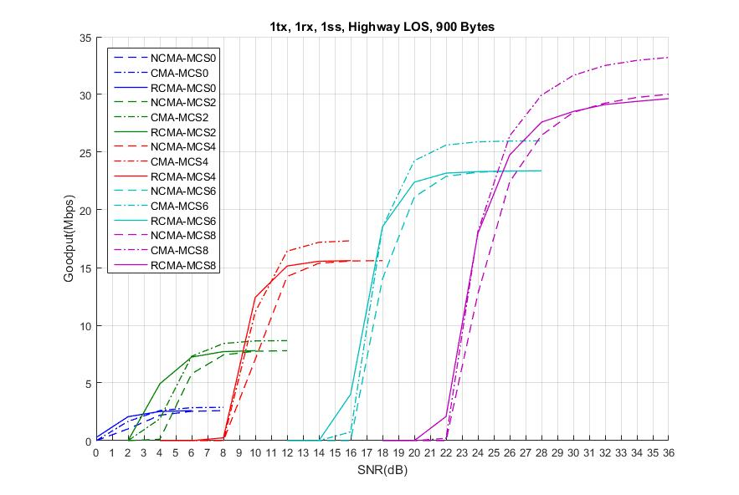
Highway LOS
PER curve in Appendix 1
For most SNR range of each MCS, Compressed MA (CMA) shows good throughput for 310 bytes and 900 bytes
For most SNR range of each MCS, Repeated CMA does not make a meaningful throughput improvement comparing to Noncompressed MA (NCMA) for 310 bytes and 900 bytes.
  For low MCS (MCS2), RCMA provides better performance with channel estimation gain at limited SNR range

Slide 11
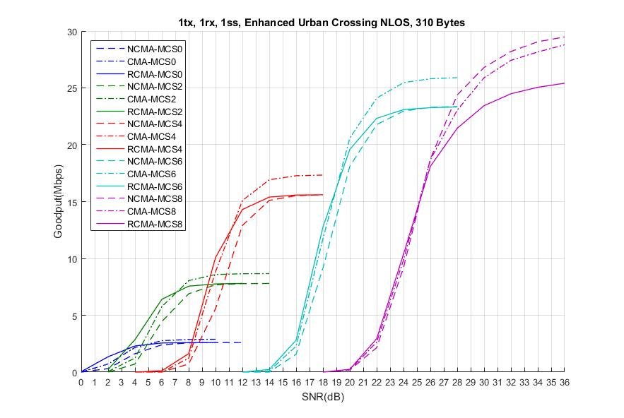
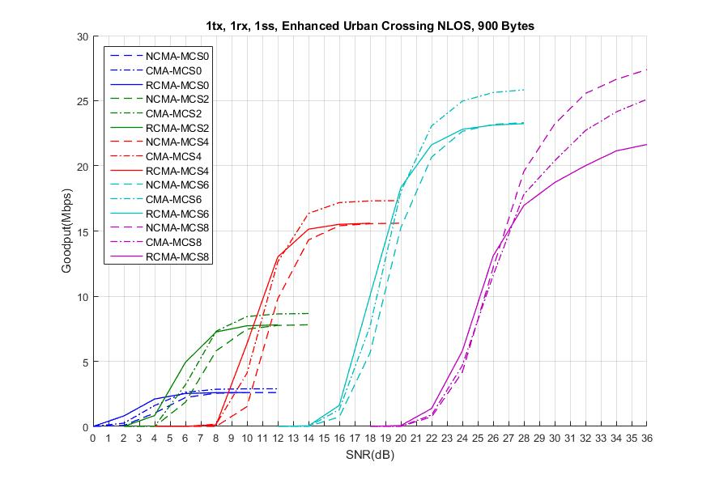
Enhanced Urban Crossing NLOS
PER curve in Appendix 1
For most SNR range of low/medium MCS, Compressed MA (CMA) shows good throughput for 310 bytes and 900 bytes.
For low MCS (MCS0 and MCS2), RCMA provides better performance with channel estimation gain at limited SNR range
For MCS 8, compressed MA (CMA) and Repeated CMA show performance degradation with interpolation loss for 310 bytes and 900 bytes.
  Noncompressed MA is preferred.

Slide 12
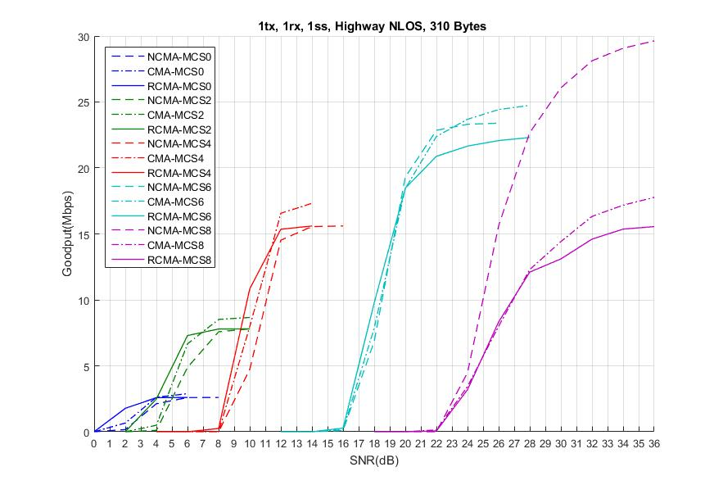
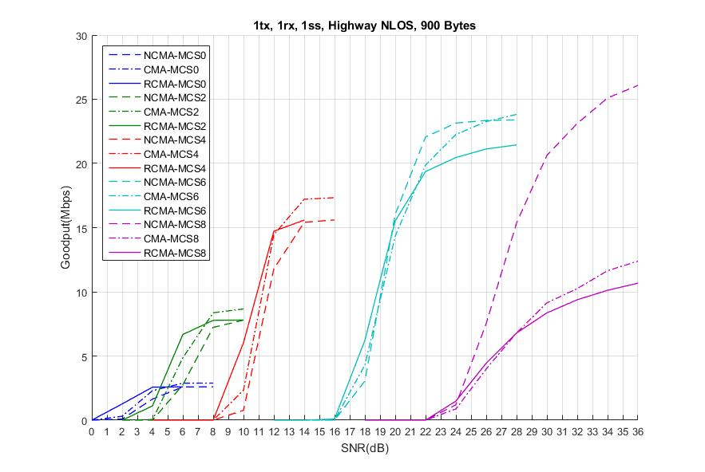
Highway NLOS
PER curve in Appendix 1
For most SNR range of low/medium MCS, Compressed MA (CMA) shows good throughput for 310 bytes and 900 bytes
For low MCS (MCS0 and MCS2), RCMA provides better performance with channel estimation gain at limited SNR range
For MCS 8, Noncompressed MA is preferred.

Slide 13
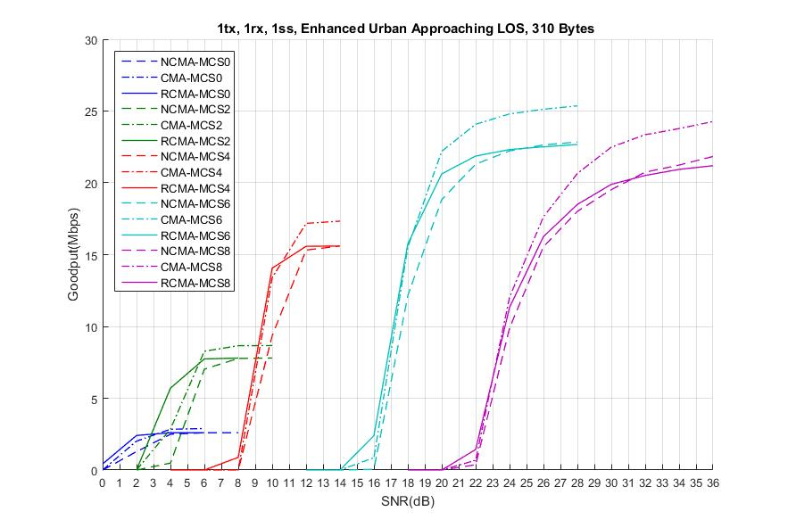
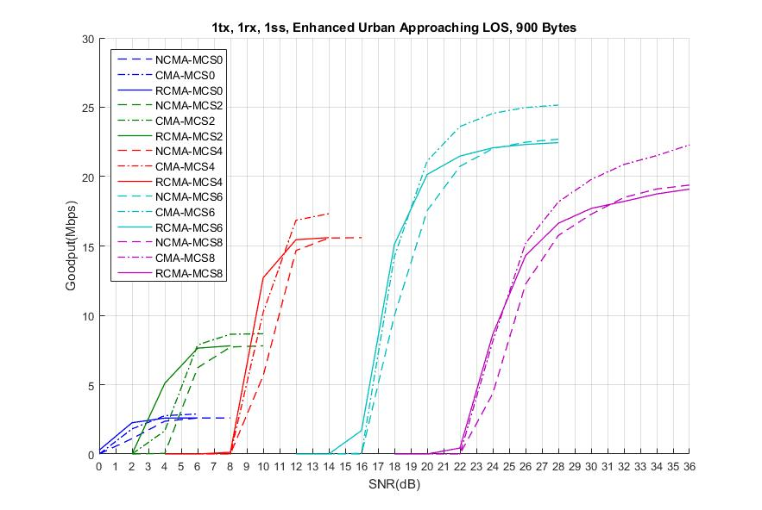
Enhanced Urban Approaching LOS
PER curve in Appendix 1
For most SNR range of low/medium MCS, Compressed MA (CMA) shows good throughput for 310 bytes and 900 bytes
For low MCS (MCS2), RCMA provides better performance with channel estimation gain at limited SNR range
For MCS 8 with performance degradation, CMA with MCS 6 provides better throughput for 310 bytes and 750 bytes.

Slide 14
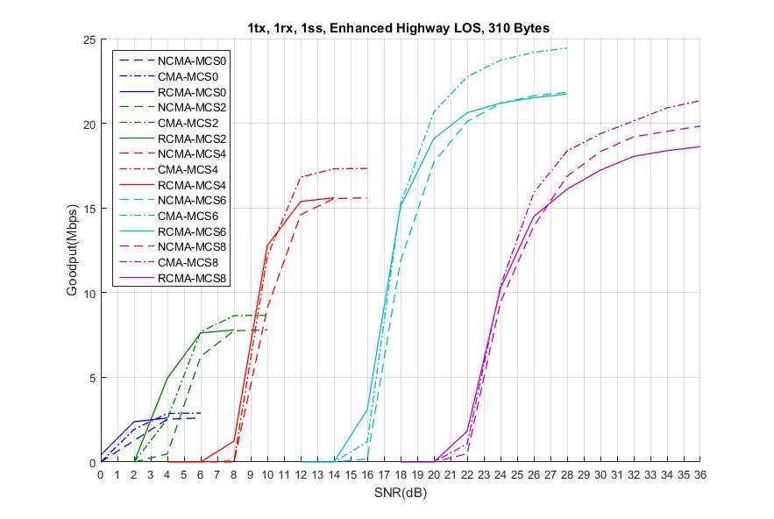
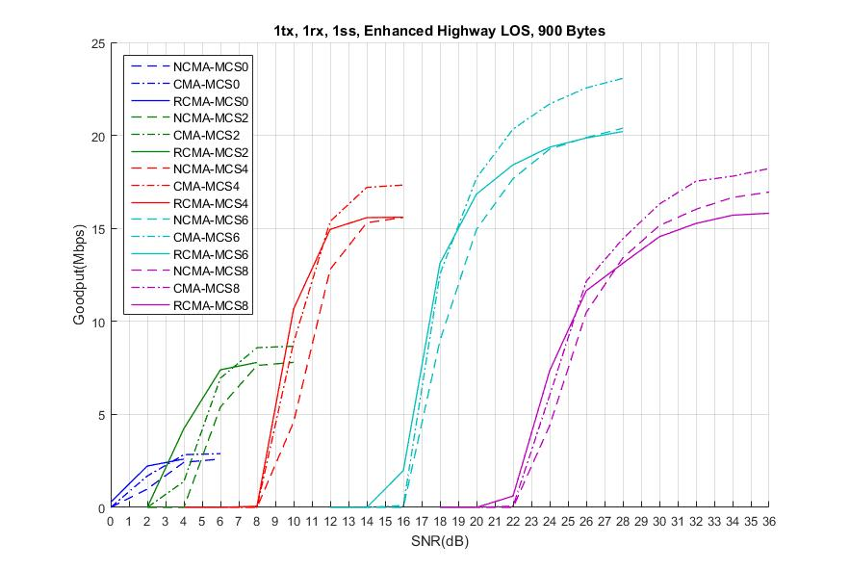
Enhanced Highway LOS
PER curve in Appendix 1
For most SNR range of low/medium MCS, Compressed MA (CMA) shows good throughput for 310 bytes and 900 bytes
For low MCS (MCS2), RCMA provides better performance with channel estimation gain at limited SNR range
For MCS 8 with performance degradation, CMA with MCS 6 provides better throughput for 310 bytes and 900 bytes.

Slide 15
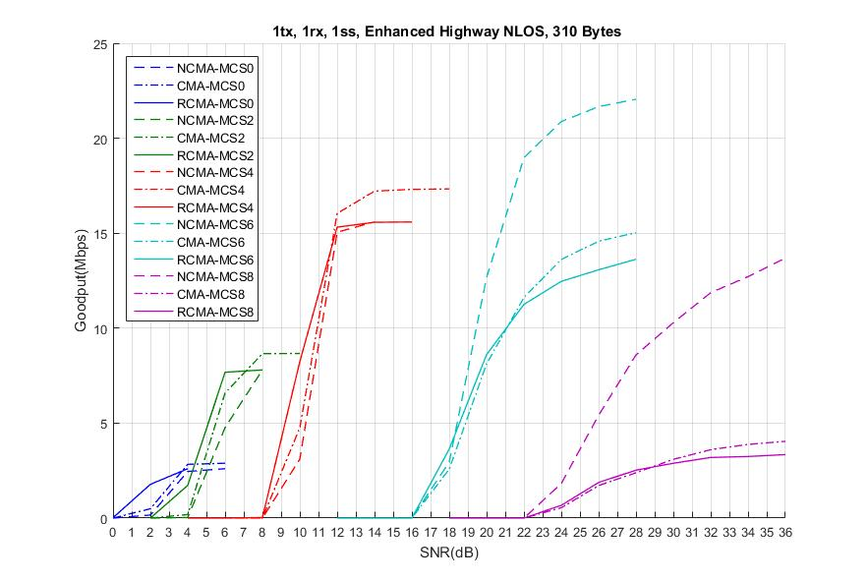
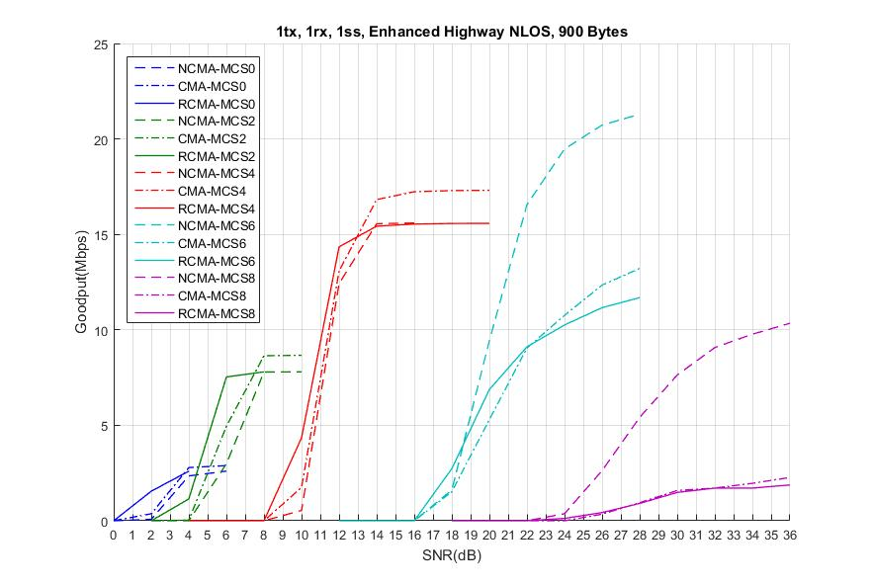
Enhanced Highway NLOS
PER curve in Appendix 1
For most SNR range of low/medium MCS, Compressed MA (CMA) shows good throughput for 310 bytes and 900 bytes
For low MCS (MCS0 and MCS2), RCMA provides better performance with channel estimation gain at limited e SNR range
For MCS 6, compressed MA (CMA) and Repeated CMA show performance degradation with interpolation loss for 310 bytes and 900 bytes.
  Noncompressed MA is preferred.

Slide 16
Midamble Periodicity
Option 1) fixed Midamble periodicity
  Insist that it can simplify Midamble design and limit PHY signal overhead.
Option 2) Midamle periodicity to be chosen depending on MCS and channel circumstance
  NGV-SIG seems to have enough room to add one bit of control information to improve performance for mid-to-high MCS or mid-to-high Doppler circumstances.
  Those are focused circumstances for gain of Midamble to be prominent comparing to DACE in terms of PER performance at the price of overhead. [4]

Slide 17
Simulation Configuration
11ac 20MHz DC2 with LDPC
M = 4 and M = 8
Payload = 310 Bytes and 900 Bytes
MCS = MCS0, MCS2, MCS4, MCS6 and MCS8
Midamble structure protecting to the last data symbol
  Option 1) Noncompressed MA (NCMA)
  Option 2) 2x Compressed MA (CMA)
…
…
NGV-LTF
DATA1
DATA1
DATA1
DATA1
MA
DATA5
…
…
NGV-LTF
DATA1
DATA1
DATA1
DATA1
2x MA
DATA5

Slide 18
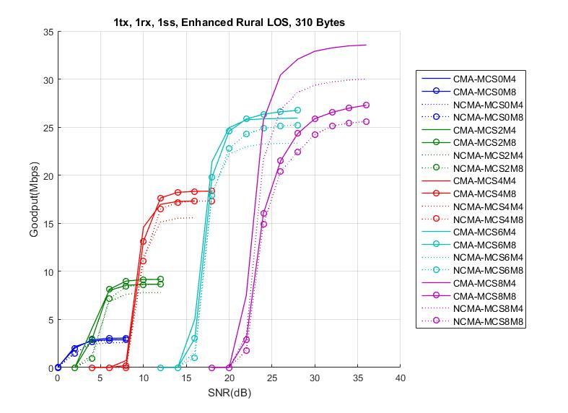
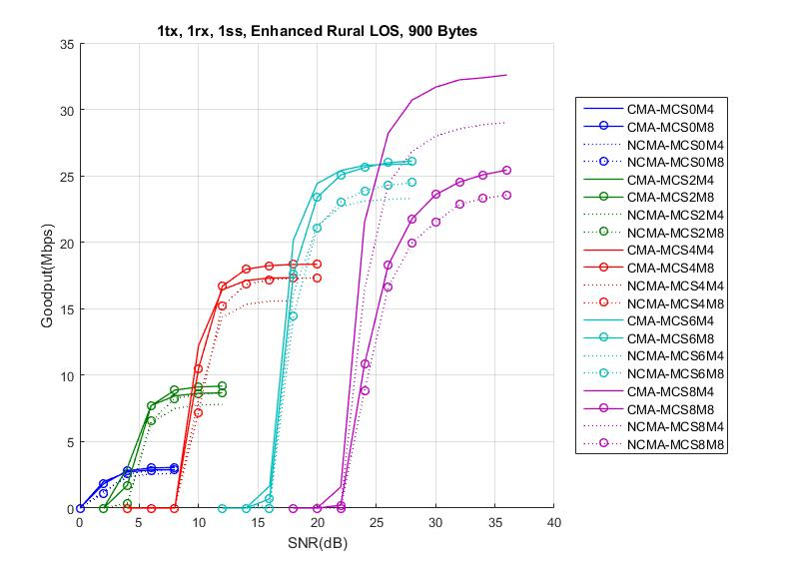
Enhanced Rural LOS
PER curve in Appendix 2
For most SNR range of low/medium MCS, Compressed MA (CMA) with M8 shows good throughput for 310 bytes and 900 bytes
For MCS 8, CMA with M4 provides prominent throughput for 310 bytes and 900 bytes.

Slide 19
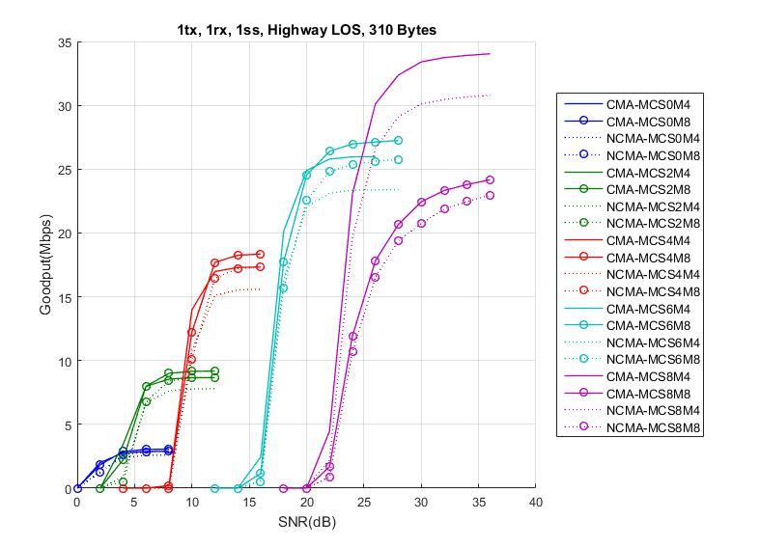
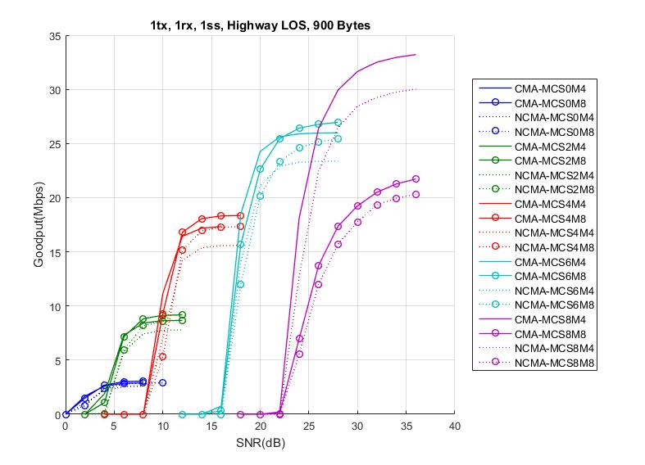
Highway LOS
PER curve in Appendix 2
For most SNR range of low/medium MCS, Compressed MA (CMA) with M8 shows good throughput for 310 bytes and 900 bytes
For MCS 8, CMA with M4 provides prominent throughput for 310 bytes and 900 bytes.

Slide 20
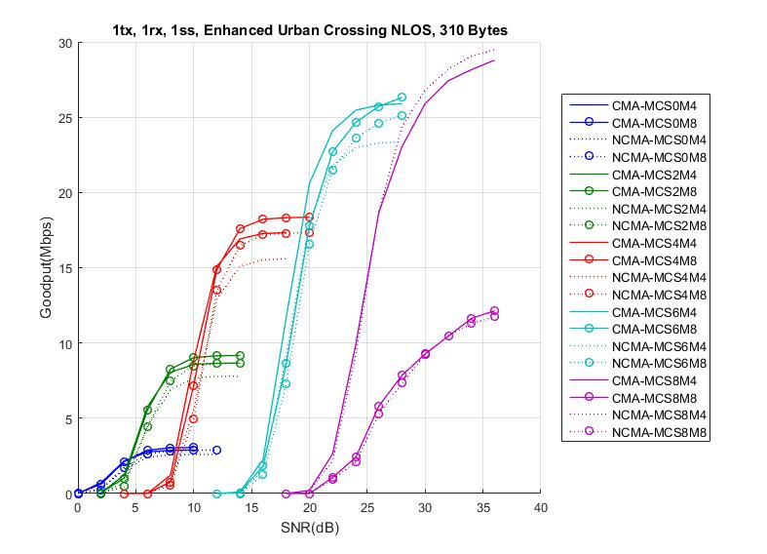
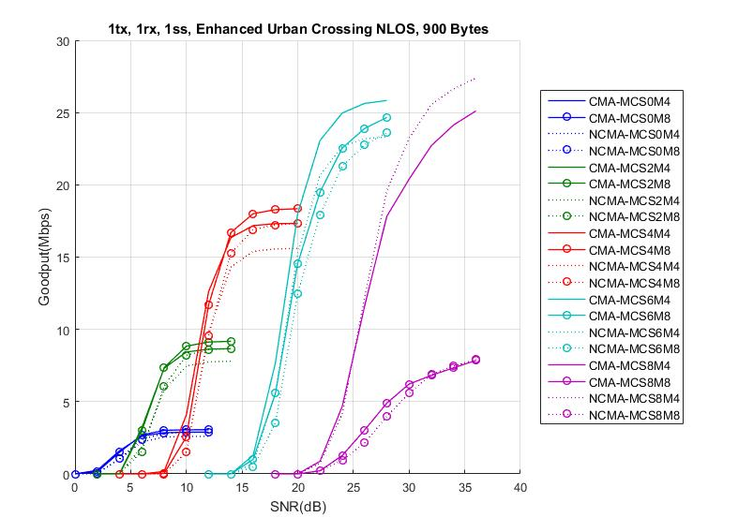
Enhanced Urban Crossing NLOS
PER curve in Appendix 2
For most SNR range of low/medium MCS, Compressed MA (CMA) with M8 shows good throughput for 310 bytes and 900 bytes
For MCS 8, Noncompressed MA with M4 provides better throughput for 310 bytes and 900 bytes.

Slide 21
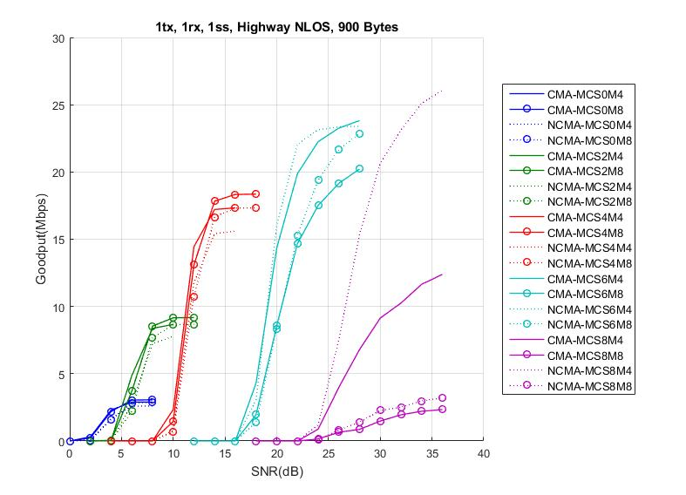
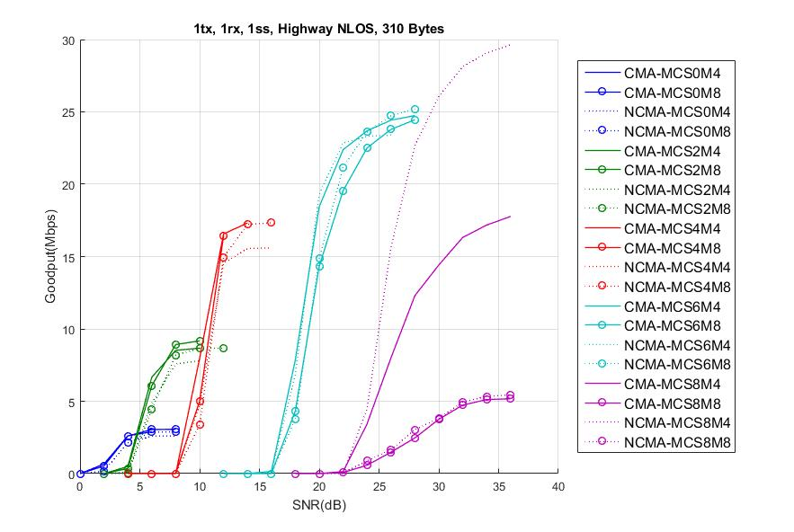
Highway NLOS
PER curve in Appendix 2
For most SNR range of low/medium MCS, Compressed MA (CMA) with M8 shows good throughput for 310 bytes and 900 bytes
For MCS 8, Noncompressed MA with M4 provides prominent throughput for 310 bytes and 900 bytes.

Slide 22
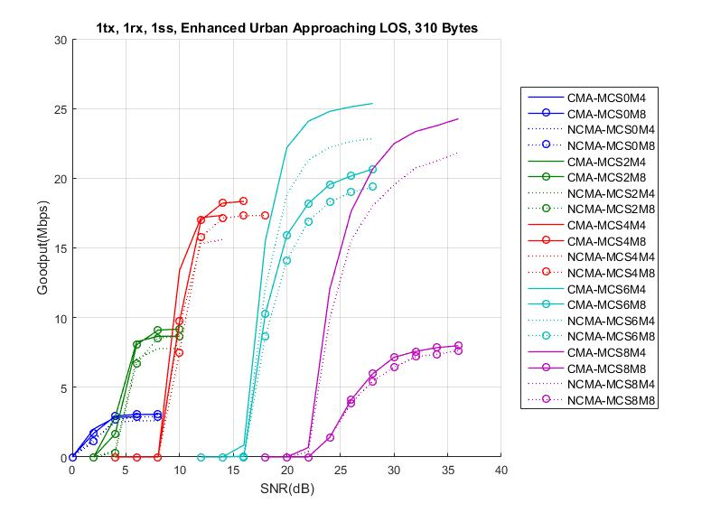
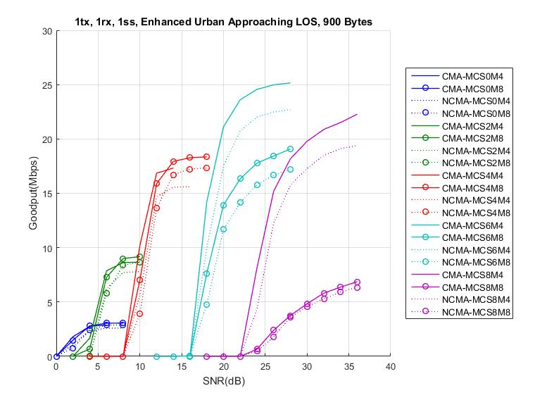
Enhanced Urban Approaching LOS
PER curve in Appendix 2
For most SNR range of low/medium MCS, Compressed MA (CMA) with M8 shows good throughput for 310 bytes and 900 bytes
For MCS 6, CMA with M4 provides prominent throughput for 310 bytes and 900 bytes.
For MCS 8 with performance degradation, CMA with M4 and MCS 6 provides better throughput for 310 bytes and 900 bytes.

Slide 23
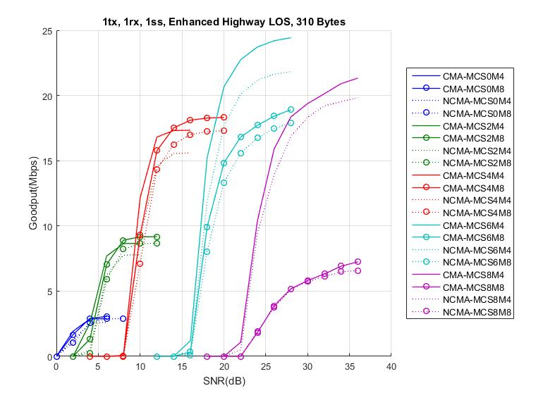
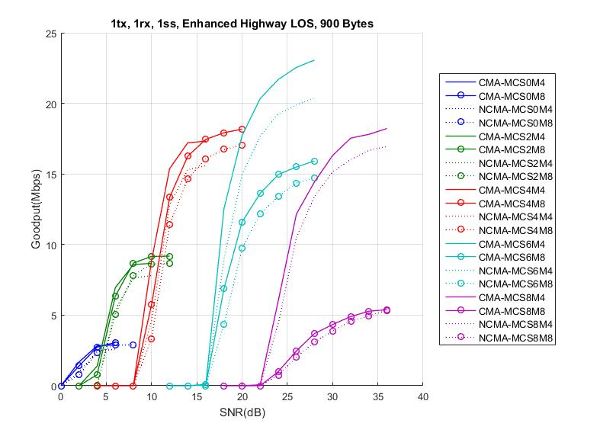
Enhanced Highway LOS
PER curve in Appendix 2
For most SNR range of low/medium MCS, Compressed MA (CMA) with M8 shows good throughput for 310 bytes and 900 bytes
For MCS 6, CMA with M4 provides prominent throughput for 310 bytes and 900 bytes.
For MCS 8 with performance degradation, CMA with M4 and MCS 6 provides better throughput for 310 bytes and 900 bytes.

Slide 24
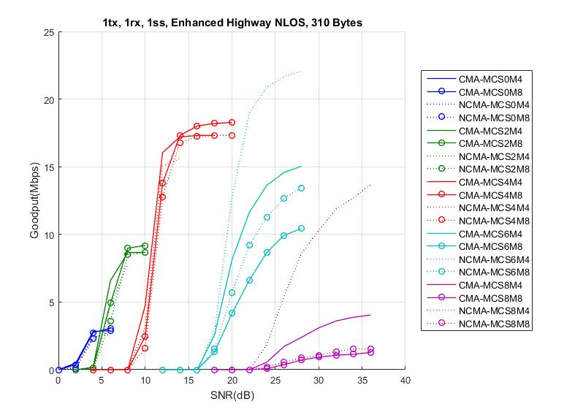
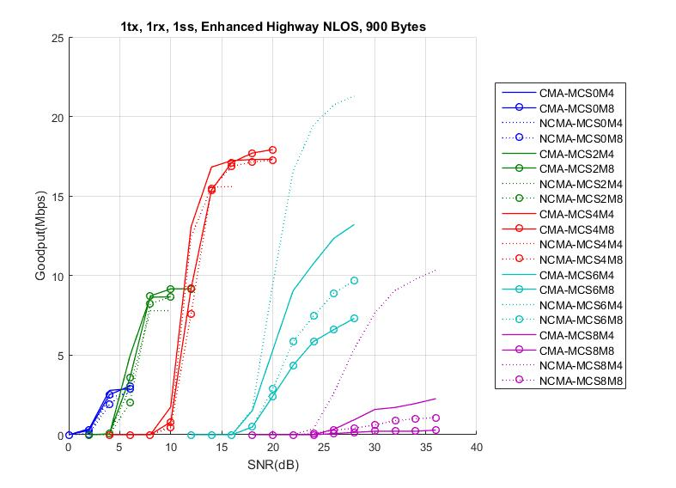
Enhanced Highway NLOS
PER curve in Appendix 2
For most SNR range of low/medium MCS, Compressed MA (CMA) with M8 shows good throughput for 310 bytes and 900 bytes
For MCS 6, Noncompressed MA(NCMA) with M4 provides prominent throughput for 310 bytes and 900 bytes.
For MCS 8 with performance degradation, NCMA with M4 and MCS 6 provides better throughput for 310 bytes and 900 bytes.

Slide 25
Summary
Compressed MA with overhead benefits should be considered as one of new features in 11bd
  Given interpolation loss, 11bd PPDU seems to support two MA types
    Repeated CMA show better performance at low MCSs for limited SNR range.
      With higher MCS its PER gain is getting decreased even at the price of overhead because of interpolation loss.
    At least Compressed midamble (CMA) and non-compressed midamble (NCMA).
Midamble periodicity with at least two values provide prominent gain with 1 bit of control information overhead
  For low-to-medium MCSs, CMA with M8 provides overhead advantages while M4 does not improve PER much.
  For medium-to-high MCSs,
    CMA with M4 result in noticeable performance gain when compensating Doppler effect well enough.
    NCMA with M4 show noticeable performance gain when interpolation loss makes an effect on channel estimation.

Slide 26
SP1
Do you agree to add the following to section 3 in 11bd SFD?
  “11bd shall support 2x Compressed NGV-LTF.
  Midamble is the same format as NGV-LTF”
  Y
  N
  A

Slide 27
SP2
Do you agree to add the following to section 3 in 11bd SFD?
  “NGV-Signal field shall include 1 bit to indicate NGV-LTF format.
  The first option is 2x compressed LTF
  The second option is non-compressed LTF”
  Y
  N
  A

Slide 28
Reference
[1] 11-19/0514r4 Motion Booklet for IEEE 802.11 TGbd
[2] 11-19/0685r2 Midamble Compression
[3] 11-19/0684r0 Midamble Periodicity
[4] 11-19/0740r4 Performance evaluation of Mid-amble
[5] 11-19/1151r0 Midamble in NGV

Slide 29
APPENDIX1

Slide 30
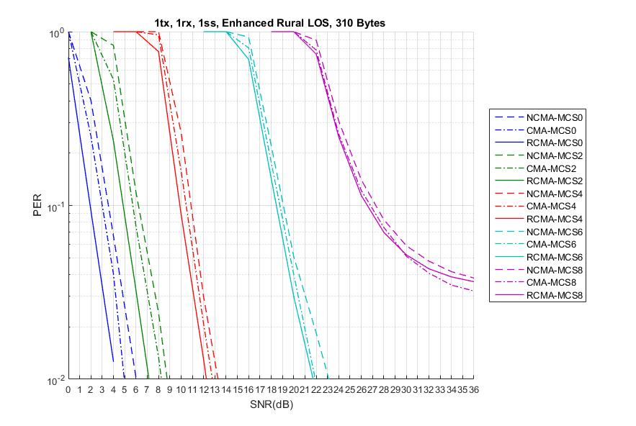
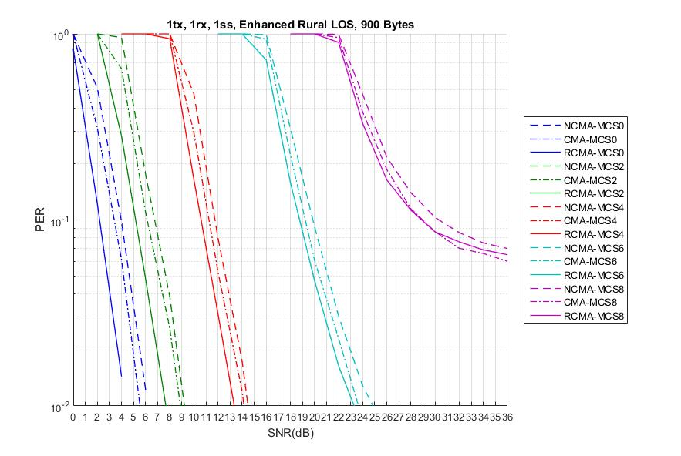
Enhanced Rural LOS

Slide 31
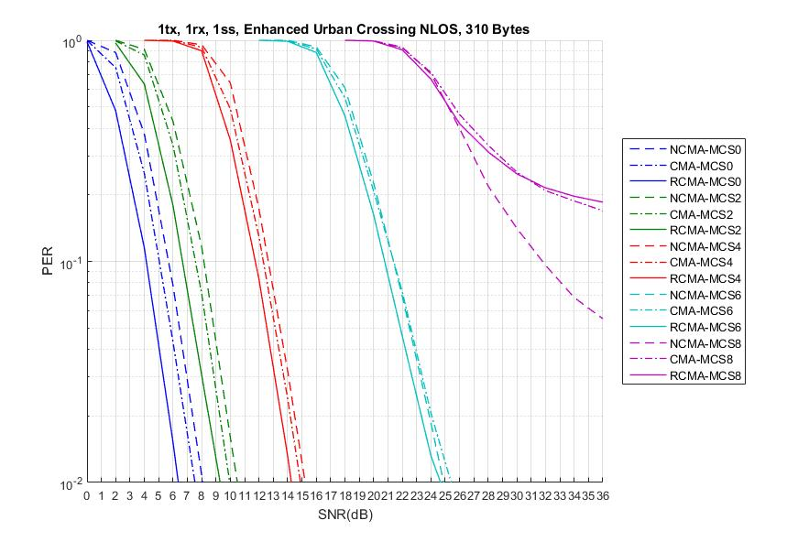
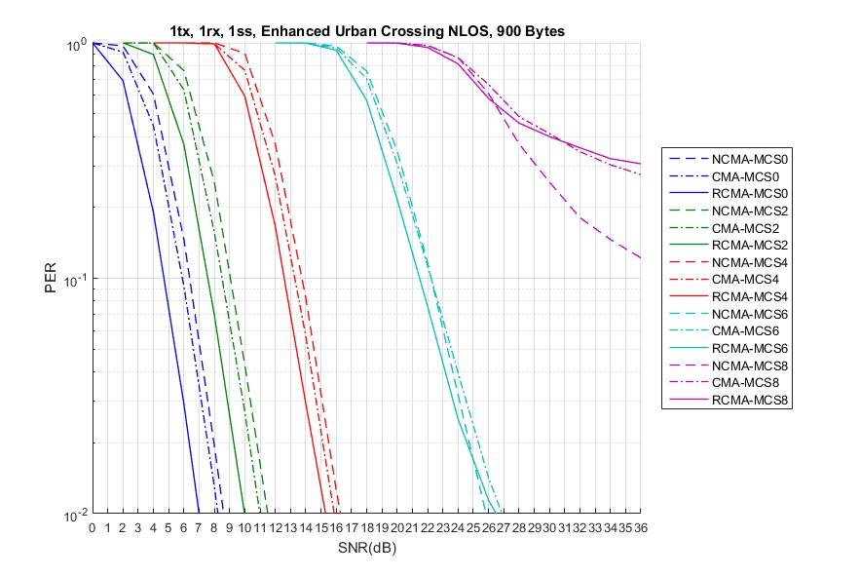
Enhanced Urban Crossing NLOS

Slide 32
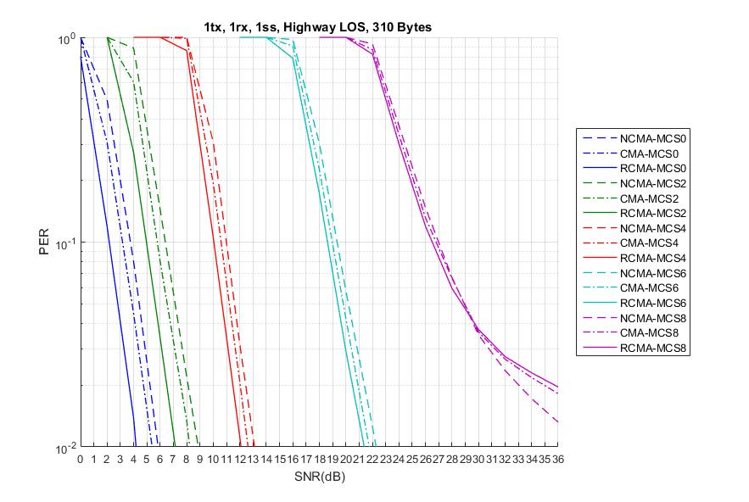
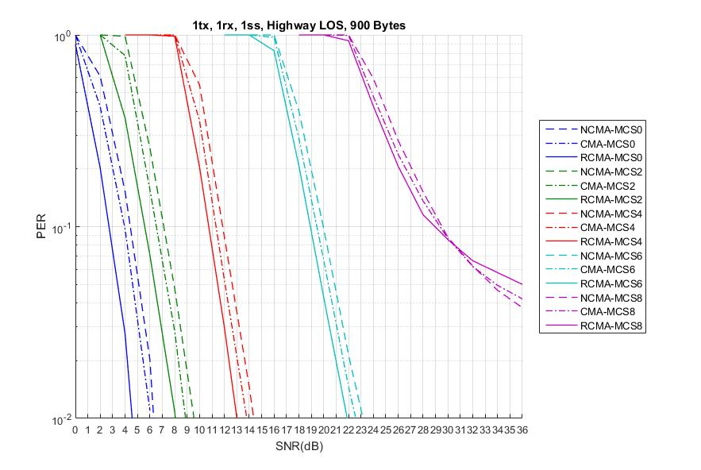
Highway LOS

Slide 33
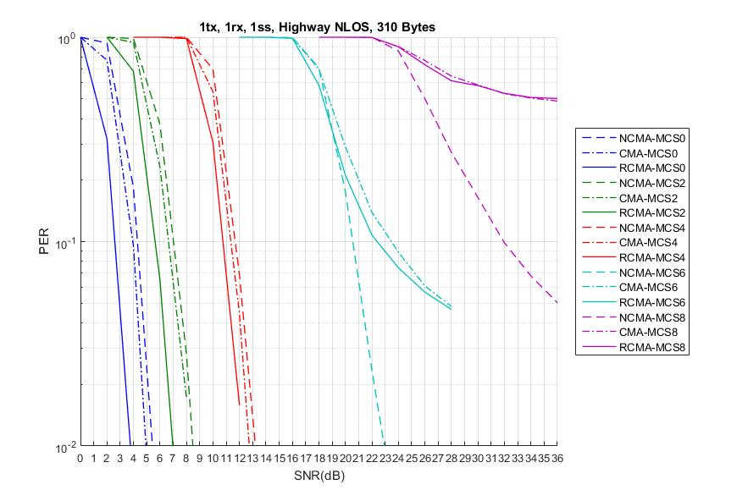
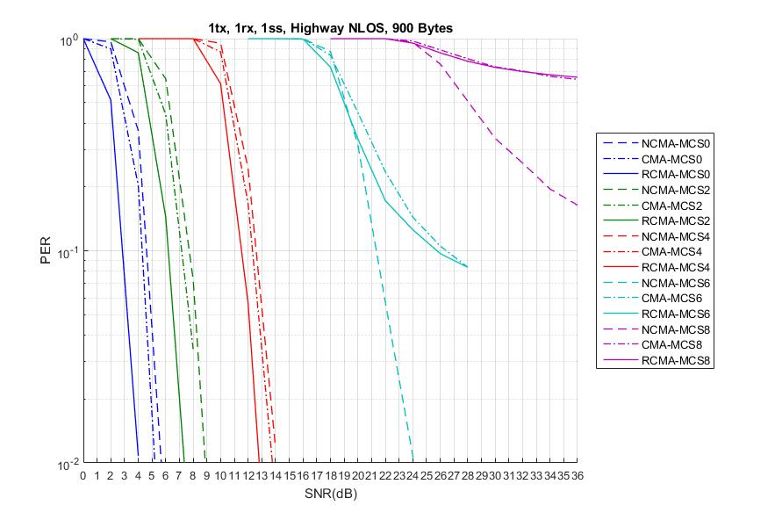
Highway NLOS

Slide 34
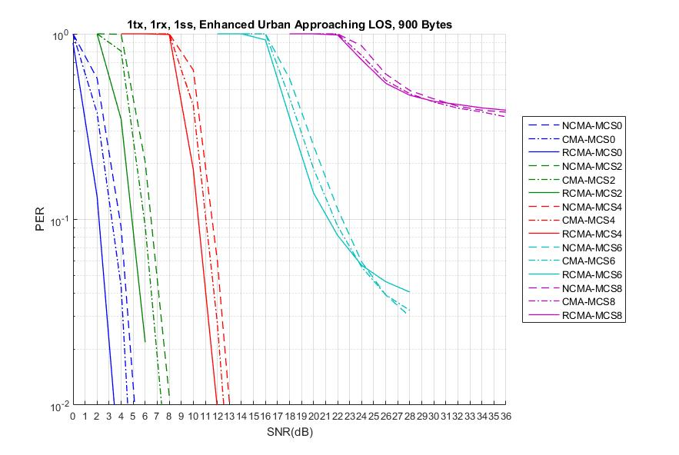
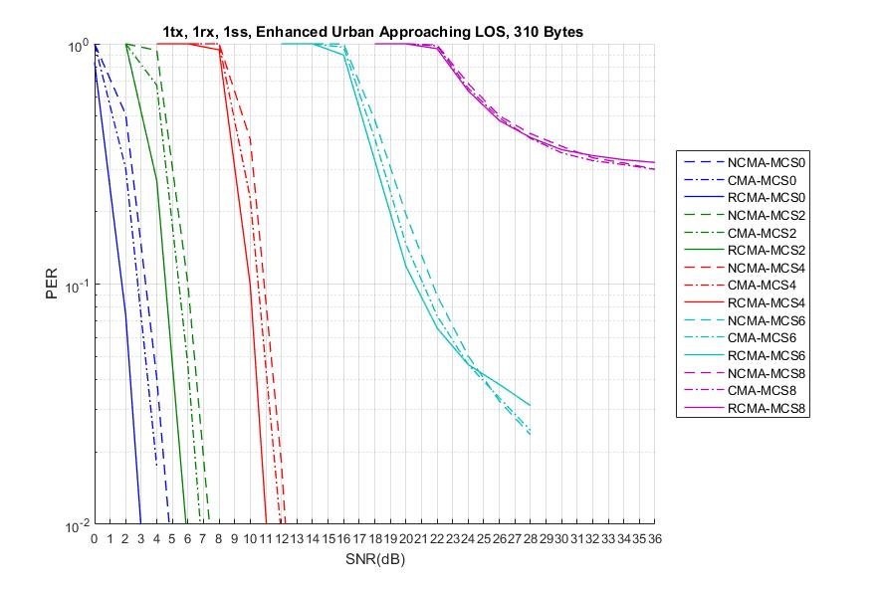
Enhanced Urban Approaching LOS

Slide 35
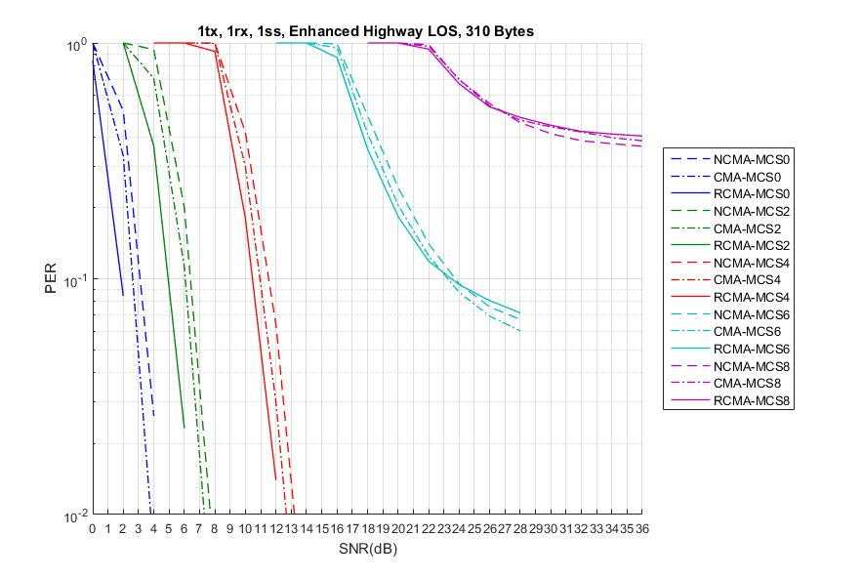
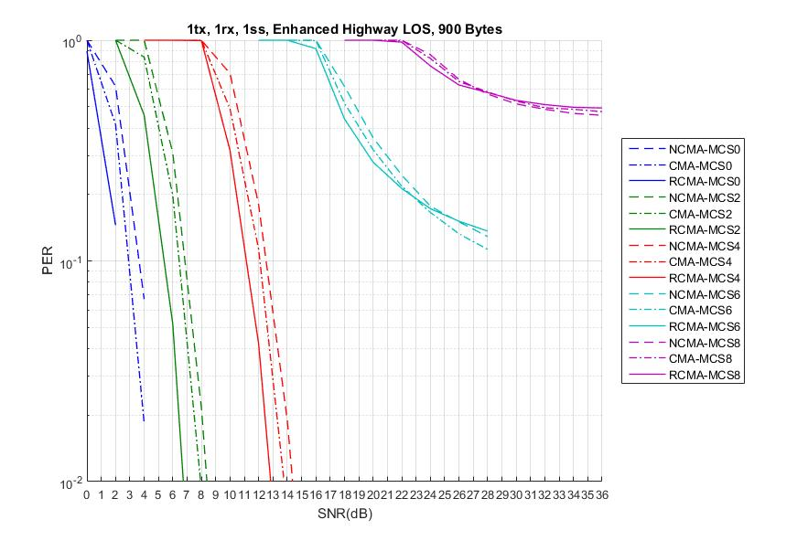
Enhanced Highway LOS

Slide 36
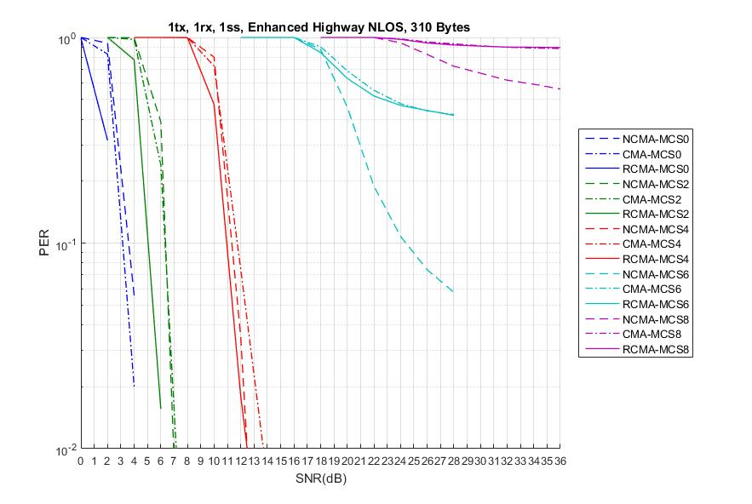
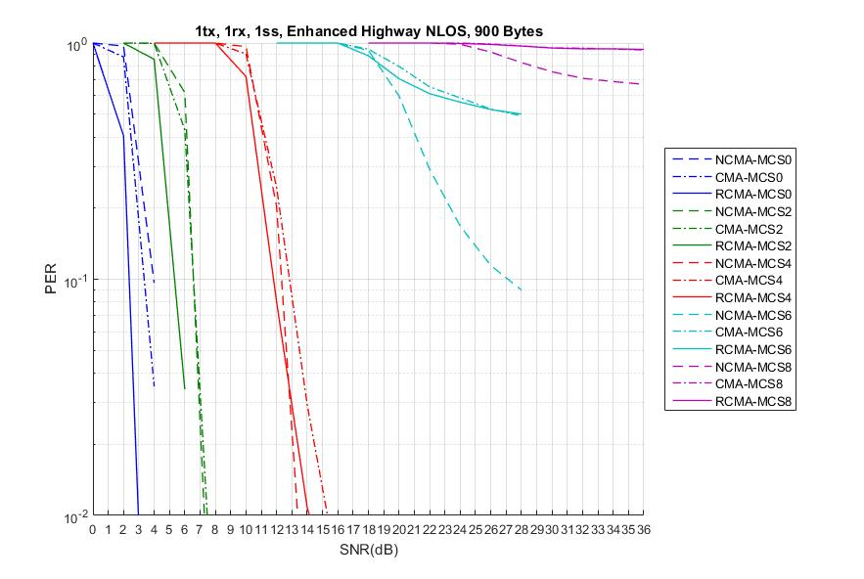
Enhanced Highway NLOS

Slide 37
APPENDIX2

Slide 38
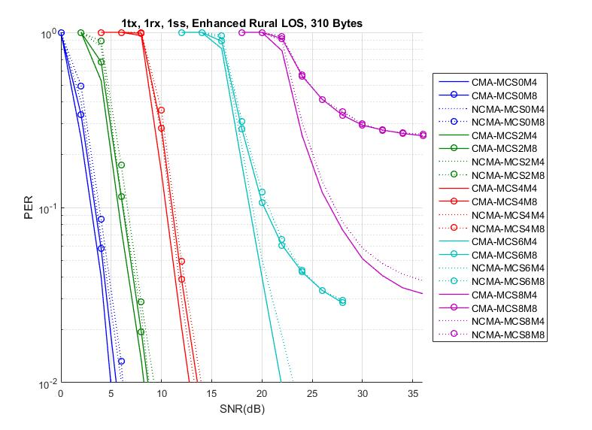
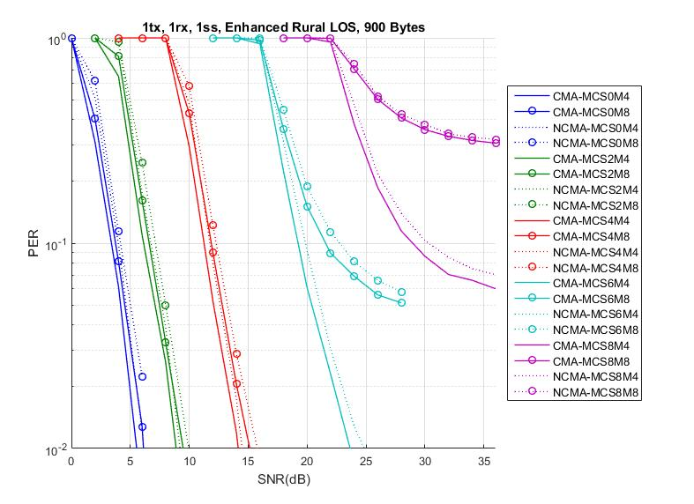
Enhanced Rural LOS

Slide 39
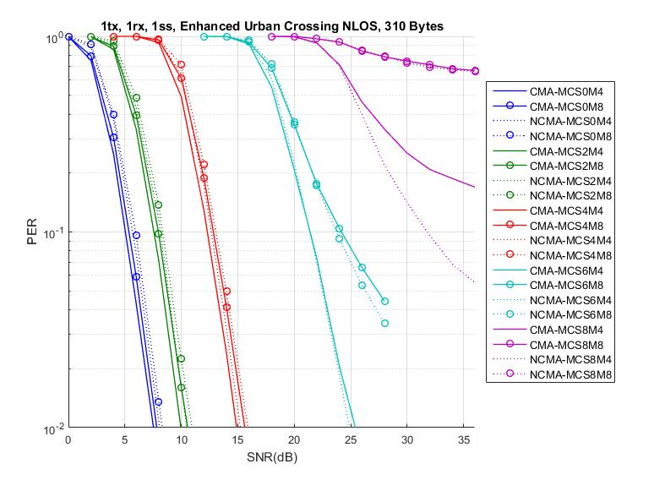
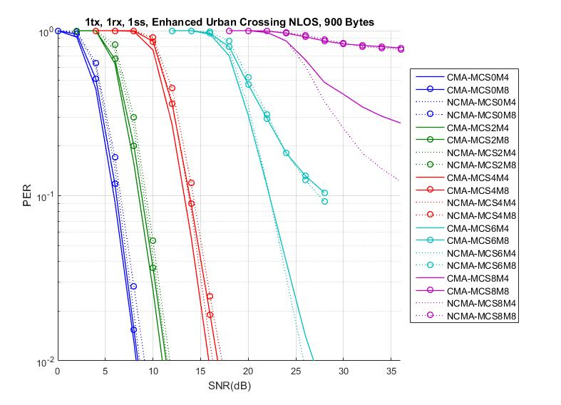
Enhanced Urban Crossing NLOS

Slide 40
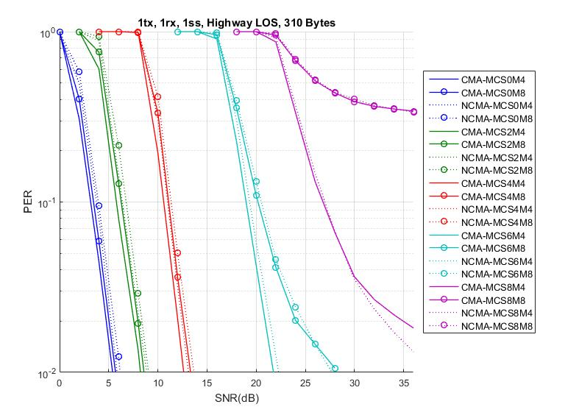
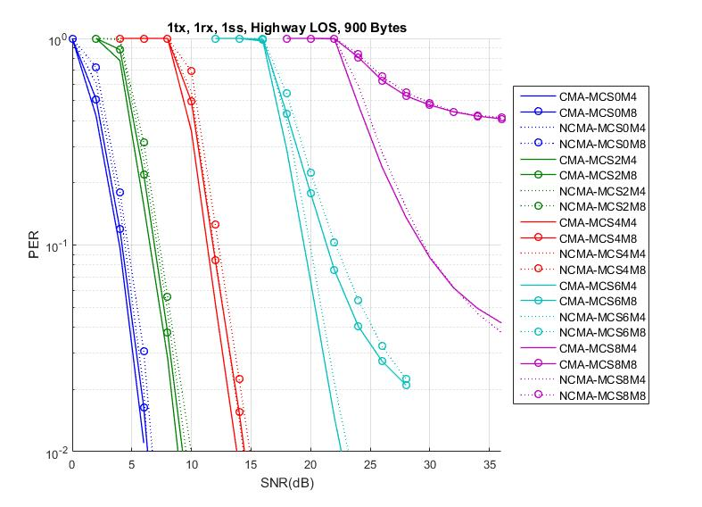
Highway LOS

Slide 41
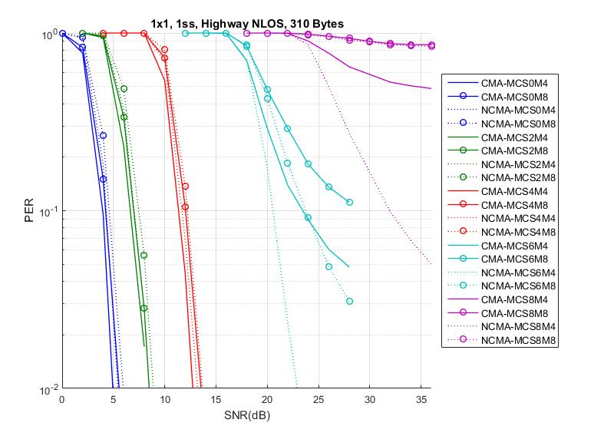
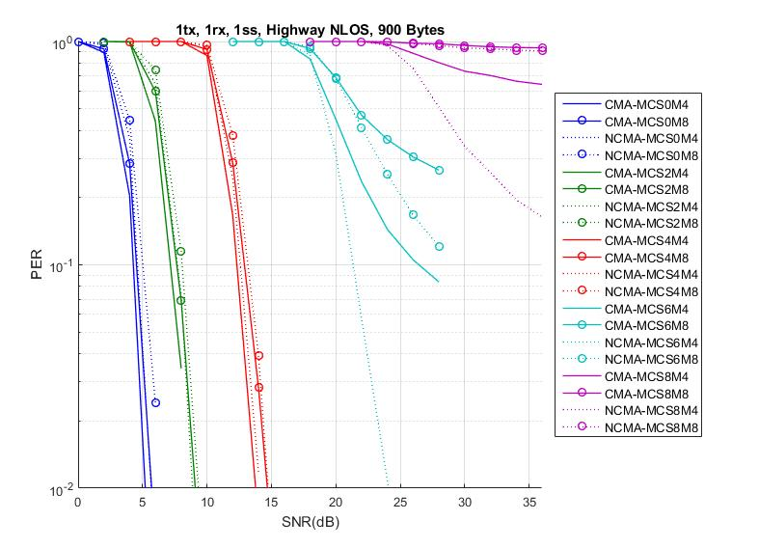
Highway NLOS

Slide 42


Enhanced Urban Approaching LOS

Slide 43


Enhanced Highway LOS

Slide 44


Enhanced Highway NLOS

