Slide 1
Agenda for IEEE 802.11 Coexistence SC meeting in Vienna in July 2019
18 July 2019
Authors:
Name | Company | Phone | email
Andrew Myles | Cisco | +61 418 656587 | amyles@cisco.com

Slide 2
Welcome to the 13th F2F meeting of the Coex SC in Vienna in July 2019
The IEEE 802.11 PDED ad hoc was formed in September 2016 at the Warsaw interim meeting
The IEEE 802.11 PDED ad hoc met in San Antonio (Nov 2016), Atlanta (Jan 2017), Vancouver (Mar 2017) and Daejeon (May 2017)
In Daejeon in May 2017 it was decided to convert the IEEE 802.11 PDED ad hoc into the IEEE 802.11 Coexistence SC
The IEEE 802.11 Coexistence SC met in Berlin (July 2017), Hawaii (Sept 2017), Orlando (Nov 2017), Irvine (Jan 2018), Chicago (Mar 2018), Warsaw (May 2018), San Diego (July 2018), Hawaii (Sept 2018), Bangkok (Nov 2018), St Louis (Jan 2019), Vancouver (Mar 2019), Atlanta (May 2019) and will meet once this week
Thu PM1

Slide 3
The first task for the Coex SC today is not to appoint a secretary
It is important to keep proper minutes of all Coexistence SC meetings
Fortunately, Guido Hiertz (Ericsson) agreed in Berlin (in July 2017) to be appointed the IEEE 802.11 Coexistence SC’s permanent Secretary …

Slide 4
The Coex SC will review the official IEEE-SA patent material for pre-PAR groups

Slide 5
The Coex SC will operate using accepted principles of meeting etiquette
IEEE 802 is a world-wide professional technical organization
Meetings shall be conducted in an orderly and professional manner in accordance with the policies and procedures governed by the organization
Individuals shall address the “technical” content of the subject under consideration and refrain from making “personal” comments to or about others

Slide 6
The Coex SC will review the modified “Participation in IEEE 802 Meetings” slide
Participation in any IEEE 802 meeting (Sponsor, Sponsor subgroup, Working Group, Working Group subgroup, etc.) is on an individual basis
Participants in the IEEE standards development individual process shall act based on their qualifications and experience (IEEE-SA By-Laws section 5.2.1)
IEEE 802 Working Group membership is by individual; “Working Group members shall participate in the consensus process in a manner consistent with their professional expert opinion as individuals, and not as organizational representatives”. (sub-clause 4.2.1 “Establishment”, of the IEEE 802 LMSC Working Group Policies and Procedures)
Participants have an obligation to act and vote as an individual and not under the direction of any other individual or group. A Participant’s obligation to act and vote as an individual applies in all cases, regardless of any external commitments, agreements, contracts, or orders
Participants shall not direct the actions or votes of any other member of an IEEE 802 Working Group or retaliate against any other member for their actions or votes within IEEE 802 Working Group meetings, (IEEE-SA By-Laws section 5.2.1.3 and the IEEE 802 LMSC Working Group Policies and Procedures, subclause 3.4.1 “Chair”, list item x)
By participating in IEEE 802 meetings, you accept these requirements. If you do not agree to these policies then you shall not participate

Slide 7
The Coex SC will consider a proposed agenda for Vienna in July 2019
Proposed Agenda
Bureaucratic stuff,
Scope of IEEE 802.11 Coexistence SC (a reminder)
Approve minutes
What is happening this week? (in no particular order)
Post mortem for Coexistence Workshop
Relationships
Review of recent ETSI BRAN meeting
Review of recent 3GPP RAN/RAN1 activities
…
Technical issues
Success for CW adjustment
…
Other business
Additional agenda items are requested from all interested stakeholders

Slide 8
Scope of IEEE 802.11 Coexistence SC

Slide 9
The agreed Coex SC scope focuses on ensuring 802.11ax has fair access to global unlicensed spectrum
Discuss the use of PD, ED or other 802.11 coexistence mechanisms with the goal of promoting “fair” use of unlicensed spectrum
Promote an environment that allow IEEE 802.11ax “fair access” to global unlicensed spectrum
Will initially focus on liaising with 3GPP RAN/RAN1/RAN4 but may also lead to interactions with regulators and other stakeholders
Will probably not conclude at least until RAN4’s 802.11/LAA coexistence testing is defined and successfully executed
May require the SC to consider other simulations and results of tests of potential LAA/802.11 coexistence mechanisms
Will initially focus on encouraging a “technology neutral” solution in the next revision of EN 301 893 that allows IEEE 802.11ax fair access to unlicensed spectrum in Europe (noting the European approach is likely to have global impact)
The effort will also focus on allowing 802.11ax to use innovative mechanisms for frequency reuse without compromising the goal of fair access

Slide 10
Coex SC will close when determined by the 802.11 WG or 802.11ax is ratified
IEEE 802.11 Coexistence SC close down criteria
The SC is closed by the IEEE 802.11 WG
… after it is determined that the SC is unlikely to make further progress towards its goals
IEEE 802.11ax completes Sponsor Ballot
… noting that the Coexistence SC ad hoc is unlikely to be relevant at that point anyway

Slide 11
Minutes

Slide 12
The Coex SC will consider approval of the meeting minutes from Atlanta in May 2019
The minutes for the Coex SC at the Atlanta meeting in May 2019 are available on Mentor:
See 11-19-1010-00
Motion:
The IEEE 802 Coex SC approves 11-19-1010-00 as minutes of its meeting in Atlanta in May 2019
Moved:
Seconded:
Result:

Slide 13
Agenda items
Workshop post mortem

Slide 14
There are some initial follow up steps after the coexistence workshop
Tasks
Finalise the budget
Went a little over budget ($767)
Ensure all documents are available
Feedback survey for participants, inc
Logistical feedback
Views on issues raised in workshop
Perspectives on next steps
…

Slide 15
The Coex SC will discuss the success or otherwise of the Coexistence Workshop
Potential discussion questions wrt Coexistence Workshop
What went well?
What did not go so well?
Was it a worthwhile effort?
What were the main issues
Staring point for 6GHz? 5GHz rules or something else?
Option or mandatory use of common preamble? Which preamble?
Does use of short LBT for DRS have adverse effect on coexistence?
What are next steps? And goals for next steps
More LS ping pong
More workshops
…
…

Slide 16
Agenda items
ETSI BRAN#102 review

Slide 17
The Coex SC will review items of interest from the BRAN#102 in June 2019
Topics for discussion
Adoption of 6GHz NWI (New Work Item)
Technical discussions at BRAN#102 for summary today
No/short LBT
Use of no/short LBT by Wi-Fi
CW adjustment for delayed feedback and broadcast
Definition of success driving CW adjustment
Relative vs absolute ED/PD thresholds
Spectral mask requirements
Paused COT
Discussion of issues discovered in testing preambles
Next ETSI BRAN meetings

Slide 18
ETSI BRAN discussed a proposal for a NWI for 6GHz operation
Six companies proposed a NWI for “6 GHz RLAN Harmonised Standard for access to radio spectrum”
HPE
Cisco
Microsoft
Broadcom
Intel
Ruckus
The proposed scope was
This Harmonised standard will specify technical characteristics and methods of measurements for Wireless access systems including radio local area networks (WAS/RLANs) operating in the band 5 925 MHz to 6 425 MHz and as further described in ETSI TR 103 524 and ECC Report 302.
The proposed rapporteur was David Boldy (Broadcom)

Slide 19
The 6GHz NWI proposal turned out to be very controversial
Qualcomm, Ericsson, Huawei & Nokia objected to the NWI approval
They objected to a sentence in the scope proposing EN 301 893 (from 5Ghz band) as a starting point
The objections were on the basis that 6GHz is “greenfield” and should not have any/many restrictions, such as adaptivity
The sentence was then moved to the remarks section as a compromise, and after the meeting it was removed altogether; they are still objecting but it is not clear why
They objected to the rapporteur
The objections were that he is “Wi-Fi aligned/biased”; their alternative was someone neutral or from a company with both Wi-Fi and NR-U interests
They objected to the ETSI BRAN Chair making a decision to adopt the NWI even though it was compliant with ETSI Directive
The objections were that there was not consensus, not enough time for discussion, and the decision was taken 5 min after scheduled adjournment

Slide 20
An alternative 6GHz NWI was uploaded (late) but not discussed in any detail
Four companies proposed an alternative NWI for “6 GHz RLAN Harmonised Standard for access to radio spectrum”
Ericsson
Nokia
Deutsche Telekom
Qualcomm
The proposed scope was
This new Harmonised standard will cover Wireless Access Systems including Radio LANs (WAS/RLANs) operating in the frequency band 5 925 MHz - 6 425 MHz as described by ETSI TR 103 524 and ECC Report 302. The standard shall align with the (draft) ECC decision on 6 GHz RLAN being developed by FM57. The standard will be developed according to the EC mandate to CEPT (Ares(2017)6222764 - 19/12/2017), for supporting the principles of service and technological neutrality, non-discrimination and proportionality insofar as technically possible.
The proposed rapporteur was Narendar Madhavan (Ericsson)

Slide 21
The discussion about 6GHz NWI in ETSI BRAN suggested sharing is not a goal of all stakeholders
Editorialising by Andrew Myles (Cisco)
The discussion in ETSI BRAN was revealing in that it was very clear at least some NR-U aligned companies are not interested in sharing based on the 5GHz adaptivity mechanism
Or maybe in any restrictions on NR-U operation in 6GHz …
… which seems to be goal of the extra (somewhat ill defined) sentence in the alternate NWI
This should be of concern for anyone who wants fair and efficient sharing of 6GHz band by all technologies, including 802.11ax/be & NR-U/LAA
Is there an alternative sharing mechanism (to LBT) that we can agree on?
Is 3GPP RAN1 going to make decisions that impact Wi-Fi for which we have no control?

Slide 22
It appears the 6GHz NWI has been adopted by ETSI BRAN …
At this point it appears the 6GHz NWI has been adopted …
It will be called EN 303 687

Slide 23
A LS from 3GPP RAN1 addressed the issue of the use of no/short LBT for short control signalling
Submission
BRAN(19)102003: LS to ETSI BRAN on EN 301 893
Summary
3GPP RAN1
Noted that short LBT is used by LAA for DRS
Noted that there is no consensus in 3GPP RAN1 on any proposals to ban or restrict the use of no/short LBT for short control signalling
Asked whether resolution of the proposal is important for completion of next revision of EN 301 893
Discussion
Discussion in ETSI BRAN postponed

Slide 24
Cisco proposed a response to 3GPP RAN1 notifying them that the no/short LBT issue is important
Submission
BRAN(19)102013: Update of no and short LBT issue (Cisco)
Summary
Cisco summarised the history of no/short LBT issue & proposed a response to 3GPP RAN1’s LS:
Noting the short control signaling cause is currently considered essential
Requesting evidence that (over) use the current clause will not have an adverse affect on fair & efficient use of spectrum
Asking why NR-U (& LAA) cannot make use of Cat 4 for short control signaling?
Discussion
There was no consensus in ETSI BRAN on Cisco’s proposal, beyond agreeing the Coex Workshop may provide further insight on the topic

Slide 25
R&S asserted that Wi-Fi gear typically makes use of no/short LBT exception in EN 301 893
Summary
R&S noted they have been observing the use of Short Control Signalling by real Wi-Fi gear
They asserted that Wi-Fi gear typically used no/short LBT with Short Control Signalling between 1-5% of time
They committed to providing detailed measurements at the next ETSI BRAN meeting
Discussion
It is not clear how R&S made their measurements or how they can distinguish Wi-Fi’s use of short LBT for Short Control Signalling from normal access
Does anyone know of Wi-Fi gear taking advantage of no/short LBT for Short Control Signalling?

Slide 26
There was no initial consensus on how to adjust CW for delayed feedback and broadcasts
Submission
BRAN(19)102004: Steps seven and eight in 4.2.7.3.2.6 (Ericsson)
BRAN(19)102014: Update of CW adjustment with delayed feedback issue (Cisco)
BRAN(19)102018: Discussion on CWS updates mechanisms in EN 301 893 (Huawei)
Summary
Ericsson proposed a CW adjustment mechanism for delayed feedback
Ignored any feedback if it was not rx’ed before next attempted COT access
Cisco offered a different proposal for CW adjustment
Assumed failure (and so doubled CW) until proven otherwise
Proposed making CW reset after broadcast explicit
…

Slide 27
There was no initial consensus on how to adjust CW for delayed feedback and broadcasts
…
Huawei observed CW adjustment in EN 301 893 does not cover:
Multiple HARQ process retx; the issue/proposal was unclear
Delayed ACK: proposed maintaining CW until feedback rx’ed
Broadcast: proposed not resetting CW in this case (unlike 802.11)
Discussion
There was consensus that the CW rules needed to be refined to:
Make behaviour clearer for broadcasts
Enable LAA operation – technically it is not allowed under current rules
There was no consensus at the time on how to adjust CW with delayed feedback but an ad hoc was formed
Qualcomm proposed a pipeline of delayed feedback
There was no significant discussion of CW adjustment for broadcast

Slide 28
The ad hoc on CW with delayed feedback reached consensus that previous proposals were flawed
The ad hoc discussed a number of approaches
Cisco’s proposal to assume failure until proven otherwise
Ericsson’s proposal to maintain CW when feedback delayed, ignoring all feed back after the next attempt to gain access
Qualcomm’s proposal to maintain CW when feedback delayed, processing delayed feedback through a pipeline
LAA approach: which was different to all of these and the current EN 301 893 rules
It was noted that all of these approaches were problematic
Cisco’s approach was too conservative
Ericsson’s approach was too aggressive, sometimes resulting in CW never increasing
Qualcomm’s approach was too complex
The LAA approach had a problem too, but I can’t recall what it was ☹

Slide 29
The ad hoc on CW with delayed feedback had consensus on some of the issues
Summary
The ad hoc agreed that it was ok to:
Rely on delayed feedback to drive CW adjustment
Use a random selection of delayed feedback as a proxy for using all off the feedback
The ad hoc could not agree on:
The definition of “success” that drives CW adjustment
ETSI agreed to progress on these issues by:
Menzo Wentik (Qualcomm) leading an effort, with support from Navendar Madhavan (Ericsson) and Andrew Myles (Cisco), to define new CW update text by 1 September
Issuing a call for new/updates proposals on the question of the definition of “success” driving CW updates

Slide 30
The ad hoc agreed that it was ok to rely on delayed feedback to drive CW adjustment
Consensus in ad hoc on using delayed feedback
It was agreed that while it was not ideal to rely on delayed feedback to drive CW adjustment …
The longer feedback is delayed, the less likely it represents the channel condition
… there was not a great alternative
… and the lack of timeliness was probably in the noise compared to other faults of LBT with exponential backoff
Note: this was more of a “finger in the air” conclusion, rather than being based on any hard science

Slide 31
The ad hoc agreed that it was ok to use a random selection of delayed feedback
Consensus in ad hoc on using only some feedback
The goal of any CW adjustment mechanism with delayed feedback is to end up with same CW “average” as with immediate feedback
If one takes a random selection of the feedbacks (assuming collisions are random) then the result should be the same CW “average”
This means one can drop feedback as long as it is done using a random process
Dropping all feedback after next COT access attempt could end up not selecting any feedback, making it not very random, or very little feedback, making the average very long term (old Ericsson approach)
Using all feedback that arrives “in order” probably is random (new approach discussed in ad hoc)

Slide 32
A small group will propose a CW update mechanism aligned with ad hoc consensus
Next steps for ad hoc are to specify a CW update mechanism in text
Menzo Wentink (Qualcomm) will provide revised CW update text to the BRAN reflector before 1st September …
… with input from Navendar Madhavan (Ericsson) and Andrew Myles (Cisco)
After the meeting, Andrew Myles suggested a starting point, but it has not yet been reviewed by Navendar or Menzo …
… and it is probably not compatible with current version of LAA

Slide 33
At least one suggestion is on the table for a CW update procedure
Andrew Myles (Cisco) suggestion for CW update
x is a storage variable, initiated with x = CW_{min}
Parallel procedures to execute CW update
Send frame
If immediate response then x doubled or reset as appropriate
Process delayed feedback (at any time)
For each delayed response received, x doubled or reset as appropriate
Unless the delayed feedback is older than delayed or immediate feedback already processed; in this case drop the older feedback to avoid problems related to reordering
Execute backoff
CW = x
The effect of these procedures is to only process the “latest” feedback, randomly dropping feedback that is out of order

Slide 34
There was no consensus on whether “success” at the start of the COT drove CW updates
Submission
BRAN(19)102015: Update of the success issue (Cisco)
Summary
Cisco asserted the importance of CW updates being driven by the “success” at the start of a COT
Discussion
There was significant support for the idea that CW adjustments should be driven by success or failure at the start of the COT (and not later)
Qualcomm, Cisco, Broadcom and others supported
Ericsson and others did not support
However, there was not consensus, and an ad hoc was formed
There was also no consensus in the ad hoc on this issue

Slide 35
ETSI BRAN is discussing whether ED/PD thresholds should be defined in absolute or relative terms
Summary
There was a proposal that a LS be sent to 3GPP RAN1 explaining that the ED thresholds in EN 301 893 standard are defined using absolute levels
Some participants at the meeting suggested that the ED (and presumably PD) thresholds should be defined as relative levels (relative to what?)
On basis that is how real devices are built
An ad hoc has been set up to discuss this issue, meeting on 1 August 2019 at 15:00-18:00 CET
...

Slide 36
Should IEEE 802.11 have a position on whether ED/PD thresholds are absolute or relative?
...
Discussion
Even if real devices implement relative ED/PD thresholds that does not mean they will not satisfy absolute thresholds
IEEE 802.11 standards is based on absolute levels
Do any IEEE 802.11 WG stakeholders have an issue with the status quo of ED/PD thresholds defined in absolute terms?
What are the pro’s/con’s of absolute and relative ED/PD thresholds?
Should IEEE 802.11 WG have a position on this question?

Slide 37
ETSI BRAN could not achieve consensus on some spectral mask questions from 3GPP RAN4
Submission
BRAN(19)102009r1: LS from 3GPP RAN4 on Interpretations of EN 301 893 for NR-U (spectrum mask) (introduced by Ericsson)
BRAN(19)102021r1: Proposed answers to questions on the ETSI spectrum mask asked by 3GPP RAN4 (Ericsson)
Summary
RAN4 had some questions about the spectral mask
How the roll off region of the spectrum mask is dependent upon Tx BW?
How to interpret the spectrum mask during puncturing?
There was not consensus on how to respond but it was agreed to have an ad hoc meeting on 31 July 2019 @15:00-18:00 CET

Slide 38
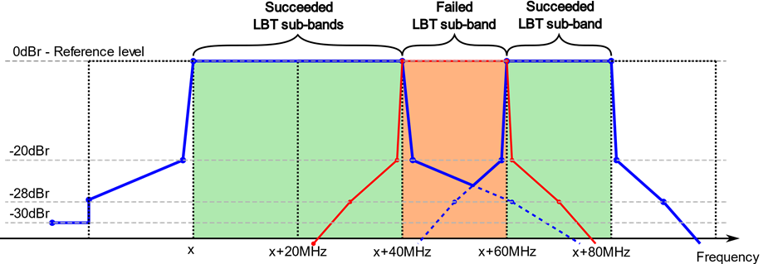
Should 802.11 WG have a position on the mask during puncturing?
IEEE 802.11ax seems to assume -20dBr. Is this a problem for which the WG should express a view?

Slide 39
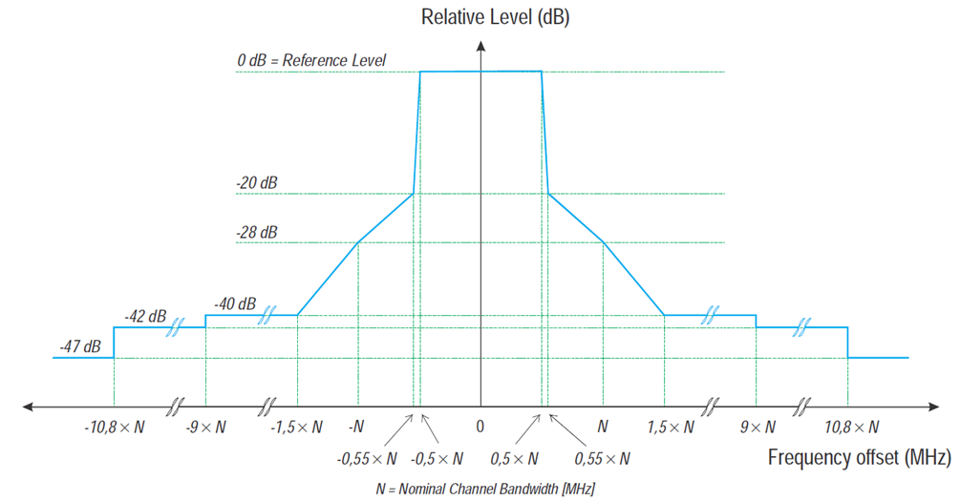
Should 802.11 WG have a position on the mask roll of being related to the BW?
Roll off is a function of the BW (20/40/80/160MHz). Does IEEE 802.11 WG have a position on this issue?

Slide 40
Little progress was made on the question of expanding the status quo for Paused COT
Submission
BRAN(19)102006r1: Paused COT clarification (Ericsson)
BRAN(19)1020010: Status update for ED For Paused COT issue (Cisco)
BRAN(19)1020011: Update on reducing interference from paused COT (Cisco)
Summary
Not much progress was made on the question of whether Paused COT should be forced to continue to use ED-only (@ -72dBm), ie status quo
Cisco explained why this made sense, and Ericsson said they disagreed
It was agreed by Cisco that the proposal to protect a SIFS gap from a Paused COT starting is probably not necessary in practice
The probability of the problem occurring is small
Outcome
..

Slide 41
R&S highlighted some difficulties they were having in testing preamble operation
Submission
BRAN(19)102040: EN 301 893 Preamble Test for Adaptivity (R&S)
Summary
One of the goals of EN 301 893 is to test the requirements
R&S has been experiencing difficulty defining a preamble test
It is believed original issue was no gap before preamble
Now they assert that a preamble only “works” when followed by an 802.11 MAC frame
Discussion
This seemed odd to many because the 802.11a preamble is used with all sorts of following modulation (for backwards compatibility reasons)
R&S are hosting a session in Munich on 20 August to investigate further

Slide 42
ETSI BRAN will next meet at BRAN#103 in Oct 2019
ETSI BRAN plans
BRAN #103
7-10 October 2019 – Sophia Antipolis
Chair election will be held
BRAN #104
2-5 December 2019 – Sophia Antipolis
BRAN #105
24-27 March 2019 – Sophia Antipolis

Slide 43
3GPP NR-U
3GPP RAN/RAN1 review

Slide 44
The Coex SC may review recent activities in 3GPP RAN/RAN1
The Coex SC may review recent activities in 3GPP RAN/RAN1
Is there a volunteer?

Slide 45
Technical topics
CW Adjustment issues

Slide 46
The Coex SC may discuss CW adjustment issues
A topic of recent interest in ETSI BRAN & the Coex SC is how CW is adjusted with delayed acks
The Coex SC may hear a summary of the current status based on a “reserve” presentation for the Coexistence Workshop
11-19-1110-00: Definition of success

Slide 47
Agenda items
Plans for next meeting

Slide 48
The Coex SC will get back to normal business in Sept 2019
Possible agenda items
Follow up on Coex Workshop
Prepare for ETSI BRAN meeting in October 2019
Review recent 3GPP RAN/RAN1 activities
Discuss various technical topics
Discuss extension of SC scope beyond life of 802.11ax
…

Slide 49
The IEEE 802.11 Coexistence SC meeting in Vienna in July 2019 is adjourned!

