Slide 1
Efficient Operation for Multi-AP Coordination
Date: 2019-07-15
Authors:
Name | Affiliation | Address | Phone | Email
Sungjin Park | LG Electronics | 19, Yangjae-daero 11gil, Seocho-gu, Seoul 137-130, Korea |  | allean.park@lge.com
Ensung Park |  |  |  | esung.park@lge.com
Jeongki Kim |  |  |  | jeongki.kim@lge.com
Jinsoo Choi |  |  |  | js.choi@lge.com

Slide 2
Introduction
The Multi-AP transmission has been discussed as one of the candidate features for adoption in 11be.
There are several types of Multi-AP transmission schemes.
Joint transmission
Coordinated transmission (Coordinated BF/OFDMA/SR)
In order to use the above Multi-AP transmission schemes effectively in 11be, it is necessary to ensure that the APs scheduled to Multi-AP transmission scheme can participate.

Slide 3
Multi-AP topology
We consider the following Multi-AP topology in this contribution.
Master AP (M-AP) is being a role of the AP coordinator.
Slave AP (S-AP) is the AP which can participate in the Multi-AP transmission.
STA “a” is associated with M-AP.
STA “b” is associated with S-AP.
M-AP
S-AP
STA a
STA b

Slide 4
Assumptions
All APs (M-AP and S-AP) already performed sounding with the STAs.
Therefore, the M-AP knows the CSI between all APs and STAs through the Multi-AP sounding.
Based on the CSI, the M-AP is about to transmit data by using one of the Multi-AP schemes.
This contribution assumes the situation after completion of the sounding and focuses on the data transmission by using the Multi-AP scheme.

Slide 5
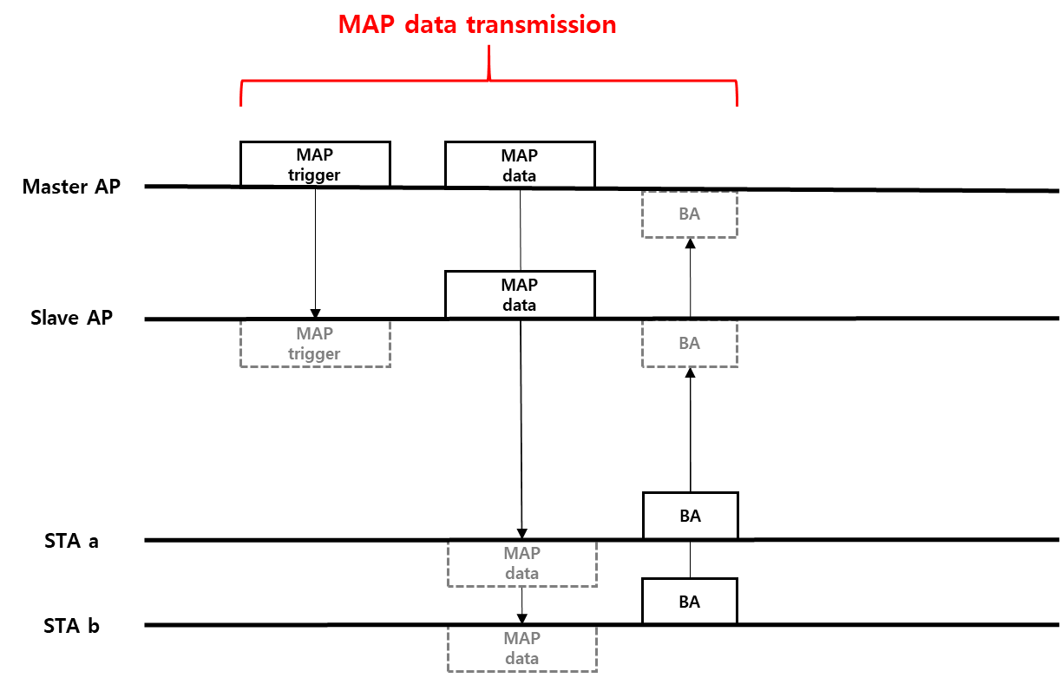
Multi-AP data transmission
In general, the data transmission using the Multi-AP scheme can be as shown below.
However, some problems may occur if the Multi-AP transmission is performed without confirming whether the S-AP is transmitted as in the above procedure.
Notes:
AP selection이 아니라 STA selection이라는 코멘트
→ AP와 STA 사이의 link를 이용하여 AP를 선택 (buffer를 보고)

Slide 6
Potential problem in Multi-AP data TX
If the S-AP fails to receive the MAP trigger frame or the channel state of the S-AP is BUSY, the S-AP cannot participate in the Multi-AP data transmission.
The M-AP cannot know the S-AP is available to participate in the Multi-AP data transmission unless a procedure that S-AP responds to the MAP trigger frame is used.
Even if the S-AP can not participate in the Multi-AP data transmission, if the only M-AP transmits the data by using Multi-AP scheme, there are potential problems as follows.
Joint TX: the gain to be achieved from the Multi-AP scheme can not be achieved.
Coordinated TX: the performance loss can cause compared to when the Multi-AP scheme is not used.
Notes:
AP selection이 아니라 STA selection이라는 코멘트
→ AP와 STA 사이의 link를 이용하여 AP를 선택 (buffer를 보고)

Slide 7
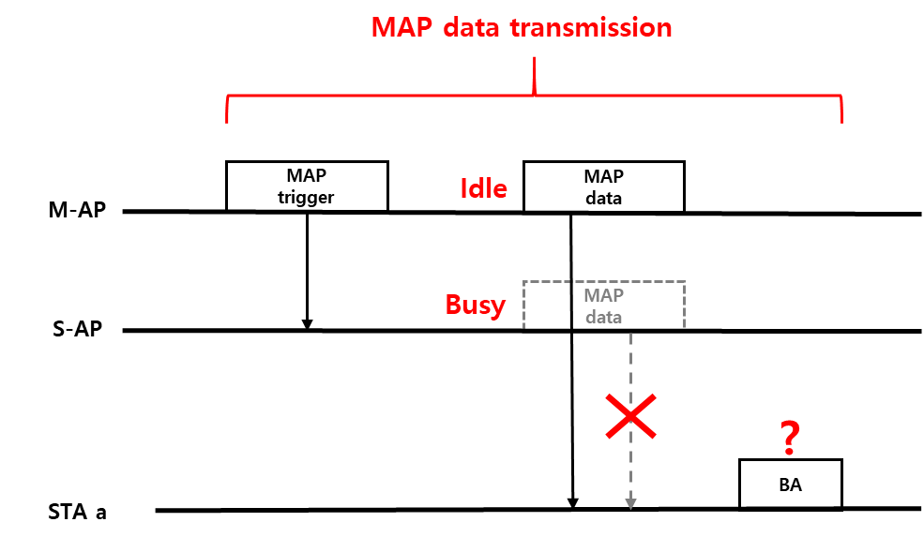
Joint transmission case
If the only M-AP without S-AP transmits data using Joint TX, the following problem occurs.
It can not be assured that the STA “a” successfully decodes the data transmitted by the only M-AP.
The selected MCS for data transmission using Joint TX can be inappropriate.
In particular, the STA at the cell edge is unlikely to decode the data.
Therefore, in the above case the expected gain of using Joint TX cannot be achieved.
Notes:
AP selection이 아니라 STA selection이라는 코멘트
→ AP와 STA 사이의 link를 이용하여 AP를 선택 (buffer를 보고)

Slide 8
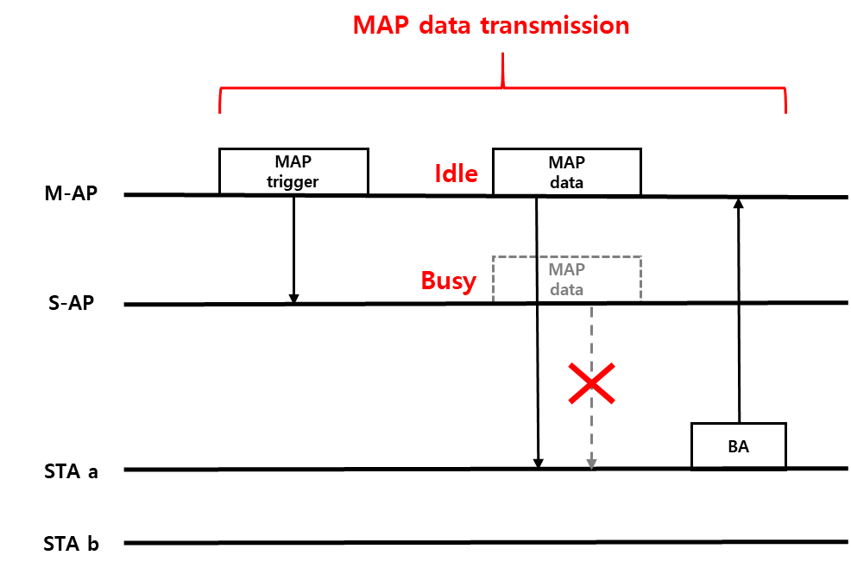
Coordinated transmission case
If the only M-AP without S-AP transmits data using Coordinated TX, the following problem occurs.
Even though Coordinated TX scheme does not need to be used, if it is used, the following gain cannot be achieved.
C-BF: the M-AP could apply optimized BF to STA a without using the nulling BF.
C-OFDMA: M-AP could allocate all available RUs to STA “a” rather than STA “b”.
Therefore, using Coordinated TX without S-AP’s participation causes the resource waste.
Notes:
AP selection이 아니라 STA selection이라는 코멘트
→ AP와 STA 사이의 link를 이용하여 AP를 선택 (buffer를 보고)

Slide 9
Multi-AP selection
Multi-AP data transmission can be guaranteed by using the Multi-AP selection procedure described in the previous contribution[1].
The Multi-AP selection means that M-AP selects the appropriate S-AP for Multi-AP transmission scheme to be used and confirms whether selected S-AP can participate in this Multi-AP transmission scheme.
We propose the procedure of Multi-AP selection as follows:
The M-AP sends MAP selection frame to the selected S-AP.
The selected S-AP sends MAP selection response frame to the M-AP.
If the selected S-AP cannot respond due to the channel state, the M-AP can reselect other S-AP.
Notes:
AP selection이 아니라 STA selection이라는 코멘트
→ AP와 STA 사이의 link를 이용하여 AP를 선택 (buffer를 보고)

Slide 10
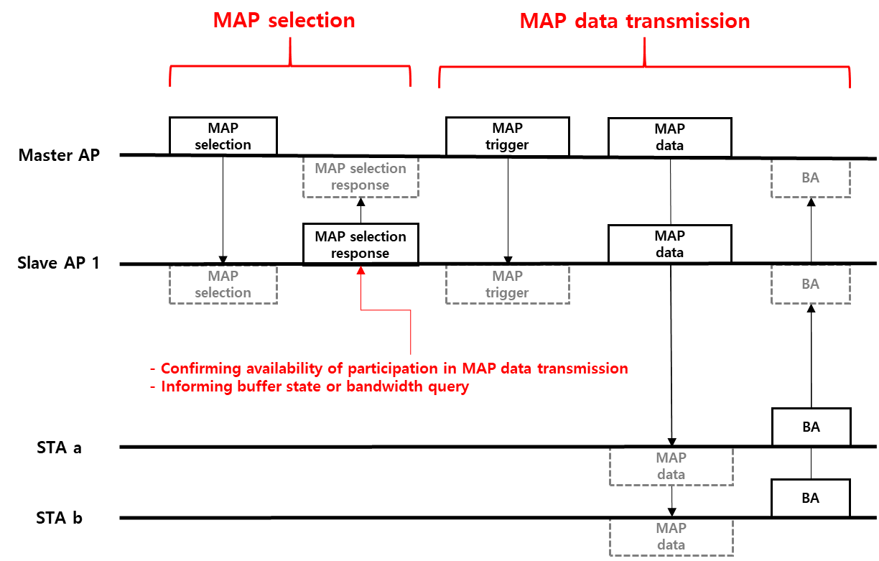
Multi-AP data transmission with Multi-AP selection
The data transmission by using Multi-AP scheme can be guaranteed by the MAP selection procedure. So we can achieve the gain we were trying to achieve.
Notes:
AP selection이 아니라 STA selection이라는 코멘트
→ AP와 STA 사이의 link를 이용하여 AP를 선택 (buffer를 보고)

Slide 11
Conclusion
In the data transmission using Multi-AP scheme, it is important whether or not the selected S-AP can participate in the Multi-AP data transmission.
There are potential problems if the data is transmitted by Multi-AP scheme without confirming availability of S-AP’s participation.
In this contribution, we propose the Multi-AP selection procedure in order to use the Multi-AP transmission scheme effectively.

Slide 12
Reference
[1] IEEE 802.11-19/0804r0, Multi-AP Transmission Procedure, Sungjin Park (LG Electronics)

Slide 13
Straw Poll
Do you support to define a procedure to confirm AP’s participation in the Multi-AP transmission schemes?
- Multi-AP transmission schemes are TBD

