Slide 1
Multi-link transmission
Date: 2019-07-12
Authors:
Name | Company | Address | Phone | Email
Rojan Chitrakar | Panasonic Corporation |  |  | rojan.chitrakar@sg.panasonic.com
Lei Huang
Yanyi Ding
Yoshio Urabe

Slide 2
Overview
Many contributions have shared the benefits of multi-link transmissions [1], [2], [3].
Multi-link packet transmissions is one option to achieve the peak throughput goal of TGbe.
In this contribution, we share our opinion on some of the issues related to multi-link transmissions.

Slide 3
Multi-link Entity
A multi-link entity may be seen as a collection of two or more STAs; each STA operating on a specific link (frequency band) and comes with its own link specific PHY and lower MAC layer.
A unified upper MAC layer interfaces with the individual link specific lower MACs and provides a unified MAC Service Access Point (SAP) to the LLC and upper layers.
  The multi-link entity may be represented by a single MAC address assigned to the UMAC.
  The UMAC is responsible for link agnostic MAC procedures such as SN/PN assignments, MPDU encryption/decryption, BlockAck scoreboarding etc.

Slide 4
Multi-link Transmissions
In order to improve the peak throughput, MPDUs belonging to the same TID may be simultaneously transmitted over multiple links.
  At TX side UMAC performs the allocation of MPDUs to different links. The same SN space is used across all links.
  At RX side UMAC consolidates the MDPUs arriving over the different links, performs BA scoreboarding, MPDUs reordering etc.
  A consolidated acknowledgment may be transmitted over one of the links.

Slide 5
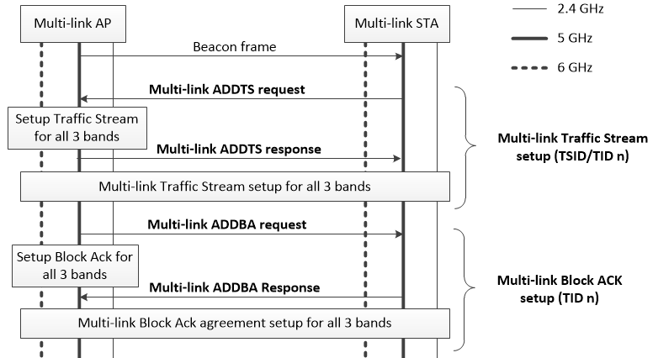
Multi-link TS and BA Setup
Block Ack for multi-link transmissions may be setup using a single pair of multi-link setup frames on any one link.
If admission control is required for a TID, Traffic Stream for multi-link transmissions may be setup using a single pair of multi-link setup frames on any one link.

Slide 6
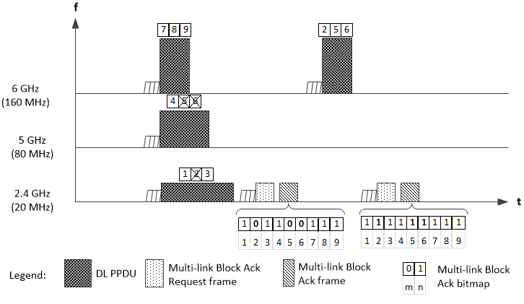
Multi-link Transmission: An Example
A Block Ack frame may consolidate the acknowledgments for MPDUs received over different links. The Block Ack frame may be transmitted on any one of the links.
Failed MPDUs may be re-transmitted on a link different from the link used for the original transmission.

Slide 7
Conclusion
In order to improve the peak throughput, MPDUs belonging to the same TID may be simultaneously transmitted over multiple links.
Block Ack or Traffic Streams for multi-link transmissions may be setup using a single pair of multi-link setup frames on any one link.
A Block Ack frame may consolidate the acknowledgments for MPDUs received over different links. The Block Ack frame may be transmitted on any one of the links.
Failed MPDUs may be re-transmitted on a link different from the link used for the original transmission.

Slide 8
Reference
11-19/731r0 - Multi-link Operation
11-19/822r0 - Extremely efficient multi-band operation
11-19/823r0 - Multi-link aggregation

