Slide 1
Joint Beamforming
Simulations
Date: 2019-07-15
Authors:
Name | Affiliations | Address | Phone | email
Sudhir Srinivasa | Marvell |  |  | sudhirs@marvell.com
Hongyuan Zhang | Marvell |  |  | hongyuan@marvell.com

Slide 2
Overview
Previous submissions [1-4] have looked at different aspects of Joint BF/MU processing
  “Joint BF” [4] refers to multiple APs jointly steering a single packet with one or more streams to one STA
In this submission, we primarily focus on the feasibility of Joint Beamforming with different non-idealities/impairments
  Independent CFO across multiple APs.
  Carrier Frequency drift in APs between NDP and steered packet.
  Timing synchronization between NDP and steered packet for slave APs.
  Propagation delay between the APs to the STA
Simulations show even a low CFO impacts the Joint-BF throughput considerably
  However, simple schemes like 11ax-midambles can be used in the jointly steered packet to offset the impact of residual CFO

Slide 3
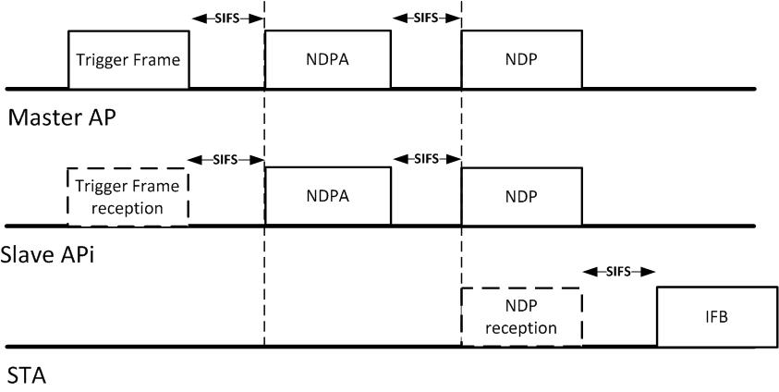
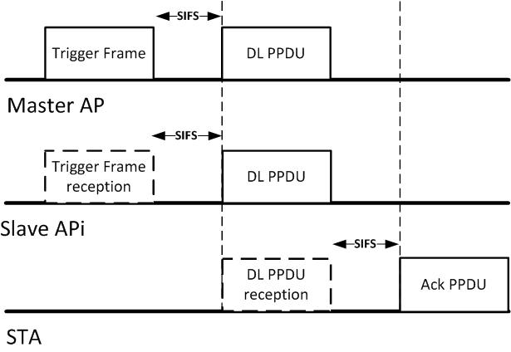
Joint AP Beamfoming
Sounding & Feedback (Synchronized transmission) Exchange
Trigger packets before NDPA-NDP and DATA can be used for control signaling as well as for synchronization.
  Carrier Frequency synchronization
  Timing synchronization
  Delay estimation
  Phase synchronization
  (MAC signaling) etc
Beamforming DATA transmission (Synchronized transmission):

Slide 4
NDP & DATA packet transmission
Sounding/NDP
  Requires synchronized (both CFO and SFO pre-compensation) transmission for NDP packet.
  The master/primary AP sends a trigger packet, and slave APs will synchronize w.r.t the master AP.
  During the NDP packet, the slave APs apply CFO & SFO pre-compensation w.r.t master AP.
DATA transmission
  The synchronization procedure is similar to sounding packet.
Timing and phase is also synchronized between the sounding and data transmission using the channel estimates of trigger packets at slave APs.

Slide 5
Simulation Setup
Two Scenarios:
  Case 1: Nss=2 STA
    Two APs with 4 antennas each; or Four APs with 2 antennas each
  Case 2: Nss=4 STA
    Two APs with 4 antennas each; (or Four APs with 2 antennas each)
Only residual timing/frequency offsets between master – slave APs are modeled
Timing offset is modeled as a 10deg ramp across the entire signal BW on the slave AP
For CFO, we consider two separate cases: 20Hz and 50Hz CFO
Feedback considered is the steering matrix
  Compression and De-compression are bypassed, i.e., quantization effects are ignored.
1ms HEW LDPC packet, 4x+3.2 LTF, Independent DNLOS channels across APs
 | CFO |  | Propagation Delay (us)
 | Residual CFO at slave AP (Hz) | Carrier drift at master AP (Hz) | AP2 | AP3 | AP4
NDP | U[-a, a] where a = 20Hz or 50Hz | 0 Hz | 0.5 us | 0.3 us | 0.1 us
DATA packet | U[-a, a]], where a = 20Hz or 50Hz | U[-b, b] where b =20 kHz | 0.5 us | 0.3 us | 0.1 us

Slide 6
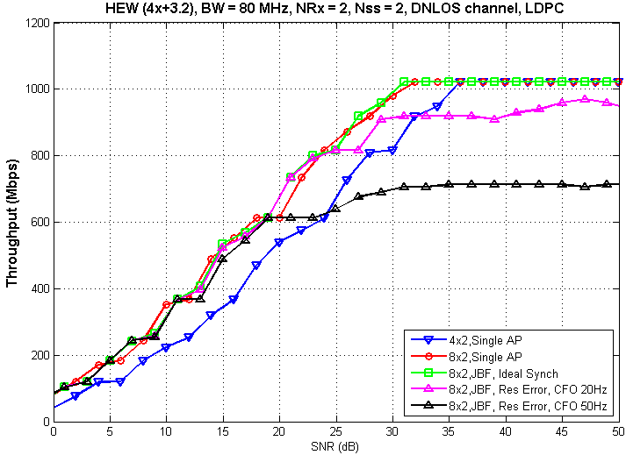
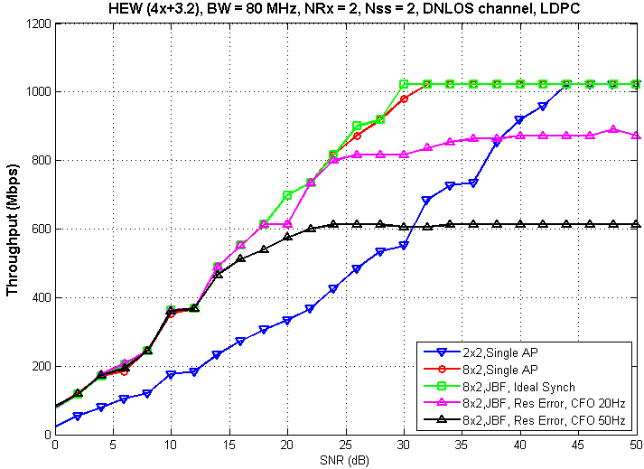
HEW, 80 MHz, Nss=2, ‘D’ channel
2AP
4AP
With SNR < 20 dB, throughput of JBF transmission is similar to single AP with 8 transmit antennas.
Significant degradation in peak throughput even with residual CFO of 20 Hz.
Peak throughput degradation higher with higher (50Hz) residual CFO

Slide 7
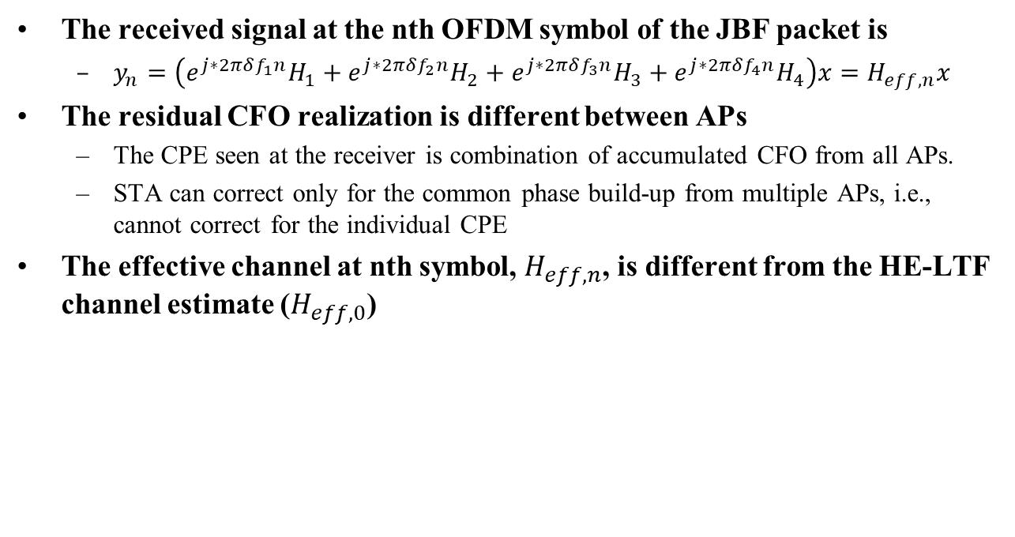
CFO: Phase build-up across symbols
The received signal at the nth OFDM symbol of the JBF packet is
  $y_{n}=\left(e^{j∗2πδf_{1}n}H_{1}+e^{j∗2πδf_{2}n}H_{2}+e^{j∗2πδf_{3}n}H_{3}+e^{j∗2πδf_{4}n}H_{4}\right)x=H_{eff, n}x$
The residual CFO realization is different between APs
  The CPE seen at the receiver is combination of accumulated CFO from all APs.
  STA can correct only for the common phase build-up from multiple APs, i.e., cannot correct for the individual CPE
The effective channel at nth symbol, $H_{eff, n}$, is different from the HE-LTF channel estimate ($H_{eff, 0}$)

Slide 8
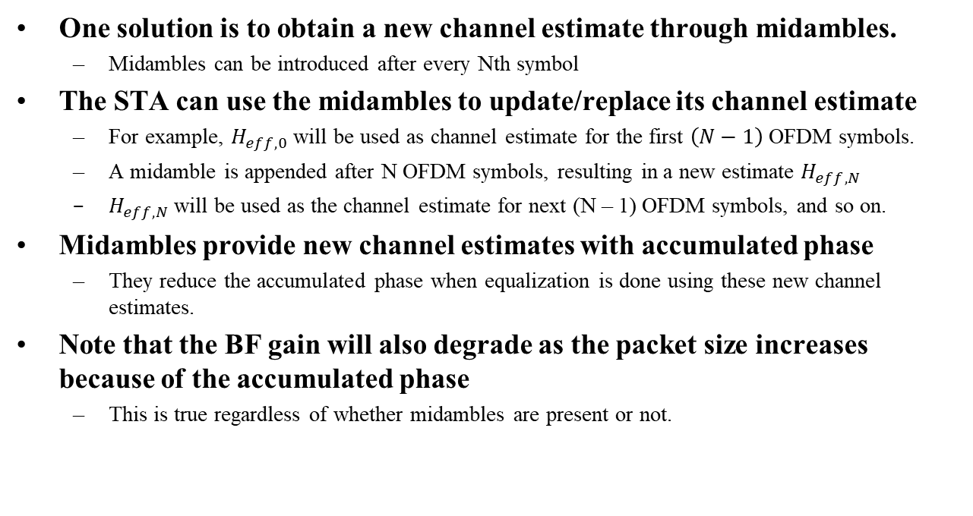
Midamble
One solution is to obtain a new channel estimate through midambles.
  Midambles can be introduced after every Nth symbol
The STA can use the midambles to update/replace its channel estimate
  For example, $H_{eff, 0}$ will be used as channel estimate for the first $\left(N−1\right)$ OFDM symbols.
  A midamble is appended after N OFDM symbols, resulting in a new estimate $H_{eff, N}$
  $H_{eff, N}$ will be used as the channel estimate for next (N – 1) OFDM symbols, and so on.
Midambles provide new channel estimates with accumulated phase
  They reduce the accumulated phase when equalization is done using these new channel estimates.
Note that the BF gain will also degrade as the packet size increases because of the accumulated phase
  This is true regardless of whether midambles are present or not.

Slide 9
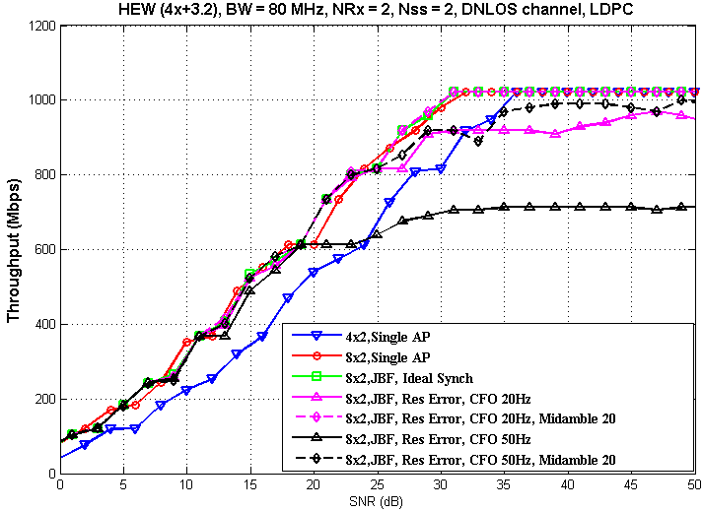
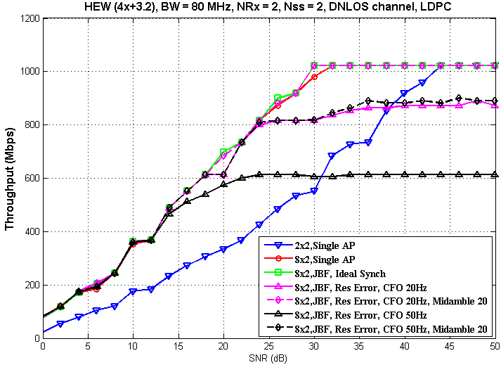
HEW, 80 MHz, Nss=2, ‘D’ channel
2AP
4AP
With midambles:
  With residual CFO = 50 Hz:
    For SNR < 25 dB, throughput is similar to that of 8x2 single AP
    No degradation compared to 8x2 single AP case up to MCS 9.
  With residual CFO = 20Hz - No degradation in peak throughput

Slide 10
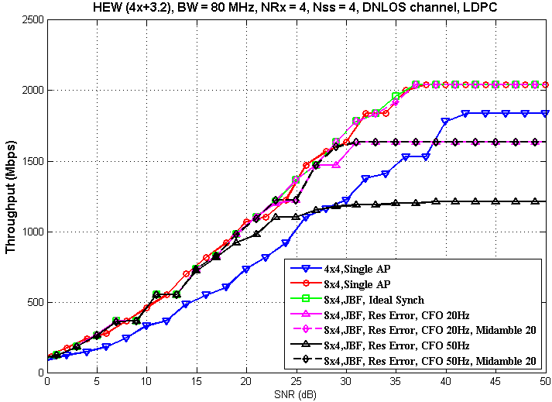
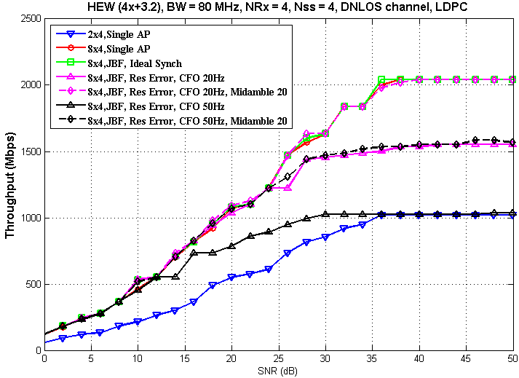
HEW, 80 MHz, Nss=4, ‘D’ channel
2AP
4AP
With midambles:
  With residual CFO = 50 Hz:
    With SNR < 30 dB in 2 AP and < 23 dB in 4 AP configuration, throughput is similar to that of 8x4 single AP.
    No degradation compared to 8x4 single AP case up to MCS 9.
  No degradation in peak throughput when residual CFO is 20 Hz.

Slide 11
Inferences
Even a small residual CFO across APs impacts throughput significantly
  Phase buildup from even a low ~20Hz residual CFO causes peak throughput degradation
Midambles help to alleviate the need for very stringent CFO/timing requirements for peak throughput
  Midambles help reset the phase buildup caused by residual CFO, and dramatically improve achievable throughput.
CFO/Timing requirements could be more relaxed for mid-range/lower MCSs

Slide 12
References
[1] IEEE 802.11-18/1510, Hongyuan Zhang
[2] IEEE 802.11-19/1484 & 0800, Ron Porat, Srinath Puducheri
[4] IEEE 802.11-19/0445, Sigurd Schelstraete
[5] IEEE 802.11-19/1926r2, Sameer Vermani

