Slide 1
Discussions of Multi-AP JT
Date: 07/15/19
Authors | Email
Xiaogang Chen | Xiaogang.c.chen@intel.com
Qinghua Li | Qinghua.li@intel.com
Feng Jiang
Ziv Avital
Laurent Cariou
Kenney Thomas
Stacey Robert

Slide 2
Outline
Potential issues for JT
  Sync between slave APs;
  Power imbalance across slave APs;
Evaluation of the sync issues;
Summary.

Slide 3
Sync issues of JT (1/2)
From the joint NDP Tx (SIFS after SLTrigger_NDP reception) to the joint Data Tx (SIFS after SLTrigger_Data reception), the relative phase difference between two JT APs comes from:
  CFO_{NDP} (after SLTrigger_NDP reception) and CFO_{Data} (after SLTrigger_Data reception).
  Timing_offset_{NDP} (after SLTrigger_NDP reception) and Timing_offset_{Data} (after SLTrigger_Data reception).
    FFT window offset between slave APs;
    SIFS counting offset between slave APs.
  LO_Initial_Phase_Offset_{NDP} (after SLTrigger_NDP reception) and LO_Initial_Phase_Offset_{Data} (after SLTrigger_Data reception) (assuming the LO phase is not correlated between SLTrigger_NDP and SLTrigger_Data due to jitter, temperature or other factors.).

Slide 4
Sync issues of JT (2/2)

Slide 5
Power imbalance across APs
Physical limitation;
Leave to implementation;
More discussions in later slides.

Slide 6
Simulation assumptions
General assumption & Sync issues
  ChD 20MHz;
  MCS1 to MCS9;
  1SS/STA; 1Rx/STA
  Residual CFO offset between NDP and Data is modeled as 4/8 degree fixed phase offset during data PPDU;
  Timing offset is modeled as 8 degree phase ramp over whole BW;
  3dB power gain is considered for 2 APs.
Model of power imbalance:
  2 APs, 4 STAs;
  Case 1 (used in Tpt curves): STA1/2 see RSSI_AP1 > RSSI_AP2; STA3/4 see RSSI_AP1<RSSI_AP2
  Case 2 : STA1/2/3/4 see RSSI_AP1 > RSSI_AP2;
  The range of power imbalance random distributed [0, MdB], M=3/10.

Slide 7
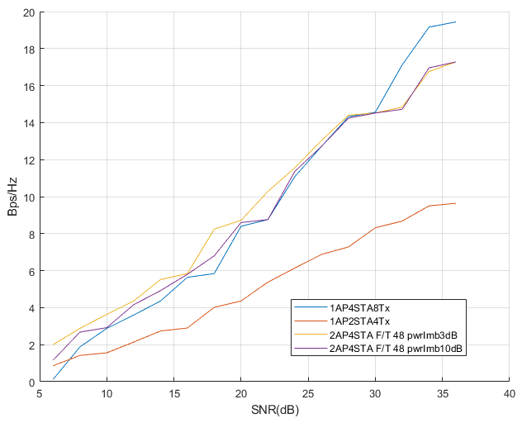
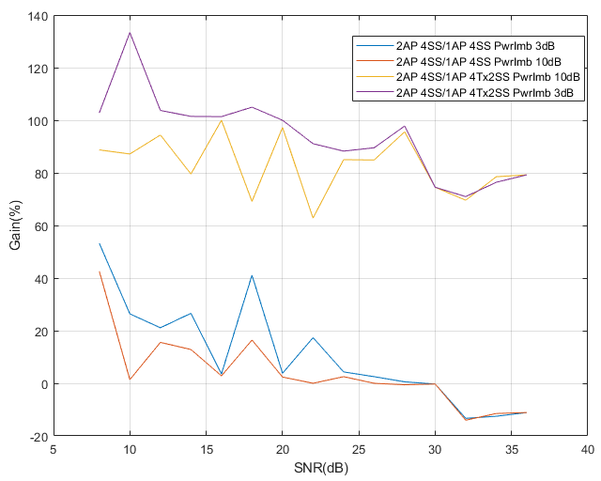
Performance evaluation (1/2)
4+4 ->4SS vs. 8->4SS vs. 4->2SS

Slide 8
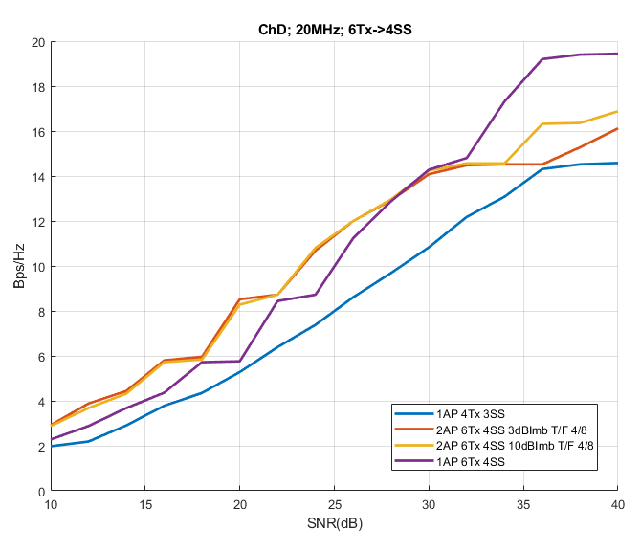
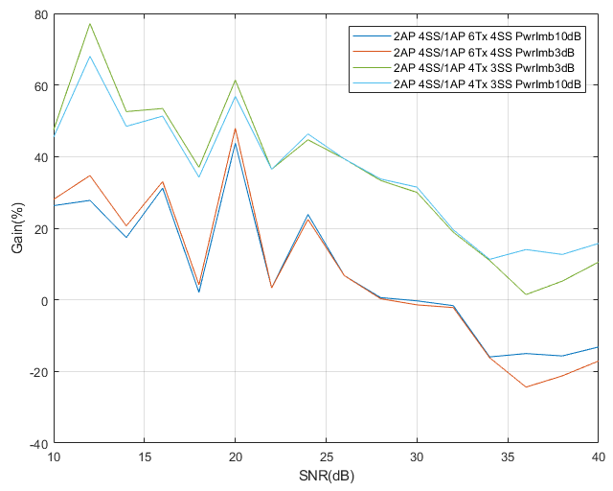
Performance evaluation (2/2)
2AP – Big (4Tx) + Small (2Tx)
4+2 ->4SS vs. 6->4SS vs. 4->3SS

Slide 9
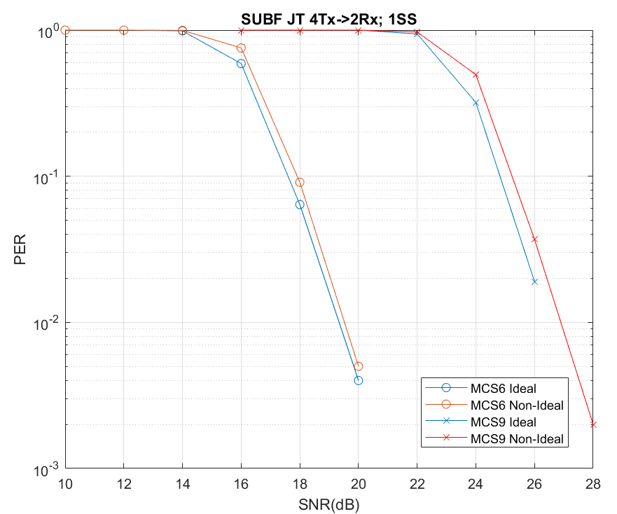
Evaluation of SU JT
Simulation assumptions:
  ChD 20MHz;
  MCS6 & MCS9;
  4Tx or 2+2Tx - > 2Rx; 1ss
  Residual CFO offset between NDP and Data is modeled as 16 degree fixed phase offset;
  Timing offset is modeled as 8 degree phase ramp over whole BW;
  3dB power gain is not considered for 2 APs for PER comparison.
Observations:
  SU BF is quite robust to sync issues;
  SU BF may be limited by the incapable of pilot tracking

Slide 10
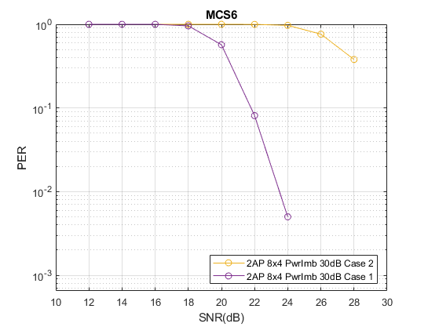
Impacts of the power imbalance (1/2)
Case 1 vs. Case 2
  Same pwr imbalance value has different impacts given different PwrImb model.
  Case 2 is similar with single AP server all clients.
Case 1 (used in Tpt curves): STA1/2 see RSSI_AP1 > RSSI_AP2; STA3/4 see RSSI_AP1<RSSI_AP2
Case 2 : STA1/2/3/4 see RSSI_AP1 > RSSI_AP2;

Slide 11
Impacts of the power imbalance (2/2)
Observations:
  Power imbalance has different affects on high MCS (impairment limited) and low MCS (Pwr limited);
AP needs to consider the extra aspects below for LA/scheduling
  RSSI difference from a client to JT AP1/AP2;
  All clients see the same stronger AP (Case 2) or otherwise (Case 1).
Pwr_imb level | Low | High
Low | Low impact: due to low Pwr_Imb level | Low impact: Dominated by Sync accuracy
High | Medium impact: Low SNR is power sensitive; Tx pwr degradation due to high Pwr_imb level. | Low impact: Pwr_imb offset the Sync impacts. Dominated by high power AP which is closer to single AP case.
Client MCS

Slide 12
Summary
For Multi AP MU vs. Single AP MU,
  if the same number of Tx antenna (over all APs) serve the same number of SS (over all STAs), i.e. Two small AP vs. one big AP
    A SNR “gain region” is observed for low~medium MCS (Up to MCS7).
    JT has loss for high MCS (MCS9 and beyond);
  if compare two small AP JT vs. one small AP (or two small AP with TDMA only), JT gain significant for all MCS.
Multi AP SU BF is robust to sync impacts.
Power imbalance in general has low impact to JT.
Need further considerations:
  Data sharing backhaul for JT.

Slide 13
Back up 1:
Accuracy of timing offset difference (T_Data – T_NDP)
For -25dB Aging: 0.6ns Timing offset @10dB (90%);
For -30dB Aging: 0.3ns Timing offset @10dB (90%);
Note: For 2 APs the timing offset could be doubled for worst case.
4Rx@AP, 20MHz, noBF.

Slide 14
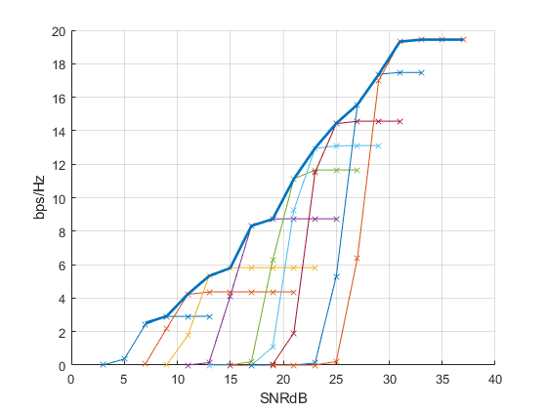
Back up 2:
Example of the TP curve generation

