Slide 1
NGV Frame Format Discussions
Date: 2019-07-15
Authors:

Slide 2
Introduction
In March meeting, the legacy portion of the 11bd preamble [1] is agreed on to support coexistence and backward compatibility.
Extended range mode is stated in the PAR [2] as part of the design scope.
In this contribution, we will discuss the preamble design for extended range to meet the PAR.
In addition, unified frame format design is also proposed.

Slide 3
Extended Range Mode
10MHz
LSTF
LLTF
LSIG
NGV Portion
The 11bd preamble shall include L-STF, L-LTF, L-SIG fields [1].
It states in the PAR [2] that: 11bd standards shall define
“at least one mode that achieves at least 3dB lower sensitivity level (longer range), than that of the lowest rate defined in IEEE Std 802.11-2016 operating in 5.9GHz band”
We term this mode as “Extended Range” (ER) mode in this presentation.

Slide 4
NGV ER Mode
10MHz
LSTF
LLTF
LSIG
R-LSIG
NGV Portion
ER mode has been defined in 802.11ax which supports 3dB better sensitivity:
New data rate: BPSK-1/2 with DCM.
Repeated L-SIG symbol and repeated HE-SIGA symbols.
power boost of L-STF, L-LTF.
DCM has been accepted as the new data modulation scheme for the ER mode. [3]
We will evaluate the effectiveness of the 11ax ER preamble design in 11bd frame.
Repeated L-SIG symbol
Power boost of L-STF, L-LTF.
.

Slide 5
Simulation Settings
10MHz DSRC channel @5.9GHz
OFDM numerology: 11ac 20MHz DC2.
1x1-1ss, 300 bytes.
LDPC with Midamble of period 10.
In ER mode, Midmable is 3dB power boosted
C2C channel models [4]
Preamble processing:
Carrier sensing, Symbol timing detection.
LSIG and RLSIG detection.
Two preamble formats:
Non-ER: LSTF + LLTF + LSIG
ER: 6dB-boosted LSTF + 3dB-boosted LLTF + LSIG + RLSIG

Slide 6
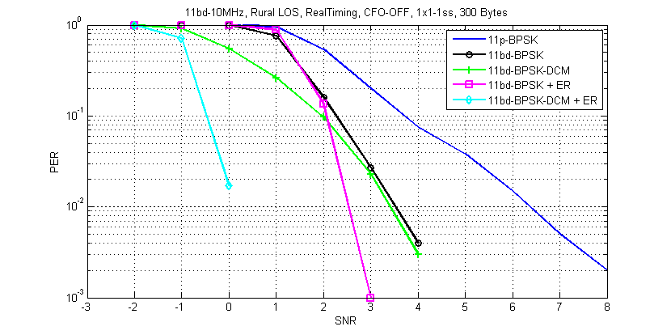
Rural LOS
~3dB sensitivity improvement for BPSK-DCM + ER.
BPSK + ER also sees sensitivity gain.

Slide 7
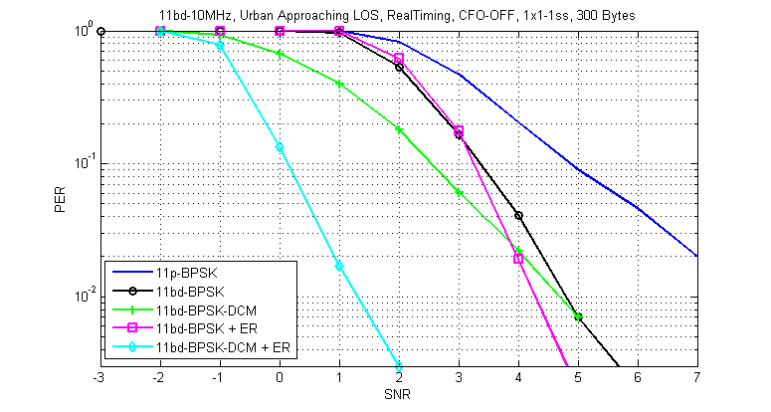
Urban Approaching Los
~3dB sensitivity improvement for BPSK-DCM + ER.
BPSK + ER also sees some sensitivity gain.

Slide 8
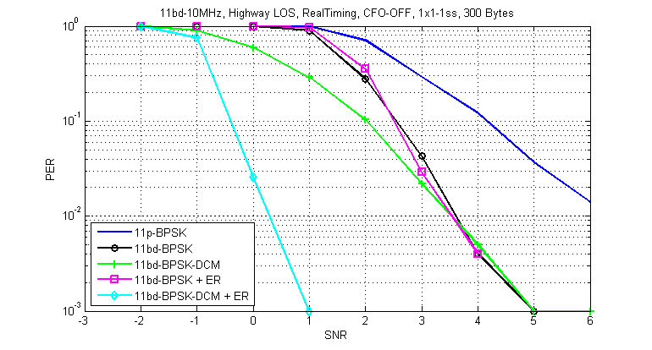
Highway Los
~3dB sensitivity improvement for BPSK-DCM + ER.
BPSK + ER also sees some sensitivity gain.

Slide 9
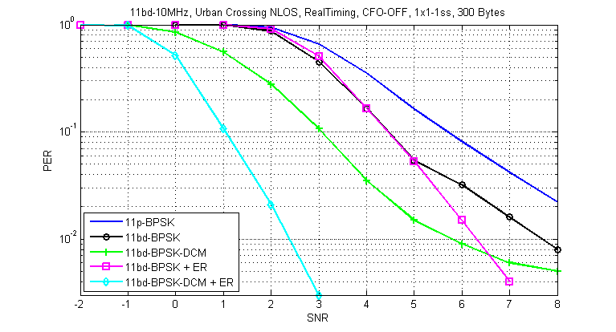
Urban Crossing NLos
>3dB sensitivity improvement for BPSK-DCM + ER.
BPSK + ER also sees some sensitivity gain.

Slide 10
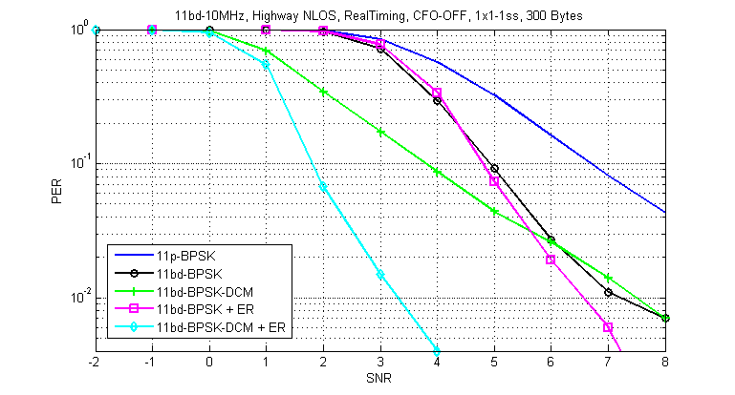
Highway NLos
>3dB sensitivity improvement for BPSK-DCM + ER.
BPSK + ER also show some sensitivity gain.

Slide 11
Result Discussions
With ER preamble (power boost + RLSIG), the 3dB DCM modulation gain can be achieved.
With ER preamble (power boost + RLSIG), even MCS0 (BPSK-1/2) observes some sensitivity gain.
It is beneficial to use ER preamble format for all NGV PPDU modes/formats.

Slide 12
Unified 11bd Frame Format
10MHz
L-STF
L-LTF
L-SIG
RL-SIG
NGV Portion
Propose unified 11bd frame format
Include RL-SIG after L-SIG
Power boost x-dB for L-STF and LLTF, xdB can be MCS dependent.
Benefits of unified frame format
In OCB broadcast transmission, no capability indication is feasible. 11bd STA needs to support all frame formats.
With only one 11bd frame format, receiver design complexity can be reduced.
The repetition check of RLSIG and LSIG can be used as 11bd PPDU classification (distinguish from 11p PPDU). No extra classification feature is needed.

Slide 13
Summary
11bd ER PPDU performance is evaluated using 11ax ER preamble design.
~3dB sensitivity can be achieved.
BPSK-1/2 can also receive some benefit with the ER preamble.
Propose to use unified frame format for 11bd PPDUs.
Include RL-SIG after L-SIG.
xdB power boost of L-STF, L-LTF

Slide 14
Reference
[1] Dungguk Lim and etc., “PHY Designs for 11bd”, IEEE 802.11-19/0332r2.
[2] Bo Sun and etc., “802.11 NGV SG Proposed PAR”, IEEE 802.11-18/0861r9.
[3] Jianhan Liu and etc., “Modulation Scheme for 11bd Range Extension”, 802.11-19/0343r0.

Slide 15
Straw Poll 1
Do you agree to add the following text into Section 3 of SFD?
“11bd shall support only one PPDU format for each bandwidth.”
Y:
N:
A:

Slide 16
Straw Poll 2
Do you agree to add the following text into Section 3 of SFD?
“The preamble of 11bd PPDU shall include repeated LSIG symbol after LSIG.”
Y:
N:
A:
10MHz
LSTF
LLTF
LSIG
R-LSIG
NGV Portion

Slide 17
Straw Poll 3
Do you agree to add the following text into Section 3 of SFD?
“11bd PPDU shall boost L-STF by x1dB, with x1 value TBD.”
“11bd PPDU shall boost L-LTF by x2dB, with x2 value TBD.”
Y:
N:
A:

Slide 18
Appendix

Slide 19
Rural LOS

Slide 20
Urban Approaching LOS

Slide 21
Urban Crossing NLos

Slide 22
Highway LOS

Slide 23
Highway NLos

