Slide 1
Do Not Fear Random MAC Addresses!
Date: 2019-07-04
Authors:

Slide 2
Abstract
The rise of MAC randomization has been treated as if it is an outbreak of an infectious disease and discussion around it has been “how do we respond?”
This submission discusses the motivations of MAC randomization, why it’s a good thing, 802c applicability, and the concerns raised over MAC randomization.

Slide 3
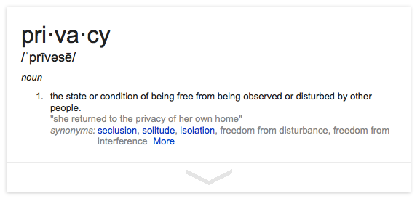
Motivation For 802.11 MAC Randomization

Slide 4
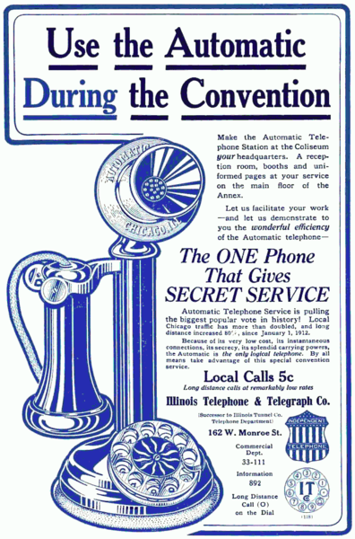
Concerns of Communications Privacy are Not New
Privacy was an important selling
point for dial phones in 1912 since
they did not require the use of an
operator to make the call

Slide 5
Privacy Concerns with 802.11
Passive observation of 802.11 bands reveals MAC addresses and more!
STAs active probing when not connected to a network
Communication to connected network
STAs frantically searching for particular SSIDs
Location plus time plus frequency plus MAC address allows sensitive information to be gleaned
This MAC address pops up at the AIDs clinic twice a week
This MAC address is near the liquor store at 8am every day
This MAC address leaves a certain apartment building in the early morning almost every weekend
Straightforward to create Personally Identifiable Information (PII) from this data

Slide 6
Privacy Concerns with 802.11
802.11 privacy is not a theoretical concern:
Wi-Fi Trashcans Now Silently Tracking Your Smartphone Data
... the company boasted that the cans, which included LCD advertising screens, "provide an unparalleled insight into the past behavior of unique devices"—and hence of the people who carry them around
Seattle Police Deactivate Wi-Fi Spy Grid After Privacy Outcry
A DHS and Seattle police network collecting location information
MAC randomization is a simple and effective way of addressing privacy concerns in 802.11
Opt-in/out schemes presume that all parties are trustworthy
Garbage in, garbage out more effective: if the data is garbage then the result of Big Data Analytics will be garbage– there will be no PII
Control is in the hands of the user, where it should be

Slide 7
How is “Client Privacy” Addressed in 802.11?
IEEE 802.11aq added a MIB variable for “privacy”
When that MIB variable is set, a STA will:
Periodically randomize its MAC address pre-association by selecting an address out of the local address space
Not probe for specific SSIDs
Reset the sequence number counter used to identify MSDUs and MMPDUs when the MAC address changes
Reseed the OFDM scrambler when the MAC address changes
Choose a random MAC address to associate to an AP and retain that MAC address during the STA’s connection to the ESS
Set its MAC address to a previously used (random) MAC address when it attempts to use some state on the AP bound to the previous MAC address
Some vendors are already randomizing MAC addresses
Whether they are doing in per-802.11aq remains to be seen

Slide 8
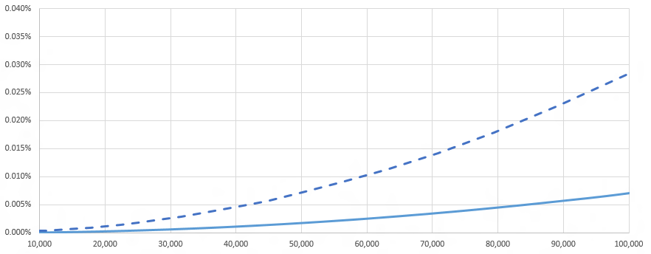
802c and MAC Randomization
802c partitioned the local address space into quadrants
ELI– prefix is a CID, remaining octets are assigned per policy
SAI– for use with 802.1CQ
AAI– administrator has some arbitrary local policy and wishes to not conflict with ELI– or SAI–style addresses that may also be on his network
Reserved
802c consumes 2 of the 46 available bits of a 48-bit MAC
This vastly increases likelihood of MAC address collision

Slide 9
802c and MAC Randomization
802c does not assign local address space
The SLAP is optional
802c provides a way to support multiple administrative policies in the same local address space if the administrator so desires, but it’s still local
Using any CID, or no CID, to construct a local address is not prohibited
802c does not restrict random MACs to a quadrant
Randomness in the AAI is an example of a possible local policy but is clearly not the only local policy for the AAI quadrant
Randomizing with all available (46) bits of a MAC…
…has always been possible, is still possible
…is the wise thing to do in order to avoid collision
802c is a LAN administrator issue, not a user/STA issue
Policy enforcement does not scale for 802.11 STAs in access network

Slide 10
802c is Not Useful for an 802.11 Network
802c motivation was data centers and non-access networks
Handle networking of a large number of VMs
Identification of weirdo L2 protocols on a data center network
Privacy Issues of 802.11 are aimed at network connectivity
Planes, trains, automobiles…shopping malls, bars, restaurants… enterprise, home, office… it’s all the same: get on the ‘net
A network that accepts all comers cannot presume to have instilled sufficient local address policy knowledge on each and every client
Privacy concerns are lessened if local policy has been provisioned already
No historical concerns about local address usage in these sorts of access networks, no reason to believe that would change going forward
MAC address is only significant on local LAN segment, once it gets to a router the MAC address of the STA is irrelevant
802c is VERY unlikely* to ever be used in an 802.11 network
* as in, will never be used

Slide 11
WBA Liasion
Raised issues that were perceived to be problems associated with randomization of 802.11 MAC addresses
Some were unserious or overblown: different MAC address used with same Passpoint Profile, Pay-per-use services are associated with MAC addresses, complimentary service offerings can be abused by changing MAC addresses, blacklisting by MAC address will no longer be effective, lawful intercept issues, etc
Some point to changes that will be necessary: band-steering will be difficult if different MACs are used on different bands, helpdesks that have come to rely on fixed MAC addresses will have issues
None of the issues raised compel a loss of privacy by users
MAC addresses are being randomized, that trend will grow
Important to ensure they do it the 11aq way

Slide 12
Summary
802.11 MAC randomization is not the networking equivalent of Ebola
There are valid reasons to for users to randomize their 802.11 MAC address
Randomization is not illegal, nor is it prevented or limited by any other 802 standards
Randomization will not create chaos in networks
It is a disruptive technology, but disruption can be good
Better ways of tracking and accounting for users will be employed– e.g. authenticated identities
Better security will be provided for network service offerings by not assuming a fixed global MAC address

Slide 13
References
IEEE 802.11-13/1448r1
– Paul Lambert’s original proposal on MAC randomization for privacy
IEEE 802.11-14/0430r2
IEEE 802c
Draft P802.11REVmd_D2.0
IEEE 802.11-18/1579r1

