Slide 1
LC-optimized PHY for TGbb
Date: 2019-05-13
Authors:

Slide 2
Abstract
The submission introduces the G.9991 PHY 1 [1] and subsequently discusses
it as a potential candidate PHY for 802.11bb.
The G.9991 PHY 1 is currently under discussion by industrial partners in the
ELIOT project for its adaptation as a LC PHY. [2]

Slide 3
The LC-optimized PHY
Recap: TGbb to support two-pronged PHY approach:
  Reuse existing 802.11 PHYs and no silicon modification as possible → lower entry barrier
  Introduce LC-optimized part in PHY → exploit full potential of LC
LC medium is different from RF
  Electrical baseband signal via optical IM/DD
  Low pass characteristic in NLOS but also LOS ([3][4])
  Much power resides in upper but attenuated part of bandwidth (-20 dB system BW is considered)
Traditional RF-PHYs work but perform suboptimal
Baseband PHYs exist and are much more suitable!
  E.g. ITU-T G.hn (G.9960) / G.vlc (G.9991)
Subsequently, we present the ITU-T G.9991 baseband PHY as suiting LC-PHY

Slide 4
G.9991 overview
G.9991 aka “G.vlc”
Part of G.999x series (optical transmission)
LC = VLC + IR
ITU-T Recommendation (Q18/15 “In-premises networking”)
  Started 2H2015
  Approval 01/04/2019
Based largely on G.9960/61 (aka “G.hn”)
Topologies:
  P2P
  P2MP
Objective: Leverage the “highly flexible OFDM engine provided by G.hn”

Slide 5

G.9991 overview (cont.)
Standard Ethernet Primitives
Data Link Layer ITU-T G.9991
Application Protocol Convergence
Ethernet encapsulation
Logical Link Control
AES 128 Security, Relaying
Physical Layer ITU-T G.9991
and Retransmissions
Medium Access Control
Master/Slave MAC
TDMA+CSMA
Physical Coding
Generation of PHY frame
Relevant
for TGbb
Physical Medium Attachment
FEC, scrambling, padding
Physical Medium Dependent
OFDM+QAM modulation

Slide 6
G.9991 overview (cont.)
2 PHY; 1 MAC
  MAC: G.hn MAC + additions (FD-prepared)
  PHY 1: G.9960 (DCO-OFDM)
  PHY 2: ACO-OFDM
Roughly:
  PHY1: Performance-oriented
  PHY2: Less performant; For cases where dimming may be an issue
Only PHY 1 has silicon available today

Slide 7
G.9991 PHY -- Functional model of PHY layer
TX direction:
Data enters the PHY layer from the MAC via the PMI in blocks of bytes called MAC protocol data units (MPDUs).
An incoming MPDU is mapped into a PHY frame in the PCS
Scrambled and encoded in the PMA
Modulated in the PMD and transmitted over the medium using specific OFDM modulation
In the PMD, a preamble is added to facilitate synchronization and channel estimation in the receiver.
RX direction:
Frames entering from the medium via the MDI are demodulated and decoded in the PHY layer.
The recovered MPDUs are forwarded to the MAC layer over the PMI.
The recovered PHY-frame headers are processed in the PHY to extract the relevant frame parameters.

Slide 8
G.9991 PHY framing (I) – PHY frame format
A PHY frame consists of a preamble, header, additional channel estimation (ACE) symbols (optional field, its presence is frame type dependent) and payload.
The preamble does not transport any user or management data and is intended for synchronization and initial channel estimation.
The PHY frame Header and Payload each contain an integer number of OFDM symbols
The PHY frame Header carries settings related to the payload (guard interval, bit loading, and FEC parameters)
The Payload includes one MPDU composed of one or more LPDUs (LLC Protocol Data Unit). Each LPDU carries a segment of the transmitted data, a header identifying the carried segment, and the CRC to detect “errored” LPDU for selective retransmission.
For the payload, different coding parameters and bit loading can be used in different frames, depending on the channel/noise characteristics and QoS requirements.

Slide 9
G.9991 PHY framing (II) – Header transmission
Other options to provide the header with more:
  Robustness
  Capacity

Slide 10
G.9991 PHY 1 – Forward Error Correction & MIMO
FEC (Forward Error Correction): QC-LDPC-BC
  Performance near Shannon theoretical limit
  Three block sizes: 21 bytes (header), 120 and 540 bytes (payload)
  Five Code rates: 1/2, 2/3, 5/6; 16/18 and 20/21
Frequency-selective fading is handled through bit-loading
  RF-PHYs usually rely on bit-interleaved coded modulation (BICM)
G.9991 defines MIMO as “for further study”
  However, the DCO-OFDM PHY (PHY 1) has inherited 2x2 MIMO capability from G.hn
  Specification of technical means (precoding) exist, must be adapted

Slide 11
G.9991 Adaptive OFDM
Dynamic bitloading tracks SNR in each sub-carrier at each receiver independently
RX spectrum
RX SNR
Bitloading
Receiver A
TX spectrum
TX
Noise
RX spectrum
RX SNR
Bitloading
Transmitter
TX
Receiver B
Noise
Noise
The transmitter makes use of adapted modulation per subcarrier

Slide 12
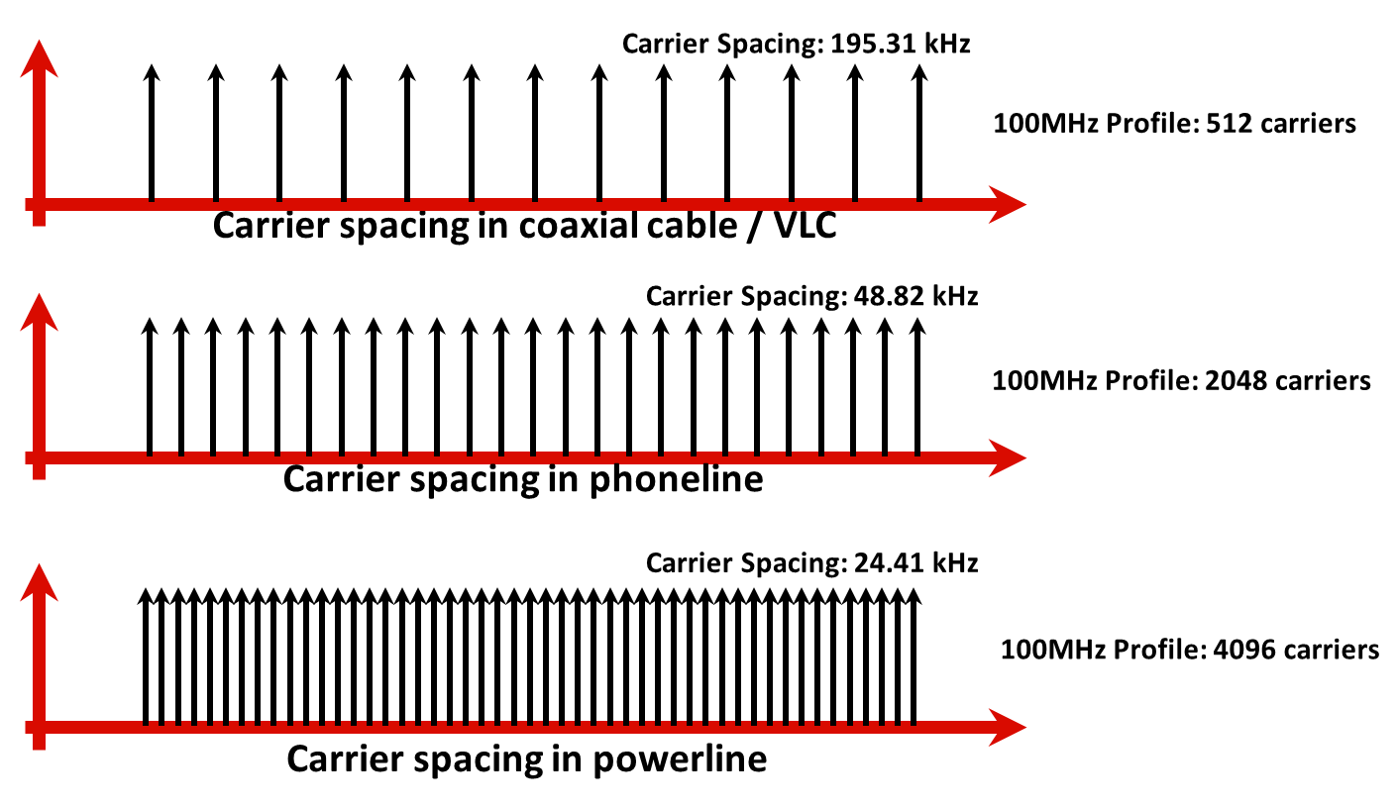
G.9991 PHY - G.hn/G.vlc Scales OFDM Parameters to Adapt to the Medium
Used for LC → TGbb

Slide 13
Summary – G.9991 Key PHY Parameters
Layer | Area | Value | Notes
Physical Layer | Modulation type | DCO-OFDM | Configurable OFDM parameters (cyclic prefix, per-subcarrier PSD, etc)
 | Max modulation | Up to 12 bits/subcarrier | Each sub-carrier is modulated with a different number of bits, depending on SNR (Bitloading)
 | FEC | LDPC | Multiple FEC rates (1/2, 2/3, 5/6, 16/18, 20/21) and block sizes dynamically selected
 | Spectrum | 5-200 MHz (VLC) | Individual sub-carriers can be notched to coexist with other services in same wire
 | Subcarrier spacing | 195 kHz (VLC) | Sub-carrier spacing optimized for the expected delay spread in each medium

Slide 14
PHY 1 Real World Performance – Industrial Scenario
Position | Uplink rate | Downlink rate
1 | 89 | 96
2 | 89 | 96
3 | 100 | 95
4 | 69 | 95
5 | 150 | 95
6 | 150 | 95
7 | 150 | 108
8 | 135 | 108
9 | 95 | 108
10 | 104 | 90
11 | 103 | 86
12 | 44 | 94
13 | 138 | 104
MIMO arrangement and analog combining in a robotic manufacturing cell
Uplink and downlink PHY rates for multiple positions:

Slide 15
PHY 1 Real World Performance – Backhaul Scenario
Outdoor point-to-point arrangement with highly directional optical aperture
Performance varies with optical frontend realization.

Slide 16
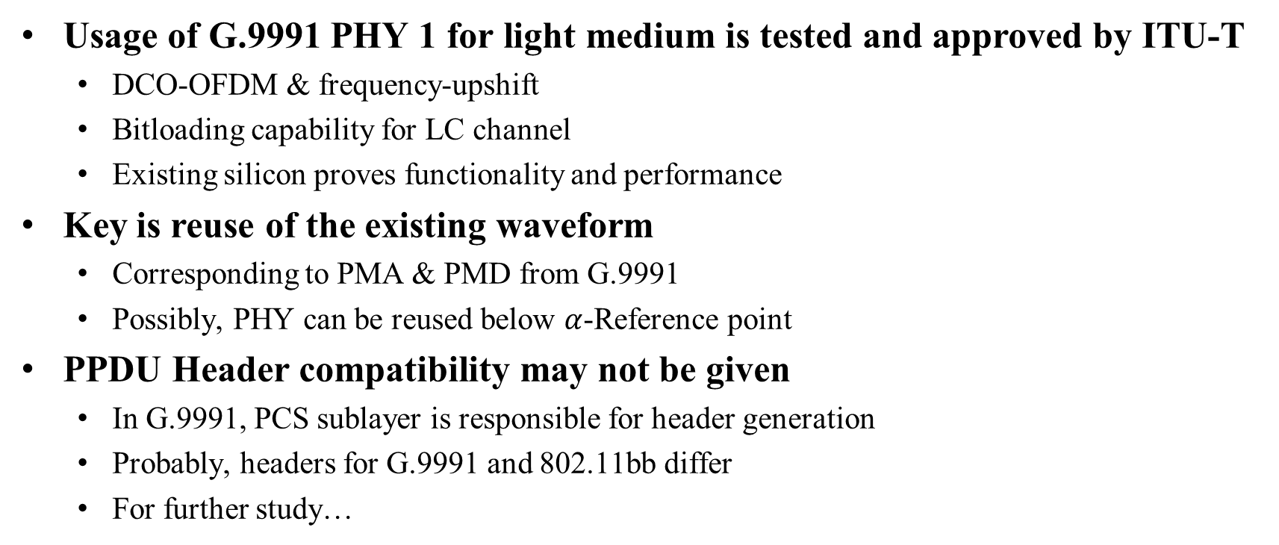
Considerations on adopting G.9991 PHY for 802.11bb
Usage of G.9991 PHY 1 for light medium is tested and approved by ITU-T
  DCO-OFDM & frequency-upshift
  Bitloading capability for LC channel
  Existing silicon proves functionality and performance
Key is reuse of the existing waveform
  Corresponding to PMA & PMD from G.9991
  Possibly, PHY can be reused below $α$-Reference point
PPDU Header compatibility may not be given
  In G.9991, PCS sublayer is responsible for header generation
  Probably, headers for G.9991 and 802.11bb differ
  For further study…

Slide 17
Anticipated adaptations in G.9991 PHY 1
Which parts of the PHY are possibly modified to make it IEEE-compatible?
  Support of 802.11 legacy preamble?
  Adapt PPDU header to 802.11 contents
  Maximum / minimum PSDU sizes?
  Enable higher order MIMO?
  …
What is additionally needed in the 802.11 MAC?
  Bitloading signalling procedure
  Traditional channelization does not apply.
  …
What must be modified in the PHY-SAP?
  …

Slide 18
References
[1] ITU-T G.9991 - Not yet published. Refer to G.9960 instead for most details regarding the PHY
[2] https://www.photonics21.org/ppp-projects/workgroup-4/Eliot.php
[3] Shokoufeh Mardani et. al.: Efficiency of Power Loading Strategies for Visible Light Communication
[4] Pablo Wilke Berenguer et. al.: The benefit of frequency-selective rate adaptation for optical wireless communications

