Slide 1
SOMA Updates
Date: 2019-00-xx
Authors:
Name | Affiliation | Address | Phone | Email
Junghoon Suh | Huawei |  |  | junghoon.suh@huawei.com
Osama Aboul-Magd |  |  |  | osama.aboulmagd@huawei.com
Jia Jia |  |  |  | justin.jia@huawei.com
Edward Au |  |  |  | edward.ks.au@huawei.com

Slide 2
Background
Semi Orthogonal Multiple Access (SOMA) was proposed to improve the efficiency of 802.11 [1]
  SISO and MIMO based SOMA was presented with the current 802.11 QAM constellation used for SOMA constellations
  The gain of the SOMA was achieved with the entire Bandwidth (BW) resource used
    The performance loss by the split power resource is smaller than the performance loss by the split BW resource
Further performance examination on SOMA
  Adaptive power allocation based SOMA for various MCS
    New QAM constellation is introduced according to the power allocation factor
    Performance is checked, based on the SNR gap between Far and Near STAs including the zero SNR gap

Slide 3
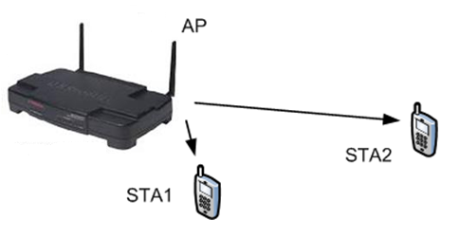
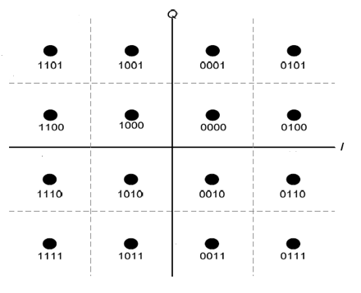
Recap: SOMA
For STA 1 (Near STA) and STA 2 (Far STA) in the figure beside, the SOMA is not just a superposition of two constellations from two STAs, but, instead, the property of more and less reliable bits in a constellation is used to schedule Far and Near STAs as seen in the figure below
For Near-STA to decode Near-STA bits, Far-STA bits need Not to be known
The Far-STA decodes its own signal, and treats Near-STA as noise just like a Superposition
The Near-STA performs the demodulation of the re-ceived signal, collecting the LLRs corresponding to the near coded bits, and then performs decoding of the near-STA codeword.
  Complexity in the Receiver side is reduced
SOMA can be applied with OFDMA and its throughput enhancement at AP side is significant, compared to the OFDMA only
STA2
STA1

Slide 4
TX/RX design flow for Single Stream based SOMA
STA 1
FEC Encoder
Interleaver
SOMA
Constellation
Mapper
Spatial
Mapping
To
Antenna
STA 2
FEC Encoder
Interleaver
IFFT
…..
…..
…..
STA N
FEC Encoder
Interleaver
De-inter-
leaver
STA 1
FEC Decoder
De-inter-
leaver
LLR
Computation
Channel
Estimation
and
Equalization
STA 2
FEC Decoder
FFT
…..
…..
….
STA N
FEC Decoder
De-inter-
leaver
The data of each STA are separately encoded and interleaved, before being combined for the SOMA constellation mapping.
The STA 1 through STA N represent the SOMA scheduled STAs.
Each STA can take the corresponding LLR information and take the De-interleaving separately, followed by FEC Decoder for each STA to recover its data

Slide 5
QPSK
Superposition of BPSK (Far STA) and QBPSK (Near STA)
When is 0.5, the constellation becomes the 802.11ac QPSK
The receivers (both the far and the near) can demodulate the received SOMA QPSK
modulated signal just like a QPSK symbol and take each bit for its corresponding purpose
Or, the far STA can take the received SOMA QPSK modulated signal as a BPSK modulated
signal, thinking of the other bit as noise.
Those two bits of a QPSK symbol can be obtained when the real part and the imaginary
part are separated in the RF, even before the received signal comes into the digital
baseband processor.

Slide 6
16-QAM
When is 0.2, the constellation becomes the 802.11ac 16-QAM
The receiver needs to know the to compute the right LLR

Slide 7
64-QAM
When is 0.2381, the constellation becomes the 802.11ac 64-QAM

Slide 8
256-QAM

Slide 9
When is 0.247, the constellation becomes the 802.11ac 256-QAM

Slide 10
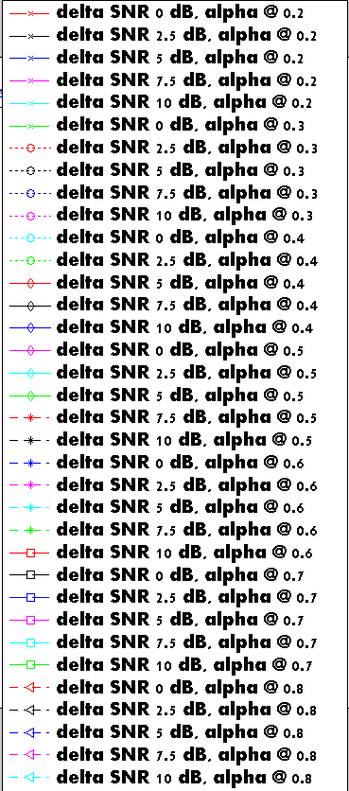
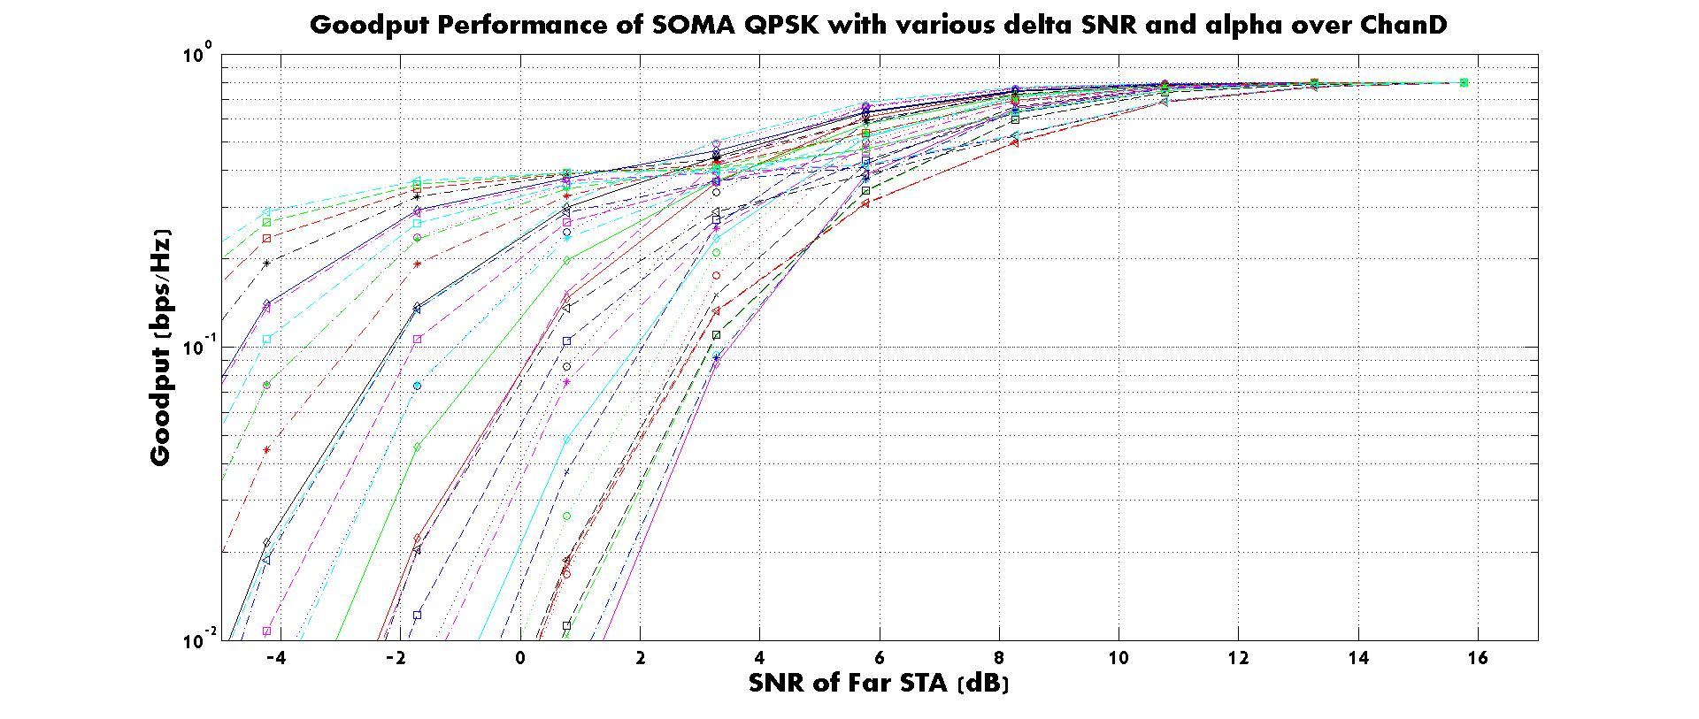
Performance: SOMA-QPSK

Slide 11
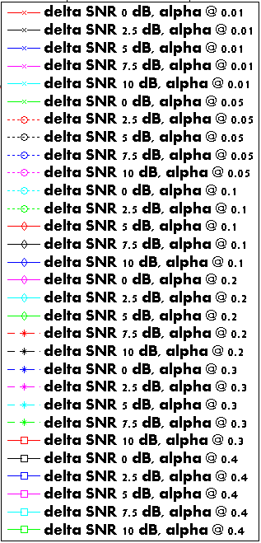
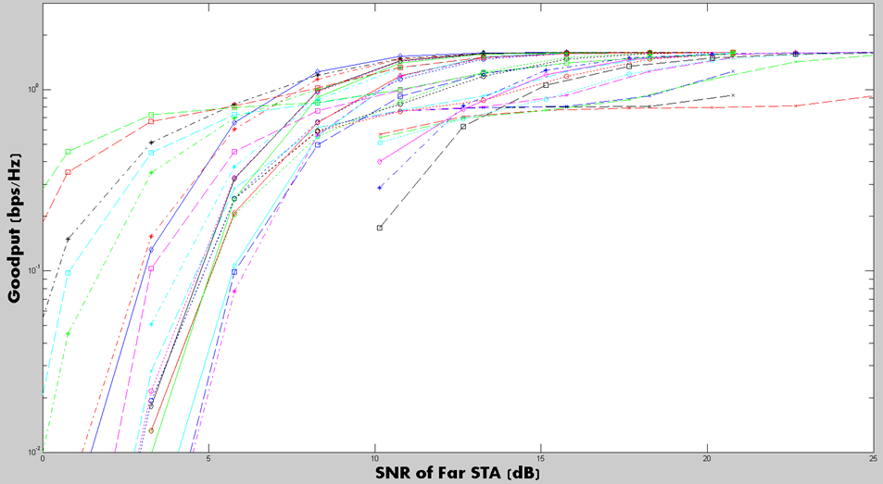
Performance: SOMA-16QAM:
Goodput performance of SOMA 16-QAM with various delta SNR and alpha

Slide 12
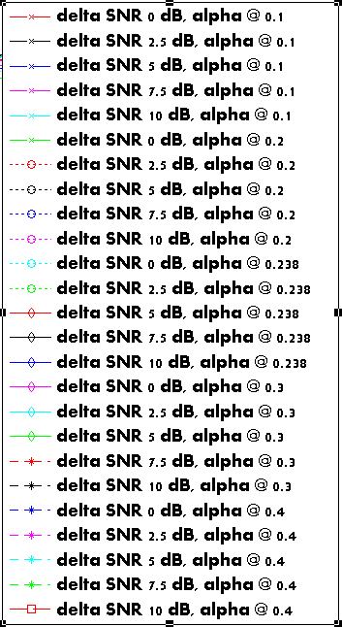
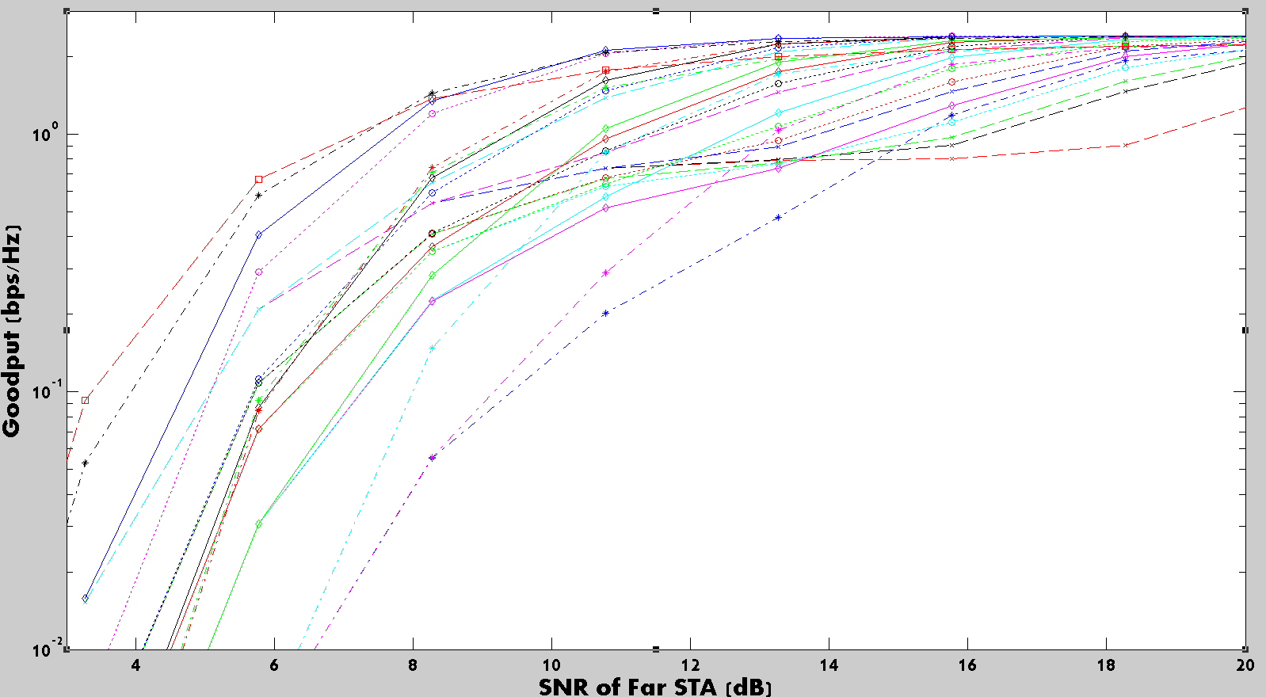
Performance: SOMA-64QAM:
Goodput Performance of SOMA 64-QAM with various delta SNR and alpha over ChanD
Far STA: QPSK, Near STA: 16 QAM

Slide 13
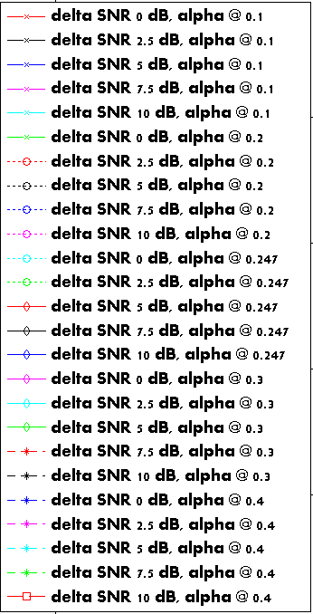
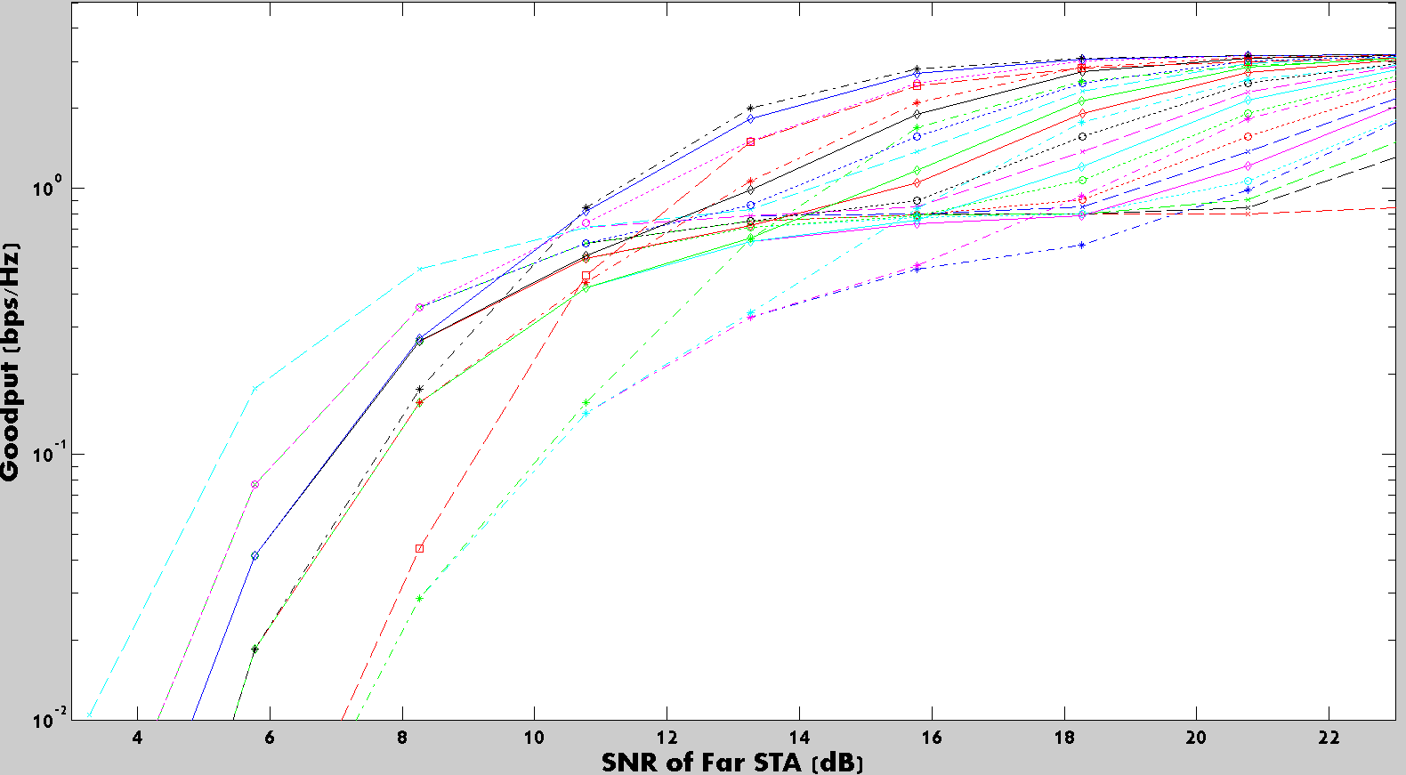
Performance: SOMA-256QAM:
Goodput Performance of SOMA 256-QAM with various delta SNR and alpha over ChanD
Far STA: QPSK, Near STA: 64 QAM

Slide 14
Conclusion
Adaptive power allocation for SOMA provides further flexibility in SOMA scheduling
  The SNR gap (delta SNR) between Far STA and Near STA had better be bigger to have more optimum SOMA performances
    Adaptive power allocation provides more freedom in scheduling, e.g. high alpha value is better for a Far STA in the low SNR region @ SOMA-64QAM
  For a SOMA-QAM constellation selection, the MCS of each STA (based on fedback CQI from each STA) needs to be considered
    The delta SNR can be configured once those STAs for SOMA scheduling are determined
    Adaptive power allocation factor can be considered afterwards
Adaptive power allocation factor needs to be indicated in each SOMA packet in addition to the SOMA indication bit

Slide 15
Appendix: Adaptive power allocation across OFDMA RUs
With adaptive power allocation across RUs
  CQI information per RU (26 tone RU) is collected
    Allocate each RU with the STA having the best CQI to the corresponding RU
    Compare the selected best CQI of each RU, and choose the top 3 RUs and the lowest 3 RUs
    Allocate 20%, 30%, 40% less power to the top 3 RUs and allocate 20, 30, 40% more power to the worst 3 RUs
Without adaptive power allocation across RUs
  CQI information per RU (26 tone RU) is collected
    Allocate each RU with the STA having the best CQI to the corresponding RU
Gain with the adaptive power allocation is minimal
STA2
STA0
AP
STA1
STA3

Slide 16
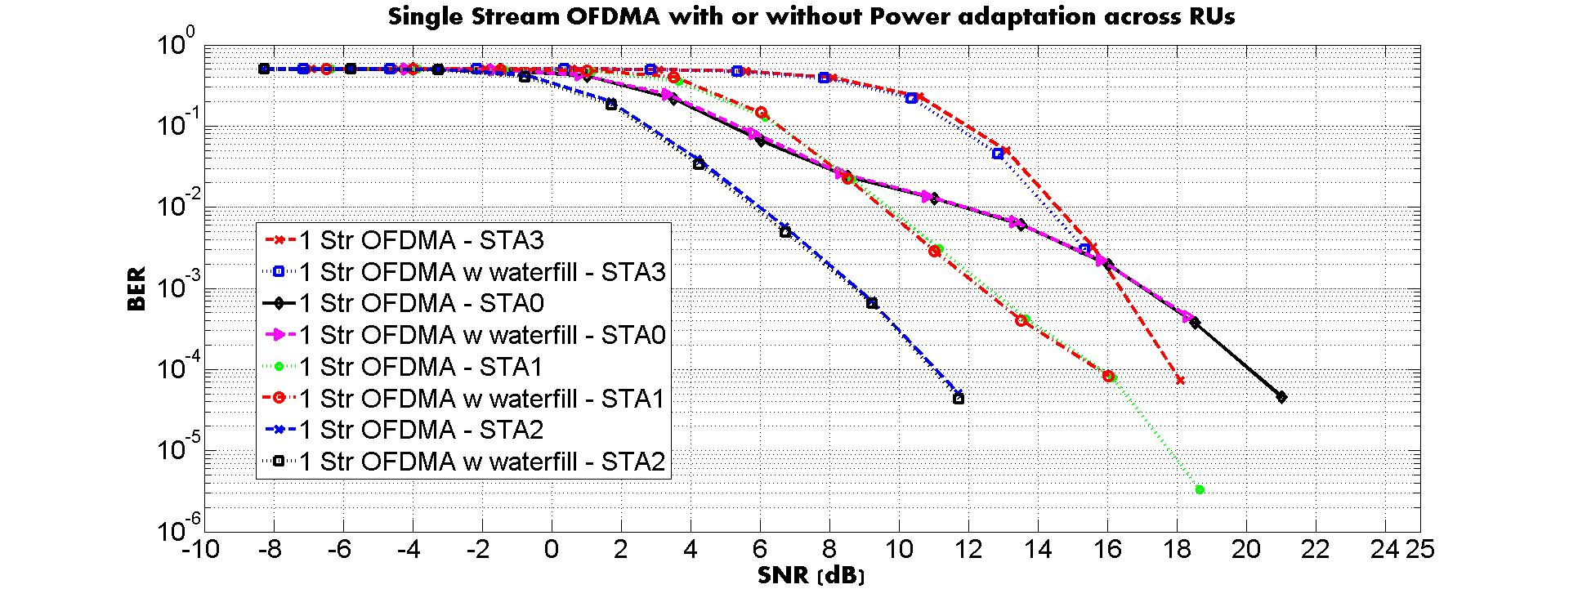
Adaptive power allocation per RU vs. Equal power allocation per RU in 20 MHz OFDMA packet
40% less or more power allocated to the top 3 RUs and bottom 3 RUs.

Slide 17

MU Transmissions (OFDMA vs SOMA)
$$∁=B\log_{2}\left(1+\frac{S}{N}\right)$$
Power Domain
Time Domain
SOMA
Freq Domain
OFDMA

Slide 18
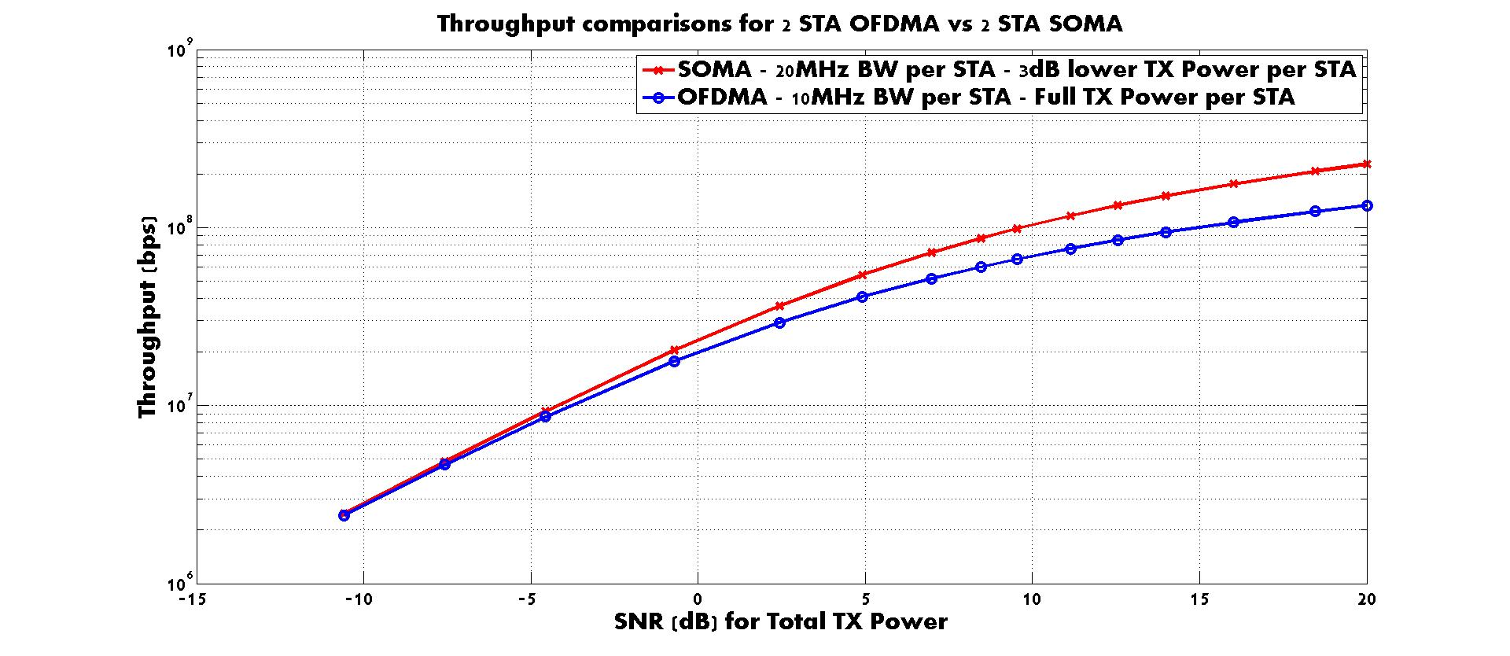
Throughput Comparison (OFDMA vs SOMA)

Slide 19
MU Transmissions (MU-MIMO vs SOMA)
2 STA MU-MIMO with a single stream each STA
Power Domain
Spatial Domain
2 STA SOMA
with two streams
Similar capacity between
MU-MIMO and SOMA according to [1],
but no CSI feedback is needed for SOMA
Freq Domain

Slide 20
References
[1] J. Suh, “18/1462r0 SOMA for EHT”, IEEE 802.11 EHT SG, Sep 2018, Waikoloa HI, USA

