Slide 1
Extremely Efficient Multi-band Operation
Date: 2019-05-12
Authors:
Name | Affiliations | Address | Phone | Email
Po-Kai Huang | Intel
Laurent Cariou
Robert Stacey
Dan Bravo
Arik Klein
Minyoung Park
Carlos Cordeiro
Notes:
September 2012

Slide 2
Abstract
Multi-band operation is a feature agreed in EHT PAR [1]
Multi-band/multi-channel aggregation and operation
We discuss the need to have extremely efficient multi-band operation, which minimizes the MAC overhead, and propose the multi-link framework to accommodate the key use case
We will explain why the term “link” is used

Slide 3
Motivation
Except aggregation, there are existing mechanisms to achieve multi-band operation (like STA switch or TID switch or OCT), but there may still be significant MAC overhead related to the operation
Ex. for nontransparent FST, the need to reassociate or the need to renegotiate for different operation (ex. TWT, key, BA, etc)
We think extremely efficient multi-band operation, which minimizes the MAC overhead for renegotiation, should be one of the focus topics
Avoiding renegotiation is also a natural direction for us to enable aggregation

Slide 4
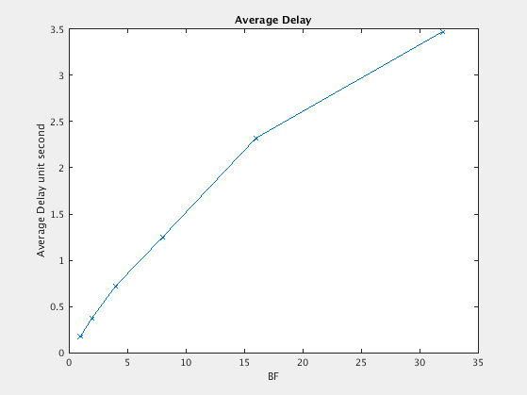
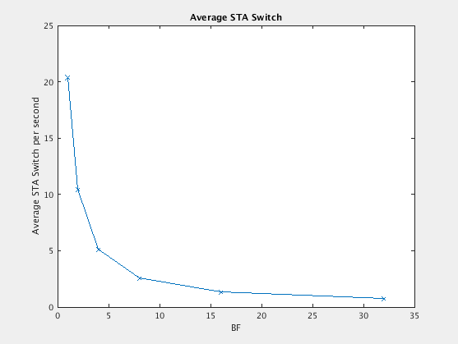
Simulation
We simulate load balancing operation for two bands and 30 STAs (see Appendix for the details) based on the frequency of STA switch, and we observe that for low delay performance (ex less than 1s), it is required to have more than 5 STA switches every second (on average) as shown below
BF = k means doing load balancing operation every k seconds
The results show that extremely efficient multi-band operation that minimize the MAC overhead is critical

Slide 5
Summary of Key Use Cases
Steering/load balancing: More efficient manner to achieve seamless steering/load balancing among multiple APs/BSSs
Existing use case of MBO/FST/11v, etc
Aggregation: aggregate the data transmitted in different APs/BSSs as one
Increase the peak throughput by enabling simultaneous operations in different links
The key enhancement is to eliminate the need of various management/data plane renegotiations
Ideally, we want a unified framework to achieve the above two use cases

Slide 6
Existing Framework
General Infrastructure
AP/non-AP STA has an address to communicate to DSM, which may not be the address used on WM
NOTE - link: In the context of an IEEE 802.11 medium access control (MAC) entity, a physical path consisting of exactly one traversal of the wireless medium (WM) that is usable to transfer MAC service data units (MSDUs) between two stations (STAs).

Slide 7
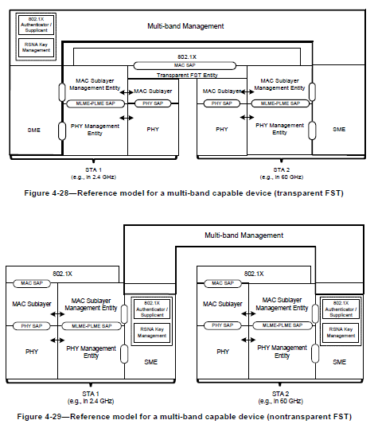
General Framework
This framework does not need change of the current 802.11 spec definition about STA and link:
station (STA): A logical entity that is a singly addressable instance of a medium access control (MAC) and physical layer (PHY) interface to the wireless medium (WM).
link: In the context of an IEEE 802.11 medium access control (MAC) entity, a physical path consisting of exactly one traversal of the wireless medium (WM) that is usable to transfer MAC service data units (MSDUs) between two stations (STAs).
Align with existing architecture

Slide 8
Infrastructure Framework
Example 1 Example 2
Multi-link AP logical entity/Multi-link non-AP logical entity has an address to communicate to DSM, which may not be the address used on each WM

Slide 9
Definition
Multi-link logical entity: A logical entity that contains one or more STAs. The logical entity has one MAC data service interface and primitives to the LLC and a single address associated with the interface, which can be used to communicate on the DSM.
NOTE –A Multi-link logical entity allows STAs within the multi-link logical entity to have the same MAC address
NOTE – The exact name can be changed
Multi-link AP logical entity: A multi-link logical entity, where each STA within the multi-link logical entity is an AP.
Multi-link non-AP logical entity: A multi-link logical entity, where each STA within the multi-link logical entity is a non-AP STA.

Slide 10
Steering/load balancing Use Case under the Framework
TBD Mechanism

Slide 11
Aggregation Use case under the Framework
TBD Mechanism

Slide 12
Multi-link Setup
Traditionally, a non-AP STA associates with a AP to start the operation, and the association provides the following functionalities:
Capability exchange
Routing: DS determines a unique answer to the question, “Which AP is serving STA X?”
Allow exchange of class 1, 2, 3 frames
Under the framework, we can define a new concept called multi-link setup between a multi-link non-AP logical entity and a multi-link AP logical entity to achieve the functionalities of “traditional association” under the new framework
Capability for different bidirectional links (ex. configuration of the link, AP capability, non-AP STA capability) can be exchanged through multi-link setup
For the distribution system (DS), the multi-link AP logical entity serves the multi-link non-AP logical entity after the multi-link setup
Exchange of class 1, 2, 3 frames is allowed at bidirectional links with exchanged capability

Slide 13
Conclusion
We discuss motivation to have extremely efficient steering/load balancing operation and aggregation
The key enhancement is to eliminate the need of various management/data plane renegotiations to enable extremely efficient operation
We propose a unified multi-link framework that addresses the key use cases (load balancing and aggregation) and keeps within the current 802.11 architecture and definition
We propose to have multi-link setup to achieve the functionalities of “traditional association” under the new framework

Slide 14
Straw Poll #1 - Terminology
Do you support the following definition:
Multi-link logical entity: A logical entity that contains one or more STAs. The logical entity has one MAC data service interface and primitives to the LLC and a single address associated with the interface, which can be used to communicate on the DSM.
NOTE –A Multi-link logical entity allows STAs within the multi-link logical entity to have the same MAC address
NOTE – The exact name can be changed

Slide 15
Straw Poll #2 - Terminology
Do you support the following definition:
Multi-link AP logical entity: A multi-link logical entity, where each STA within the multi-link logical entity is an AP.
Multi-link non-AP logical entity: A multi-link logical entity, where each STA within the multi-link logical entity is a non-AP STA.

Slide 16
Reference
[1] 11-18/1231r4 EHT draft proposed PAR

Slide 17
Appendix

Slide 18
Multi-band Switching
The simplest form of Multi-band operation is to switch one STA from one band to another band
Extremely efficient Multi-band STA switching is useful for load balancing as we will demonstrate in the following simulation
AP1:
Band 1
STA1
AP1:
Band 1
AP2:
Band 2
AP2:
Band 2
STA1

Slide 19
Simulation Setup - Buffered Video Stream
Consider two bands:
Band 1: Rate R1 = 4*R2
Band 2: Rate R2
Note – Band 2 is like 2.4 GHz band with 20 MHz bandwidth, and Band 1 is like 5 GHz band with 80 MHz bandwidth
N STAs among two bands
Each STA has buffered video steaming traffic model (one of BV1 to BV6 in [2]) with average 0.89 MBps across STAs
Packet size 1500 bytes
See [2] for details of buffered video steaming traffic model
Set R2 = 10 MBps, N=30
Around 53% load =(30*0.89 M)/(5*10 M)
Parameters can be adjusted to create different load situation

Slide 20
Load Balancing Problem
At a specific time, choose xi, yi that solve the following optimization problem
min |t1-t2|
t1 = (x1*S1+…+xn*Sn)/R1
t2 = (y1*S1+…+yn*Sn)/R2
xi+yi = 1
xi is 0 or 1
yi is 0 or 1
where
xi is a indicator variable for station i in Band 1
yi is a indicator variable for station i in Band 2
Si is the sum of packet size (with unit of bytes) of STA i
R1 is the rate of Band 1 with unit of bytes per second
R2 is the rate of Band 2 with unit of bytes per second
Balance frequency (BF) =k means solving the problem every k seconds

Slide 21
Scheduling Algorithm
Multi-band round robin:
Maintain a list of all STAs in all bands in order
Each STA has a FIFO queue for the arriving packets
For a band, serve each STA up to 4 ms in the band based on the order of the list
After a STA is served, put the STA to the end of the list
Example:
Assume a total list (1, 2, 3, 4, 5, 6)
If Band 1 has STA 1, 3, 5
Band 1 STAs service order: 1, 3, 5
Band 2 STAs service order: 2, 4, 6
After STA1 and STA2 are served, total list becomes (3, 4, 5, 6, 1, 2)
Assume that after load balancing algorithm, Band 1 has STA 1, 2, 3, 5 with total list (3, 4, 5, 6, 1, 2)
Band 1 STAs service order: 3, 5, 1, 2
Band 2 STAs service order: 4, 6
After STA1 and STA4 are served, total list becomes (5, 6, 1, 2, 3, 4)

Slide 22
Average Delay
As the value of Balance frequency (BF) decreases, the average delay performance across STA decreases
The average delay is $\frac{\sum_{served_packet_i }^{Number_of_served_packets_across_STAs}{(Finish_time_of_served_packet_i −Arrival_time_of_served_packet_i)}}{Number_of_served_packets_across_STAs}$

Slide 23
Results for Buffered Video Stream Setup
For low delay performance (ex BF=4, average delay is less than 1s), it is required to have around 5 STA switches every second (on average) as shown below

Slide 24
Simulation Setup - File Transfer
We try the file transfer traffic model in [2] and get similar conclusion
Consider two bands:
Band 1: Rate R1 = 4*R2
Band 2: Rate R2
Note – Band 2 is like 2.4 GHz with 20 MHz, and Band 1 is like 5 GHz with 80 MHz
N STAs among two bands
Each STA has file size with distribution equal to truncated lognormal [2] with
Mean = 2 Mbytes
SD = 0.722 Mbytes
Max = 5 Mbytes
Interarrival time: exponential distribution with mean T
Each file is breaking into MPDUs with size 1500 bytes
Set R2 = 1.625 MBps, N=30, T= integer chosen between 8 and 28 seconds with average 18 across STAs
Around 41% load =(30*2 M/18)/(5*1.625 M)
Parameters can be adjusted to create different load situation
Size
Packet
Packet
T

Slide 25
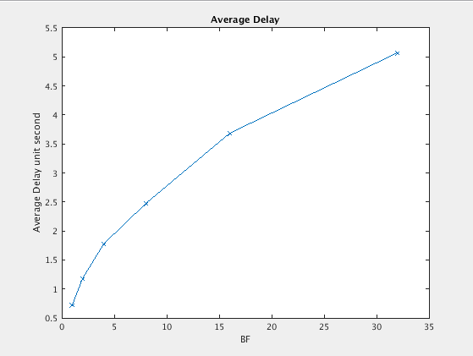
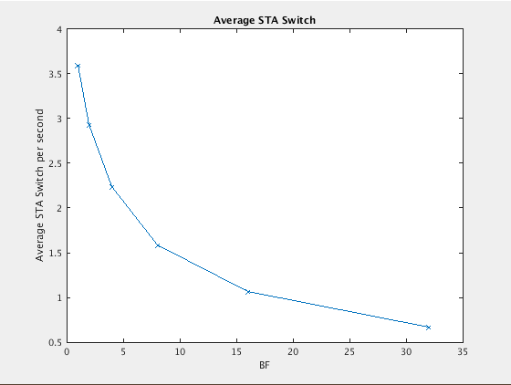
Results for File Transfer Setup
For low delay performance (ex BF=2, average delay is around 1s), it is required to have around 3 STA switches every second (on average) as shown below

