Slide 1
Comparison of Coordinated BF and Nulling with JT
Date: 2019-07-09
Authors:
Name | Affiliations | Address | Phone | email
Ron Porat | Broadcom |  |  | ron.porat@broadcom.com
Srinath Puducheri | Broadcom

Slide 2
Abstract
In contribution 19/0094, we provided performance results for JT MU-MIMO under different phase errors, and an initial estimate of the achievable residual CFO error.
In contribution 19/0384, we extended the results in 19/0094 to include asymmetrical path-loss.
In contribution 19/0401, coordinated BF and Nulling (CBF) is discussed at a high level but no simulation results are provided.
In this contribution we :
  Extend the results in 19/0384 to CBF for apples-to-apples comparison of the potential performance gains assuming the same scenarios
  Provide real CFO measurements results to validate the potential achievable CFO estimation accuracy
Revision r1 (slide 10 and after) – based on feedback on 19/0384, revised the simulation scenario (path loss X towards all OBSS, and Nss=3 in baseline) and added observation, intuition and mathematical analysis

Slide 3
Coordinated Beamforming with Nulling
CBF system model: Each AP SU/MU beamforms to self-BSS clients, while simultaneously placing nulls at OBSS clients.
  Transmissions across APs are assumed to be time/frequency synchronized.
  CSI assumption: Each AP knows its channel to all clients (self-BSS and OBSS).
Total number of beamformed and nulled spatial directions at each AP is limited by degrees of freedom available to that AP.
  Total number of simultaneous spatial streams across all BSS is limited by the size of the smallest participating AP.
  Example: if all APs are 4x4, max number of simultaneous spatial streams limited to 4.
We compare CBF versus the following baseline (same as used for JT MU-MIMO simulations in 19/0384):
  Each AP SU/MU beamforms to clients within its BSS without regard to OBSS clients, and only one AP transmits at a time.
  Overall throughput is the average of all the per-BSS throughputs.

Slide 4
CBF simulation results: 2AP (1)
Simulation configuration is same as what was used for JT MU-MMO in contribution 19/0384 (see Appendix A for JT results):
  All APs are 4 ant and all STAs are 2 ant, Channel 11nD 80MHz
  BSS1: {AP1 <--> STA1}, BSS2: {AP2 <--> STA2, STA3}
  Baseline: BSS1 Nss = [2] and BSS2 Nss = [2 1], with 50% time sharing
  AP-STA relative path loss matrix:
    X is varied across 10, 20dB and denotes higher path loss relative to 0dB
CBF: Both APs simultaneously transmit, with each AP transmitting Nss=2 and using additional two degrees of freedom for interference nulling. We consider two cases:
  Case 1: BSS1 Nss = [2] and BSS2 Nss = [1 1]
  Case 2: BSS1 Nss = [2] and BSS2 Nss = [2]. For this case, AP2 serves only one client per TX, selecting either STA2 or STA3 in a round-robin fashion.
 | AP1 | AP2
STA1 | 0 | X
STA2 | 0 | 0
STA3 | X | 0

Slide 5
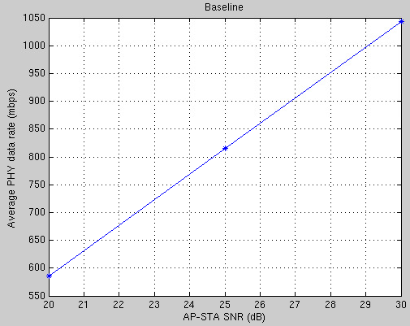
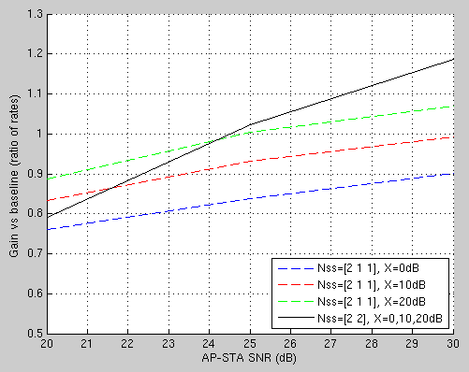
CBF simulation results: 2AP (2)
CBF worse than baseline at low SNR; shows some gains at high SNR for specific configurations and/or large relative path loss
The X-axis “AP-STA SNR” in the plots assumes X=0

Slide 6
CBF simulation results: 4AP (1)
Simulation configuration is same as what was used for JT in IEEE March 2019 contribution 384 (see Appendix A for JT results):
  BSS1: {AP1 <--> STA1}, BSS2: {AP2 <--> STA2, STA3},
    BSS3: {AP3 <--> STA4}, BSS4: {AP4 <--> STA5, STA6}
  Baseline: 25% time sharing across BSS1, BSS3 Nss = [2] and BSS2, BSS4 Nss = [2 1]
  AP-STA relative path loss matrix:
CBF: Each AP transmits Nss=1 to its STA, while using 3 degrees of freedom towards interference-nulling for the other 3 BSS.
  BSS2 time-shares between STA2/STA3 (50%) and BSS4 time-shares between STA5/STA6 (50%)
 | AP1 | AP2 | AP3 | AP4
STA1 | 0 | 0 | X | X
STA2/STA3 | X | 0 | 0 | X
STA4 | X | X | 0 | 0
STA5/STA6 | 0 | X | X | 0

Slide 7
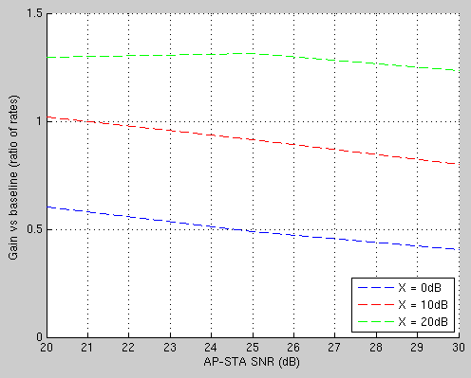
CBF simulation results: 4AP (2)
Any potential gain for CBF requires relative path loss >= 20dB

Slide 8
Discussion of results
Comparison with JT (19/0384 , see Appendix A):
  For the same 2AP configuration, JT can achieve ~2x gain over baseline, compared to best-case gain of ~1.2x with CBF at high SNR and high relative path loss.
  For the same 4AP configuration, JT can achieve ~4x gain over baseline, compared to best-case gain of ~1.3x with CBF at high relative path loss.
In general, gains of CBF are limited by the rank of the AP itself - the same number of spatial streams could be used for own BSS transmissions.
  Note in the scenarios explored the average Nss of the baseline scenario is 2.5 but for CBF we used all 4 spatial dimensions
In contrast, the gains of JT MU-MIMO can scale with the number of APs and STA.

Slide 9
CFO estimation using 11ax AP product
In contribution 19/0094, we highlighted the importance of accurate CFO estimation to minimize phase drift across APs for JT MU-MIMO.
We conducted the following experiment with a pair of 11ax chips at high SNR:
  Transmitted back-to-back 11ax frames from one chip to another, with IFS = 16us and single 4x HE-LTF per frame.
  Captured ADC samples on receiving chip and post-processed in SW.
Post-processing:
  Estimated CFO between TX and RX chips by measuring net phase rotation on HE-LTF across neighboring packets, divided by time separation between the LTFs (=124us).
Standard-deviation of estimated CFO across 15 measurements < 10Hz
  Estimated CFO able to predict actual CFO within accuracy of 10Hz.
This validates that very accurate CFO estimation across packets is possible using a real product.

Slide 10
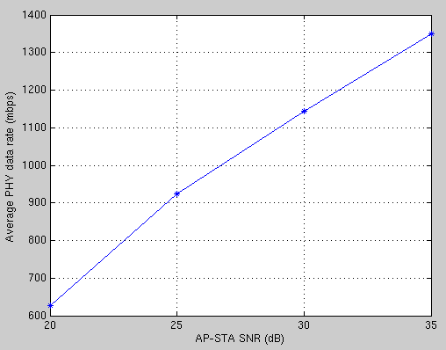
Simulation configuration r1 (1)
Multiple BSS (2 or 4): each has one 4x4 AP and two 2x2 STAs
  Per-AP transmit power same (constant for all cases)
  Channel: 11nD 80MHz, -30dBc aging
AP-STA relative path-loss:
      Path loss from each AP to all OBSS STAs is ‘X’ dB higher than to self BSS STAs
      X is varied across 0,10,20,30 dB; the X-axis “AP-STA SNR” in the plots assumes X=0
Baseline (using MU-MIMO):
  Each AP transmits Nss = [2 1] to self-BSS STAs
  Only one BSS active at a time (time-sharing).
  Overall throughput is the average of all the per-BSS throughputs.
Parallel independent transmission (PIT):
  All BSS active simultaneously
  Each AP transmits Nss=[2 1] to self-BSS STAs without nulling interference to OBSS STAs.
Baseline

Slide 11
Simulation configuration r1 (2)
JT:
  2AP: APs jointly transmit Nss = [2 1 2 1] to all 4 STAs (6 streams in total).
  4AP: APs jointly transmit Nss = [2 1 2 1 2 1 2 1] to all 8 STAs (12 streams in total).
CBF w/ nulling:
  Each AP beamforms and nulls to 3 directions in total
    75% DoF usage similar to Baseline, PIT, JT
  2AP:
    Only one STA active per BSS at any time (chosen in round-robin fashion).
    BSS1 Nss = 2, BSS2 Nss = 1 (or vice-versa)
    Each AP beamforms to one self-BSS STA and nulls to one OBSS STA.
  4AP:
    Only 3 BSS active at any time (round-robin)
    Only one STA active per active BSS at any time (round-robin)
    Nss = 1 per active BSS
    Each AP beamforms to one self-BSS STA and nulls to two OBSS STAs.

Slide 12
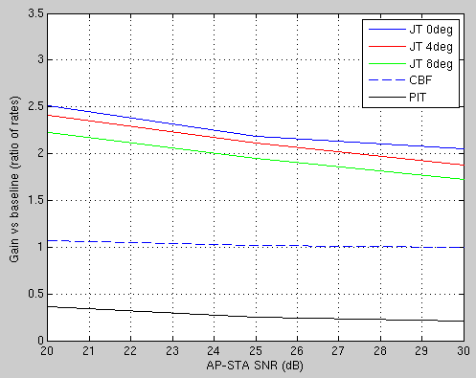
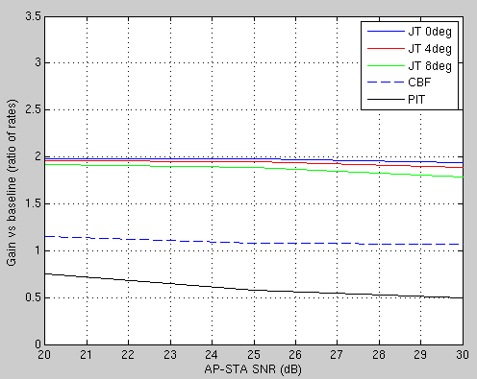
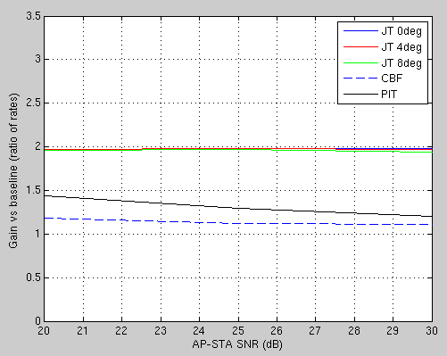
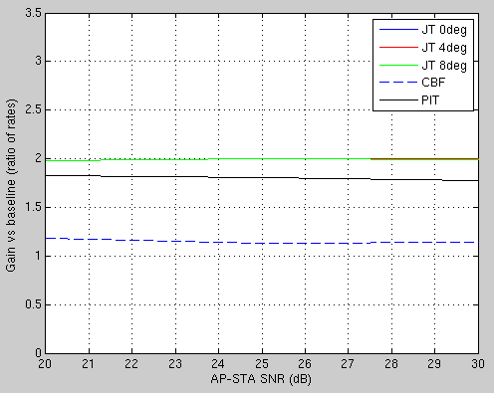
Simulation results: 2AP
X = 0dB
X = 10dB
X = 20dB
X = 30dB

Slide 13
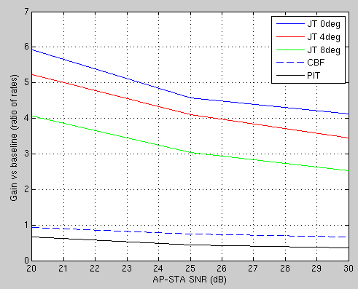
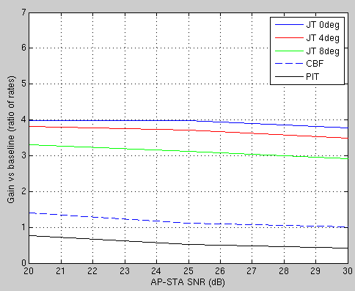
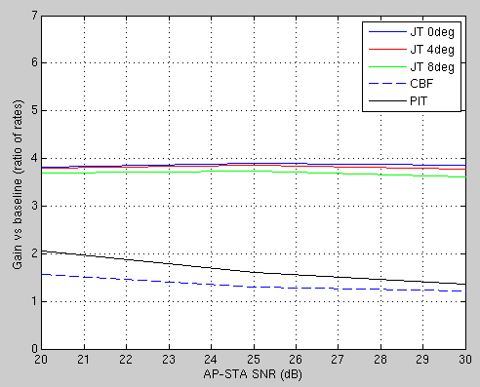
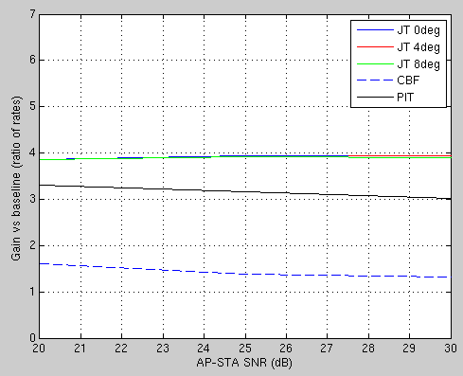
Simulation results: 4AP
X = 0dB
X = 10dB
X = 20dB
X = 30dB

Slide 14
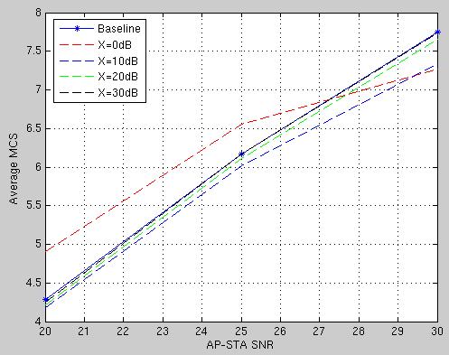
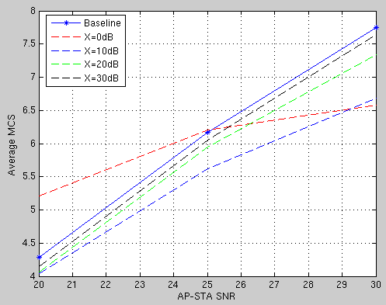
Simulation results: MCS statistics for JT
Below plots show average MCS for each case at AP-AP phase offset of 4 degrees (mostly 64QAM).
2AP
4AP

Slide 15
Key Observations and Intuition (1)
With zero phase offset, JT gains are maintained even for large X :
  Each AP splits its TX power among both self-BSS as well as OBSS signals.
  As X increases, two effects are seen:
    Received signal strength at any STA from OBSS APs diminishes due to higher path loss.
    At the same time, each AP shifts more of its TX power towards self-BSS signals and away from OBSS signals. This shift is naturally occurring with the JT precoder.
  These two effects roughly cancel each other, i.e., the desired signal power at each STA does not fall dramatically as X is increased; hence, JT gains are preserved.
JT’s sensitivity to phase error is reduced as X increases:
  With JT precoding, each AP contributes both signal and interference components at each STA
  With zero phase-offset, the signal components from different APs add up, while the interference components exactly cancel each other.
  With non-zero phase-offset, the cancellation is not perfect and residual interference is seen at each STA, adversely impacting SINR; but
  As X is made larger, the interference component from each of the APs is scaled down by X dB
  Therefore, a non-zero phase offset now results in residual interference that is also X dB smaller

Slide 16
Key Observations and Intuition (2)
Behavior of JT as X approaches infinity:
  JT precoder degenerates to emulate PIT automatically
  However, interference cancellation with JT can still provide meaningful improvements over PIT even with X as large as 30dB
See mathematical analysis in Appendix B to complement these observations

Slide 17
Conclusions
Very accurate CFO for JT is feasible
JT doesn’t suffer performance loss from increasing separation (X) between BSS; and
JT with practical X>0 is NOT as susceptible to phase offset (as with X=0)
    → X>0 is JT’s friend
CBF gain is not always guaranteed and is limited by per-AP degrees of freedom
JT is beneficial for all AP sizes:
  For small APs with insufficient degrees of freedom to support DL-MUMIMO by themselves (e.g., 2x2 APs), it provides an opportunity to pool resources and achieve greater spatial multiplexing gains.
  For larger APs, it provides a path to achieve 16 spatial streams (as currently envisioned for 11be) and beyond.

Slide 18
References
[19/0094] “Joint Processing MU-MIMO”, IEEE 802.11-19/0094r0
[19/0384] “Joint Processing MU-MIMO – Update”, IEEE 802.11-19/0384r0
[19/0401] “Coordinated Null Steering for EHT”, IEEE 802.11-19/0401r1

Slide 19
Appendix A

Slide 20
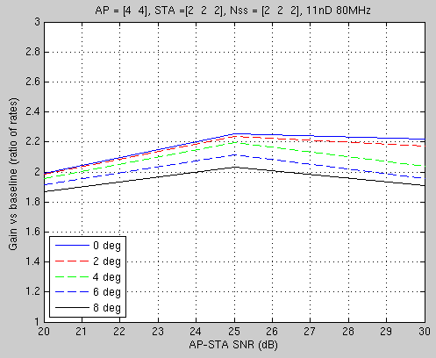
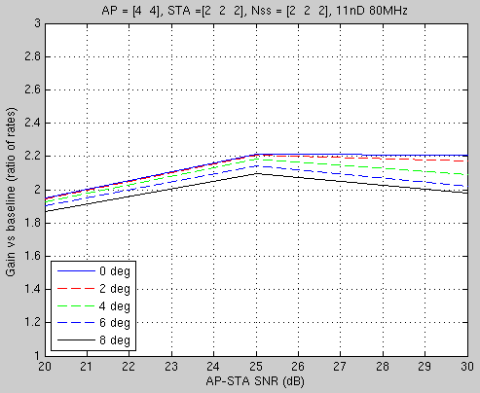
JT 2AP results
    Per-AP power fixed, X=10dB
    Per-AP power fixed, X=20dB
(Source: contribution 19/0384)

Slide 21
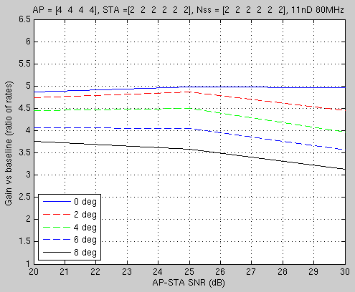
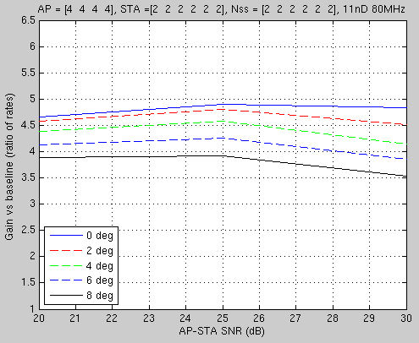
JT 4AP results
    Per-AP power fixed, X=10dB
    Per-AP power fixed, X=20dB
(Source: contribution 19/0384)

Slide 22
Appendix B

Slide 23
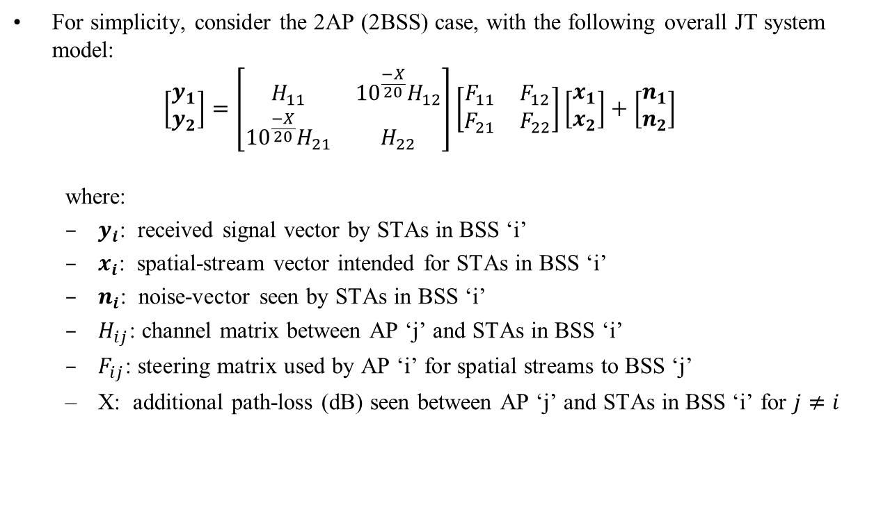
Analysis of JT with X (1)
For simplicity, consider the 2AP (2BSS) case, with the following overall JT system model:
  $$\left[\begin{matrix}y_{1} \\ y_{2}\end{matrix}\right]=\left[\begin{matrix}H_{11} & {10}^{\frac{−X}{20}}H_{12} \\ {10}^{\frac{−X}{20}}H_{21} & H_{22}\end{matrix}\right]\left[\begin{matrix}F_{11} & F_{12} \\ F_{21} & F_{22}\end{matrix}\right]\left[\begin{matrix}x_{1} \\ x_{2}\end{matrix}\right]+\left[\begin{matrix}n_{1} \\ n_{2}\end{matrix}\right]$$
  where:
  $y_{i}$: received signal vector by STAs in BSS ‘i’
  $x_{i}$: spatial-stream vector intended for STAs in BSS ‘i’
  $n_{i}$: noise-vector seen by STAs in BSS ‘i’
  $H_{ij}$: channel matrix between AP ‘j’ and STAs in BSS ‘i’
  $F_{ij}$: $\text{steering} \text{matrix} \text{used} \text{by} \text{AP}\text{ ‘}\text{i}\text{’ }\text{for} \text{spatial} \text{streams} \text{to} \text{BSS}\text{ ‘}\text{j}\text{’}$
  X: additional path-loss (dB) seen between AP ‘j’ and STAs in BSS ‘i’ for $j≠i$

Slide 24
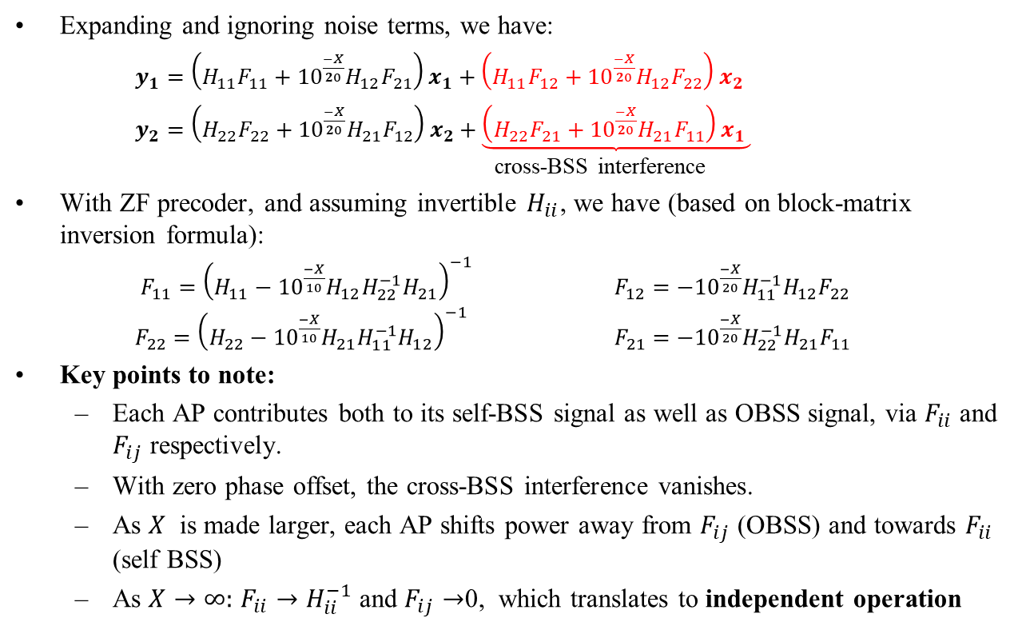
Analysis of JT with X (2)
Expanding and ignoring noise terms, we have:
$y_{1}=\left(H_{11}F_{11}+{10}^{\frac{−X}{20}}H_{12}F_{21}\right)x_{1}+\left(H_{11}F_{12}+{10}^{\frac{−X}{20}}H_{12}F_{22}\right)x_{2}$
$y_{2}=\left(H_{22}F_{22}+{10}^{\frac{−X}{20}}H_{21}F_{12}\right)x_{2}+\underbrace{\left(H_{22}F_{21}+{10}^{\frac{−X}{20}}H_{21}F_{11}\right)x_{1} }$ cross-BSS interference
With ZF precoder, and assuming invertible $H_{ii}$, we have (based on block-matrix inversion formula):
  $F_{11}={\left(H_{11}−{10}^{\frac{−X}{10}}H_{12}H_{22}^{−1}H_{21}\right)}^{−1}$ $F_{12}=−{10}^{\frac{−X}{20}}H_{11}^{−1}H_{12}F_{22}$
  $F_{22}={\left(H_{22}−{10}^{\frac{−X}{10}}H_{21}H_{11}^{−1}H_{12}\right)}^{−1}$ $F_{21}=−{10}^{\frac{−X}{20}}H_{22}^{−1}H_{21}F_{11}$
Key points to note:
  Each AP contributes both to its self-BSS signal as well as OBSS signal, via $F_{ii}$ and $F_{ij}$ respectively.
  With zero phase offset, the cross-BSS interference vanishes.
  As $X$ is made larger, each AP shifts power away from $F_{ij}$ (OBSS) and towards $F_{ii}$ (self BSS)
  As $X→∞:$ $F_{ii}→H_{ii}^{−1}$ and $F_{ij}→$0, which translates to independent operation

Slide 25
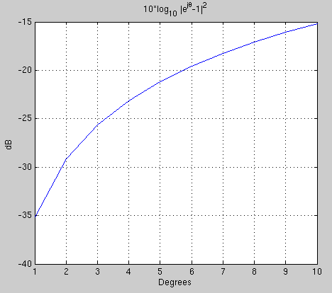
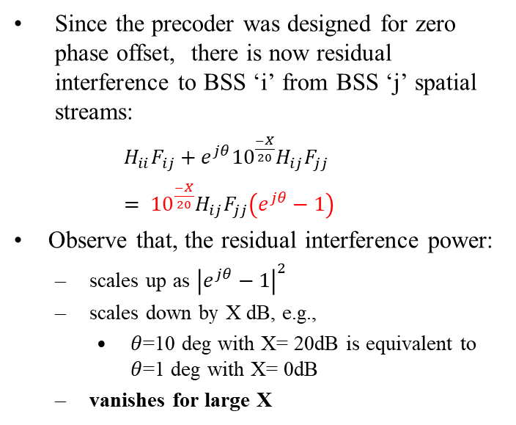
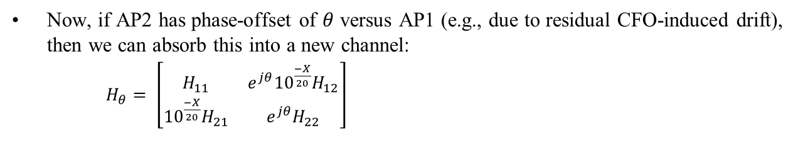
Analysis of JT with X and Phase Drift
Now, if AP2 has phase-offset of $θ$ versus AP1 (e.g., due to residual CFO-induced drift), then we can absorb this into a new channel:
  $H_{θ}= \left[\begin{matrix}H_{11} & e^{jθ}{10}^{\frac{−X}{20}}H_{12} \\ {10}^{\frac{−X}{20}}H_{21} & e^{jθ}H_{22}\end{matrix}\right]$
Since the precoder was designed for zero phase offset, there is now residual interference to BSS ‘i’ from BSS ‘j’ spatial streams:
    $H_{ii}F_{ij}+e^{jθ}{10}^{\frac{−X}{20}}H_{ij}F_{jj}$
    $= {10}^{\frac{−X}{20}}H_{ij}F_{jj}\left(e^{jθ}−1\right)$
    Observe that, the residual interference power:
      scales up as ${\left|e^{jθ}−1\right|}^{2}$
      scales down by X dB, e.g.,
        $θ$=10 deg with X= 20dB is equivalent to $θ$=1 deg with X= 0dB
      vanishes for large X

