Slide 1
Performance on Multi-Band Operation
Date: 2019-05-13
Authors:
Name | Affiliation | Address | Phone | Email
Insun Jang | LG Electronics | 19, Yangjae-daero 11gil, Seocho-gu, Seoul 137-130, Korea |  | insun.jang@lge.com
Jinsoo Choi |  |  |  | js.choi@lge.com
Jeongki Kim |  |  |  | jeongki.kim@lge.com
Suhwook Kim |  |  |  | suhwook.kim@lge.com
Sungjin Park |  |  |  | allean.park@lge.com

Slide 2
Abstract
This presentation :
provides the simulation results to show the efficiency on multi-band operation using PHY/MAC integrated simulator

Slide 3
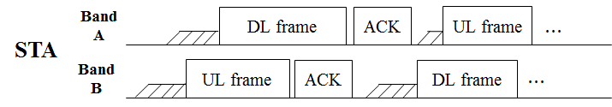
Introduction
Recap: Multi-band Operation to further improve the efficiency has been discussed [1-6], e.g., called Full Duplex over Multi-band (FD-MB) [5], [6] and Multi-channel FDD [4], enabling simultaneous (independent) DL/UL Tx over multi-bands
However, any observable results haven’t been shown yet for the operation
Therefore, in this contribution, we show the efficiency on multi-band operation using PHY/MAC integrated simulator in terms of throughput and latency
  We have renewed this contribution compared to previous version (i.e., 367r0 in EHT) for the stepwise simulation

Slide 4
Simulation Setup: Operation
We consider the multi-band operation in 11be and the single-band operation in 11ax (as the legacy)
Single-band Operation in 11ax
  The band uses 11ax features for the data exchange
Multi-band Operation in 11be
  Simultaneous (independent) DL/UL Tx over multi-bands is considered
  Traffic of each band is not shared between bands (e.g., 5GHz and 6GHz bands)
    Each band has its own queue
  Each band uses 11ax features for the data exchange (since any features haven’t been defined yet in 11be)

Slide 5
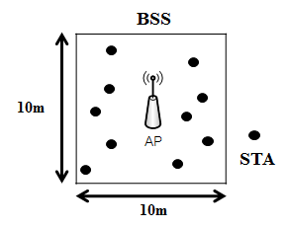
Simulation Setup: Baseline Topology
We generate topologies step by step based on Residential described in 11ax simulation document
Topology is composed of more than 1 BSS (i.e., Square) including 1 APs and 10 STAs
  APs are located in the center of square
  STAs are randomly located
Primary channel is randomly selected
  Location: Top or Bottom
  Dynamic bandwidth operation
  Example: unmanaged network

Slide 6
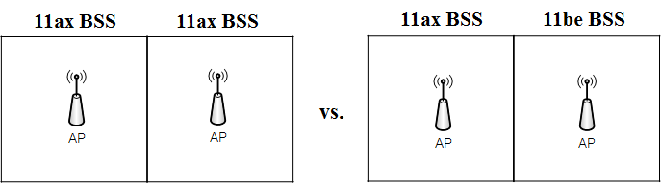
Simulation Setup: Performance
We measure and compare the performance in environments including
  1) Only 11ax BSS and 2) Coexistence of 11ax BSS and 11be BSS
  Example of 2 BSSs
Performance Metric
  Aggregated BSS Throughput (as the sum of throughputs of all BSSs)
  Average Latency (per packet transmitted in all BSSs)
    Latency means time taken from that MAC queue receives a packet till that MAC queue flushes out of the packet

Slide 7
Simulation Setup: Parameters
 | Single band | Multi-band
Simulator Type | PHY/MAC Integrated simulator
BSS Bandwidth / band | 20/80/160MHz in 5/6GHz | 80MHz in 5GHz + 80MHz in 6GHz
Tx Power (AP/STA) | 26 / 20 dBm | 23 / 17dBm for each band
Traffic Rate | Variables (Rate of each band in Multi-band = 0.5 * Rate of Single-band)
Antenna Gain (AP/STA) | 0/-2 dBi
Traffic Model | Mixed DL and UL
RU | 242
Noise Figure / Floor | 0dB / -101dBm per 20MHz
Rate Control Algorithm | MCS 7 (73.1Mbps)
MSDU size (bytes) / TXOP length | 1472 / DL only: 5ms, UL only: 4.6ms
Feedback | GENIE
Max Retx | 10
Symbol length | 16usec (OFDMA)
Metrics | Throughput, Latency
Queue Size | AP: 2000 * # of associated STA, STA:2000
Scheduling | Random

Slide 8
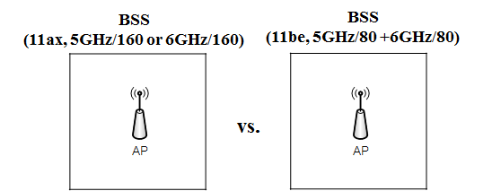
1st Step: 1 BSS
Goal is to check that the single/multi-band operates properly
Band and Bandwidth
  11ax BSS (Single band): 160MHz in 5GHz or 6GHz
  11be BSS (Multi-band): 80MHz in 5GHz + 80MHz in 6GHz
Results: the difference is less than 1%
  It enables to compare the performance between the single band and the multi-band operation depending on different parameters

Slide 9
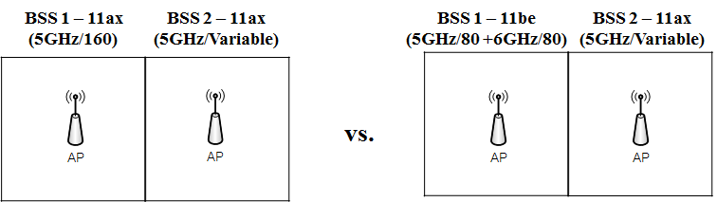
2nd Step: 2 BSSs
Band and Bandwidth of BSS 1 is fixed
  11ax BSS (Single band): 160MHz in 5GHz
  11be BSS (Multi-band): 80MHz in 5GHz + 80MHz in 6GHz
Bandwidth of 11ax BSS 2 is changed
  20, 80, or 160MHz in 5GHz
  BSS 2 can be considered as the interference in BSS 1
Traffic rate: 12Mbps (Low) or 50Mbps (High)

Slide 10
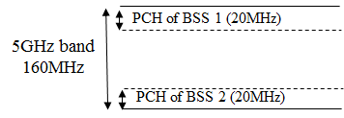
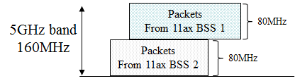
Example of Operation for 2 BSSs
For only 11ax case with 160MHz BSS 1 and 80MHz BSS 2
For BSS 1, Secondary 80 is busy

Slide 11
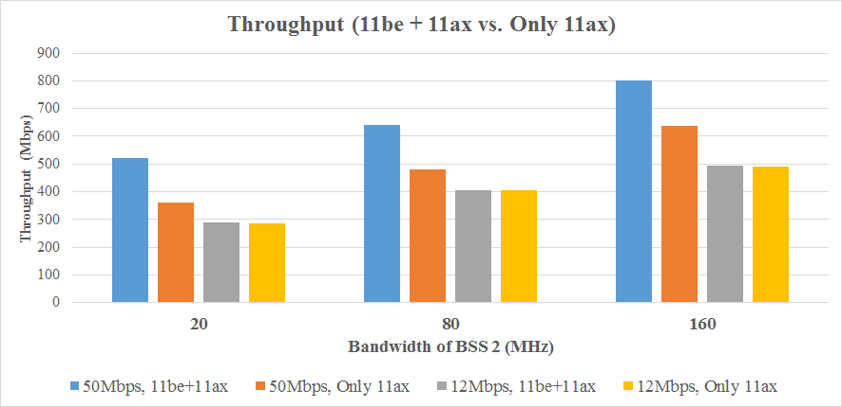
Results: Throughput
Traffic rate: 12Mbps or 50Mbps
25.8%
33.6%
45.3%

Slide 12
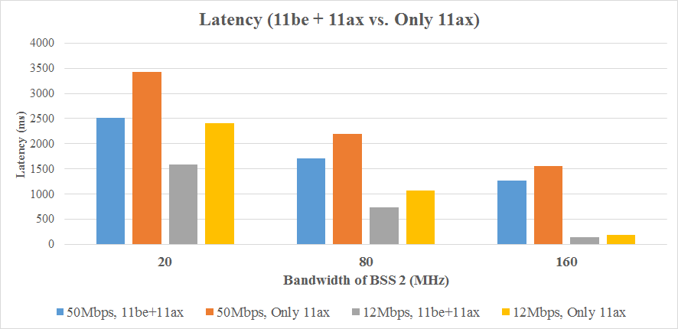
Results: Latency
Traffic rate: 12Mbps or 50Mbps
26.7%
33.7%
22.2%
18.4%
31.2%
19.8%

Slide 13
Observation
For throughput with low traffic rate and latency of multi-band operation, the relative difference to single-band operation decreases when the bandwidth of BSS 2 increases
For High traffic rate, the main factor of throughput/latency gain from multi-band operation is the flexibility of band usage, thereby preventing the waste of resources
  Multi-band in 11be can utilize the 6GHz bandwidth regardless of the 5GHz operation
  However, the latencies are too long because the portion of queue waiting time in latency is dominant
For Low traffic rate, the latency gain from multi-band operation is significant compared to the throughput gain
  Throughputs of 11ax BSS and 11be BSS are saturated with the traffic rate
    It’s a very special case, which rarely will occur in dense environments
  Meanwhile, 11be BSS can transmit packets more quickly by utilizing the 6GHz bandwidth

Slide 14
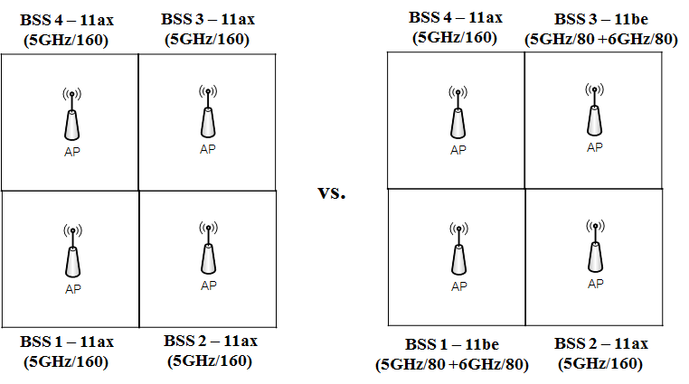
3rd Step: 4 BSSs
Bands and Bandwidths of all BSSs
  11ax BSS (Single band): 160MHz in 5GHz
  11be BSS (Multi-band): 80MHz in 5GHz + 80MHz in 6GHz
Traffic rate: 6Mbps (Low) or 50Mbps (High)

Slide 15
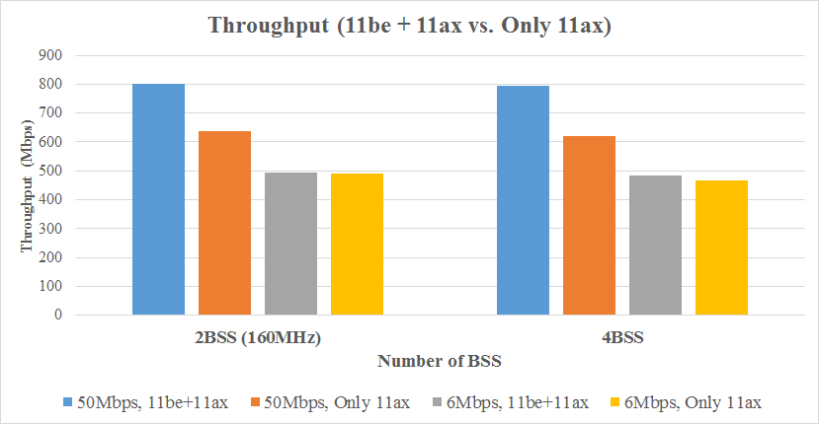
Results: Throughput
Traffic rate: 6Mbps or 50Mbps
25.8%
28.1%

Slide 16
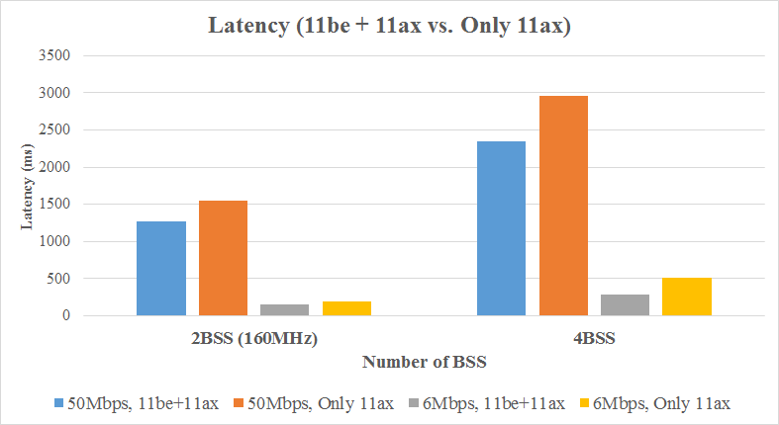
Results: Latency
Traffic rate: 6Mbps or 50Mbps
20.9%
18.4%
43.3%
19.8%

Slide 17
Observation
Like the case of 2 BSSs, multi-band operation provides throughput and/or latency gain because of the flexibility of band usage
In denser environments (i.e., more BSSs), the gain of multi-band operation can be further improved
  More BSSs, More severe contention

Slide 18
Discussion
Operation of 11ax
  In this simulation, we considered 5GHz operation of 11ax only
  In the near future, 11ax AP/STAs will operate in 6GHz band
Scheduling in Multi-band
  In this simulation, the traffic rate is fixed in each band and the RU assignment is also random
  Practically, the fixed traffic rate and random assignment is not very proper
Consequently, there are a lot of opportunities to further improve the performance of multi-band operation, which is our further step implementing several features such as
  Practical Scheduling and Assignment with 6GHz operation of 11ax AP/STAs
  Aggregation (to increase peak throughput for one target STA)
  Additional Features (e.g., mutual cooperation [6])
  ….

Slide 19
Summary
In this contribution, we have provided the simulation results for showing the efficiency of multi-band operation
We observed that the flexibility of multi-band operation can improve the performance in terms of throughput and latency
We will elaborate the PHY/MAC integrated simulator in order to show the efficiency of multi-band operation by including various environments and features

Slide 20
References
[1] 802.11-18/1155r1 Multi-AP Enhancement and Multi-Band Operations
[2] 802.11-18/1161r0 EHT Technology Candidate Discussions
[3] 802.11-18/1171r0 View on EHT Objectives and Technologies
[4] 802.11-18/1518r0 EHT Multi-Channel Operation
[5] 802.11-18/1525r1 EHT features for Multi-Band Operation
[6] 802.11-18/1908r0 Overview of Full Duplex over Multi- Band (FD-MB) for EHT

Slide 21
  Appendix - Results: 20MHz (2 BSSs)
Tput [Mbps] | Only 11ax | 11ax + 11be | Difference
50Mbps, MCS 7 | 359.5 | 522.1 | 45.3%
20Mbps, MCS 7 | 358 | 405.2 | 13.2%
12Mbps, MCS 7 | 285 | 288.1 | 1.1%
Latency (ms) | Only 11ax | 11ax + 11be | Difference
50Mbps, MCS 7 | 3423.3 | 2508.6 | 26.7%
20Mbps, MCS 7 | 2993 | 2024.7 | 32.3%
12Mbps, MCS 7 | 2404.3 | 1594.3 | 33.7%

Slide 22
  Appendix - Results: 80MHz (2 BSSs)
Tput [Mbps] | Only 11ax | 11ax + 11be | Difference
50Mbps, MCS 7 | 478.7 | 639.8 | 33.6%
20Mbps, MCS 7 | 480.4 | 524.2 | 9.1%
12Mbps, MCS 7 | 404.4 | 405.8 | 0.3%
Latency (ms) | Only 11ax | 11ax + 11be | Difference
50Mbps, MCS 7 | 2188.2 | 1702.5 | 22.2%
20Mbps, MCS 7 | 1811.2 | 1246.5 | 31.2%
12Mbps, MCS 7 | 1068.2 | 734.8 | 31.2%

Slide 23
  Appendix - Results: 160MHz (2 BSSs)
Tput [Mbps] | Only 11ax | 11ax + 11be | Difference
50Mbps, MCS 7 | 638 | 802.8 | 25.8%
20Mbps, MCS 7 | 636.2 | 686.1 | 7.8%
12Mbps, MCS 7 | 491.2 | 493.7 | 0.5%
Latency (ms) | Only 11ax | 11ax + 11be | Difference
50Mbps, MCS 7 | 1552 | 1266.7 | 18.4%
20Mbps, MCS 7 | 1020.5 | 705.6 | 30.8%
12Mbps, MCS 7 | 188.9 | 151.4 | 19.8%

Slide 24
  Appendix - Results: 4BSSs
Tput [Mbps] | Only 11ax | 11ax + 11be | Difference
50Mbps, MCS 7 | 621.1 | 795.6 | 28.1%
20Mbps, MCS 7 | 621.5 | 797.6 | 28.3%
6Mbps, MCS 7 | 465.5 | 485.1 | 4.2%
Latency (ms) | Only 11ax | 11ax + 11be | Difference
50Mbps, MCS 7 | 2957.7 | 2340.7 | 20.9%
20Mbps, MCS 7 | 2703.1 | 2052.2 | 24.1%
6Mbps, MCS 7 | 517 | 293 | 43.3%

