Slide 1
Enhanced Multi-band/Multi-channel Operation
Date: 2019-05-14
Authors:

Slide 2
Outline
As described in the EHT PAR, one of the needs of the EHT program is to provide high throughput and meet stringent real-time delay requirements of 4k and 8k video, virtual reality or augmented reality, gaming, remote office and cloud computing applications.
In this presentation, we have analyzed how the EHT multi-band/multi-channel operation can be helpful to meet those PAR requirements.

Slide 3
EHT Multi-band/Multi-channel
Functional Requirement
In a legacy multi-band and multi-channel operation (e.g., FST), sessions of an individual STA can be transferred from one channel to another channel, in the same or different frequency bands.
But, a limitation is that MSDUs belonging to single TID can only use single bands and/or channels.

Slide 4
EHT Multi-band/Multi-channel
Functional Requirement
As discussed in [1], if a STA can simultaneously use the multiple bands and/or channels, per-session throughput and per-session latency can be significantly improved.
  Because MSDUs belonging to single session (e.g., TID) can be sent on multiple bands and/or channels simultaneously.

Slide 5
EHT Multi-band/Multi-channel
Functional Requirement
A STA may perform a channel access on multiple bands and/or channels independently.
When the STA obtains TXOPs on multiple bands and/or channels, it can send frames belonging to the same TID over multiple links simultaneously.
AP
Data [Seq3, TID1]
Data [Seq4, TID1]
6GHz
STA
Block ACK
backoff
Data [Seq1, TID1]
Data [Seq2, TID1]
Data [Seq5, TID1]
…
AP
5GHz
STA
Block ACK
<Async Multi-band/Multi-channel Operation>

Slide 6
EHT Multi-band/Multi-channel
Functional Requirement
But, if the STA has an in-device coexistence interference on multiple bands and/or channels, it may not transmit and receive frames simultaneously.
In such a case, the STA needs to coordinate and synchronize the transmission and reception timing over bands and/or channels.
AP
backoff
Data [Seq3, TID1]
Data [Seq4, TID1]
Data [Seq6, TID1]
…
6GHz
STA
Block ACK
backoff
Data [Seq1, TID1]
Data [Seq2, TID1]
Data [Seq5, TID1]
…
AP
5GHz
STA
Block ACK
<Sync Multi-band/Multi-channel Operation>

Slide 7
EHT Multi-band/Multi-channel
Functional Requirement
In this operation, the STA should access multiple bands and/or channels without additional protocol overhead.
  With legacy FST, when switching sessions, the SME of the STA needs to initiate the FST Setup Request and Response frame exchanges as well as the FST Ack Request and Response frame exchanges.
Also, control information (e.g., control frames, A-Control fields) for a channel can be transmitted in a different channel/band.
  Allowing out-of-band exchange of control information can result in more efficient resource allocation.

Slide 8
Performance Evaluation via Simulation
Throughput comparison between single band operation (legacy) and multi-band operation
Single-band
(Legacy)
AP
Link 1/5GHz
STA
Multi-band
AP
Link 1/5GHz
STA
Link 2/6GHz

Slide 9
Performance Evaluation via Simulation
Async Operation
Link 1/5GHz
Busy
Busy
Link 2/6GHz
Single primary channel (on Link 1) Sync Operation
Link 1/5GHz
Busy
Busy
Link 2/6GHz
Dual primary channels (on Link 1 and Link 2) Sync Operation
Link 1/5GHz
Busy
Busy
Link 2/6GHz

Slide 10
Simulation Setup
Simulation Parameters:
  Bandwidth: 80 MHz
  MCS: 9 (453.7 Mbps)
  Full buffer DL UDP traffic.
  Busy percentage: Percentage of Link 1/5GHz air time occupied by OBSS interferences.

Slide 11
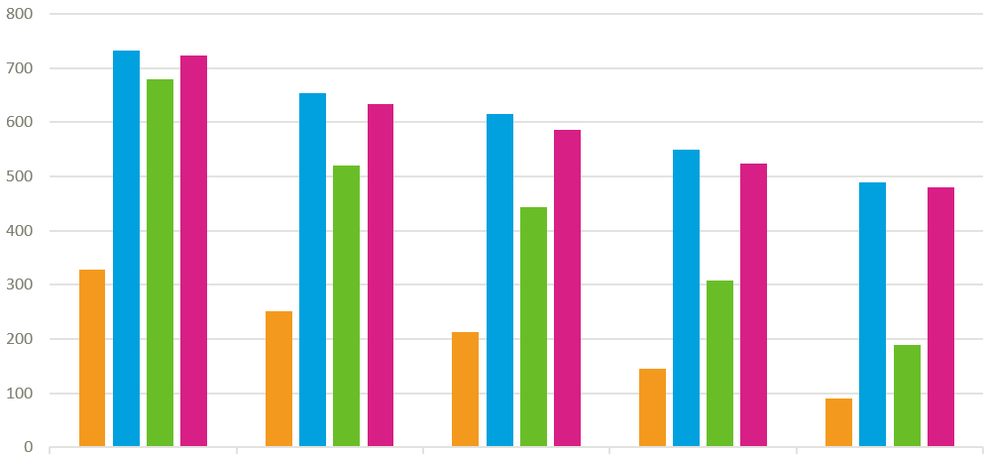
Performance Evaluation via Simulation
Throughput (Mbps)
Legacy with Link1/5GHz
Async Operation
Single Primary Channel Sync Operation
Dual Primary Channel Sync Operation
15% Busy
34% Busy
44% Busy
60% Busy
76% Busy

Slide 12
Conclusion
In this contribution we discuss the limitations of legacy multi-band/multi-channel operation and the desired EHT multi-band/multi-channel function requirements.
  Key improvement should be that a STA can transmit frames of same TID or different TIDs over multiple bands and/or channels concurrently or non-concurrently.
Via Simulation, we showed that it is possible for multi-band/multi-channel operation (synchronous and asynchronous) to achieve significant performance enhancements under heavy interference.

Slide 13
Reference
[1] https://mentor.ieee.org/802.11/dcn/18/11-18-1155-01-0eht-multi-ap-enhancement-and-multi-band-operations.pptx

