Slide 1
Multi-Link Aggregation: Peak Throughput Gains
Date: 2019-05-02
Name | Affiliation | Address | Phone | Email
Abhishek Patil | Qualcomm Inc. |  |  | appatil@qti.qualcomm.com
George Cherian | Qualcomm Inc.
Alfred Asterjadhi | Qualcomm Inc.
Duncan Ho | Qualcomm Inc.

Slide 2
Motivation for Multi-Link Aggregation (MLA)
New devices are expected to be multi-band/multi-channel capable
Trend to grow, with 6 GHz band support
Benefits of Multi-band/channel (MLA)
Increased peak throughput
Packets of the same flow can be sent over multiple links
Channel diversity helps to smoothen out the data flow during link fluctuations
Helps quickly flush out per-user queues
Increased spectral efficiency
Packets from a high-volume link can be multiplexed on an under-utilized link
Smooth transition between multiple radios
Enables framework for a control channel/data channel separation
Emerging applications such as wireless-VR and interactive multi-player gaming would benefit from MLA
Such applications have strict requirements such as low latency, short turnaround times and have burst traffic that need to be quickly flushed out.
STA 1
Same flow on both links
Link 1
Link 2
STA 2

Slide 3
Multi-Link Aggregation Benefits
Increases peak throughput
Improves latency

Slide 4
Peak Throughput Gain Analysis
Simulation Setup
Traffic Model: full buffer DL
AP has a very large file to DL to a single STA (full buffer case)
All PPDUs transmitted at 480 Mbps (MCS9 @80MHz).
TXOP: varies between 4-12ms
Channel load is modeled by varying the number of full buffer OBSS contenders from 1-8
Gains are compared between the following schemes
Baseline: No Aggregation (single link)
Simultaneous mode
EDCA back-off performed on single primary; ED check on secondary link before transmission
Aggregated if 2nd link is idle. Otherwise, single transmission on primary link
Independent mode
EDCA back off & TXOP duration on each link are independent
Gains are expressed as peak throughput

Slide 5
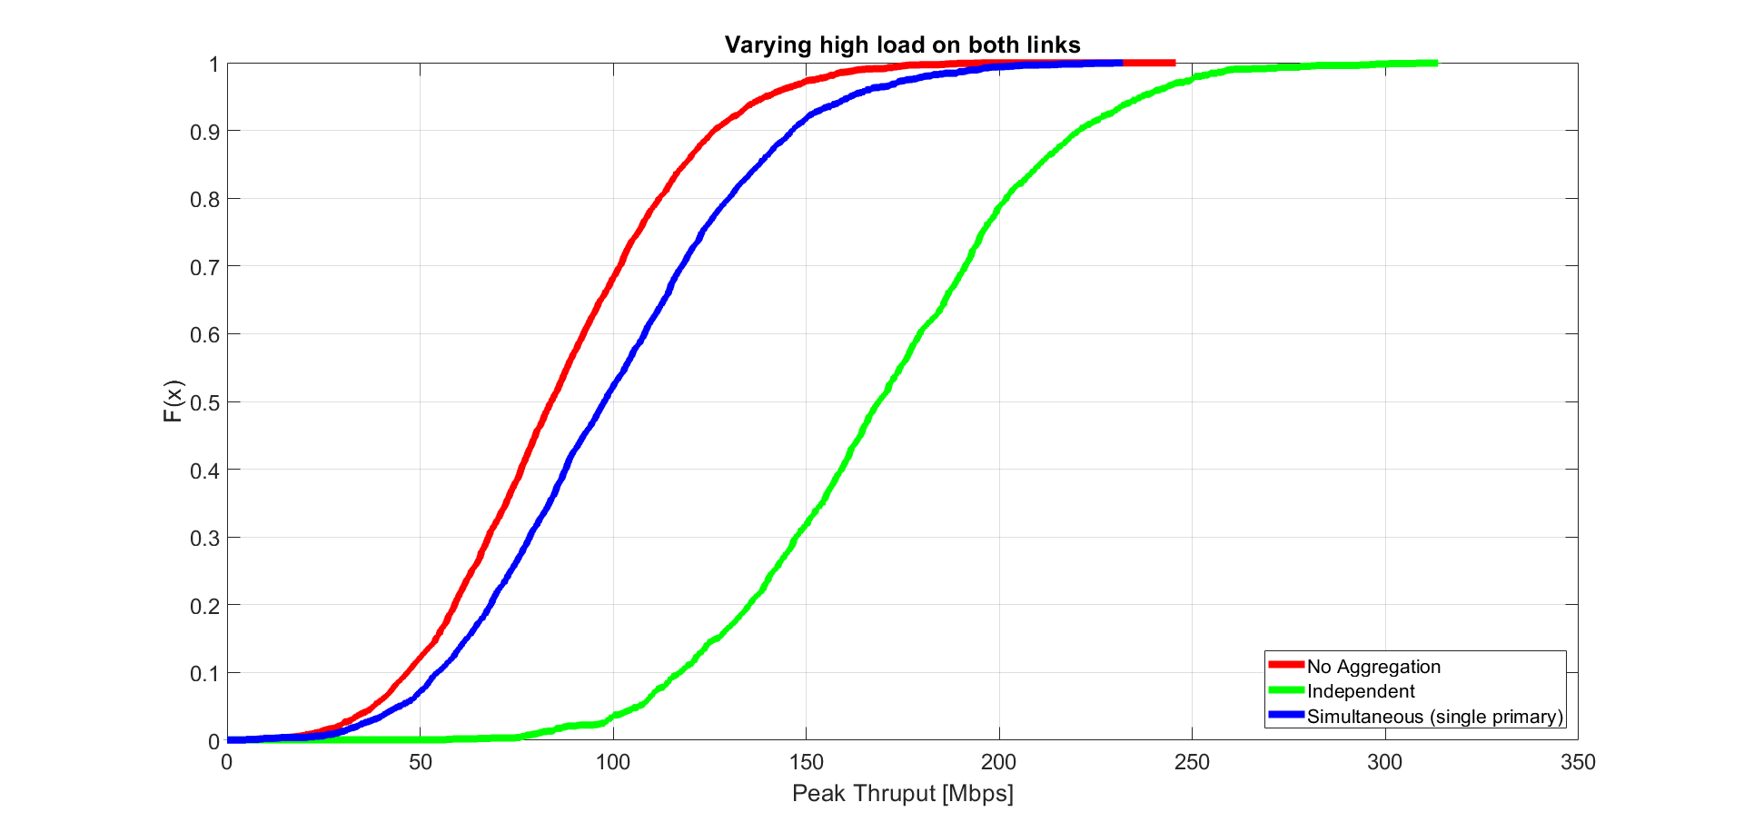
Simulation Results Varying high load on both links
Setup
AP under test: Full buffer DL
Channel load modeling:
Both links: Sweep of 2 to 8 OBSS STAs
Link 1: Starts with 2 STAs, and 1 new STA is added every 100ms up to 8 STAs, and drops back to 2 STAs, and repeats
Link 2: Starts with 8 STAs, and 1 STA is removed every 100ms until 2 STAs, and jumps back to 8 STAs, and repeats
Observation
Significantly higher 5%ile gains for independent mode operation because of higher opportunity to transmit due to independent channel access, than a simultaneous mode operation
Agg Scheme | 5%ile (Mbps/Gain-x) | 50% | 95% ile
Independent mode (gains w.r.t baseline) | 106.58 (2.81x) | 168.75 (2.01x) | 236.78 (1.70x)
Simultaneous mode (gains w.r.t baseline) | 44.55 (1.18) | 97.69 (1.16x) | 161.30 (1.16x)
Baseline | 37.87 | 83.97 | 139.29

Slide 6
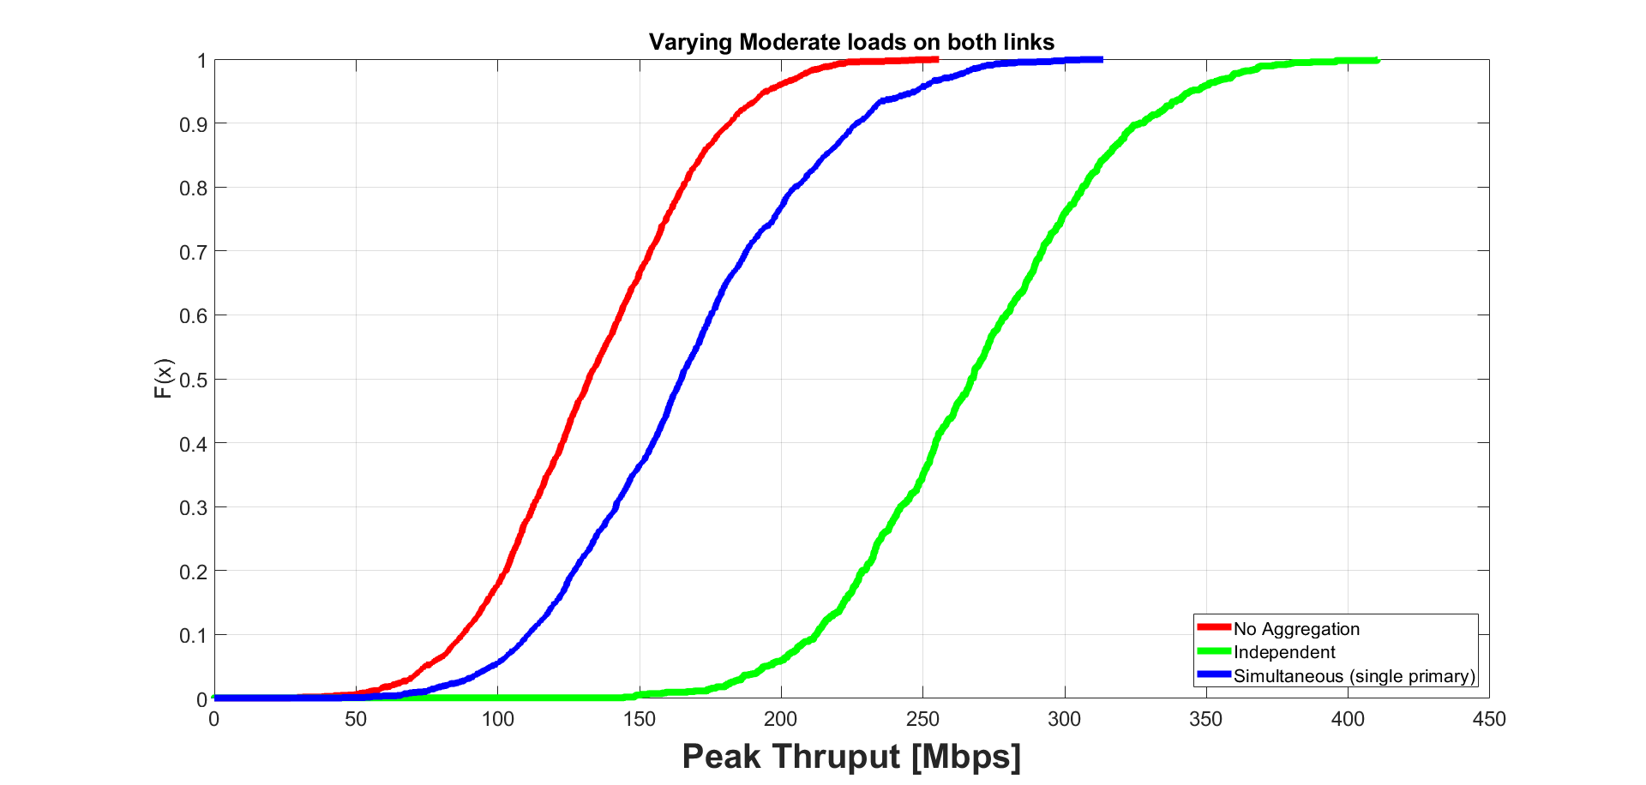
Simulation Results Varying moderate loads on both links
Setup
AP under test: Full buffer DL
Channel load modeling:
Both links: Sweep of 1 to 4 OBSS STAs
Link 1: Starts with 1 STA, and 1 new STA is added every 200ms up to 4 STAs, and drops back to 1 STAs, and repeats
Link 2: Starts with 4 STAs, and 1 STA is removed every 200ms until 1 STA, and jumps back to 4 STAs, and repeats
Observation
Most pronounced gains for independent mode compared to simultaneous mode
Agg Scheme | 5%ile Mbps (Gain-x) | 50% | 95% ile
Independent mode (gains w.r.t baseline) | 194.20 (2.62x) | 267.02 (2.02x) | 344.51 (1.76x)
Simultaneous mode (gains w.r.t baseline) | 97.55 (1.31x) | 164.77 (1.25x) | 247.55 (1.27x)
Baseline | 74.18 | 132.28 | 195.43

Slide 7
Summary
In this contribution, we present the benefits of multi-link aggregation and present simulation results showing gains for two different aggregation schemes

Slide 8
Appendix

Slide 9
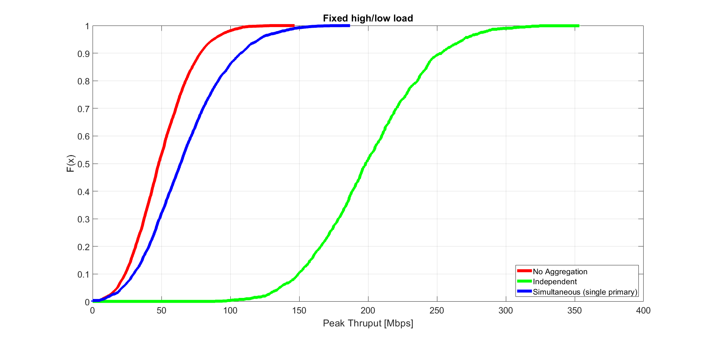
Simulation Results Fixed high / low load
Setup
AP under test: Full buffer DL
Channel load modeling:
Link 1: 8 OBSS STAs
Link 2: 2 OBSS STAs
Observation
Significantly higher 5%ile and overall gains seen for independent mode operation because of higher opportunity coming from low-load link 2
Agg Scheme | 5%ile (Mbps/Gain-x) | 50% | 95% ile
Independent mode (gains w.r.t baseline) | 135.44 (7.56x) | 198.20 (4.13x) | 269.33 (3.07x)
Simultaneous mode (gains w.r.t baseline) | 21.36 (1.19x) | 63.83 (1.33x) | 120.76 (1.37x)
Baseline | 21.36 | 63.83 | 120.76

Slide 10
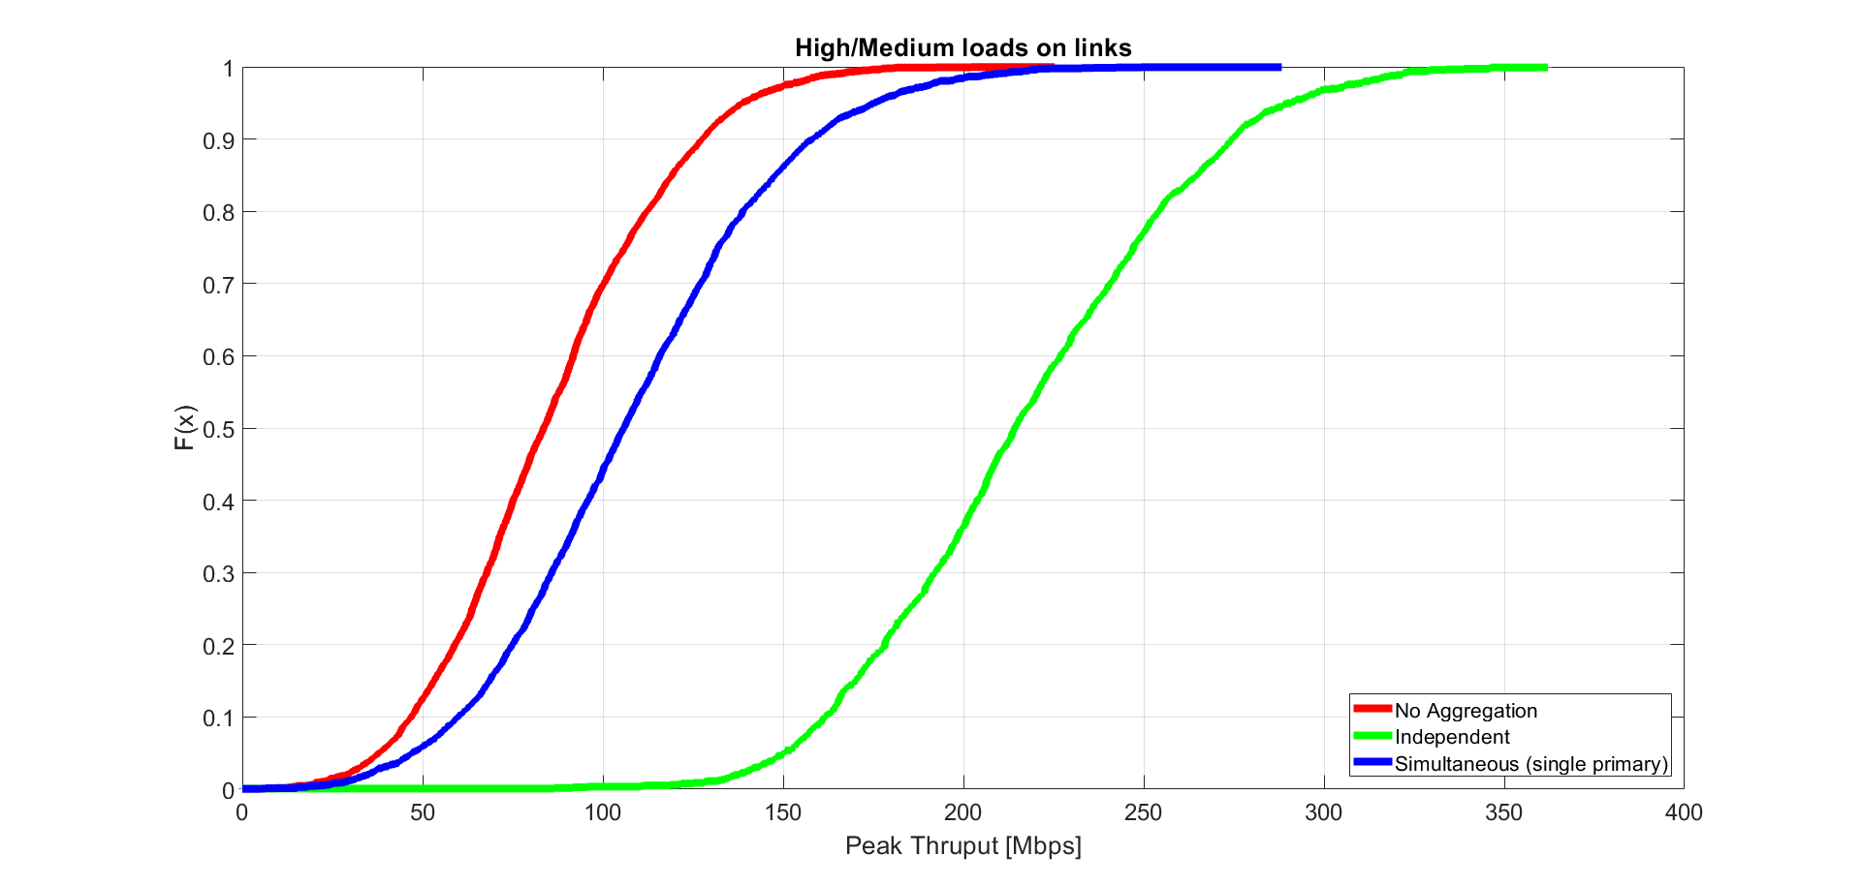
Simulation Results Varying high/medium loads on links
Setup
AP under test: Full buffer DL
Channel load modeling:
Link 1: Sweep of 2 to 8 OBSS STAs. Starts with 2 STAs, and 1 new STA is added every 100ms up to 8 STAs, and drops back to 2 STAs, and repeats
Link 2: Sweep of 1 to 4 OBSS STAs. Starts with 1 STA, and 1 new STA is added every 200ms up to 4 STAs, and drops back to 1 STAs, and repeats
Observation
Most pronounced gains for independent mode compared to simultaneous mode
Agg Scheme | 5%ile Mbps (Gain-x) | 50% | 95% ile
Independent mode (gains w.r.t baseline) | 150.39 (3.96x) | 214.25 (2.56x) | 290.77 (2.10x)
Simultaneous mode (gains w.r.t baseline) | 46.93 (1.23x) | 105.82 (1.27x) | 175.16 (1.26x)
Baseline | 38.02 | 83.55 | 138.51

Slide 11
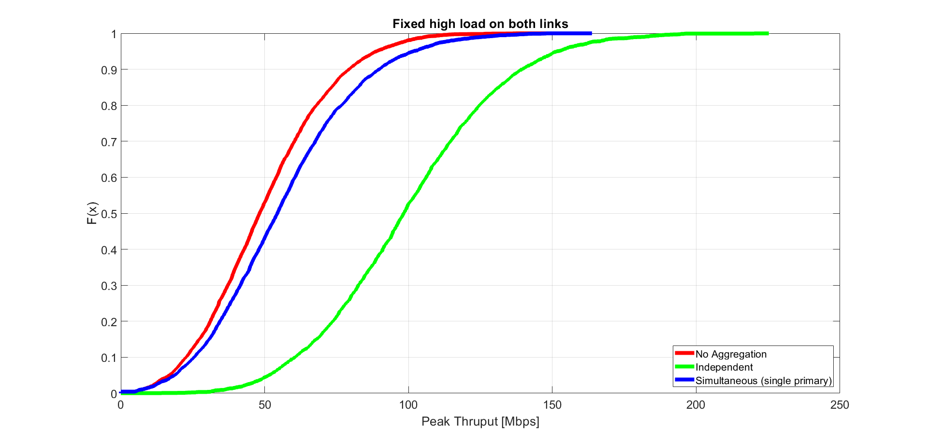
Simulation Results Fixed high load on both links
Setup
AP under test: Full buffer DL
Channel load modeling:
Both link 1 & link 2 have 8 OBSS STAs
Observation
Pronounced gains for independent mode compared to simultaneous mode
Agg Scheme | 5%ile (Mbps/Gain-x) | 50% | 95% ile
Independent mode (gains w.r.t baseline) | 51.34 (3.05x) | 98.29 (2.04x) | 151.55 (1.70x)
Simultaneous mode (gains w.r.t baseline) | 18.63 (1.11x) | 54.43 (1.13x) | 101.68 (1.14x)
Baseline | 16.82 | 48.25 | 88.95

Slide 12
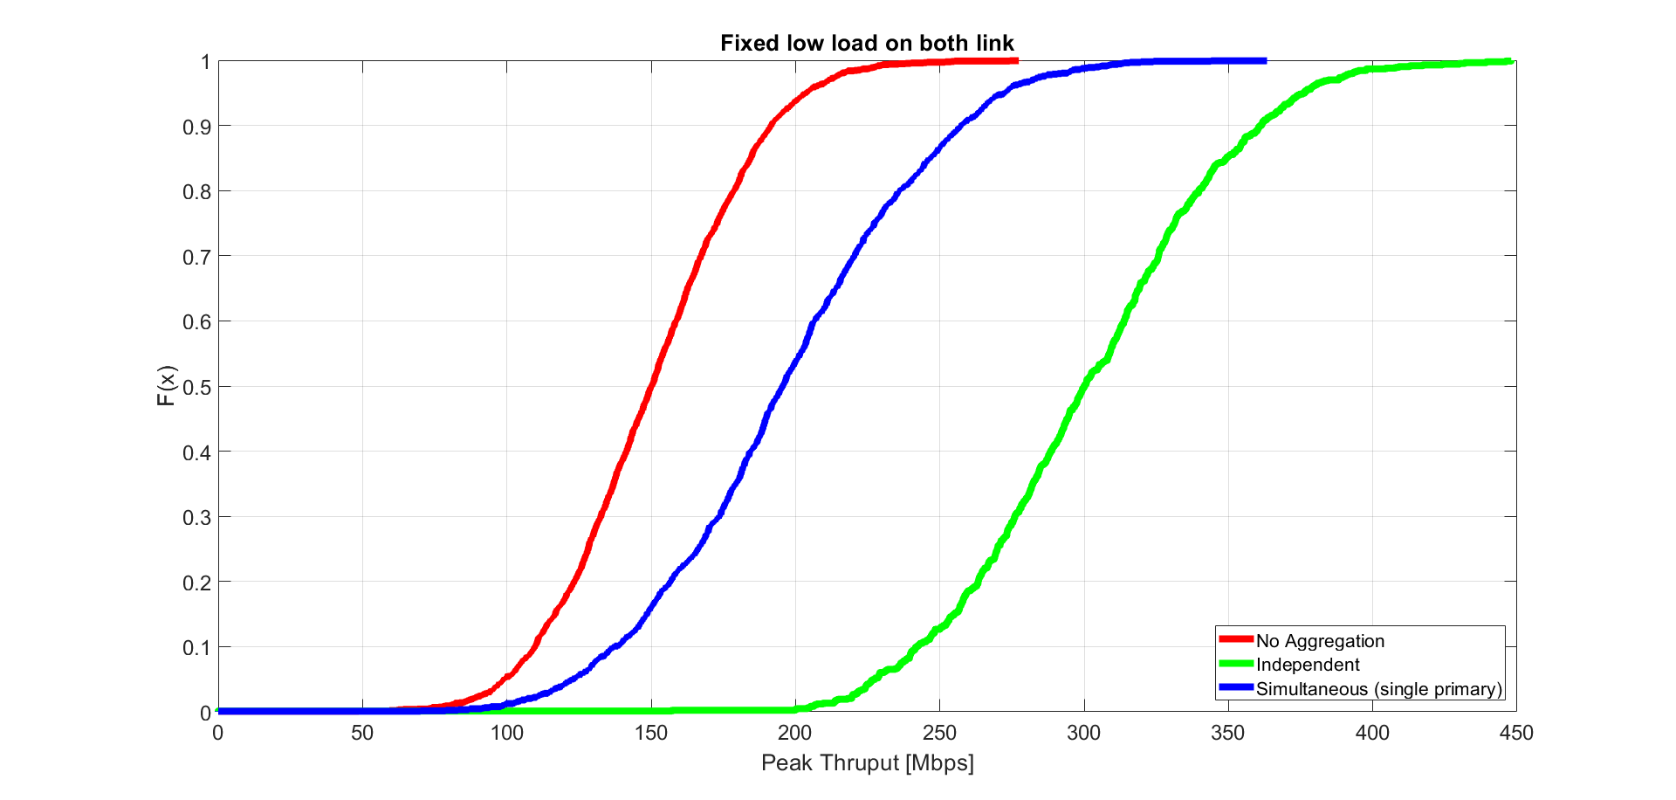
Simulation Results Fixed low load on both links
Setup
AP under test: Full buffer DL
Channel load modeling:
Both link 1 & link 2: 2 OBSS FB STAs
Observation
Higher 5%ile gains for independent mode operation because of higher opportunity to transmit due to independent channel access, than a simultaneous mode operation
Agg Scheme | 5%ile (Mbps/Gain-x) | 50% | 95% ile
Independent mode (gains w.r.t baseline) | 227.40 (2.3x) | 300.19 (2.00x) | 376.37 (1.85x)
Simultaneous mode (gains w.r.t baseline) | 122.65 (1.24x) | 195.57 (1.30x) | 272.61 (1.34x)
Baseline | 99.03 | 150.15 | 203.60

