Slide 1
Latency analysis for EHT
Date: 2019-05-13
Authors:
Name | Affiliation | Address | Phone | Email
Suhwook Kim | LG Electronics | 19, Yangjae-daero 11gil, Seocho-gu, Seoul 137-130, Korea |  | suhwook.kim@lge.com
Jinsoo Choi |  |  |  | js.choi@lge.com
Jeongki Kim |  |  |  | jeongki.kim@lge.com
Insun Jang |  |  |  | insun.jang@lge.com
Taewon Song |  |  |  | taewon.song@lge.co
Sungjin Park |  |  |  | allean.park@lge.com
Saehee Bang |  |  |  | saehee.bang@lge.com
Kiseon Ryu |  |  |  | kiseon.ryu@lge.com

Slide 2
Abstract
This presentation addresses the latency analysis and simulation results for EHT to reduce latency and jitter. This analysis may allow EHT to review technologies to support low latency traffic.

Slide 3
Low latency support discussion
We have discussed supporting low latency application in EHT
Low latency is mentioned in several sub-clauses in the PAR document
  5.2.b. Scope of the project: “This amendment defines at least one mode of operation capable of improved worst case latency and jitter.”
  5.5 Need for the Project: “New high-throughput, low latency applications will proliferate such as virtual reality or augmented reality, gaming, remote office and cloud computing”. “With the high throughput and stringent real-time delay requirements of these applications, users expect enhanced throughput, enhanced reliability, reduced latency and jitter, and improved power efficiency in supporting their applications over WLAN.”

Slide 4
Submissions in March meeting
[1] introduces Real Time Application and Time-Sensitive Networking
  RTA TIG provides final report (18/2009r6) which contains description of real-time application usage model, problem statement, technical requirements and potential solutions
  It addresses opportunity for improving reliability for RTA and time-sensitive applications in EHT
[2] proposes multiple primary channels for EHT to mitigate channel access delay
  It also shows simulation results
[3] suggests streaming game as a part of EHT use case

Slide 5
Latency analysis
The latency will be analyzed by dividing into several portions
To facilitate the better analysis, we will start with the analysis in limited environment
  DL or UL only traffic
  Single BSS
  Fixed number of STA
  Constant Bit Rate (CBR) traffic
  Fixed MCS
And then we will move to next step

Slide 6
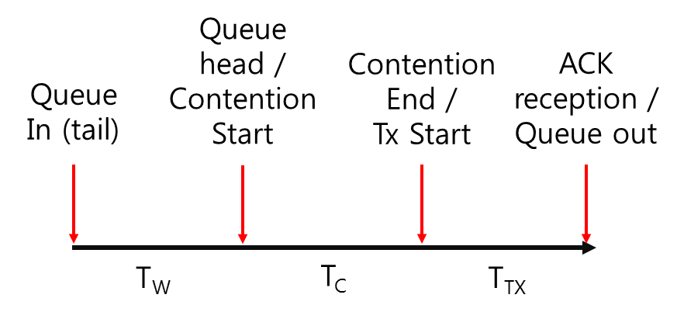
Latency portions – No error case
T_{W}: Contention waiting time
  Time to transmit previously arrived packets
T_{C}: Contention time
  AIFS + backoff + busy time
T_{TX}: Transmission time
  Data TX time + SIFS + ACK TX time

Slide 7
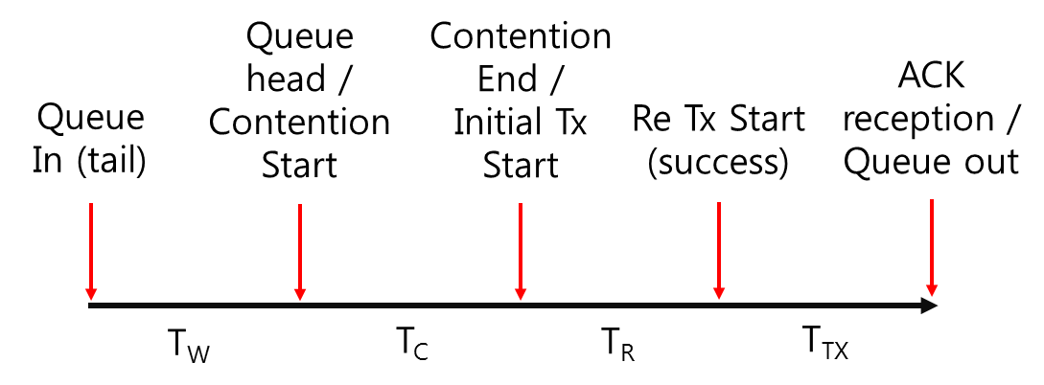
Latency portions – Error case
T_{R}: Additional time for retransmission
  Time spent for failed transmission
T_{W}: Contention waiting time
T_{C}: Contention time
T_{TX}: Transmission time

Slide 8
Simulation setting for DL
AP-STA distance: 45 meter
1 AP – 1 STA
Channel model: TGnD
Fixed MCS
Traffic model: CBR, DL only, 1500 bytes MSDU
TX power: 20 dBm(AP), 17 dBm(STA)
40, 80, 160 MHz BW in 5 GHz band

Slide 9
Simulation cases
We will analyze trend of latency portions in environments where the following variables change.
  Case 1: MCS 1 ~ 5
    50 Mbps traffic load, 80 MHz BW
  Case 2: BW 40 MHz, 80 MHz, 160 MHz
    50 Mbps traffic load, MCS 4
  Case 3: Traffic load 50 Mbps ~ 200 Mbps
    MCS 4, 80 MHz BW
Since there is only one contention device (AP), the impact of ‘Contention time’ can be ignored

Slide 10
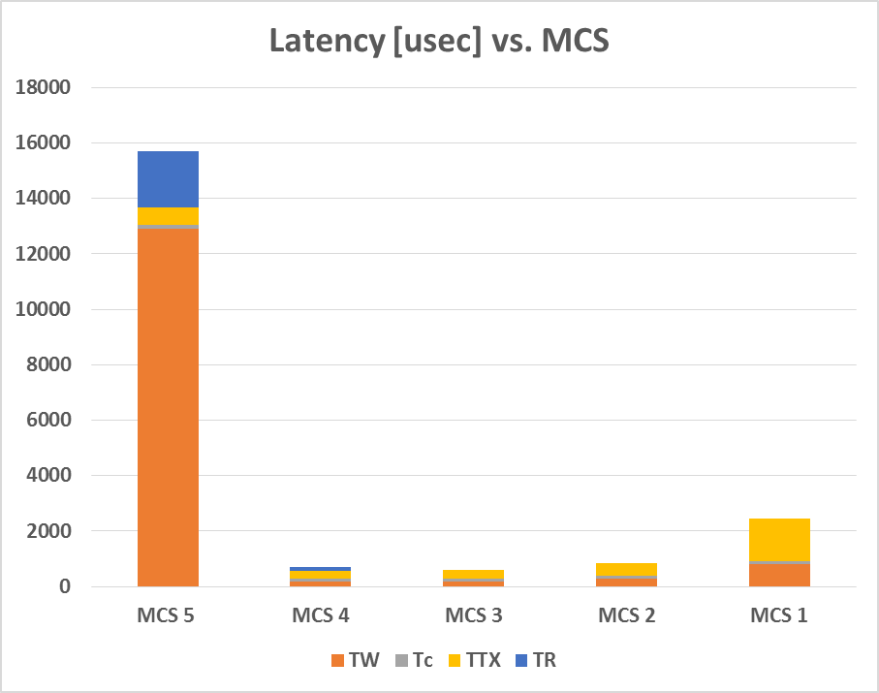
DL Latency analysis: Case 1 (MCS)
 | Tput [Mbps] | PER [%] | Total Latency [usec]
MCS 5 | 47.3 | 46.6 | 15,689
MCS 4 | 50.0 | 6.9 | 694
MCS 3 | 50.0 | 0 | 614
MCS 2 | 50.0 | 0 | 854
MCS 1 | 50.0 | 0 | 2,464

Slide 11
DL Latency analysis: Case 1 (MCS)
Detail results
 |  |  |  | Each latency portion [usec]
 | Tput [Mbps] | PER [%] | Total Latency* [usec] | T_{W} | T_{C} | T_{TX} | T_{R}
MCS 5 | 47.3 | 46.6 | 15,689 | 12,920 (82.4%) | 114 (0.7%) | 645 (4.1%) | 4,312 (12.8%)
MCS 4 | 50.0 | 6.9 | 694 | 188 (27.1%) | 110 (15.8%) | 266 (38.3%) | 1,899 (18.8%)
MCS 3 | 50.0 | 0 | 614 | 188 (30.7%) | 109 (17.8%) | 316 (51.5%) | -
MCS 2 | 50.0 | 0 | 854 | 291 (34.0%) | 109 (12.8%) | 455 (53.2%) | -
MCS 1 | 50.0 | 0 | 2,464 | 815 (33.1%) | 109 (4.4%) | 1,540 (62.5%) | -
*Total latency = T_{W} + T_{C} + T_{TX} + PER * T_{R}

Slide 12
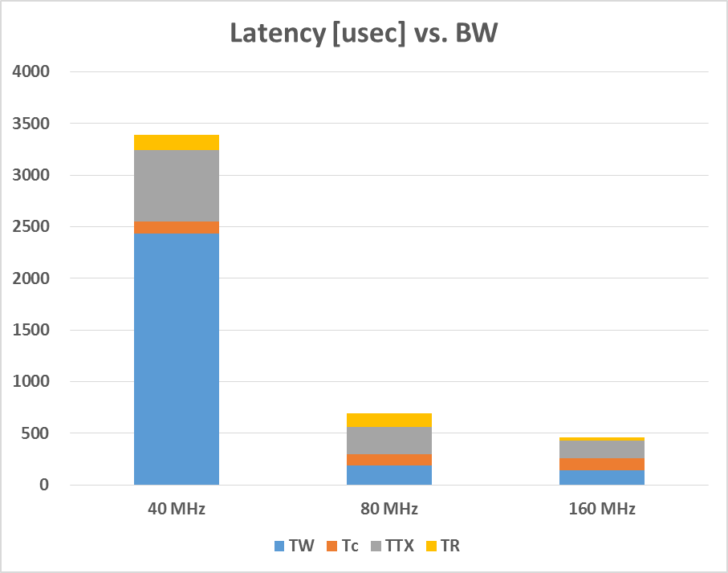
DL Latency analysis: Case 2 (BW)
 | Tput [Mbps] | PER [%] | Total Latency [usec]
40 MHz | 50.0 | 2.2 | 3,392
80 MHz | 50.0 | 6.9 | 694
160 MHz | 50.0 | 6.8 | 463

Slide 13
DL Latency analysis: Case 2 (BW)
Detail results
 |  |  |  | Each latency portion [usec]
 | Tput [Mbps] | PER [%] | Total Latency* [usec] | T_{W} | T_{C} | T_{TX} | T_{R}
40 MHz | 50.0 | 2.2 | 3,392 | 2,436 (71.8%) | 112 (3.3%) | 697 (20.6%) | 6,816 (4.3%)
80 MHz | 50.0 | 6.9 | 694 | 188 (27.1%) | 110 (15.8%) | 266 (38.3%) | 1,899 (18.8%)
160 MHz | 50.0 | 6.8 | 463 | 145 (31.3%) | 111 (24.1%) | 174 (37.7%) | 471 (6.9%)
*Total latency = T_{W} + T_{C} + T_{TX} + PER * T_{R}

Slide 14
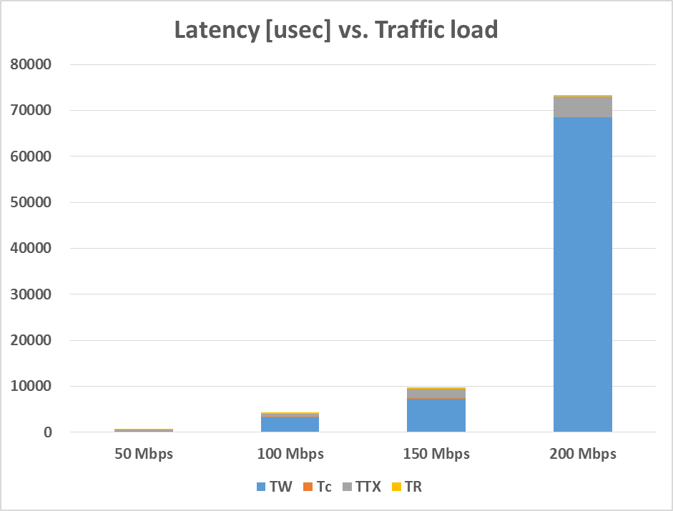
DL Latency analysis: Case 3 (Traffic load)
 | Tput [Mbps] | PER [%] | Total Latency [usec]
50 Mbps | 50.0 | 6.9 | 694
100 Mbps | 100.0 | 5.3 | 4,342
150 Mbps | 147.7 | 4.1 | 9,760
200 Mbps | 159.5 | 4.0 | 73,391

Slide 15
DL Latency analysis: Case 3 (Traffic load)
Detail results
 |  |  |  | Each latency portion [usec]
 | Tput [Mbps] | PER [%] | Total Latency* [usec] | T_{W} | T_{C} | T_{TX} | T_{R}
50 Mbps | 50.0 | 6.9 | 694 | 188 (27.1%) | 110 (15.8%) | 266 (38.3%) | 1,899 (18.8%)
100 Mbps | 100.0 | 5.3 | 4,342 | 3,265 (75.2%) | 109 (2.5%) | 690 (15.9%) | 5,268 (6.4%)
150 Mbps | 147.7 | 4.1 | 9,760 | 7,292 (74.7%) | 110 (1.1%) | 2,113 (21.6%) | 5,932 (2.5%)
200 Mbps | 159.5 | 4.0 | 73,391 | 68,487 (93.3%) | 109 (0.1%) | 4,513 (6.1%) | 7,031 (0.4%)
*Total latency = T_{W} + T_{C} + T_{TX} + PER * T_{R}

Slide 16
Observation on DL results
MCS that maximizes Tput and MCS that minimizes latency can be different
  In normal cases, Tput is maximized at the PER 10~20%
  However, the results shows that latency is the minimum when the PER is near 0%
Even though the PER increases, the latency decreases as the BW increases
The latency increases dramatically when traffic is saturated
The variation in T_{W} is greater than the others

Slide 17
Simulation setting for UL
AP-STAs distance: 45 meter
STAs are co-located (1 ~ 40 STAs)
Channel model: TGnD
Fixed MCS 4
Traffic model: CBR, UL only, 1500 bytes MSDU
TX power: 20 dBm(AP), 17 dBm(STA)
80 MHz BW in 5 GHz band
RTS/CTS on/off

Slide 18
Simulation cases
We will analyze trend of latency portions in environments where the following variables change.
  Case 1: Number of STA, 1 ~ 10 STAs
    Traffic load = 10 Mbps per STA, RTS/CTS on/off
  Case 2: Number of STA, 10 ~ 40 STAs
    Traffic load = 1 Mbps per STA, RTS/CTS on/off
  Case 3: Access category, 6 STAs
    5 low rate STAs + 1 high rate STA
    High rate STAs: 100 Mbps traffic load, AC_BE/VI/VO
    Low rate STAs: 1 Mbps traffic load per STA, AC_BE only
    RTS/CTS off

Slide 19
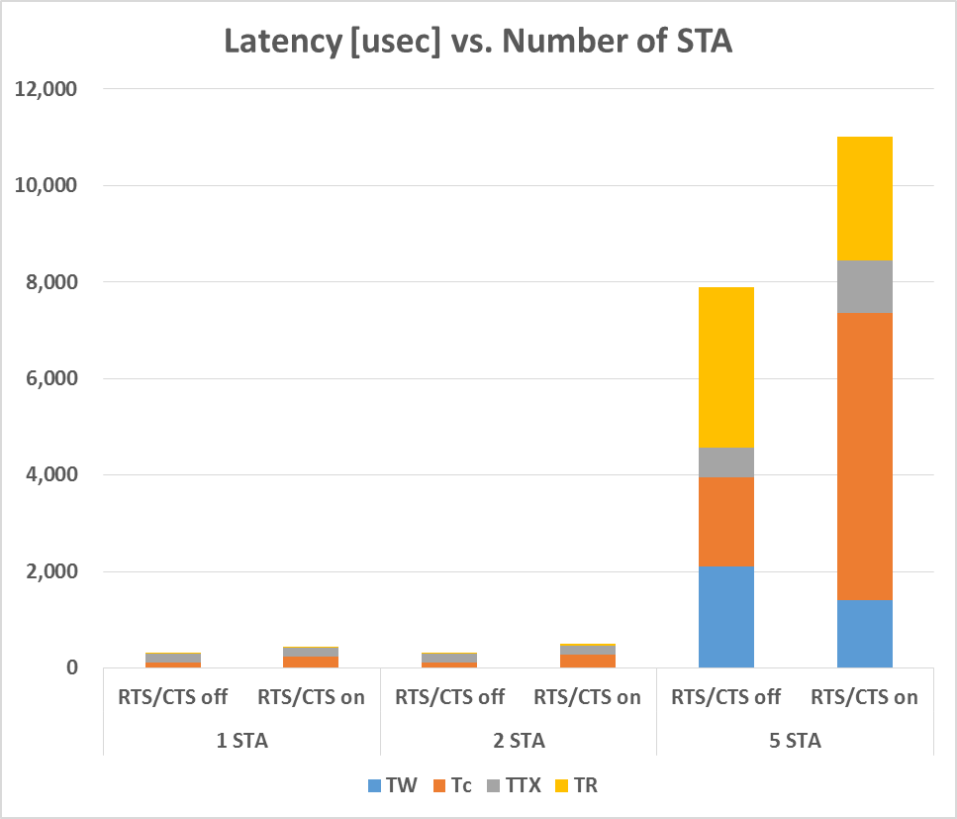
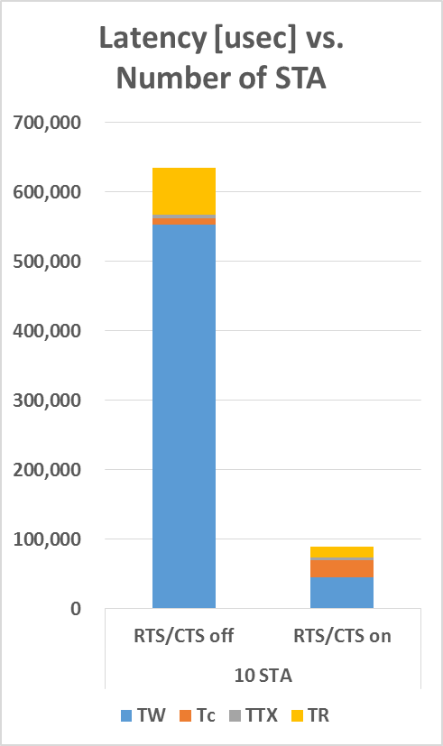
UL Latency analysis: Case 1
(Number of STA)

Slide 20
UL Latency analysis: Case 1
(Number of STA)
Detail results
 |  |  |  |  | Each latency portion [usec]
 | RTS/ CTS | Tput [Mbps] | PER [%] | Total Latency* [usec] | T_{W} | T_{C} | T_{TX} | T_{R}
1 STA | Off | 9.88 | 1.9 | 313 | 2 | 110 | 193 | 483
 | On | 9.88 | 1.8 | 441 | 1 | 237 | 193 | 526
2 STA | Off | 19.76 | 3.7 | 324 | 3 | 111 | 193 | 460
 | On | 19.76 | 4.6 | 506 | 3 | 270 | 196 | 833
5 STA | Off | 49.37 | 47.9 | 7,902 | 2,102 | 1,844 | 631 | 6,947
 | On | 49.34 | 19.6 | 11,019 | 1,402 | 5,955 | 1,095 | 13,109
10 STA | Off | 81.67 | 55.3 | 634,556 | 553,085 | 9,826 | 4,053 | 122,299
 | On | 98.27 | 24.3 | 89,986 | 45,902 | 24,775 | 3,232 | 66,044
*Total latency = T_{W} + T_{C} + T_{TX} + PER * T_{R}

Slide 21
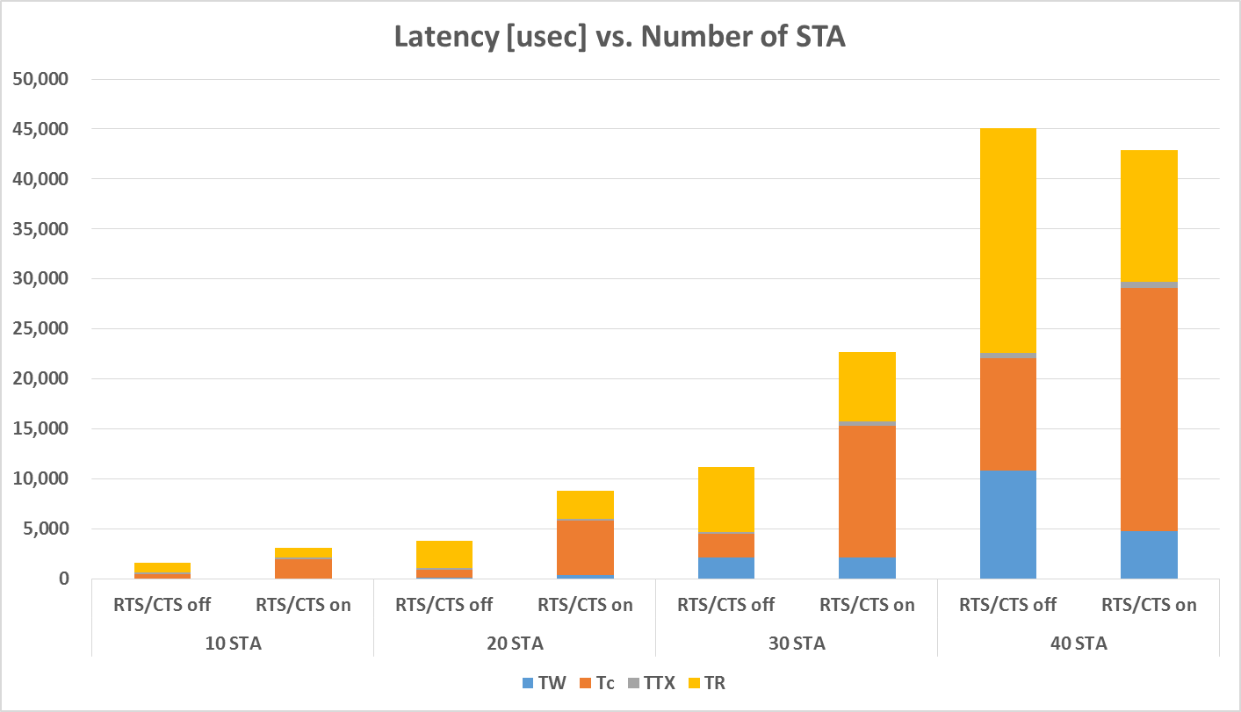
UL Latency analysis: Case 2
(Number of STA)

Slide 22
UL Latency analysis: Case 2
(Number of STA)
Detail results
 |  |  |  |  | Each latency portion[usec]
 | RTS/ CTS | Tput [Mbps] | PER [%] | Total Latency* [usec] | T_{W} | T_{C} | T_{TX} | T_{R}
10 STA | Off | 9.88 | 53.9 | 1,617 | 21 | 422 | 193 | 1,819
 | On | 9.88 | 30.4 | 3,121 | 4 | 1,972 | 194 | 3,135
20 STA | Off | 19.76 | 65.3 | 3,804 | 105 | 748 | 194 | 4,224
 | On | 19.76 | 32 | 8,784 | 374 | 5,423 | 226 | 8,641
30 STA | Off | 49.37 | 67.4 | 11,215 | 2,115 | 2,363 | 230 | 9,651
 | On | 49.34 | 31.5 | 22,641 | 2,168 | 13,168 | 368 | 22,016
40 STA | Off | 81.67 | 66.6 | 45,097 | 10,828 | 11,248 | 486 | 33,836
 | On | 98.27 | 32.7 | 42,853 | 4,794 | 24,313 | 591 | 40,249
*Total latency = T_{W} + T_{C} + T_{TX} + PER * T_{R}

Slide 23
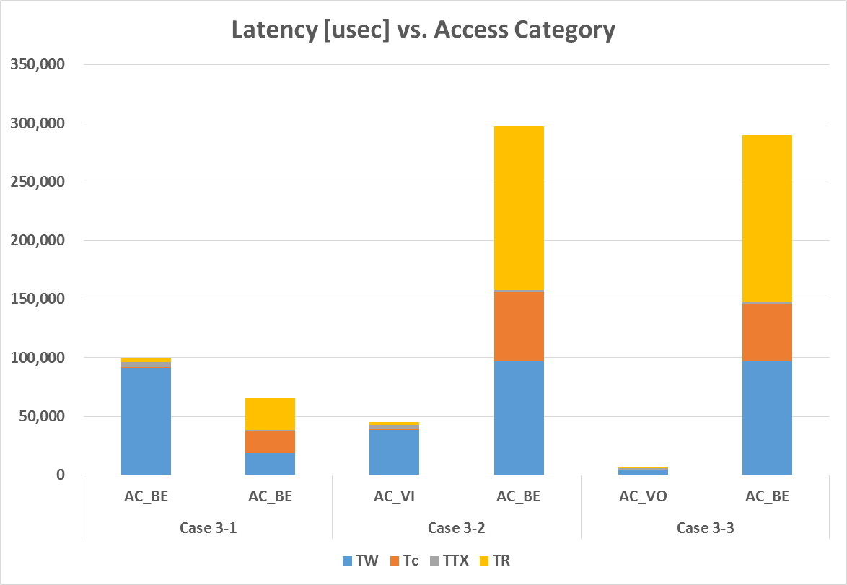
UL Latency analysis: Case 3
(Access Category)

Slide 24
UL Latency analysis: Case 3
(Access Category)
Detail results
 |  |  |  |  | Each latency portion[usec]
 | AC | Tput [Mbps] | PER [%] | Total Latency* [usec] | T_{W} | T_{C} | T_{TX} | T_{R}
Case 3-1 | BE | 85.48 | 43.1 | 100,014 | 91,656 | 397 | 4,360 | 8,346
 | BE | 4.90 | 50.7 | 65,308 | 18,623 | 19,019 | 575 | 53,471
Case 3-2 | VI | 94.32 | 36.5 | 45,278 | 38,604 | 377 | 3,656 | 7,224
 | BE | 4.74 | 67.5 | 297,566 | 97,028 | 58,690 | 1,982 | 207,227
Case 3-3 | VO | 98.61 | 23.5 | 7,038 | 4,178 | 297 | 1,692 | 3,710
 | BE | 4.17 | 82.1 | 289,752 | 97,017 | 48,329 | 1,997 | 173,362
*Total latency = T_{W} + T_{C} + T_{TX} + PER * T_{R}

Slide 25
Observation on UL results
RTS/CTS shows performance gains not only in Tput but also in latency when the number of STAs is above a certain level
  On the contrary, RTS/CTS degrades latency performance if the number of STAs is below the certain level
  The level depends on number of STA and traffic load
Unlike in DL case, the portion of T_{C},T_{R} by collision increases significantly if the number of STAs increases
We can enhance latency performance of certain traffic dramatically by allocating AC_VI,VO instead of AC_BE
  However AC_BE STAs should be prepared for performance degradation on Tput and latency

Slide 26
How to reduce latency
We could see from the simulation results that the followings can reduce latency
  Use appropriate MCS for latency and wider BW
  Use RTS/CTS only when the number of STAs is high
  Use AC_VI/VO instead of AC_BE
And it can be inferred that the followings can also reduce latency indirectly
  Enhance PHY data rate
  Use HARQ
  Multi-user transmission

Slide 27
Further step
Applying TST (time sensitive traffic) model
  We will apply TST which is defined in 11ax Evaluation Methodology document and RTA TIG report
Latency performance on OFDMA
  We will address performance gain on latency when we adopt OFDMA
    Preliminary results were submitted in TGax [4][5]
    We will conduct in-depth review in terms of latency on OFDMA
OBSS performance
  We will extend current simulation to OBSS environment
We will evaluate latency performance of EHT features
  Multi-band, 16 streams, 320 MHz, etc.

Slide 28
Summary
We conducted in-depth latency analysis on non-MU system
  The latency is divided into several portions and analyzed with simulation
  We could identify some variables that affect latency
  We also were able to check some things to reduce latency by simulation results

Slide 29
References
[1] 11-19-0373-00-0eht-time-sensitive-applications-support-in-eht.pptx
[2] 11-19-0402-01-0eht-reducing-channel-access-delay.pptx
[3] 11-19-0430-00-0eht-low-latency-streaming-capability-for-game-applications.pptx
[4] 11-16-1363-01-00ax-11ax-par-verification-through-ofdma.ppt
[5] 11-15-1095-10-00ax-ofdma-performance-in-11ax.ppt

Slide 30
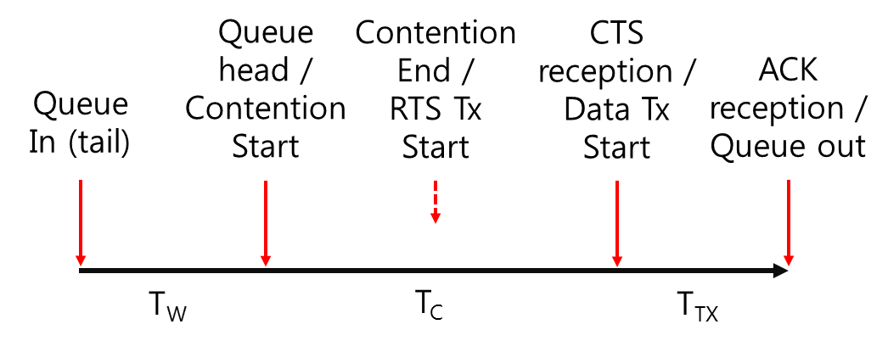
Appendix
Latency portion in RTS/CTS case

