Slide 1
EUHT Technical Brief
Date: 2019-04-08
Authors:

Slide 2
Abstract
A brief introduction of EUHT technology and use cases.

Slide 3
Outline
EUHT : Technology, Standards
  EUHT System Architecture
  System Parameters
  Flexible , Self-Contained Frame Structure
  Latency Optimization in EUHT
  Optimized for High Reliability
  Optimized for Ultra-high Vehicle Speed
  Fast and Reliable Handover
Use Cases
  EUHT Wide Area Wireless Coverage
  EUHT High Speed Rail Solutions
  EUHT Subway Solutions
  EUHT ITS ( Intelligent Transportation System) Solutions
  EUHT Industrial Internet Solutions

Slide 4
EUHT System Architecture
High Throughput, High Reliable, Low Latency Wireless Access Network
Light Weight, Low Latency core network with Mobile Edge Computing capability

Slide 5
System Parameters
Duplex | Flexible TDD
Waveform | OFDM for both DL/UL
Frame Structure | Highly Flexible, Self-Contained
Sub-carrier Interval | 78.125 /39 /31.25 kHz
Multiple Access | TDMA/OFDMA/SDMA
OFDMA Unit | 16 Sub-Carriers
Data Sub-carrier | 224 With 20MHz
Bandwidth | 8/10/20/40/80/100/200/400 MHz
MIMO | 8T8R for both BS and MS
Max. MCS | 1024QAM，7/8 code rate
FEC | LDPC with ultra-low error floor
All the system parameters are carefully designed for ultra-reliability, low latency and high flexibility

Slide 6
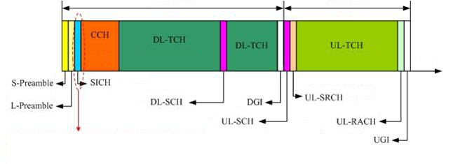
Flexible , Self-Contained Frame Structure
Downlink
Uplink
Time
MORE EFFICIENCY: Dynamic Arrangement of Channel Resources based on
Service Requirement
LESS OVERHEAD: Dynamic Adjustment of Frame Length based on
Channel Characteristics
S-Preamble | Sync , AGC | UL-SRCH | Service Request Channel
L-Preamble | Fine Sync | UL-RACH | Random Access Channel
SICH | Broadcast Information | DL-TCH | DL Traffic Channel
CCH | Resource Allocation Information | UL-TCH | UL Traffic Channel
DL-SCH | DL Channel Measurement | DGI | DL Guard Interval
UL-SCH | UL Channel Measurement | UGI | UL Guard Interval

Slide 7
Flexible and Efficient for Various Scenarios
Scenarios | Requirements | Impact of System Design
Home broadband access | Static | Sparse Pilot Density, Long frame length downlink-dominant
Wireless video surveillance | Static | Sparse Pilot Density, Long frame length Uplink-dominant
Metro video surveillance | High vehicle speed | Dense Pilot Density, middle frame length Uplink-dominant
HST passengers network service | Very High vehicle speed | Denser Pilot Density, short frame length Downlink-dominant;
Different requirements for Different application scenarios
EUHT is extremely flexible and easy to adapt to given scenario
  Frame length : 0.1ms ~ 14 ms
  Pilot Density: 0.04ms ~ 14ms Pilot interval
  DL/UL ratio can be fine-tuned in unit of one OFDM symbols, from 0: 511 to 511: 0

Slide 8
Latency Optimization in EUHT
Self-contained frame structure to ensure instant ACK/feedback
Low overhead MAC protocol to reduce frame duration, especially for short packets
Much shorter frame and OFDM symbol
  Configurable to 0.1ms frame, OFDM symbol: 14.4us
Pipeline Processing
  Latency < 14.4us
  Don’t need to buffer!
Grant Free
  No need to perform Service Request/Grant for emergency services
Mobile Edge Computing
  Data need not to go through core network

Slide 9
Optimized for High Reliability
Diversity
  MIMO and inter-stream interleaving to achieve spatial diversity
  Frequency interleaving and LDPC to achieve frequency diversity
  No time domain interleaving to reduce the latency
  Multiple connection to achieve macro diversity
LDPC with Extra-Low Error Floor
  PER < 10e-9
Fast adaptive to channel condition
  Self-contained frame structure: the extremely low latency of ACK/CSI feedback

Slide 10
Optimized for Ultra-high Vehicle Speed
Problems in ultra-high speed scenarios
  High Doppler Shift ( up to 2.1KHz)
  Fast Changing Channel
  Frequent Handover
Solutions in EUHT
  Higher sub-carrier interval for tolerating higher Doppler offset
    78KHz for EUHT, 15KHz for LTE
  Flexible pilots density for fast channel tracking
    Interval between pilot symbols can be configured to 0.04ms~14ms in EUHT
    LTE: fixed to 0.5ms, channel may change significantly at 350km/h@6GHz
  Advanced algorithms for accurate channel estimation and prediction

Slide 11
Fast and Reliable Handover
Fast Handover
  Simplified handover process
  Terminal triggered handover
    No need go through core network
  Flexible and self-contained frame
    Faster request/response
Reliable Handover decision based on
  Signal strength
  Ranging results
  Channel tracking and prediction results ..
Multiple connection achieves 0ms handover interruption

Slide 12
Performance in High Speed Train Use Case
Performance Index | Result
Vehicle speed | 350 km/h
Join network success rate | 100%
Handover success rate | 100%
Handover delay | < 37 ms
End-to-end delay Air interface delay | < 5ms < 1ms
Peak throughput rate | 260Mbps
Average throughput rate | 143Mbps
Data packet loss rate | < 0.4%
Quoted from 3rd party Field Test Results in Beijing-Tianjin HST in June 2017

Slide 13
Performance in Metro Use Case
Performance Index | Result
Join network success rate | 100%
Handover success rate | 100%
Handover delay | 4 ms
End-to-end delay Air interface delay | 3ms 1ms
Average throughput rate | 409Mbps
Data packet loss rate | 0.001%
Quoted from 3rd party Field Test Results in Guangzhou Metro and Beijing Metro in 2018

Slide 14
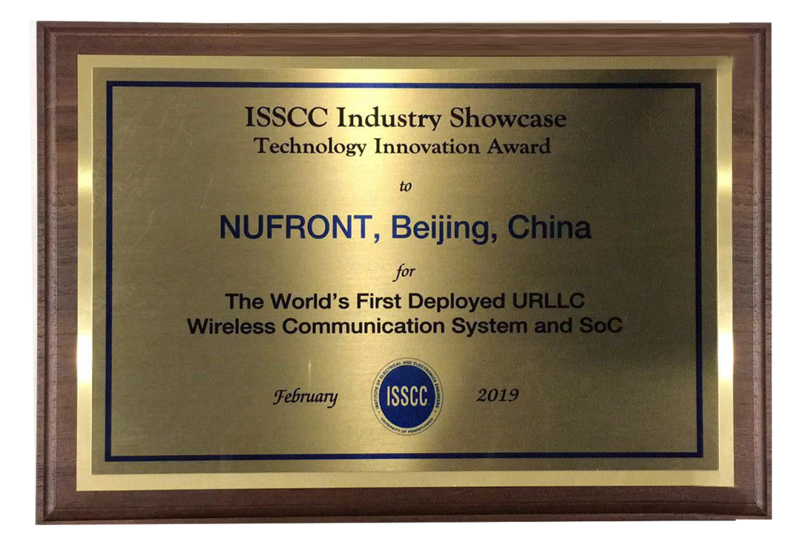
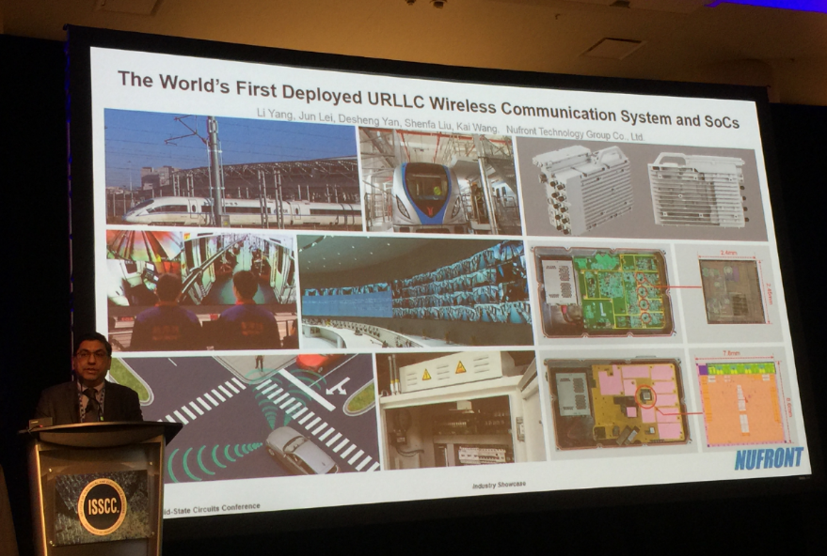
ISSCC 2019 Technology Innovation Award
“The World’s First Deployed URLLC Wireless Communication System and SoC”

Slide 15
EUHT: Standards for Multiple Field in China
Industrial Standard for Wireless Communication
  Part I (YD/T 2394.1-2012) and Part II (YD/T 2394.2-2012(Part )
National Standard for Cooperative Intelligent Transportation Systems
  Part I (GB/T 31024.1-2014) and Part II (GB/T 31024.2-2014)
Industrial Standard for Real-Time Video Transmission Systems in Rail Transit
  CJ/T500-2016
National Standard for High Throughput Wireless Communication
  GB/T 36454-2018

Slide 16
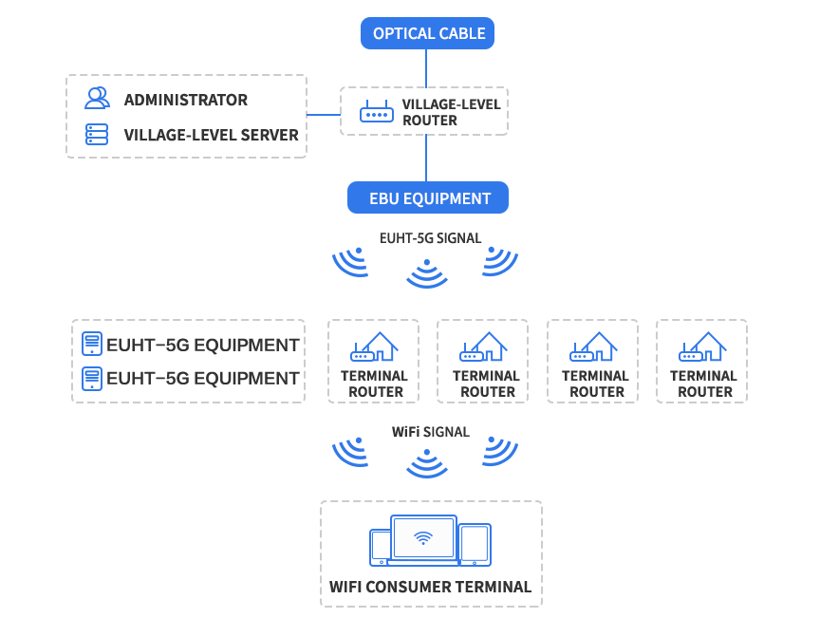
EUHT Use Case: Wide Area Wireless Coverage

Slide 17

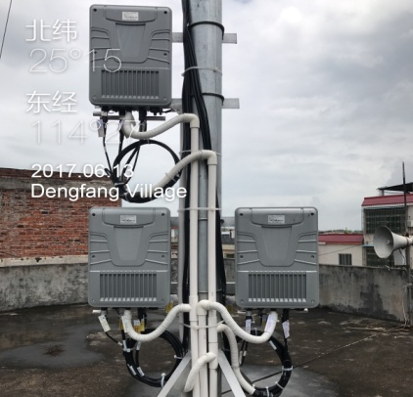
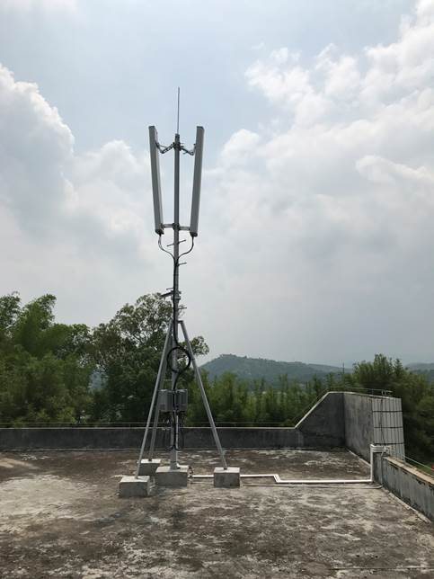

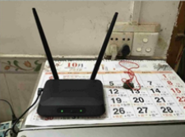
EUHT Network is Serving 10 Million Users
In December 2015, EUHT-5G was selected as the wireless broadband coverage solution for more than 10,000 villages after completely comparing with 4G LTE, Wi-Fi and optical fiber solutions, solving the problem of broadband internet access for 10 million people in rural areas

Slide 18
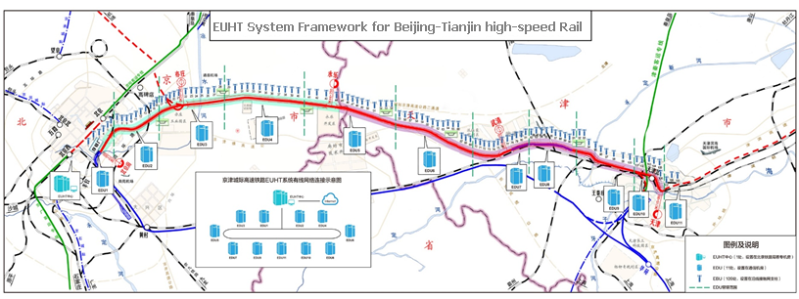
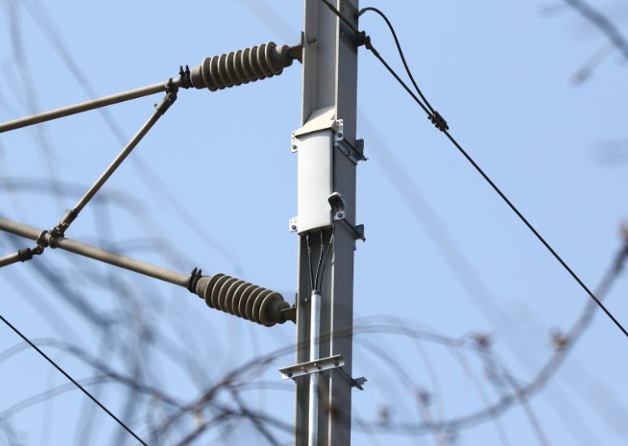
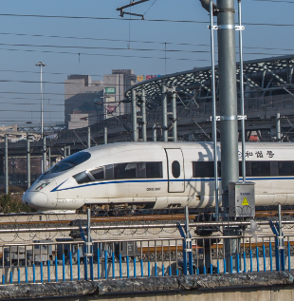
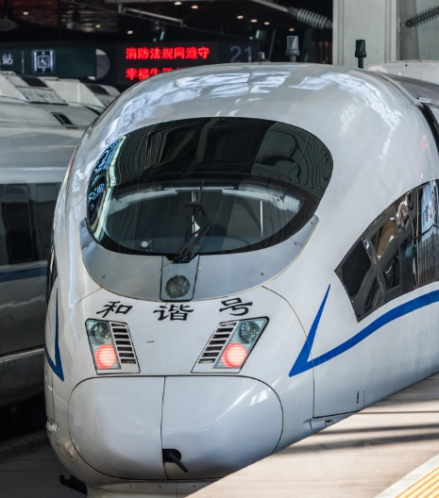
EUHT Use Case :High Speed Rail
Install 109pcs
Base Stations
Connect to
control center
Gigabit ring
fiber network
BS connect to
machine room
In January 2017, the 120 kilometer high-speed rail EUHT-5G system of Beijing-Tianjin intercity was completed and put into use, which became the world's first high-speed railway to achieve ultra-wideband wireless network coverage at 300 km/h.
Support 16 channels of real-time HD video surveillance
Support Internet service to passengers
Stably ran more than 2 years, and passed all test by third-part

Slide 19
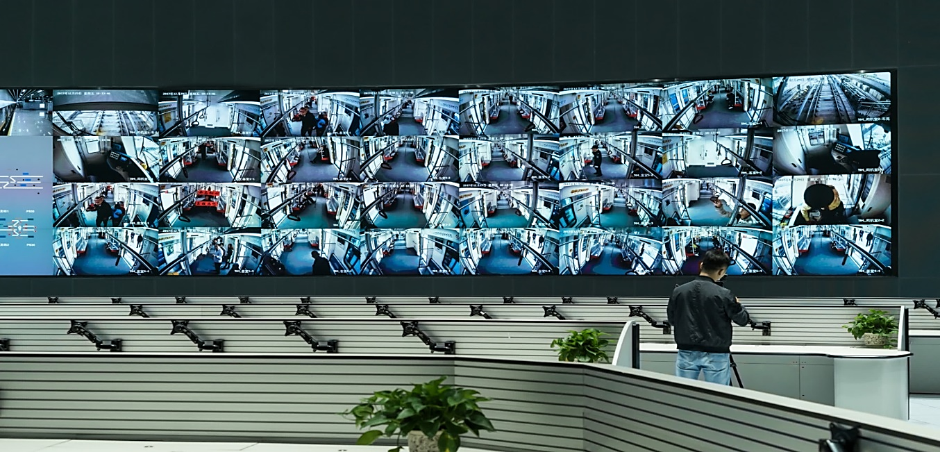
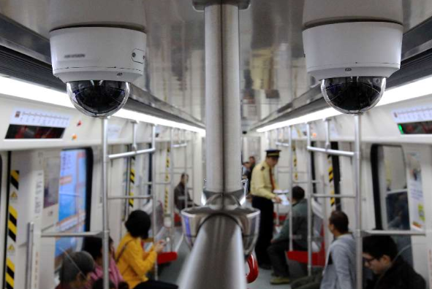
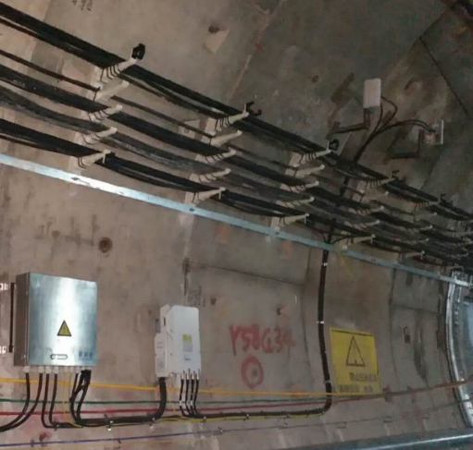
EUHT Use Case: Subway
Metro traffic command center, real-time monitoring for operating train
In December 2017, the Guangzhou Metro Knowledge City branch EUHT-5G system was officially commercialized.
The world's first real-time monitoring of high-speed subway train with 30 channels of 1080P HD video (CCTV)
PIS（Passenger Information System），live broadcast

Slide 20
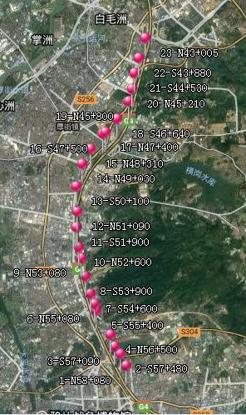
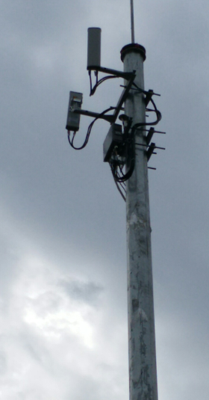
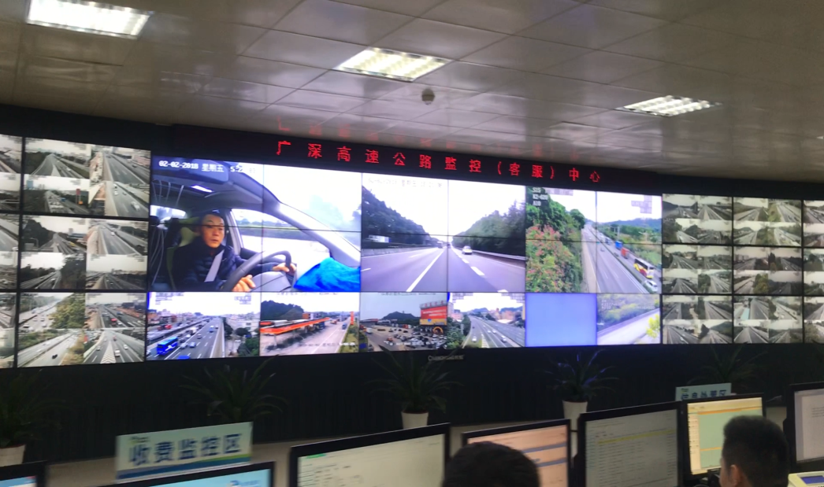

EUHT Use Case: V2X in Guangzhou-Shenzhen Highway
In August 2018, Guangzhou-Shenzhen Highway EUHT-5G system was officially online.
The world's first case to meet C-ITS
Realized real-time video security monitoring and data acquisition of the operating vehicles

Slide 21
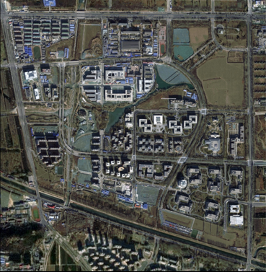
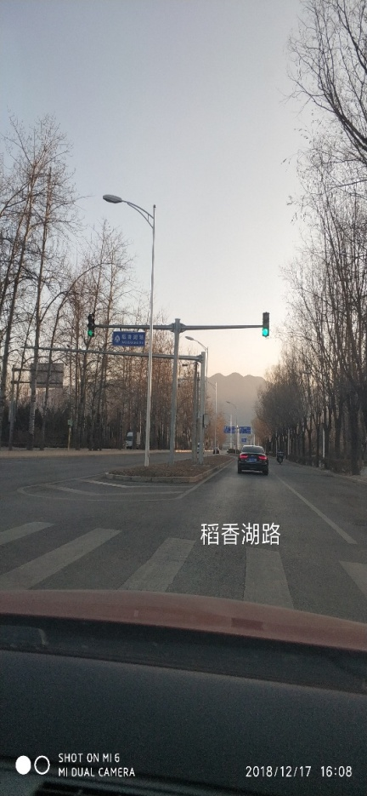
EUHT Use Case: V2X Network Trial Park in Beijing
In the beginning of 2019, EUHT-5G is used to build the basic wireless vehicle networking system for the Beijing self-driving car demonstration park.
Support the interconnection between vehicles and vehicles
Provide a communication bridge between self-driving vehicles and surrounding intelligent transportation facilities and control centers
Base site
Base site
Base site
Base site
Base site
Base site
Base site
Base site
Related companies : Unicom, Baidu, Nufront, TRANSINFO, DiDi, JD, Navinfo, Meituan, UISEE, Pony.ai, idriverplus, etc.

Slide 22
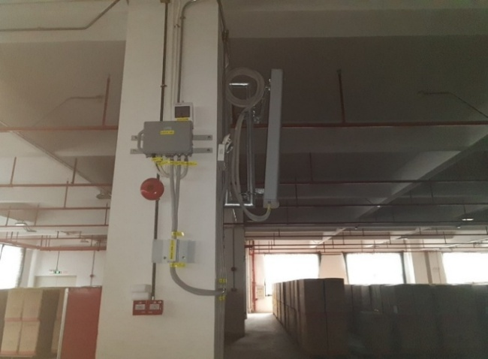
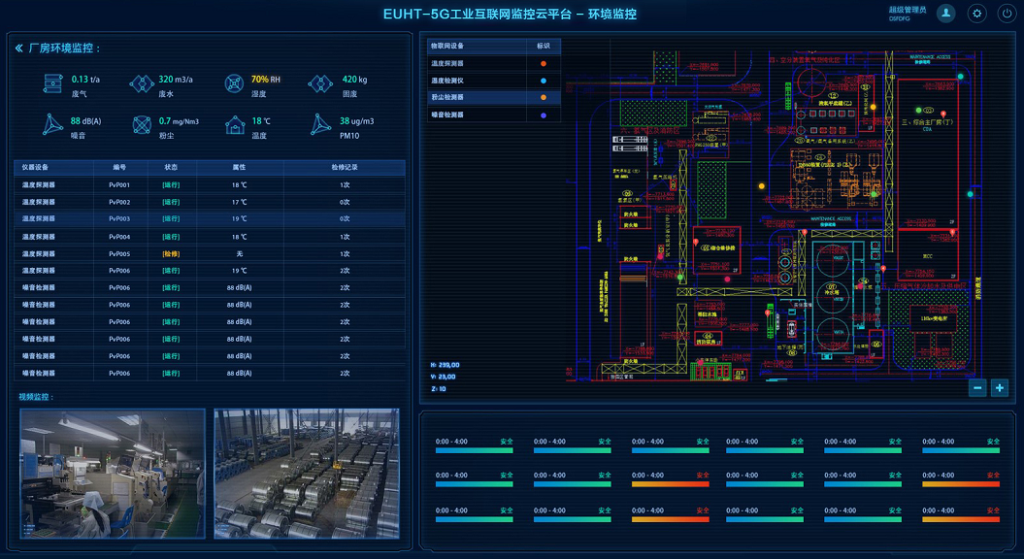
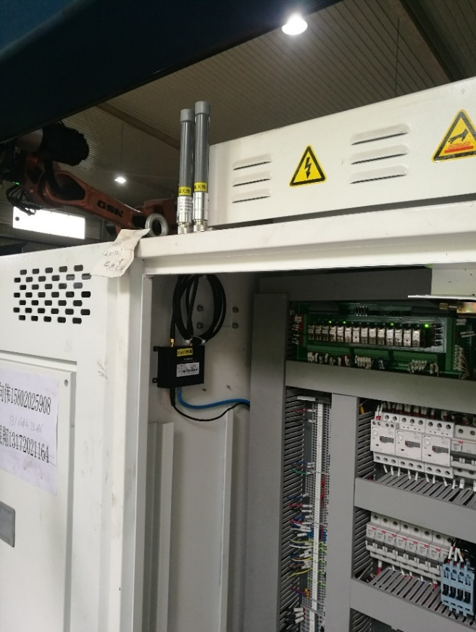
EUHT Use Case — A CNC Enterprise
In May 2018, a CNC factory installed EUHT-5G wireless communication system to replace the original large and complex optical fiber and Wi-Fi connection network.
Realize reliable interconnection of production equipment
Real-time monitoring and dynamic control of production processes and states
Unified intelligent and visual management of integrated processes of production, warehousing and logistics

Slide 23
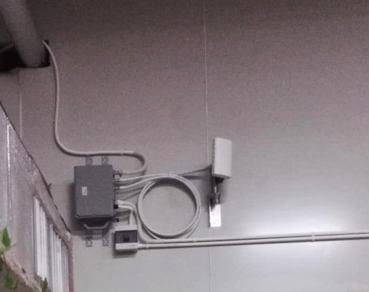
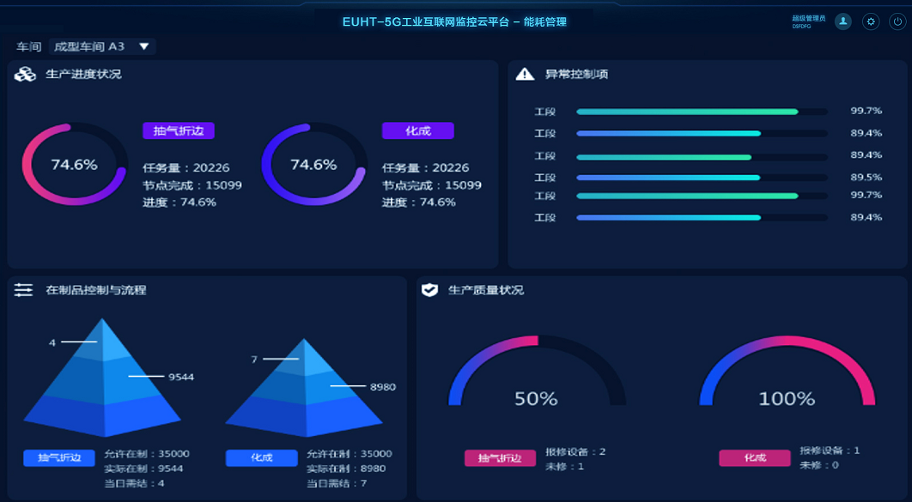
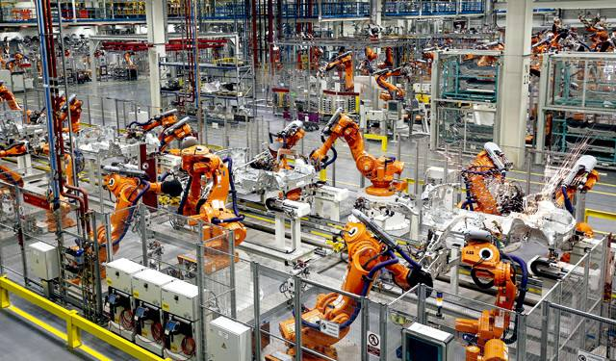
EUHT Use Case — An Equipment Manufactory
In December 2018, a equipment manufacturer completed the full deployment of the EUHT-5G network.
Achieve unified intelligent management of multi-scenarios such as assembly, warehousing and logistics, and electronic production SOP
Real-time unified visualization of production status, product quality, product information, management data, etc.
Real-time collection of environmental data and safety status
Industrial center access equipment and antenna
Industrial terminal and antenna

