Slide 1
ns-3: Open Source Simulator for Wireless Network Performance Evaluation
Date: 2019-03-12
Authors:

Slide 2
Abstract
Use of ns-3 for simulation of 802.11 systems and coexistence between 802.11 and other systems.

Slide 3
Overview
History & Context
Introduction to ns-3 simulator
- Core - User Modules
Recent Upgrades ns-3 802.11 PHY/MAC
- Improved CCA (.11a → .11n/ac) & PHY Abstractions
- Link-to-System Mapping
- New .11ax MAC features
  SPATIAL REUSE (BSS COLOR)
  OFDMA

Slide 4


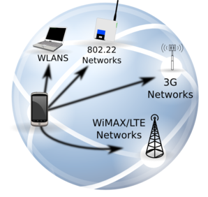




ns-3: Open Source Network Simulator
network performance evaluation for research & educational use
model developers
Research
ns-3 software
NS-3 Consortium
ns-3 maintainers
Education

Slide 5
Acknowledgements (Support)
National Science Foundation (NSF) – original funding for ns-3 core simulator design and implementation (2006-15)
NSF: Subsequent episodic funding for network stack modules
Google Summer of Code: 10 yrs of supporting ns-3 student projects
INDUSTRY/LABS SUPPORT
WiFi Alliance, CableLabs: LAA/WiFi Coexistence (2015-16)
NIST: Public Safety Extensions to LTE (2017-19)
Cisco [Malcolm Smith]
Intel [Carlos Cordeiro] 802.11ax MAC (2018-19)

Slide 6
Acknowledgements: Key Contributors
U. Washington, INRIA (Sophia Antipolis), Georgia Tech, INESC Porto
- Core development of ns-3 in the early days
CTTC (Barcelona)
- Lead authors and maintainers of ns-3 LTE and 5G NR stack
U. Washington, INRIA, CTTC, Alcatel-Lucent, Nokia, Televic Conference
- Lead authors and maintainers of ns-3 Wi-Fi stack
NYU/U. Padova, Italy
- 5G LTE mmWave module
NIST/IMDEA, Spain
- 802.11ad/ay
Space precludes fully listing the ~200 authors credited in ns-3 code

Slide 7
Key Personnel
Lead maintainer, ns-3 Consortium Director
Tom Henderson (tomhend@uw)
Maintainers (partial list)
Peter Barnes (core)
Sebastien Deronne, S. Avallone (WiFi)
Tomasso Pecorrella (6LowPAN, IP/UDP)
B. Bojovic, M. Requena, M. Miozzo, N. Patriciello, A. Krotov, Z. Ali (LTE)

Slide 8
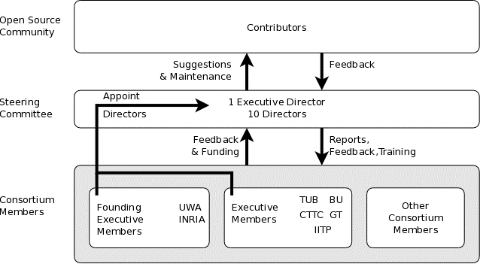
ns-3 consortium www.nsnam.org/consortium
Annual Meeting
Workshop on ns-3
ns-3 Training
(Jun 18-21, Florence Italy)

Slide 9
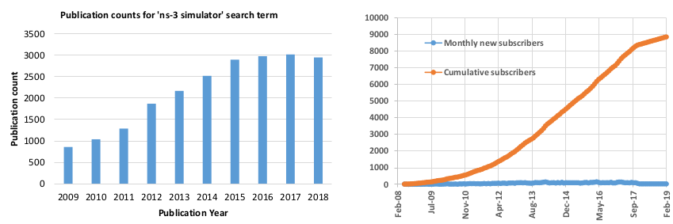
ns-3 User Statistics
Publication results Google Scholar,
'ns-3 simulator' search
Growth in ns-3-users Google Groups forum subscribers

Slide 10
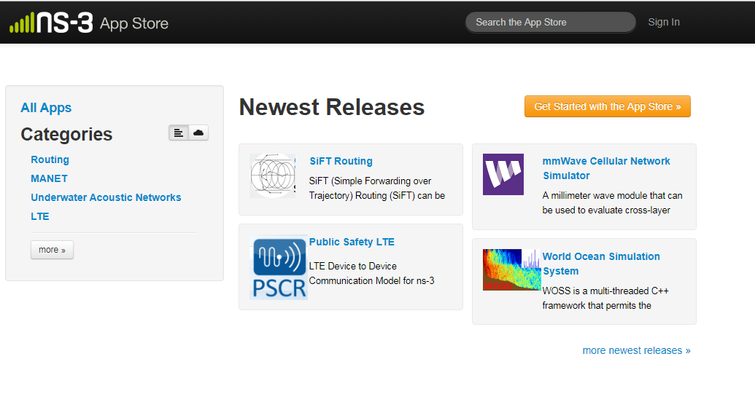
App Store: Current
Growth of project has led to the launch of an ``app store” for organizing
ns-3 extensions

Slide 11
How ns-3 Operates
Aims for 3 annual software releases
Users interact on mailing lists and chat room
Code in repos may be proposed for merge
  - Code reviews occur on GitLab.com
Maintainers for each module fix or delegate bugs, participate in reviews
ns-3 conducts annual workshop and developer meeting
Summer projects (Google Summer of Code, ESA Summer of Code in Space ....)

Slide 12

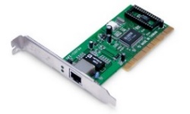

What is ns-3?
Software environment to build models of computer networks & conduct performance evaluation studies
Open source (GPLv2 license), packet-level network simulator
featuring a high-performance core enabling parallelization
across a cluster, ability to run real code, and interact with
testbeds
Application
Application
real applications
via Direct Code
Execution
Application
Application
real applications
via Direct Code
Execution
modular
interconnections
real applications
via Direct Code
Execution
Application
Application
modular
interconnections
Native ns-3
models of
these layers
Transport
Linux
stack
run Linux
kernel code
via Direct
Code Execution
modular
interconnections
Alternatively,
scenarios can be parallelized
across a cluster
Native ns-3
models of
these layers
Transport
Linux
stack
run Linux
kernel code
via Direct
Code Execution
Native ns-3
models of
these layers
Transport
Network
run Linux
kernel code
via Direct
Code Execution
Linux
stack
Network
modular
interconnections
Network
modular
interconnections
MAC
packets can
be sent out over real NICs (realtime
scheduler)
modular
interconnections
A single simulation instance can run on a workstation
or laptop
MAC
packets can
be sent out over real NICs (realtime
scheduler)
Phy/Channel
MAC
Phy/Channel
packets can
be sent out over real NICs (realtime
scheduler)
Phy/Channel

Slide 13
Software orientation
Key differences from other network simulators-
1) Command-line, Unix orientation
  vs. Integrated Development Environment (IDE)
2) Simulations and models written directly in C++ & Python
  vs. a domain-specific simulation language

Slide 14
ns-3: Software Overview
models written in C++
  - makes use of a collection of C++ design patterns and enhancements with applicability to network simulation
ns-3 build system generates C++ libraries and Python modules
simulation programs written in C++ or Python
- programs can link to other C++ libraries or Python modules as needed

Slide 15
Software organization
1) Several supporting libraries, not system-installed, can be used in parallel to ns-3
Two levels of ns-3 software and libraries
Netanim
pybindgen
Click routing
ns-3
2) ns-3 modules exist
within the ns-3 directory
module
module
module
module
module
module

Slide 16
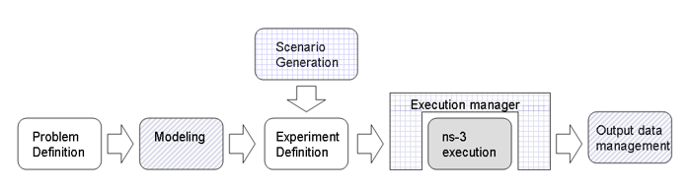
ns-3 Workflow
ns-3 programs: C++ executables that link the needed shared libraries (or Python programs that import the needed modules)
ns-3 build tool 'waf’ used to run programs
- waf will place headers, object files, libraries, and executables in a 'build' directory

Slide 17
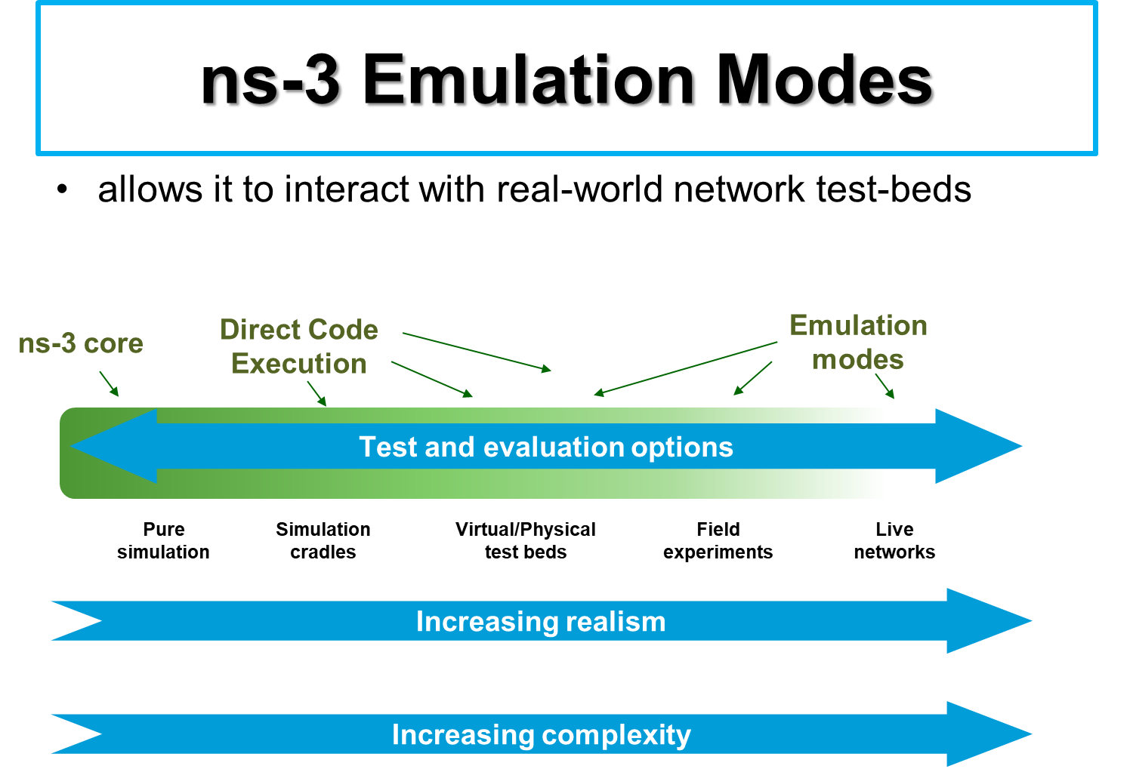

Slide 18
ns-3 Scenario Simulation: Example
TR 36.889 LAA Rel. 13 LTE-LAA/Wi-Fi Coexistence

Slide 19
Discrete-Event Simulation Basics
Simulation time moves in discrete jumps from event to event
C++ functions schedule events to occur at specific simulation times
A simulation scheduler orders the event execution
Simulation::Run() executes a single-threaded event list
Simulation stops at specific time or when events end
Execute a function
(may generate additional events)
Virtual time

Slide 20
ns-3 Modules
utilities
devices
protocols
visualizer
bridge
mesh
config-
store
applications
internet-apps
aodv
Node class
NetDevice ABC
Address types
(Ipv4, MAC, etc.)
Queues
Socket ABC
Ipv4 ABCs
Packet sockets
csma
spectrum
internet
(IPv4/v6)
dsdv
flow-monitor
energy
emu
Packets
Packet Tags
Packet Headers
Pcap/ascii file writing
tap-bridge
traffic-control
olsr
netanim
mpi
point-to-
point
uan
click
stats
mobility
virtual-
net-device
network
nix-vector-
routing
topology-
read
lte
Events
Scheduler
Time arithmetic
propagation
lr-wpan
wifi
core
openflow
BRITE
wimax

Slide 21
Location & Mobility
The MobilityHelper combines a mobility model and position allocator.
Position Allocators setup initial position of nodes (only used when simulation starts):
  List: allocate positions from a deterministic list specified by the user;
  Grid: allocate positions on a rectangular 2D grid (row first or column first);
  Random position allocators: allocate random positions within a selected form (rectangle, circle, …).
Mobility models specify how nodes will move during the simulation:
  Constant: position, velocity or acceleration;
  Waypoint: specify the location for a given time (time-position pairs);
  Trace-file based: parse files and convert into ns-3 mobility events, support mobility tools such as SUMO, BonnMotion (using NS2 format) , TraNS

Slide 22
Channels: Propagation Models
Propagation module defines:
  Propagation delay models:
  Calculate the time for signals to travel from the TX antennas to RX antennas.
  Propagation loss and shadowing models:
  Calculate the Rx signal power considering the Tx signal power and the mutual Rx and Tx antennas positions.
Propagation delay models:
  ConstantSpeedPropagationDelayModel: In this model, the signal travels with constant speed. The delay is calculated according with the transmitter and receiver positions.
  RandomPropagationDelayModel: The propagation delay is random, and changes each time the model is called. All packets experience a random delay → packet order is not preserved.

Slide 23
Propagation Models - 2
Path loss models available include:
    Abstract propagation loss models:
    FixedRss, Range, Random, Matrix, …
    Deterministic path loss models:
    Friis, LogDistance, ThreeLogDistance, TwoRayGround, …
    Stochastic fading models:
    Nakagami, Jakes, …
  Propagation loss models can be “chained”, making a list
  → final Rx power takes into account all the chained models.
  Example: path loss model + shadowing model + fast fading model

Slide 24
Overview
History & Context
Introduction to ns-3 simulator
- Core - User Modules
Recent Upgrades 802.11 PHY/MAC (2015 -)
- Improved CCA (.11a → .11n/ac) & PHY Abstractions
- Link-to-System Mapping
- New .11ax MAC features
  SPATIAL REUSE (BSS COLOR)
  OFDMA

Slide 25
802.11 PHY/MAC Work (UW coordinated)
ACKNOWLEDGEMENTS:
depts.washington.edu/funlab
Improved PHY Abstractions (FUNLAB students)
T. Bosaw, B. Cizdziel, F. Nadeem, H. Safavi, R. Patidar,
A. Chandramohan, W. Jiang
New .11ax MAC features (FUNLAB Collaborators)
S. Carpenter, M. Maity, S. Deronne, L. Lanante, Y. Gao, X. He,
V. Ramaiyan, S. Avallone

Slide 26


Physical layer abstraction in ns-3
Transmitted
Signal
Transmitter
Channel
Receiver
Received
Signal
Error
Physical Layer
End-to-end FULL PHY simulations are time expensive
→ cannot be incorporated into a MAC
Layer simulation @ run-time
For MAC and above layers, all the information needed at a particular state:
  whether packet is successfully decoded or not?
Physical Layer Abstraction for ns-3
ns-3 transports packets (not symbols).
Link layer abstraction is necessary
- Any accurate link abstraction must be
conducted off-line and results available for
use (at run-time in ns-3) via look-up tables
Notes:
Add OSI layers

Slide 27
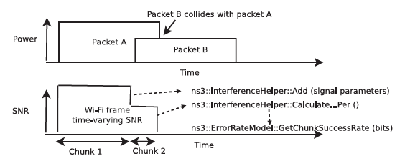
March 2019
Narrowband, Additive White Gaussian Noise (AWGN) models
- no wideband modulation or freq. selective channel models
How was Interference handled?
- added to noise power and treated as equivalent (SINR model)
Temporal interference is handled via
  - Split the frame based on changing SINR boundaries
  - Assume independence across these “chunks”
ns-3 PHY Packet Error Models: status c. 2015

Slide 28
Wi-Fi 802.11a PHY Error Model c. 2015 (YANS)
Original error rate model (for ns-2, thereafter ported to ns-3) from YANS
  - Upper bound on probability of error assuming: binary convolution coding and hard decision Viterbi decoding
*M Lacage and T. Henderson ``Yet Another Network Simulator (YANS)” Proc of w-ns2, ACM 2006.

Slide 29
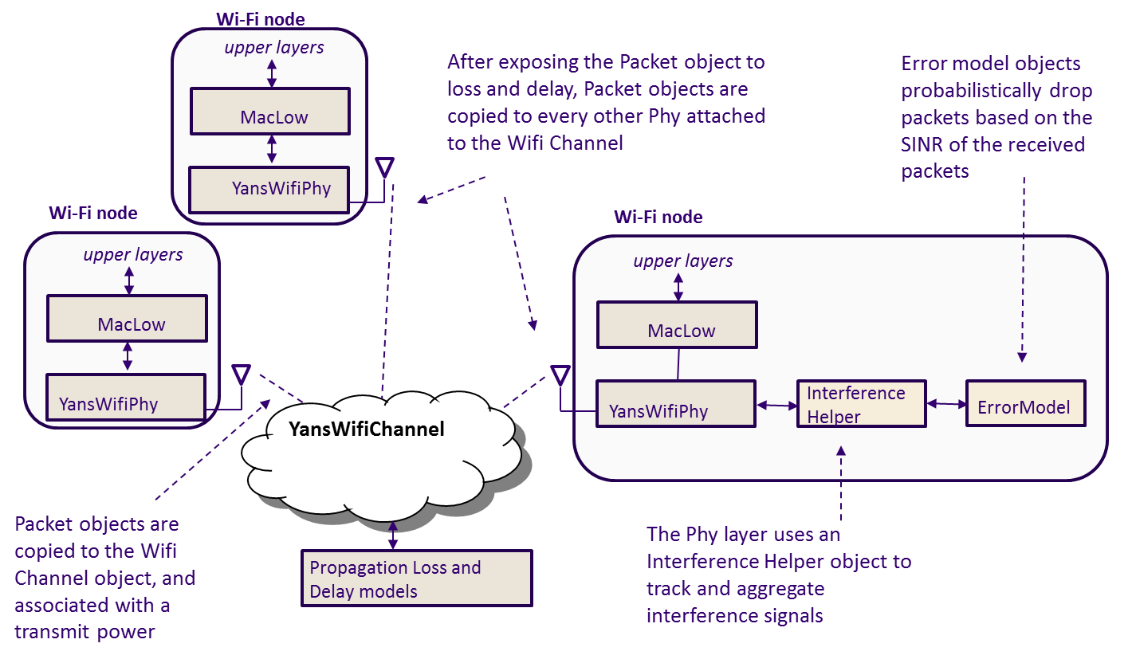
March 2019
ns-3 Wi-Fi PHY model

Slide 30
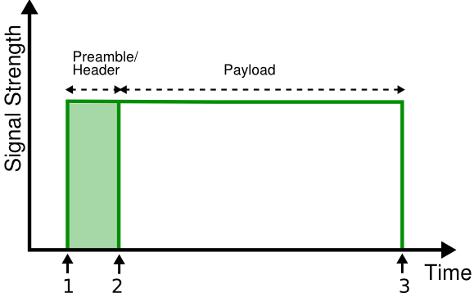
March 2019
Issues with ns-3 WiFi PHY Abstraction c. 2015
No separate model for PREAMBLE DETECT (i.e. no separation of Header & Payload in ns-3)
1st decision: is the header
successfully decoded?
2nd decision: is the payload
then successfully decoded?
Lack of packet capture
  due to difference in received signal strength

Slide 31
ns- 3 Wi-Fi Status c. 2015
- No MIMO (only SISO single spatial stream)
- No roaming (no support for multi-channel operation)
  Physical layer supports channel switching in state machine logic (deferring channel switch until end of Tx) but not supported in MAC
- Active and Passive probing both supported
- STA associates with 1st beacon

Slide 32
Changes: `Spectrum’ Wi-Fi
Followed similar framework implemented for LTE (by Nicola Baldo)
`Spectrum’ framework enables
1. time-frequency (spectral) representations of PHY signals
2. multiple signals on a channel (co-channel interference)

Slide 33
March 2019
SPECTRUM MODULE
Dev 1
(SpectrumPhy)
Dev 2
(SpectrumPhy)
Dev N
(SpectrumPhy)
SpectrumValue
SpectrumValue
SpectrumValue
SpectrumChannel
Three key pieces
  SpectrumValue, SpectrumChannel, SpectrumPhy
SpectrumValue is the signal abstraction being passed through to the channel (and to users)
SpectrumChannel delays/attenuates/modifies the transmitted signal as specified before providing copies to all receivers
SpectrumPhy allows different types of devices to interact through the wireless channel

Slide 34
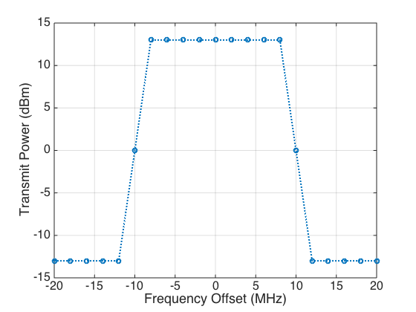
SPECTRUM VALUE: SIGNAL ABSTRACTION
March 2019
SpectrumValue : a vector of sub-band attributes
Each sub-band:
  Center frequency - Bandwidth
  Sub-band power spectral density
Each wireless technology populates the correct sub-band values (e.g. the correct PSD / FFT resolution)
Adjustable granularity for power spectral density
Allows for sub-band interference
Automatically converts signals with differing
resolution

Slide 35
CURRENT ns-3 WI-FI MODELS IN SPECTRUM PHY
March 2019
Switch physical layer models from legacy WifiPhy to SpectrumWifiPhy
PHY characterization is typically conducted with symbol-level "link simulators" for higher fidelity
  e.g. MATLAB WLAN System Toolbox
Convert Link Sim (Symbol-Error-Rate) to Block/Packet Error Rates
via Link-to-System Mapping
Additions (some completed, others ongoing work)
Error Rate models for some frequency selective fading channels (TGn Channel Model D) [completed]
Include SU MIMO scenarios (multiple streams) [completed]
MU-MIMO [ongoing]

Slide 36
WiFi Error Model Design Target
Wi-Fi node
SpectrumChannel
Wi-Fi node
upper layers
upper layers
MacLow
MacLow
PER Look up Table
Error model objects
probabilistically drop
packets based on the Effective SINR of the received
packets
SpectrumWifiPhy
SpectrumWifiPhy
Signal Tracker
ErrorModel
Sub channel SINRs
Effective SINR
RBIR/EESM
Effective SINR Mapping

Slide 37
March 2019
Added: Multi-Stage Reception for Wi-Fi
Legacy ns-3 reception model
  Lack of preamble reception
  Only Packet Decision at the end of the frame
New reception model
  Packet Capture
  Potential frame drops at PLCP preamble/header
    Low SNR/SINR
    Significant in coexistence studies
Threshold-based models for
various CCA detection algorithms & channels

Slide 38
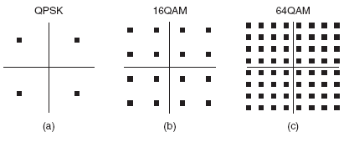

.11a → .11n
BPSK
PER is a function of Signal to Noise Ratio (SNR) for the packet.
Packet Size and MCS (Modulation and coding scheme)
I
Q
MCS No. | Modulation Type | Coding Rate | Data Rate (Mbps)
0 | BPSK | 1/2 | 6.5
1 | QPSK | 1/2 | 13
2 | QPSK | 3/4 | 19.5
3 | 16-QAM | 1/2 | 26
4 | 16-QAM | 3/4 | 39
5 | 64-QAM | 2/3 | 52
6 | 64-QAM | 3/4 | 58.5
7 | 64-QAM | 5/6 | 65
BPSK: Binary Phase Shift Keying
QPSK: Quadrature Phase Shift Keying
QAM: Quadrature Amplitude Modulation

Slide 39
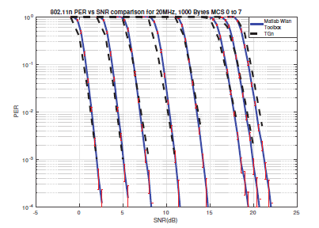
.11n AWGN Error Models Validation - using Matlab WLAN ToolBox
Link Sim Configuration
  802.11n sim for SISO configuration under AWGN channel, MCS 0 –7 and packet size 1000 Bytes.
Validation with TGn results
  Better alignment for all MCS
MCS-7
< 1 dB
MCS-0
< 0.5 dB
E . Perahia and R. Stacey. 2013, ``Next Generation Wireless LANs: 802.11n and 802.11 ac,” Cambridge University Press.
S. A. Mujtaba, `` TGnSync Proposal PHY Results. IEEE P802.11 Wireless LANs, 2005.

Slide 40
March 2019
ns-3 Wi-Fi PHY reception (1)
Packet reception occurs originally in 2 stages:
  - PLCP preamble and header (lower modulation rate than the payload);
  - Payload of the packet (generally use a higher modulation).
If both the preamble/header and payload are successfully received, the packet is passed up to the MacLow object.
Even if packet objects received by the PHY are not part of the reception process, they are remembered by the InterferenceHelper object for purposes of SINR computation and making clear channel assessment decisions.
TX vector added as a packet tag and read once all PHY payload has been successfully received, then forwarded up.

Slide 41
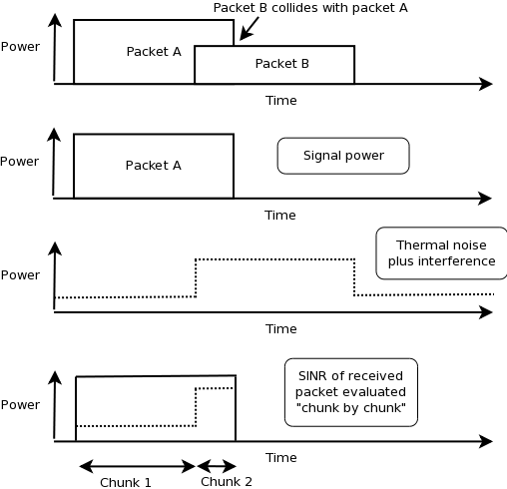
March 2019
ns-3 Wi-Fi PHY reception (2)
InterferenceHelper
  - Object that tracks all incoming packets;
  - Calculates probability of error values for packet being received;
  - Evaluates whether energy on the channel rises above the CCA threshold.
Example

Slide 42
March 2019
OfdmTableErrorModel (AWGN)
For each MCS: step through SNR range in 0.2 dB increments
Send enough packets to meet confidence interval goals
Simulations performed in accordance with CC-59:
  Ideal channel, perfect estimation, perfect synchronization, known noise variance, no phase noise, etc.
Table loaded at initialization, and users can replace default tables with their own
# MCS 0
-4.00000 1.00000
-3.80000 1.00000
...
-0.80000 1.00000
-0.60000 0.99751
-0.40000 0.98284
-0.20000 0.93473
0.00000 0.77713
0.20000 0.61598
0.40000 0.39391
0.60000 0.23602
0.80000 0.12170
Sample table data, 802.11n, MCS 0, 1458 byte packets
First column is SNR (dB), second is PER

Slide 43
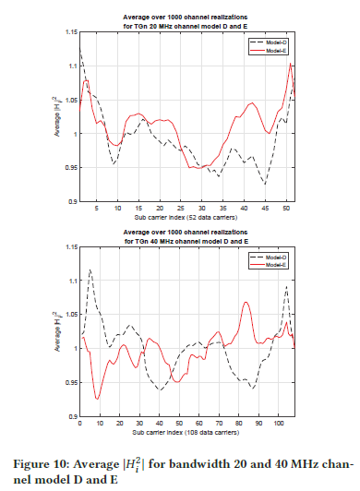
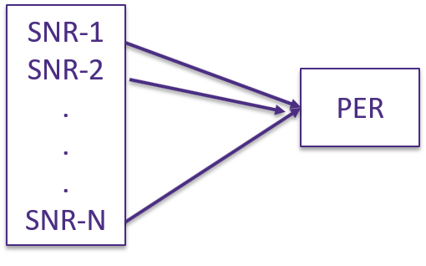
AWGN → Freq. Selective Fading
Frequency-selective channels present a vector of subcarrier SNRs to the receiver
  Generating tables for all channel realizations is not feasible.
Mapping with less complexity is desired
  Link to System Mapping approach
    Distills offline link simulation into simpler table representation
312.5 KHz subcarriers
312.5 KHz subcarriers

Slide 44

Exponential Effective SNR Mapping (EESM )
Several approaches for Link to System Mapping:
  RBIR, MIESM
  EESM: Union-Chernoff bound on error probabilities to define an "effective SNR“
Mapping
  PER for Frequency Selective Channel can be obtained from AWGN table for PER vs SNR using the effective SNR as an input.
subcarrier SNRs
SNR-1 (ϒ₁)
SNR-2 (ϒ₂)
.
.
.
SNR-Nd (ϒ_{Nd})
EESM
SNR_{eff}
(ϒ_{eff})
MatlabOfdmErrorModel
PER
empirically determined constant

Slide 45
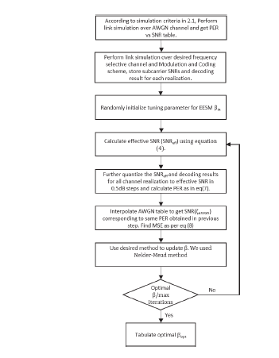
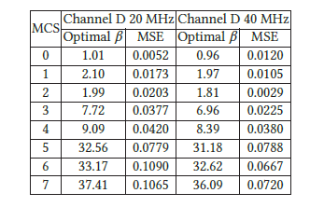
EESM Parameter tuning
For each channel model of interest: conduct # of link simulations for each MCS, collect subcarrier SNRs and PER.
Use iterative optimization method to find a value of EESM parameter (β) for each MCS such that PER vs effective SNR aligns with AWGN PER vs SNR.
Compile a per-channel model of MCS and beta values

Slide 46
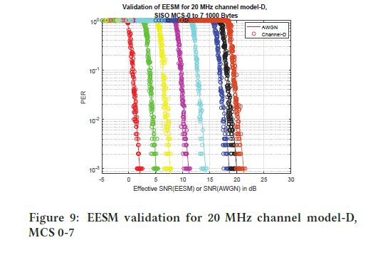
Sample results EESM Validation
SISO simulations for TGn indoor channel model D
Comparison between actual PERs due to the link simulations (discrete points) and predicted values based on EESM (solid lines)

Slide 47
ns-3 MAC - PHY Workflow
Offline
  1000 channel realizations for channel model-D (indoor scenario) made available in ns-3
  β parameter tables available.
Online
Tx
ns-3 Mac
Rx
ns-3 Mac
Transmit Power
ns-3 MAC Layer
Accept or Drop Packet
ns-3 PHY Layer
Pick a Realization
PER
Table Spectrum
Propagation Loss Model
Subcarrier SNRs: ϒi (1 to N)
Effective SNR: ϒeff
EESM
MatlabOFDM
Error Model
Channel Model D
-1.04 + j0.98 ... -0.78 + j1.28
0.94 – j1.08 ... 0.91 + j1.02
...
1.24 + j0.89 ... 0.87 + j1.12
# MCS 5
SNR PER
-4.000 1.000
-3.800 1.000
...
-0.800 1.000
-0.600 0.997
-0.400 0.982
Number of subcarriers
R. Patidar, S. Roy, T. R. Henderson, and A. Chandramohan. Link-to-System Mapping for ns-3 Wi-Fi OFDM Error Models. Proc. of the 2017 Workshop on ns-3, Porto, Portugal.

Slide 48
Wi-Fi PHY Models: Comments
New frequency-selective fading models developed for SpectrumWifiPhy usage
  - MATLAB code for generating channel realizations is not publicly releasable via ns-3
Configuration of fading model (in the channel object) and EESM table to load (in the SpectrumWifiPhy) must be coordinated
Expand desired configurations (40/80 MHz channels, MIMO configurations)
→ generating tables laborious due to link simulation runtimes

Slide 49
Reproducing/Extending
Extendable
  Replaceable PER vs SNR data file (AWGN) in given format.
  Determine β values for different channel realizations (must provide propagation model underlying the realization)
Reproducible (using MATLAB WLAN System Toolbox)
  - Scripts for WLAN toolbox available^{[7]} for AWGN simulation.
  - Script for optimal EESM parameter estimation and performance evaluation
  - Provision for generating tables for desired channel model and channel bandwidth.
[7] https://bitbucket.org/rohanpatidar/wlan7] https://bitbucket.org/rohanpatidar/wlan
[7] https://bitbucket.org/rohanpatidar/wlan

Slide 50
LTE-LAA/WiFi Coexistence
Funded by Wi-Fi Alliance, CableLabs, 2015-16
- University of Washington and CTTC collaboration
Enhance ns-3 modeling capability for LTE/Wi-Fi coexistence simulations
i. Added missing simulator features essential for starting to build scenarios mapping to TR36.889 LAA Rel. 13 scenarios
  ii. develop initial indoor and outdoor scenarios corr. to TR36.889 + initial test plan

Slide 51
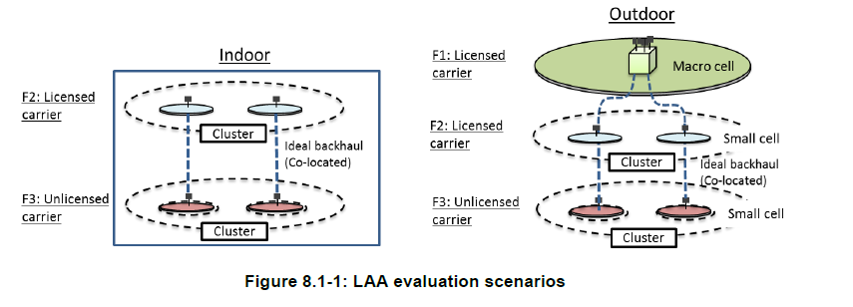
ns-3 enhancements
- Wi-Fi SpectrumPHY model permits LTE-like signals as interferers (new LTE interference helper)
- Enhancements to Wi-Fi CCA (preamble detect), RSS-based AP selection/roaming
- Enhancements to LTE interference model for non-synchronized LTE and Wi-Fi transmissions
- .11ax indoor and outdoor propagation models, ITU UMi out
- Wi-Fi MIMO 2x2 DL, 1x2 DL for AWGN & TGn model D

Slide 52
Coexistence SpectrumPHY
Enhanced ns-3
LTE NetDevice
Higher layers
Enhanced ns-3
Wi-Fi NetDevice
Higher layers
AP Station
Manager
LTE RRC
collision detection
via Hybrid ARQ (HARQ)
LTE MAC
MacLow
LBT
Channel
Access
Manager
Interference/
error models
WiFi
Spectrum
Phy
Interference/
error models
LTE PHY
request/
grant
access
PHY signals
(LTE and Wi-Fi)
overhears
transmissions
PHY signals
(LTE and Wi-Fi)
ns-3 MultiModel Spectrum Channel
applies propagation loss models

Slide 53
ns-3 enhancements: LBT Access Mgr.
Several key aspects of the design not specified fully in the standard → so implemented our own options after consultations
  - How to handle TXOP arrivals that may occur asynchronously, not on subframe or slot boundaries (reservation signal)
  - How to reconcile the scheduled aspect of LTE with the opportunistic arrival of TXOPs (MAC to PHY delay)

Slide 54
LTE scheduling constraints in ns-3
ns-3 LTE model implements a MAC-to-PHY delay of 2 msec, between when scheduler is executed and channel is actually occupied.
- legacy LTE responds to events in UL subframe #n (i.e. HARQ and CQI feedback), in subframe #n+2.
- The UE responds to DL events in subframe #n (i.e. scheduler event) in subframe #n+4.
- LAA ns-3 model inherits this delay, and requires 2 full subframes plus a partial subframe to start using a provided TXOP.
- To force other nodes to defer, send reservation signals to occupy the channel until the start of a subframe for data transfer.

Slide 55
Comparison to 3GPP indoor scenario
March 2019
Some differences in our models at the lower layers
Limited to 802.11n 2x2 MIMO (with a MIMO abstraction) and MCS 15 maximum rate, rather than 802.11ac
Do not support transmission beamforming (TxBF)
Wi-Fi rate control is adaptive feedback-based, similar in concept to closed loop link adaptation but with SINR instead of TXBF information
802.11ax indoor propagation model instead of ITU InH
Sumit Roy, University of Washington

Slide 56
Parameters
Wi-Fi to Wi-Fi uses CCA-CS at the signal level at which frame sync succeeds (around -88 dBm)
Wi-Fi's CCA-ED (for LAA signals) is fixed at -62 dBm
LAA ED is separately tunable (-62 dBm default)
LAA model defaults to a fixed defer of 43 us
LAA CCA slot time 9 us
CWmin=15, CWmax=1023
LAA model defaults to 4 ms TXOP, configurable upward to 20 ms
LAA model employs exponential CW increase
FTP Model 1 with lambda (0.5, 2.5) can be UDP or TCP based
UDP best effort (up to saturation level)
Voice model

Slide 57
Implemented CW update rule
March 2019
For CWS adjustment based on HARQ-ACKs,
  Based on R1-156332
  The CWS is increased if at least Z % of the HARQ-ACK feedback values for a reference subframe set are NACK. Otherwise, the CWS is reset to the minimum value (i.e., 15).
    Reference subframe set (to be down selected)
      Alt. 1: the latest DL subframe for which HARQ-ACK feedback is available
      Alt. 2: the first DL subframe of the latest DL data burst for which HARQ-ACK feedback is available.
      Alt. 3: all subframes of the latest DL data burst for which HARQ-ACK feedback is available.
    Z value: Select one out of {10%, 50%, 75%, 100%}.
Sumit Roy, University of Washington

Slide 58
Simple two-cell scenario
Wi-Fi STA falls below ED
threshold for LAA eNB at d2=30,
but only at ED -62 dBm
Vary d2, keep d1 fixed and
small (10 m)
Here, d2 grows large
enough that SINR is
large enough to
compensate

Slide 59
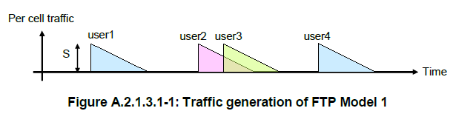
Traffic model considerations
3GPP FTP Model 1 is a bursty, UDP based traffic model, where files of size 0.5 MB (optionally 2 MB) are transferred
The highly bursty nature allows LTE LAA inefficiencies to be amortized (fully occupied TXOPs)
However, other traffic patterns are not so bursty
  FTP based on TCP rather than UDP
  Constant-bit-rate flows like voice or video

Slide 60


120 m
4 co-channel cells
per operator (eNB
or Wi-Fi AP)
Non-mobile indoor
scenario (IEEE
propagation loss
model)
50 m
5 UEs/STAs per cell
per operator
(20 UEs or STAs per
operator) randomly
dropped
Downlink on
shared channel;
LTE has separate
licensed uplink
Step 1: Both operators A and B are Wi-Fi
co-channel on separate SSID
Step 2: Replace operator A network with
LTE LAA
Performance metrics:
File transfer throughput
File transfer latency
Voice flow latency
Idealized
backhaul
network

Slide 61
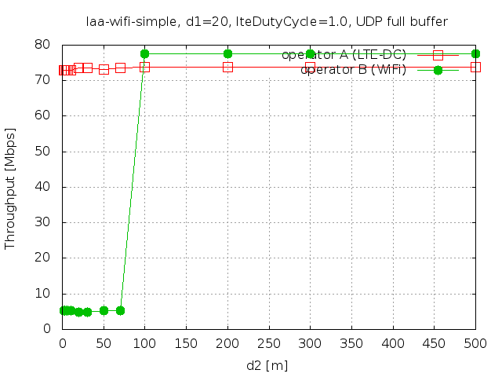
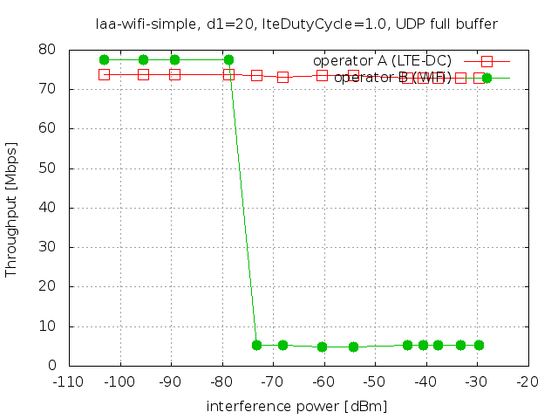
Simple scenario, varying cell separation
UDP full buffer (saturation) traffic load, no LTE duty cycle, BS/UE separation 20m
802.11n SISO model at 5.18 GHz, 20 MHz (ideal rate control)
As LTE cell moves
closer, it interferes
with Wi-Fi
Same data plotted using two different x axes (distance and interference power)

Slide 62
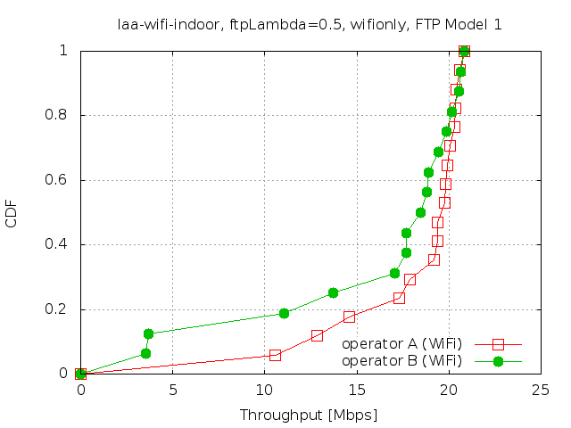
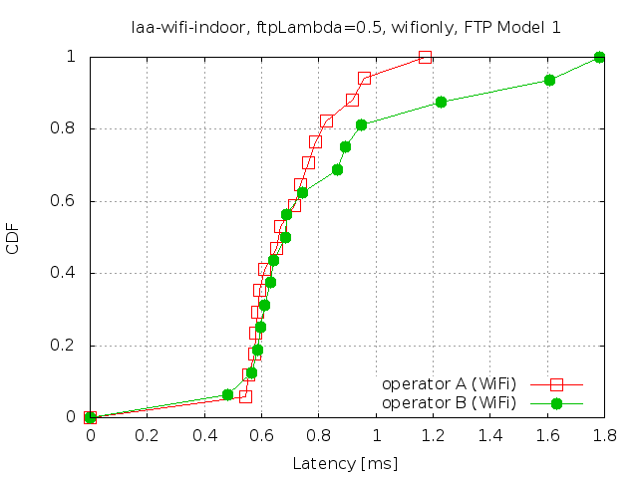
3GPP TR36.889 indoor scenario baseline
4 cells per operator, 10 UEs per cell (80 UEs total). Both networks Wi-Fi.
FTP Model 1 traffic load, LTE duty cycle of 0.5
802.11n SISO model at 5.18 GHz, 20 MHz (ideal rate control)
Throughput CDF from one run; in general
networks are identical so over many runs
performance (sharing) will be equal
Latency statistics measured end-to-end
at the IP layer

Slide 63
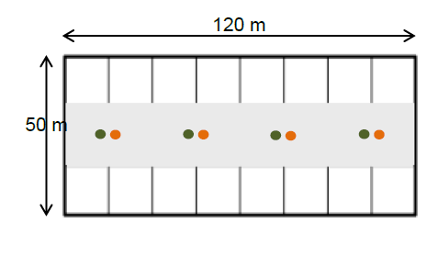
3GPP TR36.889 indoor scenario baseline
4 cells per operator, 10 UEs per cell (80 UEs total). Both networks Wi-Fi.
FTP Model 1 traffic load.
802.11n SISO model at 5.18 GHz, 20 MHz (ideal rate control)
Throughput CDF from one run; typical over many runs
→ performance (sharing) will be equal
Latency statistics measured end-to-end
at the IP layer

Slide 64
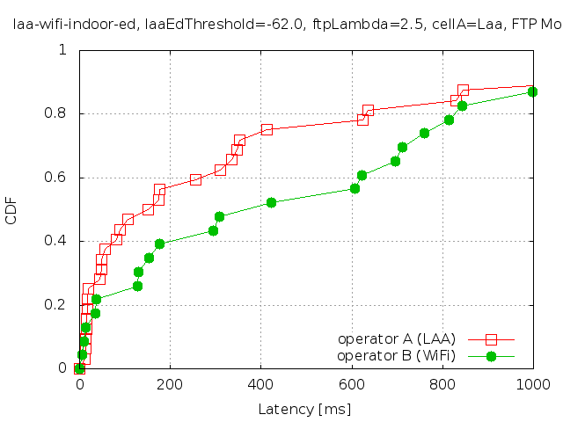
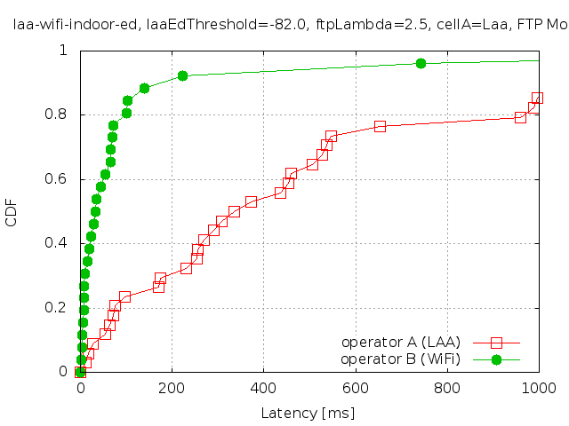
Results: changing ED threshold
Latency (per-packet) of FTP flows
  Notice the green curve pulls leftward
-62 dBM LAA ED threshold
-82 dBM LAA ED threshold
Each FTP transfer is a flow of fixed file size, and the FTP takes
a variable amount of time to complete, leading to a per-flow throughput

Slide 65
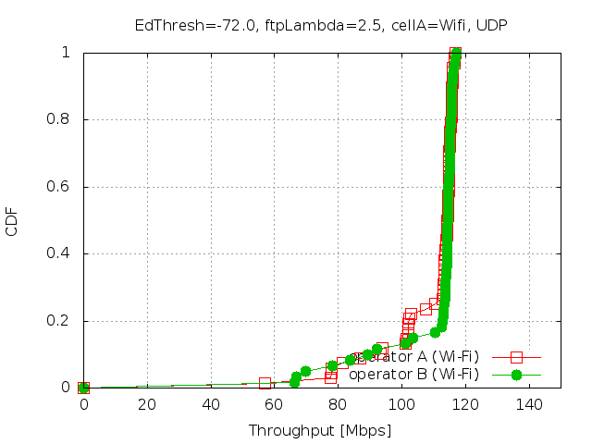
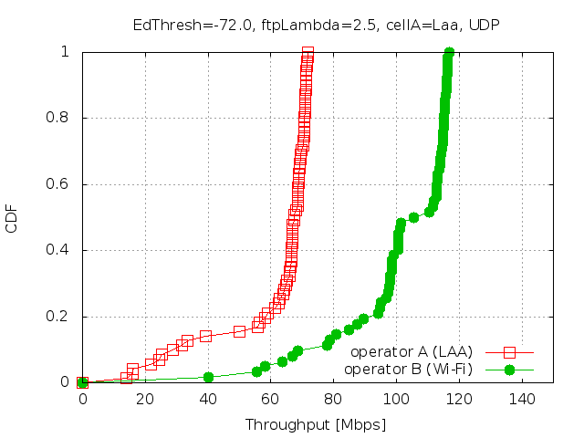
Coexistence (FTP/UDP)
These flows (the majority in the
scenario) experience no contention
and achieve close to the MCS 15 limit
Increased contention from LAA network lowers Wi-Fi throughput
for about half of the flows
LAA limit
MCS 15 limit
MCS 15 limit
Some flows experience contention and must
slow down
Wi-Fi/Wi-Fi
LAA/Wi-Fi

Slide 66
Key Observations
Coexistence performance is highly sensitive to all factors that affect the channel occupancy → not only affected by the PHY-MAC layers including LAA access parameters, but also upper layer protocols, such as TCP/UDP and RLC.
A very bursty-like traffic pattern (like FTP 1 run over a UDP-like transport) may be a best case scenario for fair coexistence among LAA/Wi-Fi. Other less bursty traffic models, or other transport protocols, e.g. TCP, may cause LTE LAA to occupy much more the channel.
Implementation details (mostly vendor dependent) regarding how the asynchronous access of the channel is reconciled with the synchronous way the LTE protocol stack works, may significantly affect the channel occupancy and coexistence.
- use of the TxOP, especially for non-bursty traffic significantly affects the
channel occupancy in LAA access
- specific vendor implementation resulting in delays between MAC-scheduler events
and when the channel is actually occupied, also significantly impacts
channel occupancy.

Slide 67
Current Effort - 11ax (Cisco & Intel)
Spatial Reuse Features -
Sebastien Deronne, L. Lanante, S. Carpenter
OFDMA, UL Random Access -
Stefano Avallone, S. Deronne, R. Getachew

Slide 68
11ax OBSS_PD Spatial Reuse (1)
BSS coloring:
  The BSS color is a numerical identifier of the BSS.
  BSS color information is present in preamble of 802.11ax PHY header, the HE SIG-A field contains a 6-bit BSS color field.
  802.11ax radios are able to differentiate between BSSs using BSS color identifier when other radios transmit on the same channel.

Slide 69
11ax OBSS_PD Spatial Reuse (2)
Spatial reuse: ignore transmissions from an OBSS and therefore transmit at the same time.
Legacy
11ax

Slide 70
11ax OBSS_PD Spatial Reuse (3)
OBSS_PD algorithm: used to dynamically select appropriate Clear-Channel-Assessment (CCA) thresholds.

Slide 71
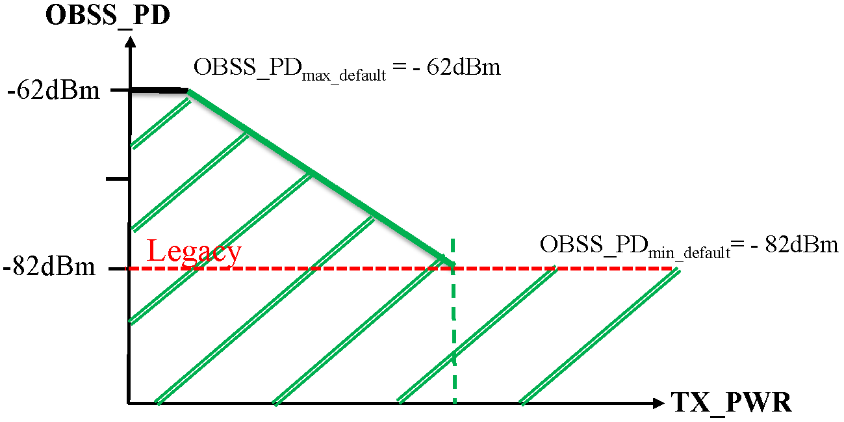
11ax OBSS_PD Spatial Reuse (4)
TX power restriction: If STA ignored inter-BSS PPDU, it starts an OBSS_PD SR transmit power restriction period.

Slide 72
11ax OBSS_PD SR evaluation in ns-3
Goal: Evaluate IEEE 802.11ax OBSS_PD spatial reuse feature
Approach: Extend current ns-3 Wi-Fi model:
  Consolidate current model (11ac/ax, A-MPDU, ADDBA & Block ACK)
  Rework PHY thresholds;
  Add preamble detection model;
  Transport PHY headers between TX and RX PHYs;
  Add more PHY events (end of PHY legacy header, start of PHY payload reception, …);
  Add OBSS_PD SR algorithm(s).

Slide 73
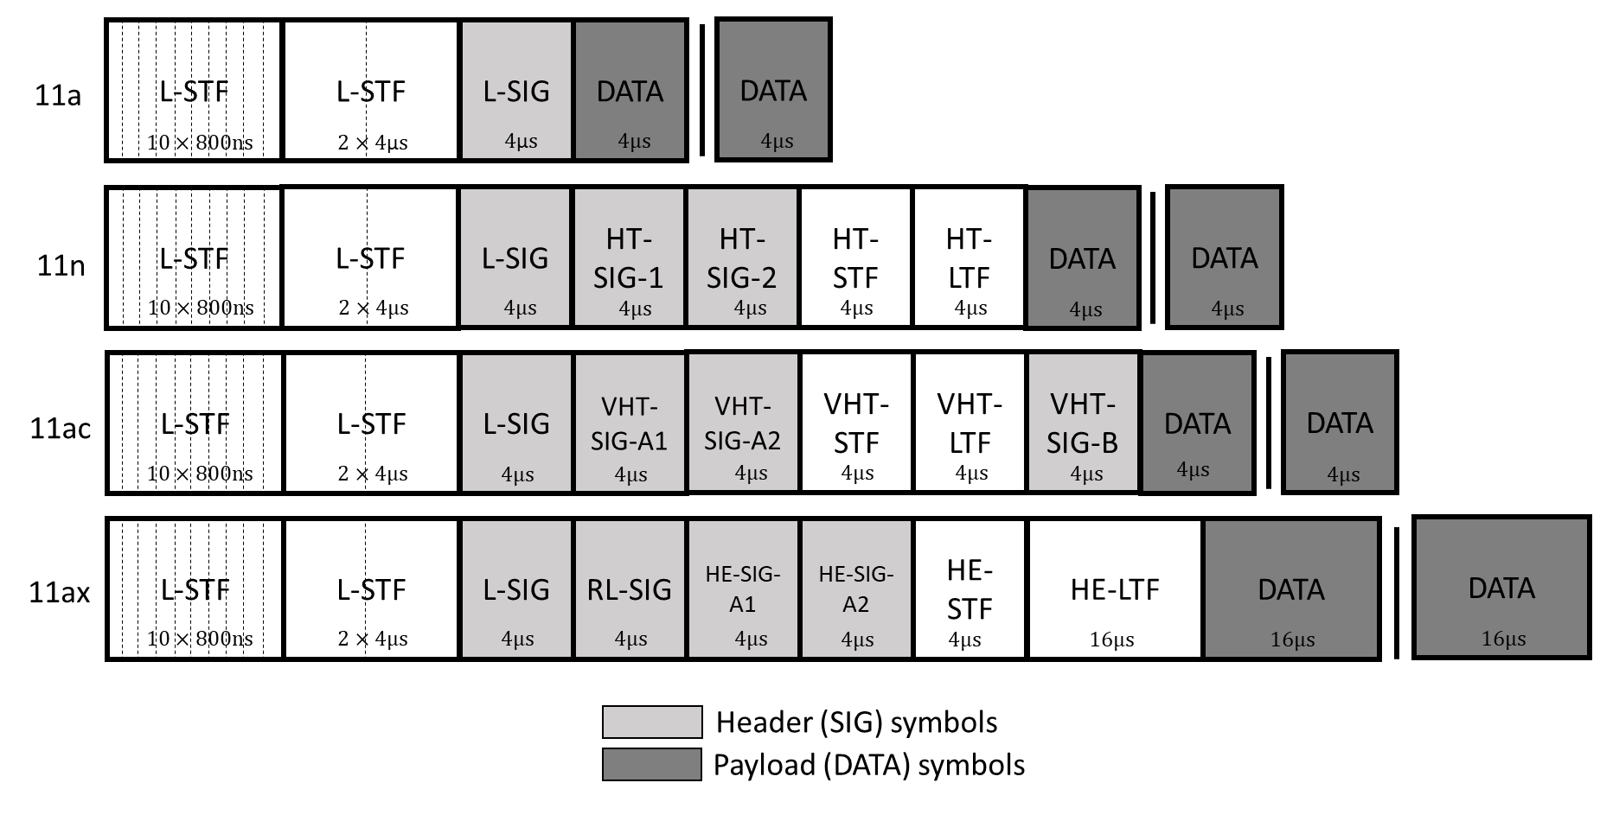
ns-3 Wi-Fi PHY : new model (1)
Transport PHY headers:
  Notify RX about TX PHY parameters. (instead of adding TX vector as packet tag!)
  5 PHY headers added:
  DSSS (11b), L-SIG (11a/g), HT (11n), VHT (11ac) and HE (11ax).

Slide 74
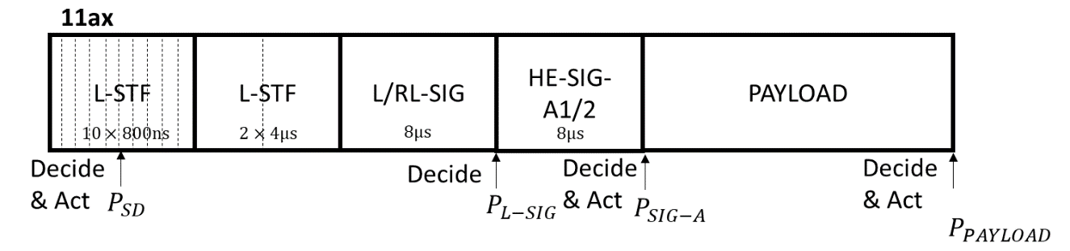
ns-3 Wi-Fi PHY : new model (2)
Multi stage reception:
  Preamble detection event (4us after reception started):
  => signal detection: move to RX state if SNR above a given threshold (3dB)
  End of L-SIG:
  => read length field in L-SIG PHY header: deduce RX duration (for the whole PPDU!)
  => compute PHY header SNIR: drop packet if reception failed
  Start of PHY payload:
  => deduce real RX duration and deduce BSS color if HE PPDU
  => call OBSS_PD algorithm
  => compute PHY header SNIR: drop packet if reception failed
  End of PHY payload:
  => compute SNIR: forward up if successfully received (unchanged)

Slide 75
ns-3 Wi-Fi PHY : new model (3)
Rework PHY threshold: ns-3 WiFi stack only had a CCA-ED mechanism whose threshold was set to an extremely high sensitivity value.
  RxSensitivity: new threshold to throw away very low signals (< - 101 dBm by default).
  CcaEdThreshold: replace CcaMode1Threshold.
approx -90 dBm
approx -90 dBm
-82 dBm
-101 dBm
-82 dBm
-62 dBm
‘RxSensitivity’ attribute
default; below this
value, received packet
is discarded at start of receive.
No attribute here; the PreambleDetection
model will make decisions at
time 4us as to whether to receive
or stay at IDLE.
82 dBm is a
standard-compliant value
but we do not implement
anything specific for this because
PreambleDetection block takes
care of this.
‘CcaEdThreshold’ attribute
default;
all signals above
this value will either
cause RX or CCA_BUSY.

Slide 76
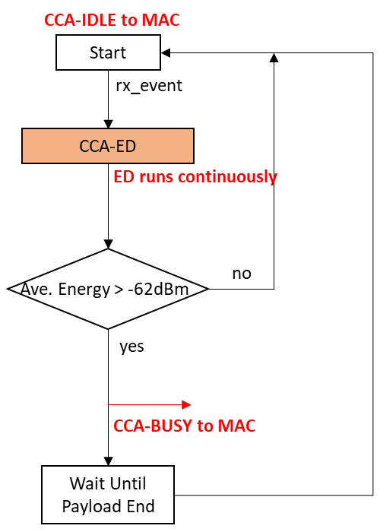
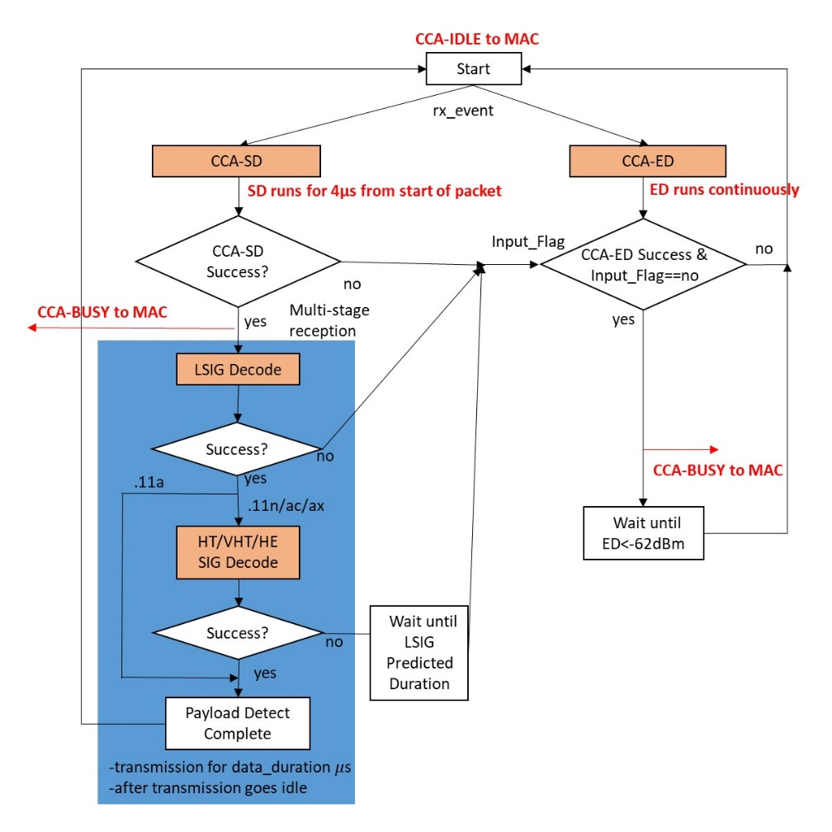
ns-3 Wi-Fi PHY : new model (4)
Current ns-3 CCA vs. new ns-3 CCA

Slide 77
OBSS_PD SR algorithm
ConstantObssPdAlgorithm: resets the PHY if OBSS frame is below the constant threshold (attribute) and impose Tx power restrictions.
  - PHY fires trace source right before payload reception stage
  => OBSS_PD algorithm registered to the trace source
  - Once a HE preamble has been received, algorithm checks whether this is an OBSS frame by comparing its BSS color with the BSS color of the received preamble.
  - If this is an OBSS frame, it compares the received RSSI with its configured OBSS_PD level value.
  - Resets PHY to IDLE state if RSSI is lower than that constant OBSS_PD level value, and is informed about a TX power restrictions to be applied.

Slide 78
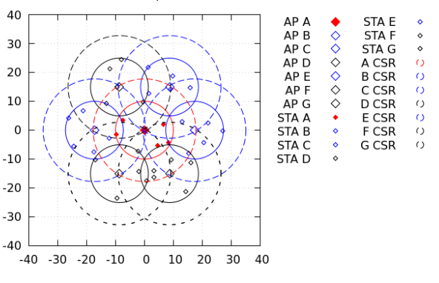
Simulation results (1)
Parametric studies:
  All nodes operate as 802.11ac (baseline) or 802.11ax (OBSS_PD SR performance evaluation)
  BSS “of interest” centrally located (red)
  Surrounded by 6 other BSSs in hexagonal pattern, for reuse factor N=7.

Slide 79
Simulation (2)
Use to run parametric study simulations (example: 11ax OBSS_PD SR):
  Launch run-spatial-reuse-study2.sh - this generates a script file ”./study2.sh”.
  Launch study2.sh script – this runs the necessary simulations (some are run in parallel to use multiple cores).
  Run make-data-files-study2.sh - this creates data files for plotting from the set of all simulation results.
  plot-study2.sh and plot-study2-ecdf.sh - this generates plots of results.
Those scripts are related to previously described scenarios, but modification of run-spatial-reuse-study2.sh and plot-study2.sh allows tuning of
  offered load;
  Number of stations per BSS;
  OBSS_PD threshold (per BSS also possible);
  Inter-BSS distance
  …

Slide 80
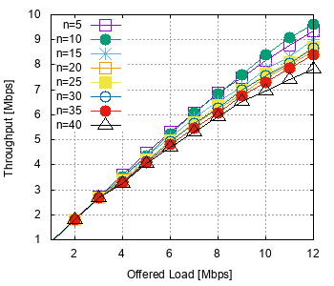
Simulation (3)
802.11ac (study 1): average throughtput per BSS versus offered load, for various number of stations in BSS.

Slide 81
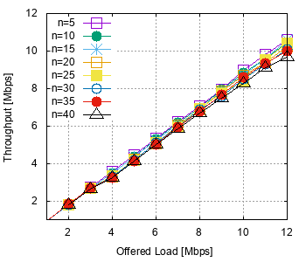
Simulation (4)
802.11ax with OBSS_PD SR (study 2): average throughtput per BSS versus offered load, for various number of stations in BSS.
OBSS_PD SR enabled with threshold set to -82 dBm.

Slide 82
Summary
Repository: https://bitbucket.org/tomhend/ns-3-dev-11ax
Most of the code already merged to ns-3-dev (OBSS_PD still to be done).
11ac/ax highly tested and in very dense scenarios => make sure to have a valid baseline after having solved all bugs that came along.
ns-3 wifi PHY model has been extended: new reception stages, PHY headers, thresholds reworked, …
11ax OBSS_PD SR implemented in ns-3, with scripts available to run parametric studies and plot results.

Slide 83
Current: OFDMA Support
Aim to first support basic OFDMA sequences
  - single-TID A-MPDUs (only aggregating QoS Data and Trigger frames)
  - No dynamic fragmentation
  - Single NAV
  - Associated stations only

Slide 84
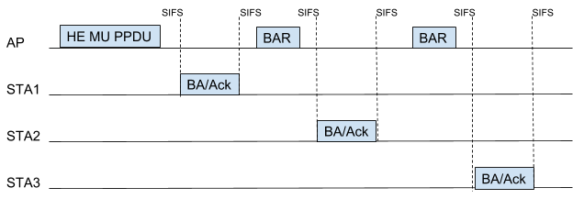
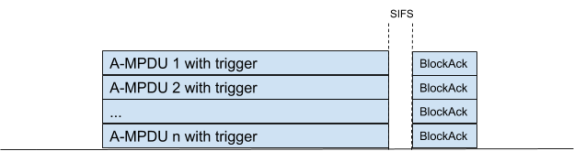
DL OFDMA Acknowledgment Sequences
The selected ack sequence will be initiated after the transmission of every MU-PPDU
Another supported sequence includes the transmission of a MU-BAR a SIFS after the MU PPDU
Support for MU-RTS/CTS is planned
#1
#2

Slide 85
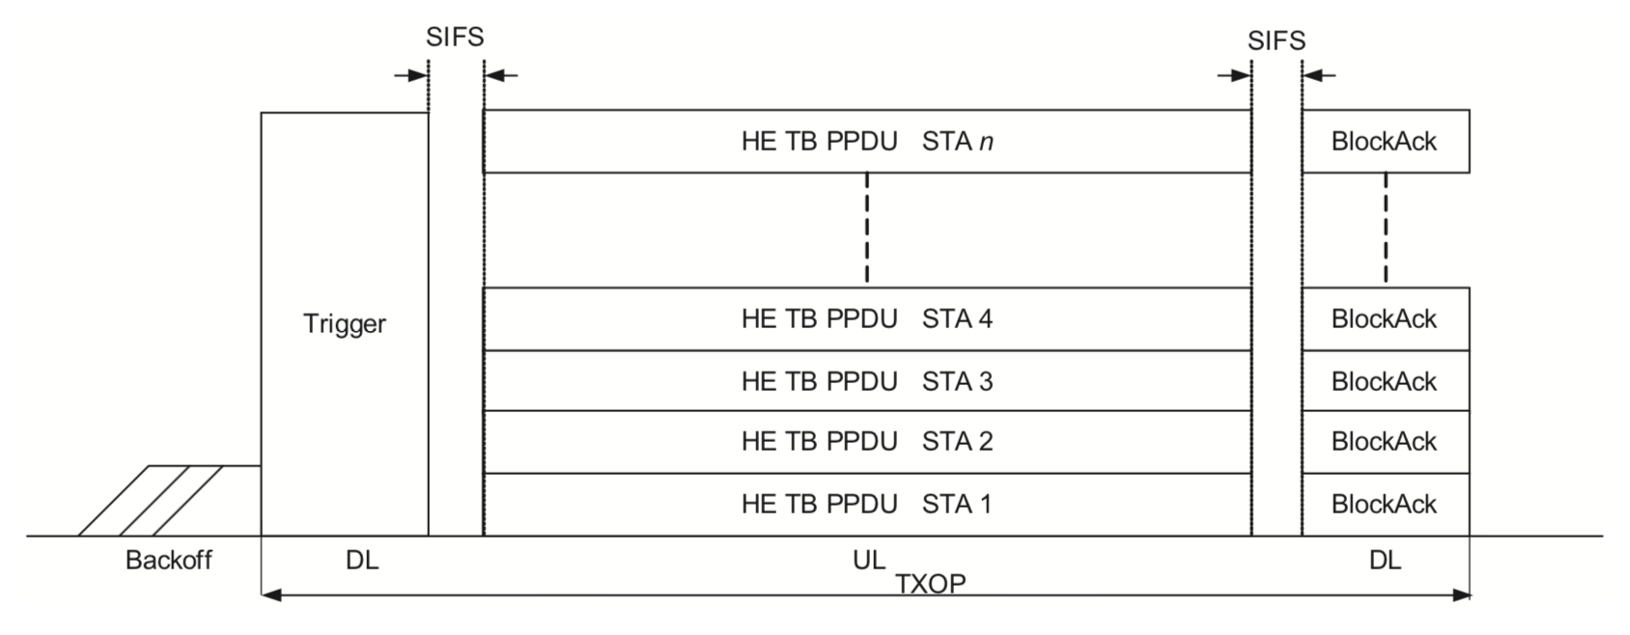
UL OFDMA Acknowledgment Procedure
- Acknowledgment with a Multi-STA BlockAck may be implemented
- Support for HE bandwidth query report operation also planned

Slide 86
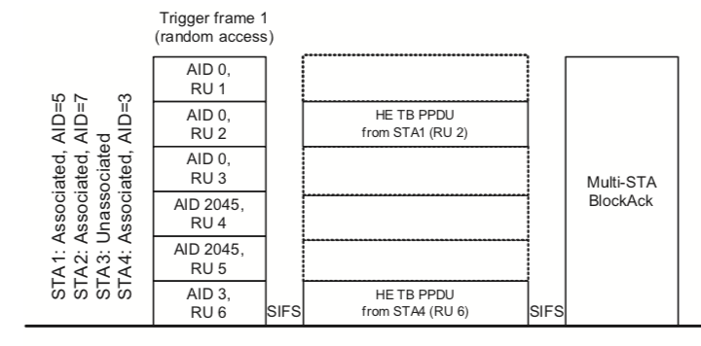
UL OFDMA-based random access
The implemented acknowledgment procedures for UL OFDMA will be available for UORA

Slide 87
OFDMA Support
Significant logic behind OFDMA operations
  Selection of receivers/transmitters, RUs, tx rates and powers,…
An abstract base class will define the API
- Sub classes will implement different logic
A simple round robin scheduler will be initially developed for both DL and UL OFDMA

Slide 88
Thank You!!
Questions?

