Slide 1
Feedback Overhead Reduction in 802.11be
Date: 2019-03-09
Authors:

Slide 2
Abstract
In this contribution, we discuss methods to reduce the overhead of channel acquisition at the transmitter to assist in 16 Spatial Stream MIMO and Multi-AP coordination in 802.11be.

Slide 3
Introduction
  The use of 16 spatial streams has been discussed as a possible feature for 802.be [1].
    Preliminary simulation results show performance benefits in increasing the number of spatial streams [2].
    However, this comes with an attendant increase in the amount of sounding and feedback needed.
  Multi-AP coordination has also been discussed as a possible 802.11be feature [1] [15].
    Preliminary results also show some performance benefits [15].
    However, this may require an increase in the feedback needed as a STA may send feedback to each of the APs in the multi-AP set.
To reduce the overhead required it has been suggested that:
  Feedback overhead be reduced by limiting the amount of information fed back while ensuring no performance loss [5]
  Feedback overhead be eliminated in reciprocal systems by using implicit feedback methods [7]
This contribution discusses both features with information on the following:
  Improvement of existing explicit and implicit feedback schemes
  New explicit feedback schemes

Slide 4
Feedback in 802.11
  Both implicit and explicit feedback have been specified in 802.11
    802.11n [3] supports (a) implicit feedback, (b) explicit MIMO non-compressed feedback and (c) explicit MIMO compressed beamforming feedback
    802.11ac [3] supports explicit MIMO compressed beamforming feedback only with 802.11n as baseline.
    802.11ah [8] supports explicit feedback with 802.11ac as a baseline and simplification of the N x 1 feedback case
    802.11ax [4] supports explicit feedback with 802.11ac as a baseline and
    Large Ng: Increase the tone grouping size {Ng} during feedback
    Partial Bandwidth Feedback: Allows feedback over a range of RUs.
    CQI based feedback: Allows feedback of the SNR of an RU
  802.11ad [3] supports explicit time domain feedback
  802.11ay [9] uses 802.11ad as baseline and supports explicit MIMO compressed beamforming feedback with 802.11ac as baseline for hybrid beamforming
We will discuss the improvement schemes for 802.11be from this set of schemes.

Slide 5
Explicit Feedback Reduction (Improvement Schemes)
For explicit feedback reduction, we may improve the current beamforming feedback methodologies in 802.11 using any one of the following:
  ϕ Only Feedback: Feed back ϕ only in N x 1 transmission and assume a fixed ψ (802.11ah) [5]
  Time Domain Channel Feedback (802.11ad/ay) [3]
  Differential Given’s Rotation : Feed back time or frequency difference in Given’s Rotation angles [6]
  Variable Angle Quantization : Use different quantization levels for different Given’s rotation angles (ϕ_{i}, ψ_{i})
where (ϕ, ψ) are the angles of the premultiplication matrices and Given’s rotation matrices used in compressing the right singular matrix of the channel for feedback

Slide 6
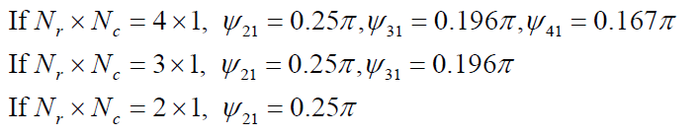
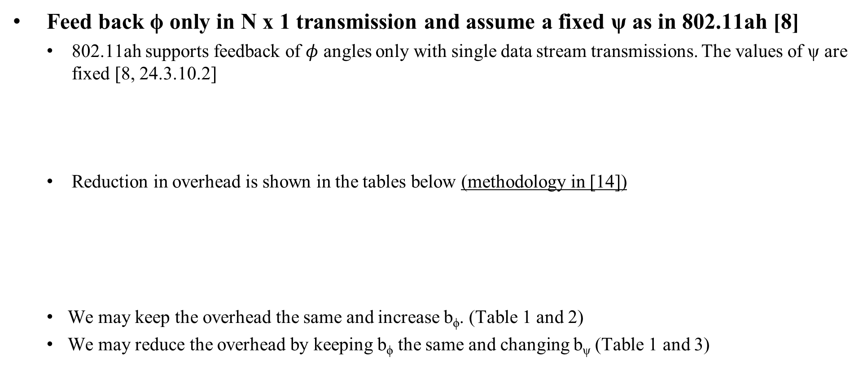
ϕ Only Feedback
Feed back ϕ only in N x 1 transmission and assume a fixed ψ as in 802.11ah [8]
  802.11ah supports feedback of $φ$ angles only with single data stream transmissions. The values of ψ are fixed [8, 24.3.10.2]
  Reduction in overhead is shown in the tables below (methodology in [14])
  We may keep the overhead the same and increase b_{ϕ}. (Table 1 and 2)
  We may reduce the overhead by keeping b_{ϕ} the same and changing b_{ψ} (Table 1 and 3)

Slide 7
Time domain channel feedback
Feed back time domain channel as in 802.11ad/ay [9]
  The number of significant taps may be much less than the number of tones and may result in feedback overhead savings.
  However, we may need to feed back the actual channel or the SVD components of the channel (U, S and V matrices) to enable transformation of the channel to the frequency domain.
    This may increase the number of matrices fed back
  It may be necessary to indicate the position of the channel taps as they are not fixed as in frequency domain feedback.
  Therefore, there is a trade-off between increasing the feedback per tap and the smaller number of taps fed back in reducing the feedback overhead.

Slide 8
Differential Given’s Rotation
Feed back time or frequency difference in Given’s Rotation angles
  Send differential information between Given’s rotation angles of ‘baseline’ channel and next channel in time [10], frequency or frequency subcarrier indices (802.11ay) [9].
    e.g. in the frequency domain, we can use scalar difference (subtraction) between the angles as shown below.
CDF of δ_ϕ with a frequency separation of 4 sub-carriers with 312.5 kHz separation.
CDF of δ_ψ with a frequency separation of 4 sub-carriers with 312.5 kHz separation

Slide 9
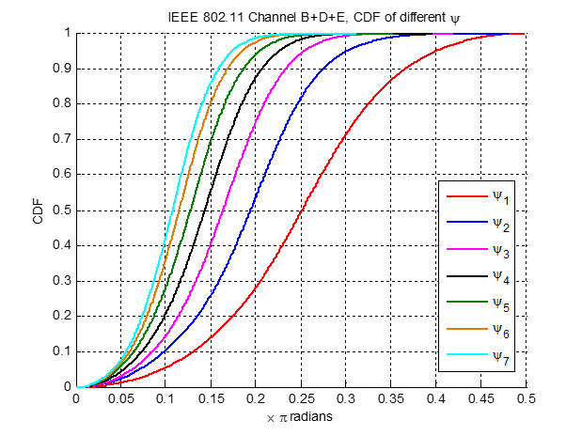
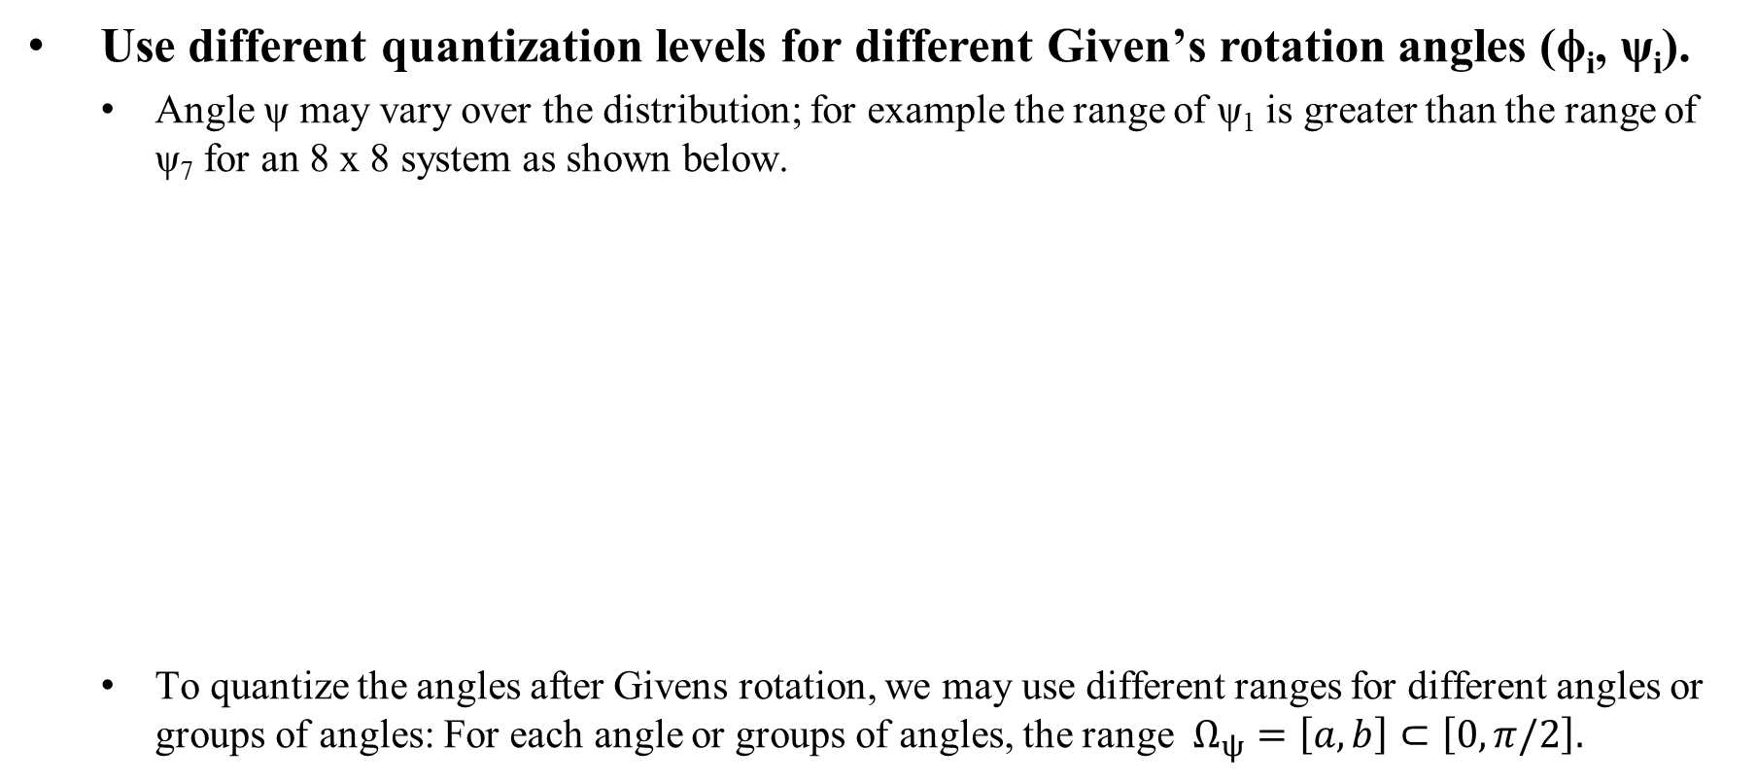
Variable Angle Quantization
Use different quantization levels for different Given’s rotation angles (ϕ_{i}, ψ_{i}).
  Angle ψ may vary over the distribution; for example the range of ψ₁ is greater than the range of ψ₇ for an 8 x 8 system as shown below.
  To quantize the angles after Givens rotation, we may use different ranges for different angles or groups of angles: For each angle or groups of angles, the range $Ω_{ψ}=\left[a,b\right]⊂\left[0, π/2\right].$

Slide 10
Explicit Feedback Reduction (New Schemes)
Multiple component feedback: splits feedback into multiple components [5][11]
  One component has a larger size and is fed back at longer intervals.
  One component is smaller and is sent back at shorter intervals.
  The combination of both may reduce the overall feedback
  Examples include (1) Feed back long term / short term information or (2) Feed back wideband / sub-band information
Codebook-based feedback: Feed back codeword from a well designed codebook [12]
  Overall feedback may reduce based on the size of the codebook.
Two way channel training [13]
  The transmitter sends out its training signal, the receiver repeats its received signal back to that transmitter.
  From this round-trip training signal, together with the one way training signal from the receiver, the transmitter is able to estimate its own outgoing channel

Slide 11
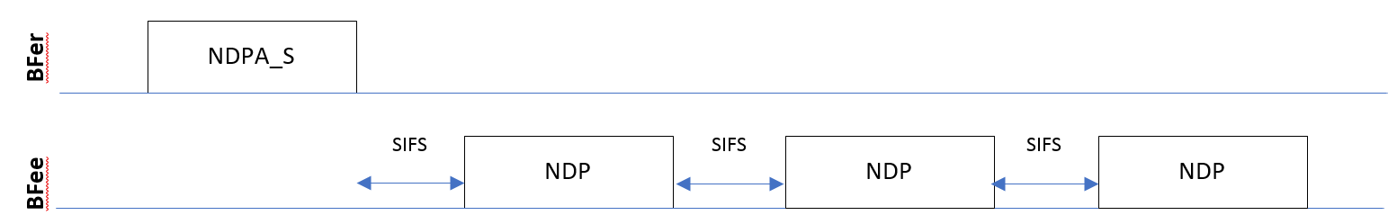
Implicit Feedback
Bfer solicits packets suitable for channel estimation in the reverse direction [7]
  Avoids overhead of the CSI feedback but needs calibration to compensate for any variations in reciprocity.
  Implicit feedback and calibration were specified in 802.11n [4] and should be used as baseline.
    May need to update to enable uplink MU-sounding [7]
  For MU-MIMO, there is a trade-off between implicit and explicit feedback depending on the number of STAs, the duration of the feedback and the duration of the uplink sounding frame
    e.g. as the number of STAs increases, the number of frames transmitted in the uplink also increases as shown in the figure below.
  This implies both implicit and explicit feedback should be considered in the discussion.
Sequential implicit feedback [7]

Slide 12
Pros and Cons
 | Scheme | Pros | Cons
1 | ϕ only feedback | exists in 802.11ah | single data stream only
2 | time domain channel | exists in 802.11ad/ay | may need additional signaling to identify tap positions and the extra matrix
3 | Differential Givens Rotation | Simple improvement from 802.11ax, variant in 11ay | Additional processing, Error Propagation
4 | Variable Angle Quantization | simple improvement from 802.11ax | additional processing
5 | Multi-component Feedback | Well understood, reduced feedback overhead | May need additional design
6 | Codebook based Feedback | Well understood, reduced feedback overhead | May need additional design
7 | Two way channel training | Do not need calibration, reduced feedback overhead | May need additional design
8 | Implicit Feedback | Simple improvement from 802.11n | Needs calibration

Slide 13
Conclusions
In this contribution, we have discussed methods to reduce the overhead of channel acquisition at the transmitter to assist in 16 Spatial Stream MIMO and Multi-AP coordination in 802.11be.
  We discussed both explicit and implicit feedback methods by which the channel acquisition overhead may be reduced.
  For explicit feedback, we discussed simple improvements to 802.11ax explicit feedback as well as schemes new to 802.11.
  For implicit feedback, we highlighted the need for an update to the 802.11n methods.

Slide 14
References
11-19/244r0 EHT PAR document, Michael Montemurro (BlackBerry)
IEEE 802.11-18/0818r3, 16 Spatial Stream Support in Next Generation WLAN, Sameer Vermani (Qualcomm)
IEEE P802.11-REVmdTM/D2.1, February 2019, Draft Standard for Information technology telecommunications and information exchange between systems, Local and metropolitan area networks, Specific requirements
IEEE P802.11ax™/D4.0, February 2019, (amendment to IEEE P802.11REVmd/D2.0)
IEEE 802.11-18/1184r1, EHT discussions on throughput enhancement, Tianyu Wu (Samsung)
IEEE 802.11-15/1321r2, Reducing Explicit MIMO Compressed Beamforming Feedback Overhead for 802.11ax Kome Oteri (InterDigital)
IEEE 802.11-18/1191r0, MU sounding improvements, Sigurd Schelstraete (Quantenna)
IEEE P802.11ah™/D2.0 Amendment 6: Sub 1 GHz License Exempt Operation
IEEE P802.11ay™/D3.0, February 2019 , (amendment to IEEE P802.11REVmdTM/D2.1 as amended by IEEE P802.11ax™/D3.3)
Porat, R.; Ojard, E.; Jindal, N.; Fischer, M.; Erceg, V., "Improved MU-MIMO performance for future 802.11 systems using differential feedback," in Information Theory and Applications Workshop (ITA), 2013 , vol., no., pp.1-5, 10-15 Feb. 2013
Chaiman Lim; Taesang Yoo; Clerckx, B.; Byungju Lee; Byonghyo Shim, "Recent trend of multiuser MIMO in LTE-advanced," in Communications Magazine, IEEE , vol.51, no.3, pp.127-135, March 2013
Love, D.J.; Heath, R.W.; Lau, V.K.N.; Gesbert, D.; Rao, B.D.; Andrews, M., "An overview of limited feedback in wireless communication systems," in Selected Areas in Communications, IEEE Journal on , vol.26, no.8, pp.1341-1365, October 2008.
L. P. Withers, R. M. Taylor and D. M. Warme, "Echo-MIMO: a two-way channel training method for matched cooperative beamforming," IEEE Trans. Signal Process., vol. 56, no. 9, pp. 4419-4432, Sep. 2008.
IEEE802.11-16/0030r1, Maximum Tone Grouping Size for 802.11ax Feedback with MU-MIMO, Kome Oteri (InterDigital)
IEEE802.11-18/1926r2, Terminology for AP Coordination, Sameer Vermani (Qualcomm)

