Slide 1
Frame aggregation in P802.11bd
Date: 2019-05-10
Authors:

Slide 2
Abstract
802.11bd will support higher data rates than 802.11p
Being based on 802.11a, there is no frame aggregation in 802.11p
802.11n and later implementations increased frame sizes (using aggregation) as rates increased
Should 802.11bd pursue frame aggregation for higher rates to improve overall performance/efficiency?

Slide 3
High level concept
Visualization of non-aggregated and aggregated frames
NOTE – Can also aggregate non-full size frames
2302 Bytes
2302 Bytes
1337 Bytes
2302 Bytes
2302 Bytes
1337 Bytes

Slide 4
High level concept
Visualization of using aggregation only at higher rates
At slow 11p rates
At fast 11bd rates
Most recent 802.11 amendments specify maximum size based on airtime duration which promotes fairness based on medium usage. [Higher rates x More data using aggregation = same airtime usage]
2302B
2302B
1337B
2302B
2302B
1337B

Slide 5
Need for larger frames
Basic Safety (BSM or CAM) messages are not large frames so no aggregation is needed. Also these applications don’t typically send multiple frames in short succession.
However, several NGV use cases propose larger data payloads: (from 802.11-18.1323r2)
  Use case 2 – Sensor Sharing
  Use case 4 – Infrastructure Applications
  Use case 6 – Automated Driving Assistance

Slide 6
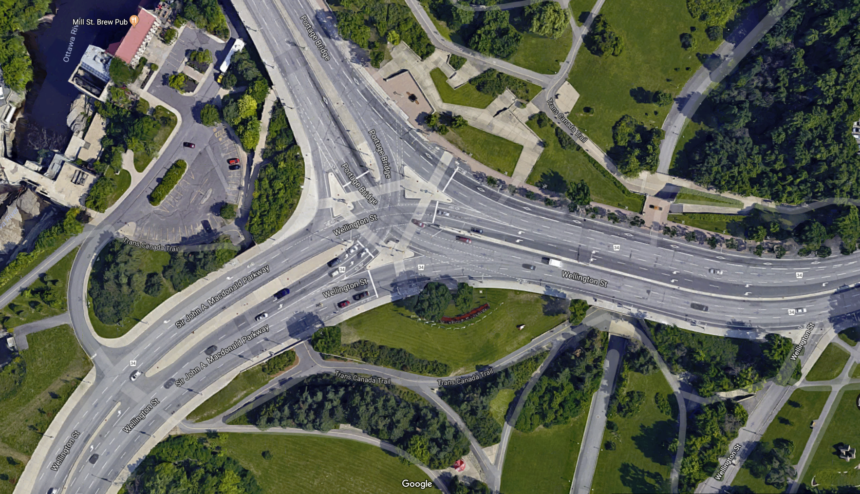
Large MAP messages
doc.: IEEE 802.11-19/0375r1
Encoding of MAP messages is specified in SAE J2375 dictionary
The MAP messages are put into 802.11p frames and broadcast from RSUs
There exist some very complex intersections
Encoding the lane-level topography of complex intersections sometimes pushes beyond 2000 bytes[1].

Slide 7
When to aggregate
I have not done my own simulation yet.
Literature study seems to show that the benefits of aggregation appear somewhere between 50 Mbps and 100Mbps.
  Not a coincidence that this lines up with the move from 802.11a (max 54Mbps) to 802.11n (max 150Mbps per stream per 20MHz).
Nature of OCB applications might be different than the TCP and UDP traffic models studied in traditional 802.11 networks. Distribution of frame sizes and timing also a factor.
Defining aggregation limits based on time (TXOP limits) rather than size (like 11ac/11ax) makes it more straightforward than 11n.

Slide 8
Some example studies on aggregation
Ginzburg, Kesselman; Performance Analysis of A-MPDU and A-MSDU
Aggregation in IEEE 802.11n
Kowsar, Biswas; Performance improvement of IEEE 802.11n WLANs via frame aggregation in NS-3
Daldoul, Ahmed, Meddour; IEEE 802.11n Aggregation Performance Study for the Multicast
Kim, Choi, Jang, Hwang; Throughput enhancement of IEEE 802.11 WLAN via frame aggregation
Skordoulis et al; IEEE 802.11n MAC Frame Aggregation Mechanisms
Many, many more.

Slide 9
Discussion
For
Frame aggregation improves system performance
  Depending on data rates
  Depending on traffic patterns
Use cases requiring larger data payloads have been discussed
IEEE 1609 doesn’t do fragmentation, it relies on application to fragment data
Need for larger data payloads discussed in 05/07 teleconference with 1609 members.
Against
If 802.11bd isn’t pushing beyond 50Mbps it might not be worth it
Not all V2X applications need aggregation (occasional, small frame traffic patterns)
Open Questions
IEEE 802.11n introduced two classes of frame aggregation. Other amendments since have added more technologies. Should A-MSDU or A-MPDU be considered? Do we need both?

Slide 10
Straw poll 1
Should 802.11bd consider frame aggregation?
Yes
No
Abstain

Slide 11
Straw poll 2
Should 802.11bd consider frame aggregation?
Yes – A-MPDU
Yes – A-MSDU
Yes – Both (A-MPDU and A-MSDU)
Yes – Something new
No need for aggregation
Abstain

Slide 12
References
1) MAP data size: NYC DSRC Pilot
  https://rosap.ntl.bts.gov/view/dot/35363/dot_35363_DS1.pdf
NGV Study Group submission on frame sizes
  https://mentor.ieee.org/802.11/dcn/18/11-18-1255-00-0ngv-ngv-target-use-case-frame-sizes.pptx

