Slide 1
Consideration on Positioning with 802.11bd
Date: 2019-03-12
Authors:

Slide 2
Abstract
802.11mc contains Fine Timing Measurement (FTM) Protocol for round trip ranging and positioning.
802.11az proposes some improvements on FTM such as NDP SU/MU ranging, trigger based ranging, AOA/AOD measurements, …
What are the implications for 802.11bd positioning mode?
This is a discussion document so feedback highly welcome.

Slide 3
Introduction
PAR [1]:
“This amendment defines at least one mode that achieves at least 2 times higher throughput” … “in high mobility channel environments at vehicle speeds up to 250 km/h (closing speeds up to 500 km/h);”
“this amendment defines procedures for at least one form of positioning in conjunction with V2X communications”
“This amendment shall provide interoperability, coexistence, backward compatibility, and fairness with deployed OCB (Outside the Context of a BSS) devices.”
Use Case (UC) baseline document [2]:
UC5 Vehicular Positioning & Location
UC8 Train-to-Train
UC9 Vehicle-to-Train

Slide 4
Current Situation V2X
Proprietary solution [3] with road side units (RSUs) exists
RSUs generally broadcast their position information in either,
Wave Service Announcements (WSA) (IEEE 1609)
Geonetworking messages (ETSI ITS)
Ranging measurements
Enhanced signal processing algorithms to
improve robustness with regard to multipath effects
achieve range accuracy in the order of nanoseconds Time-of-flight even in multipath channels
RSUs honor SIFS timing: IEEE 802.11 devices should respond to Unicast packets with a short ACK at a very specific period of time after receipt of Unicast packet. ➔ 32µs@10 MHz

Slide 5
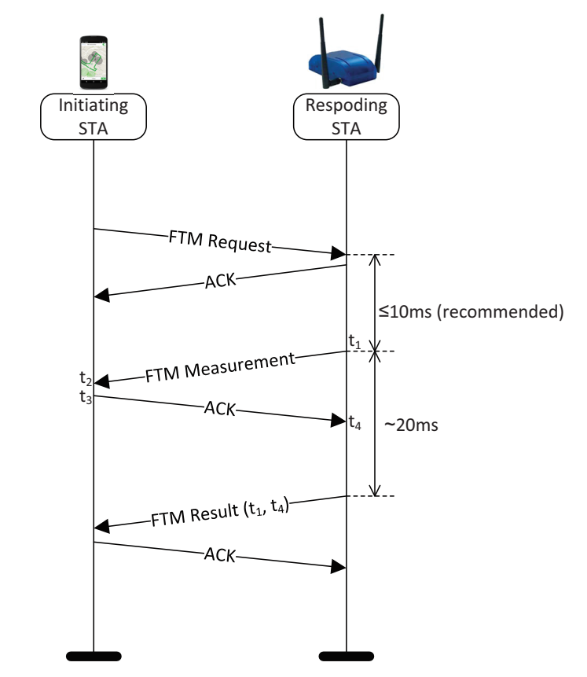
Fine Timing Measurement (FTM) Protocol
According to [4] FTM
Time to obtain range ~ 30 ms
Position: 3 ranges needed ➔ 100 – 120 ms
50 km/h=13.9 m/s ➔ 0.4m moved while obtaining one range ➔1.4m - 1.7m moved while obtaining three ranges
ACK on FTM Measurement: aSIFSTime (32µs@10 MHz)
Default accuracy ±1.3µs ➔ 390m error
0.1% error (1/3 of sample) ➔10m error

Slide 6
Discussion
5.9 GHz mode:
V2X (X=V,I,P,T) ranging?
Limits of round-trip ranging for high mobility?
One way ranging useful?
Multi-antenna approaches?
Bandwidth and aSIFSTime?
802.11az features [5]?
Quality indicators for higher layer(data fusion: Channel impulse response, clock parameters, etc.?
Can we reuse existing messages or do we need dedicated 11bd ranging message?
Simulation and channel models [6]?
60 GHz mode: ranging mode (large bandwidth ➔ high ranging accuracy)?

Slide 7
References
[1] TGbd, “Project Authorization Request (PAR)”, IEEE 802.11-18/0861r9
[2] NGV SG, “Use Case Baseline Document Approved By SG”, IEEE 802.11-18/1323r2
[3] Cohda Wireless, “V2X-Locate Positioning Whitepaper”, https://cohdawireless.com/wp-content/uploads/2018/08/Whitepaper_V2X-Locate.pdf
[4] L. Banin, et al., “High-Accuracy Indoor Geolocation using Collaborative Time of Arrival (CToA) - Whitepaper”, IEEE 802.11-17/1387r0
[5] L. Chu, et al., “NGV Ranging Discussion“, IEEE 802.11-18/1250r0
[6] P. Unterhuber, et al., “Considerations on Vehicular Channel Models”, IEEE 802.11-19/0034r1

