Slide 1
802.11 WG March 2019 Closing Reports
Date: 2019-03-15
Authors:

Slide 2
Abstract
This document is a digest of the closing reports of all 802.11 sub-groups for presentation at the March 2019 closing plenary meeting. Liaison reports (including liaison reports from the mid-week plenary) are also included.

Slide 3
Attendance by breakout

Slide 4
Attendance by affiliation

Slide 5
802.11 WG Editor’s Meeting (March 2019)
Date: 2019-03-14
Authors:

Slide 6
Agenda for 2019-03-12 meeting
Roll Call / Contacts / Reflector
Go round table and get brief status report
Draft Numbering
MIB variable deprecation
802.11 Mandatory Draft Review before SB
WG Style Guide for 802.11 draft 09/1034r13
REVmd MDR Report 260r4
Review WG Style Guide

Slide 7
Volunteer Editor Contacts
TGax – Robert Stacey – robert.stacey@intel.com
TGay – Carlos Cordeiro – carlos.cordeiro@intel.com
TGaz – Chao Chun Wang – chaochun.wang@mediatek.com , RoyWant@google.com
TGba – Po-kai Huang – po-kai.huang@intel.com
TGbb – Volker Jungnickel volker.jungnickel@hhi.fraunhofer.de
TGbc – Carol Ansley carol.Ansley@arris.com
TGbd – Bahar Sadeghi Bahareh.sagedhi@intel.com
REVmd – Emily Qi – emily.h.qi@intel.com, Edward Au – edward.ks.au@huawei.com,

Slide 8
March 12th roundtable status report
11ax – D4.0 1625 comments in resolution, expecting to recirc out of July
11ay – Resolving comments, might recirc out of May
11az – Resolving 1526 comments, hope to recirc out of July, maybe Sept recirc
11ba – Resolving ~827 comments, hope to recirc out of July
11bb – in proposal phase until July, request a PHY template
11bc – in proposal phase until July
11bd – Hope to have D0.1 in September
REVmd – resolved ~220 comments out of 723, MDR after March, expecting to recirc out of July

Slide 9
MDR Status
802.11 Working Group Mandatory Draft Review
802.11-11/615r6 documents the process. MDR now in the 802.11 Operating Manual 802.11-14/0629r8. The process needs some change so the report is done after the editing is done.
P802.11ax was started on D4.0 out of January meeting (Robert Stacey, Edward Au, Yongho Seok, Emily Qi, Naveen Kakani, Perry Correll, Peter Ecclesine, Po-Kai Huang)
P802.11ay will be started on D3.0 out of March meeting (Robert Stacey, Solomon Trainin, Edward Au, Emily Qi, Yongho Seok, Peter Ecclesine)
REVmd on Draft 2.1 was started out of February (Robert Stacey, Joseph Levy, Carol Ansley, Menzo Wentink, Bahar Sadeghi, Mark Hamilton, Yongho Seok, Emily Qi, Edward Au, Peter Ecclesine)

Slide 10
802.11 Style Guide
See https://mentor.ieee.org/802.11/dcn/09/11-09-1034-13-0000-802-11-editorial-style-guide.docx
We update 802.11 Style Guide based on 2012 IEEE Standards Style Manual and consistency changes in final publication of the 802.11 standard
Editor’s responsibility includes checking the 2014 IEEE Standards Style Manual when creating or updating drafts. https://development.standards.ieee.org/myproject/Public/mytools/draft/styleman.pdf
Submissions with draft text should conform to both the WG11 Style Guide and IEEE Standards Style Manual
Note that the 802.11 Style Guide evolves with our practice

Slide 11
MIB Style, Visio and Frame Practices
11-15/355r13 MIB TruthValue usage patterns
MIB Style: We use a single style with appropriately set tabs, and use leading Tabs to distinguish the syntax and description parts. (Adrian Stephens Feb 9, 2010)
Two ways to format a figure & its caption in frame:
Insert a table. Insert anchored frame inside table cell to hold graphics. Use table caption as figure caption.
Insert an anchored frame. Insert caption inside a text frame inside the anchored frame. Insert graphics inside the anchored frame.
Keep embedded figures using visio as long as possible (not in Word)
Near the end of sponsor ballot, turn these all into .emf (windows meta file) format files (you can do this from visio using “save as”). Keep separate files for the .vsd source and the .emf file that is linked to from frame. There is high likelihood we should use .emf
Frame format figures are tables

Slide 12
Editor Amendment Ordering
Data as of Mar 2019
See http://grouper.ieee.org/groups/802/11/Reports/802.11_Timelines.htm
In Jan 2019, Editors discussed REVmd schedule and possible completion in 2020. We will revisit the running order in May.
Amendment Number | Task Group | Projected REVCOM Date
REVmd REVmd Amendment 1 | TGmd – 4604 TGax – 745 | May 2020* Jun 2020*
REVmd Amendment 2 | TGay – 763 | May 2020*
REVmd Amendment 3 | TGaz – 147 | Mar 2021
REVmd Amendment 4 REVmd Amendment 5 | TGba – 130 TGbb – | Sept 2020 Jul 2021
 | *REVmd might be March or May, 2020

Slide 13
Draft Development Snapshot
Mar 2019
Changes from last report shown in red.
Most current doc shaded green.
TG | Published or Draft Baseline Documents |  |  |  |  |  |  |  |  | Source | MDR | Style Guide | Editor | Snapshot Date
 | Published | md | ax | ay | az | ba | bb | bc | bd
md | Y | 2.1 |  |  |  |  |  |  |  | Frame | No | 2012 | Emily Qi Edward Au | 12-Mar
ax | Y | 2.0 | 4.0 |  |  |  |  |  |  | Framemaker 2017 release | No | 2012 | Robert Stacey | 12-Mar
ay | Y | 2.1 | 3.3 | 3.0 |  |  |  |  |  | Word | No | 2012 | Carlos Cordeiro | 12-Mar
az | Y | 2.0 | 3.3 | 2.2 | 1.0 |  |  |  |  | Word | No | 2012 | Chao Chun Wang Roy Want | 12-Mar
ba | Y | 1.6 | 3.0 | 1.4 | 0.3 | 2.0 |  |  |  | Framemaker 2017 release | No | 2012 | Po-Kai Huang | 12-Mar
bb
bc
bd

Slide 14
AANI SC Closing Report March 2019
Date: 2019-03-14
Authors:

Slide 15
Abstract
Abstract
This Document is the closing report for AANI SC,
November 2016 Meeting in San Antonio, TX
This Document is the closing report for AANI SC,
March 2019 Meeting in Vancouver, Canada

Slide 16
802.11 AANI SC – March 2019
Meeting Goals:
Continue Discussion on: NENDICA activity, 3GPP Status 802.11 Technical performance relative to IMT-2020 requirements work
Future section planning
Agenda: 11-19/0236r1 , met for one sessions Minutes: 11-19/0519r0
Reviewed AANI SC Status/Background
Contributions:
11-19/0240r0 “ITU IMT-2020 Status” (Joseph LEVY)
Call for support of: IMT-2010 eMBB Dense Urban simulation effort (contact Sindhu Verma or the AANI Chair)

Slide 17
Future Session Planning
Teleconference:
As required with 10 days’ notification
10-16 May 2019 F2F, Grand Hyatt Atlanta in Buckhead, Atlanta, Georgia, USA:
The AANI SC is contribution driven, contributions are requested:
Technical and discussion contributions on 802.11 technical performance relative to IMT-2020 requirements.
Technical and discussion contributions on interworking/integration of 802.11 with the 3GPP Next Generation System:
In support of 802.1 Nendica
Note: IMT-2020 proposal contribution deadline is 2 July 2019 therefore May F2F is the final AANI meeting before the deadline
Meeting time requested: 1 sessions – Thursday AM1 (TBC)

Slide 18
ARC Closing Report
Date: 2019-03-13
Authors:

Slide 19
Abstract
This document is the closing report for ARC SC,
March 2019 Meeting in Vancouver, British Columbia, Canada

Slide 20
Work Completed
Agenda is here: 11-19/0241r3
MAC Address randomization and changing
Reviewed proposal to form a TIG to discuss any issues/concerns raised by random or changing MAC addresses, and determine if next steps are needed or desired
Presented the TIG proposal at mid-week plenary for feedback
Small updates to TIG proposal, based on feedback, to clarify scope
Will propose formally at Friday’s closing plenary
Source Address Validation Improvements (SAVI)
Considered an IETF draft on SAVI: https://datatracker.ietf.org/doc/draft-bi-savi-wlan
We need more time, and some background to understand the context, before we have high-level comments
Will review off-line for May meeting, checking 802.11 details for accuracy

Slide 21
Work Completed (cont)
“What is an ESS?”
Focused in on the key aspects (we believe) of the ESS (infrastructure BSSs, per se) concept
Examined current definition and description in REVmd D2.0. Noted that the current definition needs an understanding of “LLC” and thereby the reference to ISO/IEC 8802-2 (née: 802.2)
Believe we can simplify the way ESS is described, to use 802.1 terms (in 802.1Q and 802.1AC), and cleanup the mapping language for 802.2/LLC
Ran out of time to consider further, will work off-line for next session.
“What is a STA?”
Correctly, what name(s) should we use for our STA concepts (STA, AP, non-AP STA)? 11-19/0106r0
General support for aligning the names with common usage outside 802.11. But, need to consider the amount of effort it would take, and confusion it could cause (is it any worse than the confusion we already have?)

Slide 22
Work Completed (cont)
IETF/802 coordination
Noted that Deterministic Networking/Time-sensitive Networking discussions are ongoing.
IETF is forming a BOF (PAW) at the upcoming meeting March 23-29
IEEE 802.1CQ update
802.1 met this week, including 802.1CQ. 802.11 experts in the meeting, had a productive exchange about explicit description of 802.11 aspects within 802.1CQ
Potential for address assignment protocol work within 802.1, based on IEEE 1722 (“MAAP”)
802.1 will liaise with IEEE 1722 and keep us CC’d

Slide 23
Work Completed (cont)
802.1AS-rev use of Fine Timing Measurement
Our previous inputs have been incorporated. Continue to monitor.
Being worked directly by 802.11 experts, with 802.1AS
Started Sponsor Ballot phase
Noted status of IEEE 1588 mapping to IEEE 802.11
No changes. Ongoing balloting. No action needed. Continue to monitor
Related activity: 802.1AS REVision use of FTM
MLME-RESET, versus MLME-JOIN and MLME-START
Didn’t have time. Will carry over to November session.
AP/DS/Portal architecture, 802/802.1 mappings
Didn’t have time. Need to consolidate agreements, and provide input to REVmd.

Slide 24
Teleconference(s)
None

Slide 25
May 2019 Plans
Three standalone meeting slots planned:
“What is an ESS?”, “What is a STA?” and DS/AP/Portal architecture discussions
MLME-RESET, versus MLME-JOIN and MLME-START (add MLME-SCAN?) – feedback to REVmd
802.1CQ references to 802.11, AP configuration, address assignment protocol(s), etc.
IETF SAVI draft
Status updates on other IETF work, IEEE 1588 work
Multiple MAC Addresses (and IPv6), “Multiple radios”
System architecture views for common use scenarios
New topic? What is the (“STA(s)”) architecture of off-channel TDLS?

Slide 26
IEEE 802.11 Coexistence SC closing report in Vancouver in Mar 2019
15 March 2019
Authors:
Name | Company | Phone | email
Andrew Myles | Cisco | +61 418 656587 | amyles@cisco.com

Slide 27
IEEE 802.11 Coexistence SC achieved its goals as an effective discussion forum for coexistence issues
802.11 Coex SC achievements in Vancouver in Mar 2019 (agenda)
Discussed Coexistence Workshop arrangements
Action: submit presentation proposals by 12 May 2019
Action: register from end of April 2019 ($50)
Action: volunteer your company to sponsor ($5000)
Reviewed coexistence activities in ETSI BRAN
Mostly refining of EN 301 893
Raised question of CW adjustment rules for delayed block ack in 802.11
Issue of use of no/short LBT not resolved
Reviewed coexistence activities in ETSI BRAN
Highlighted cultural/protocol differences
Issue of use of no/short LBT not resolved
Issue of use of 802.11a preamble not resolved

Slide 28
IEEE 802.11 Coexistence SC achieved its goals as an effective discussion forum for coexistence issues
802.11 Coex SC achievements in Vancouver in Mar 2019 (agenda)
Discussed proposal to FCC for synchronised access in UNII-7
If accepted by FCC then there is a substantial impact on 802.11 access to UNII-7 or 802.11be design
Agreed to send LS to 3GPP RAN asking them to continue discussing potential use of 802.11a preamble, assisting coexistence

Slide 29
IEEE 802.11 Coexistence SC will continue its work in Atlanta in May 2019
IEEE 802.11 Coexistence SC will meet in Atlanta in May 2019
Continue to act as a forum for discussion of coexistence issues between IEEE 802.11 and non-IEEE 802 technologies
Review ETSI BRAN activities
Review 3GPP RAN/RAN1 activities
Plan detailed Coexistence Workshop agenda

Slide 30
The 802.11 WG will consider approval of a LS to 3GPP RAN/RAN1/RAN2/RAN4 related to preambles
Coex SC motion
The IEEE 802.11 Coex SC recommends to the IEEE 802.11 WG that the contents of 11-19-0500-01 be liaised to 3GPP RAN, RAN1, RAN2 & RAN4
Moved: David Boldy, Seconded: Jeremy Foland
Result: 22/0/5
WG Motion
The IEEE 802.11 WG approves sending the contents of 11-19-0500-02 to 3GPP RAN, RAN1, RAN2 & RAN4
Moved: Andrew Myles
Seconded
Note: needs to be sent today because of RAN meeting next week
R2 has some editorial adjustments to send to RAN/RAN1/RAN2/RAN4

Slide 31
PAR Review SC - Meeting Agenda and Comment slides - March 2019 - Vancouver
Date: 2019-03-14
Authors:

Slide 32
Abstract-PAR Review SC PARs under consideration
PAR Submission Deadline is
WG PAR submission to 802 EC: 25 Jan 2019
WG PAR Submission to NesCom: 8 Feb 2019 (for NesCom March mtg)
The Proposed PARs are posted to the “IEEE 802 PARs Under consideration Webpage:
http://grouper.ieee.org/groups/802/PARs.shtml
And listed on the next slide.
PAR Review SC Meeting times: Monday PM2, Tuesday AM1, AM2, Thursday AM2

Slide 33
IEEE 802 PARs & ICAIDs under consideration March 10-15, 2019, Vancouver, BC, Canada
802.1 Industry Connections: Nendica, ICAID Extension and background
802.3cu - Amendment, 100 Gb/s and 400 Gb/s Operation over Single-Mode Fiber, PAR and CSD
802.11be - Amendment, Enhancements for Extremely High Throughput (EHT), PAR and CSD

Slide 34
PAR Review SC – March 2019 Chair: Jon Rosdahl
Draft Agenda:
Monday Agenda (2 mtg slots):
Welcome
Approve Previous Minutes
Determine order of review
Review PARs/CSD posted for review this week.
Recess
Thursday Agenda:
Review Response to Comments
Prepare Report for 802.11 WG closing plenary
Adjourn

Slide 35
Motion to Approve Previous Minutes
Move to approve previous Meeting minutes: 11-18/1946r0:
https://mentor.ieee.org/802.11/dcn/18/11-18-1946-00-0PAR-minutes-november-2018-session.docx
as the minutes for PAR Review SC from November 2018 meetings in Bangkok, Thailand.
Moved: Kiwin Palm
2nd: David Kloper
Results: 3-0-0

Slide 36
Par Review Comments

Slide 37
802.1 Industry Connections: Nendica, ICAID Extension and background
No Comments

Slide 38
802.3cu - Amendment, 100 Gb/s and 400 Gb/s Operation over Single-Mode Fiber, PAR and CSD
2.1 Title: Suggest incorporating the differentiating nature from the scope “optical interfaces for reaches up to 10 km based on 100 Gb/s per wavelength optical signaling.” into the title to make it more unique.
4.2 – Suggest 3/2020 instead of 4/2020. The 6th Month delta is the minimum. Suggestion is to start in March which is a Plenary Date, then the October date is a deadline for December SASB, and is understood.

Slide 39
Responses from 802 Working Groups

Slide 40
802.3 Response
PAR item 2.1 Title: The title has been updated with the text 'at 100 Gb/s per wavelength' based on the scope appended. The full title now reads 'Standard for Ethernet Amendment: Physical Layers and Management Parameters for 100 Gb/s and 400 Gb/s Operation over Single-Mode Fiber at 100 Gb/s per wavelength'.
PAR item 4.2 Expected Date of submission of draft to the IEEE-SA for Initial Sponsor Ballot: As suggested, the date has been updated to 03/2020.
An updated draft PAR is available at <https://mentor.ieee.org/802-ec/dcn/19/ec-19-0006-01-00EC-ieee-p802-3cu-draft-par.pdf> with the above changes marked in strikeout and underscore.

Slide 41
Final Report to 802.11

Slide 42
Final Report
All suggestions from our comments were implemented.

Slide 43
Motion To Approve Report
Move to accept 11-19/0249r2 as the report from PAR Review SC for the March 2019 plenary.
Moved: Stuart Kerry
2nd: Edward Au
Results: 3-0-0
Notes:
This Document

Slide 44
References:
IEEE 802 PARs Under consideration Webpage:
http://grouper.ieee.org/groups/802/PARs.shtml
Minutes:
Previous Plenary: 11-18/1946r0:
https://mentor.ieee.org/802.11/dcn/18/11-18-1946-00-0PAR-minutes-november-2018-session.docx
Current Meeting: 11-19/426r0
https://mentor.ieee.org/802.11/dcn/19/11-19-0426-00-0PAR-minutes-March-2019-session.docx

Slide 45
WNG SC Closing Report
Date: 2019-03-15
Authors:

Slide 46
Abstract
Closing report for WNG SC for March 2019 in Vancouver (British Columbia, Canada)

Slide 47
Summary
Final Agenda
https://mentor.ieee.org/802.11/dcn/19/11-19-0231-00-0wng-agenda-for-wng-sc-2019-march.ppt
Presentations at March 2019 meeting
“ns-3: Open Source Simulator for Wireless Network Performance Evaluation” – Sumit Roy (University of Washington - Seattle)
https://mentor.ieee.org/802.11/dcn/19/11-19-0425-01-0wng-ns-3-open-source-simulator-for-wireless-network-performance-evaluation.pptx
No motions, No straw polls
Minutes
https://mentor.ieee.org/802.11/dcn/19/11-19-0460-00-0wng-wng-sc-meeting-minutes-for-2019-march-vancouver-meeting.docx
Plans for May 2019
TBD
No motions in the SG, no conference calls

Slide 48
IEEE 802 JTC1 Standing Committee March 2019 (Vancouver) closing report
15 March 2019
Authors:
Name | Company | Phone | email
Andrew Myles (Chair) | Cisco | +61 418 656587 | amyles@cisco.com
Peter Yee (Vice Chair) | AKAYLA | +1 415 215 7733 | peter@akayla.com

Slide 49
IEEE 802 JTC1 SC focused on executing the PSDO process
IEEE 802 JTC1 SC achievements in Vancouver in Mar 2019
Agenda - 11-19-0233-09
WG | Completed | In-process
802.1 | 24 | 14
802.3 | 13 | 7
802.11 | 7 | 10
802.15 | 2 | 1
802.16 | 0 | 0
802.21 | 3 | 0
802.22 | 3 | 0
All | 52 | 32

Slide 50
IEEE 802 JTC1 SC focused on executing the PSDO process
Status of PSDO process
Recent publications
802.1CB, 802.1Qci, 802.1Qch, 802c*
802.3bs, 802.3cc
802.11ai
802.15.6*
Recent ballot completions
FDIS ballot
802.11ah*,
60 day ballot
802.1Q*, 802.1AR-Rev, 802.1Xck*, 802.1AE-Rev*
802.11aj*, 802.11ak*, 802.11aq*
Ballots in progress
60 day ballot
802.3cb, 802.3-REV
FDIS ballot
802.1CM, 802.1AC/Cor-1
Note: * = comment resolution required

Slide 51
IEEE 802 JTC1 SC considered other SC6 related issues
Other SC6 related issues
Systematic review of two standards passed ISO ballot
ISO/IEC/IEEE 8802-1X:2013 (closed 4 March 2019)
ISO/IEC/IEEE 8802-1AE:2013 (closed 4 March 2019)
ISO/IEC/IEEE 8802-1AS:2014 (closing 4 June 2019)
SC6 agreed to withdraw old standards, based on IEEE 802 LS
ISO/IEC TR 8802-1:2001
ISO/IEC 15802-1:1995
ISO/IEC 15802-3:1998
ISO/IEC 8802-5:1998
ISO/IEC 8802-5:1998/Amd.1:1998
No one from IEEE 802 will be attending the SC6 meeting in April
Peter Yee will call in for IEEE 802 report

Slide 52
IEEE 802 JTC1 SC will focus on executing the PSDO process in Atlanta in May 2019
IEEE 802 JTC1 SC plans for Atlanta in May 2019
Execute PSDO process
Review results of SC6 meeting

Slide 53
The JTC1 SC approved a response to the 802.11ak comments
SC Motion
The IEEE 802 JTC1 SC recommends to the IEEE 802.11 WG that the contents of 11-19-0278-02 be liaised to ISO/IEC JTC1/SC6 as responses to comments on IEEE 802.11ak by the China NB during the 60-day ballot that was run as part of the PSDO process
Moved: Harkins, Seconded: Karen Randell
Result: 9/0/1
WG motion
The IEEE 802.11 WG recommends to IEEE 802 EC that the contents of 11-19-0278-02 be liaised to SC6 as IEEE 802.11 WG’s response to the comments on the IEEE 802.11ak 60-day ballot
Moved: Andrew Myles (on behalf of SC)

Slide 54
The JTC1 SC approved a response to the 802.11aq comments
SC Motion
The IEEE 802 JTC1 SC recommends to the IEEE 802.11 WG that the contents of 11-19-0279-01 be liaised to ISO/IEC JTC1/SC6 as responses to comments on IEEE 802.11aq by the China NB during the 60-day ballot that was run as part of the PSDO process
Moved: Harkins, Seconded: Karen Randell
Result: 9/0/1
WG motion
The IEEE 802.11 WG recommends to IEEE 802 EC that the contents of 11-19-0279-01 be liaised to SC6 as IEEE 802.11 WG’s response to the comments on the IEEE 802.11aq 60-day ballot
Moved: Andrew Myles (on behalf of SC)

Slide 55
The JTC1 SC discussed liaising 802.11 drafts to SC6 for information
Normally, 802.11 WG liaises drafts for information to SC6 once they reach a reasonable level of maturity
The JTC1 SC discussed three potential draft liaisons
The 802.11 WG approved liaison of 802.11ay in Jan; EC approval is required
The 80211ax draft should probably be liaised before Sponsor Ballot stage given its importance; WG and EC approval is required
Discussion during the JTC1 SC meeting suggested that 802.11az was not ready to be liaised to SC6

Slide 56
The JTC1 SC discussed liaising 802.11ax to SC6 for information
WG motion
The IEEE 802.11 WG recommends to IEEE 802 EC that the 802.11ax draft be liaised to SC6 for information
Moved: Andrew Myles
Seconded:

Slide 57
TGmd March 2019 Closing Report
Date: 2019-03-14
Authors:

Slide 58
Abstract
This presentation contains the IEEE 802.11 TGmd closing report for the March 2019 session.

Slide 59
Work completed this week
Continued comment resolution of 723 comments received in LB236
Approximately 250 Comments resolved to date
Planned teleconferences and Ad-hoc meeting
March 29, April 12, April 26, May 3, 2019 10am Eastern, 2 hours
Next ad-hoc: April 2-3-4, 2019 – Portland Oregon
Mandatory Draft Review (MDR) nearly completed
TGmd schedule: will be updated in May
Agenda
https://mentor.ieee.org/802.11/dcn/19/11-19-0221-04-000m-2019-march-tgmd-agenda.pptx

Slide 60
TGmd schedule – to be updated
January 2018 – Initial WGLB
November 2018 –D2.0 WGLB Recirculation LB
March 2019 – Form SB Pool
March 2019 – MEC/MDR done
August 2019 – Initial SB
November 2019 – Recirculation SB
March 2020 – Final WG/EC approval
May 2020 – RevCom/SASB approval

Slide 61
References
https://mentor.ieee.org/802.11/dcn/17/11-17-0004-03-0000-revision-par-proposal-tgmd.doc
Approved PARs: https://standards.ieee.org/about/sba/index.html
Comment spreadsheet: https://mentor.ieee.org/802.11/dcn/18/11-18-0611-15-000m-revmd-wg-ballot-comments.xls

Slide 62
TGax March 2019 Closing Report
Date: 2019-03-14
Authors:

Slide 63
Abstract
This document is the closing report for the TGax for the March 2019 session.

Slide 64
Work Completed
The TG completed the resolution of about 200 comments.
Completed the assignment of almost all the CIDs
The TG passed a motion to have an adhoc meeting in San Diego during the period May 8-10.
The TG agenda is available at:
https://mentor.ieee.org/802.11/dcn/19/11-19-0238-05-00ax-tgax-march-2019-meeting-agenda.pptx

Slide 65
May 2019 Goals
Continue the comment resolution on draft D4.0.

Slide 66
Teleconference Schedule
10:00 – 12:00 ET
Thursday March 28
Thursday April 11
Thursday April 25
Thursday May 21

Slide 67
Task Group AY March 2019 Closing Report
Date: 2019-03-14
Authors:

Slide 68
Abstract
This document is the closing report for Task Group AY for the March 2019 session.

Slide 69
Work Completed
19 submissions are covered during the meeting covering areas related to comment resolution on recirculation working group letter ballot 239 (Draft 3.0)
115 CIDs are resolved and approved.

Slide 70
Goals for May 2019 interim
Comment resolution on D3.0
Technical presentation
Consider draft readiness for the second recirculation WGLB (D4.0)

Slide 71
Teleconference Schedule
March 20 (Wednesday), 10:00am ET – 11:30am ET
March 27 (Wednesday), 10:00am ET – 11:30am ET
April 3 (Wednesday), 10:00am ET – 11:30am ET
April 10 (Wednesday), 10:00am ET – 11:30am ET
April 17 (Wednesday), 10:00am ET – 11:30am ET
April 24 (Wednesday), 10:00am ET – 11:30am ET
May 1 (Wednesday), 10:00am ET – 11:30am ET
May 8 (Wednesday), 10:00am ET – 11:30am ET

Slide 72
TGaz Next Generation Positioning March Meeting Closing Report
Date: 2019-03-14
Authors:

Slide 73
Abstract
This document is the TGaz Next Generation Positioning closing report for the Vancouver Canada meeting, March 2019.

Slide 74
TG Status And Work Completed
Successful Initial WG ballot LB240 with 79.15%, ~800 technical/~700 editorial.
Approve a 3 day TG Ad-hoc for WG consideration.
Committed to updated TG timelines.
Performed comment assignment of 481 CIDs.
Group met for 5 meeting slots and reviewed a total of 14 submissions.
Reviewed process for CID consideration from telecon/ad-hoc to IEEE week.

Slide 75
Goal For May 2019 Meeting and Beyond
Continue comment resolution for LB240.
Continue comment assignment as needed.

Slide 76
Teleconference Schedule
Mar. 27th (Wednesday), 13:00 ET – 14:30 ET
Apr. 3rd (Wednesday), 13:00 ET – 14:30 ET
Apr. 10th (Wednesday), 13:00 ET – 14:30 ET
Apr. 17th (Wednesday), 13:00 ET – 14:30 ET
Apr. 24th (Wednesday), 13:00 ET – 14:30 ET
May 22nd (Wednesday), 13:00 ET – 14:30 ET

Slide 77
2019 March TGba Closing Report
Date: 2019-3-14
Authors:

Slide 78
Work Completed
TGba worked on the comment resolution on D2.0
40% completed (327 comments resolved out of 827)
TGba approved to hold an ad-hoc meeting at the Bay area on April 10-11, 2019
Reviewed TG timeline
Agenda: doc:11-19/242r8

Slide 79
Goals for May 2019
Complete comment resolution on D2.0
Publish D3.0
Start WG recirculation letter ballot
Review TG timeline

Slide 80
Teleconference Call Schedule
Three teleconference calls (Mondays, 1.5 hours each):
March 25th, 10:00 ET
April 22nd, 17:00 ET
April 29th, 23:00 ET

Slide 81
TGbb March 2019 Closing Report
Date: 2019-03-16
Author:

Slide 82
Abstract
This presentation contains the IEEE 802.11 Light Communications Task Group closing report for the March 2019 session.

Slide 83
TGbb activities in March meeting
Content
TGbb is in proposal preparation phase
Joint PHY proposal on in doc. 11-19/0388r0
Second PHY proposal in doc. 11-19/0419r0 (not yet presented)
Updated task group doc. 11-19/0187r3 on evaluation methodology, New: simulator calibration, clarification of the metrics
New deadlines in TGbb Call for Proposals (PHY: 1st July 2019) in doc. 11-18/2039r3
Accordingly updated timeline 11-18/1290r3
Conference call schedule
Meeting agenda and motions are available as doc. 11-19/0235r5
Minutes of the meeting will be available as doc. 11-19/0532r0.

Slide 84
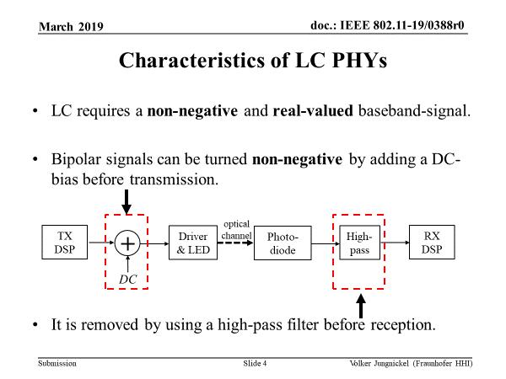
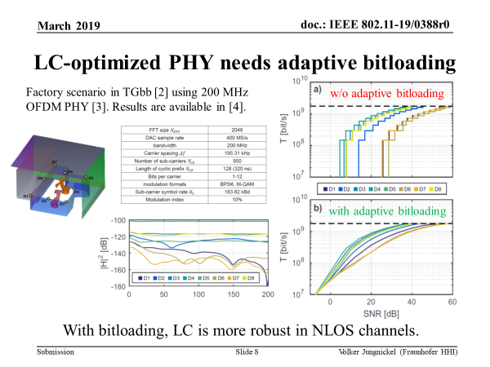
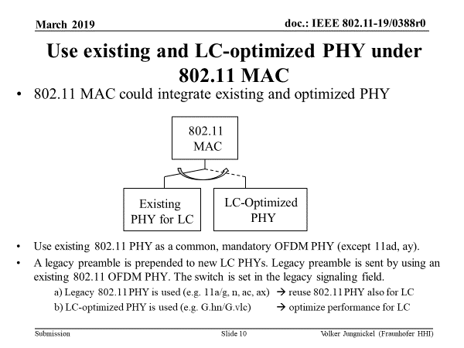
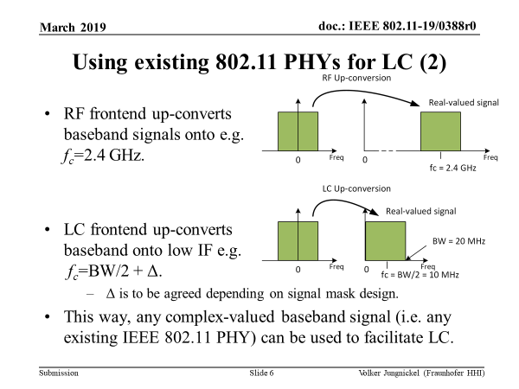
Joint pre-proposal for TGbb PHY in doc. 11-19/0388r0

Slide 85
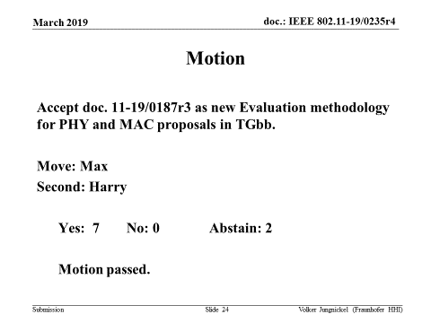
Evaluation methodology update

Slide 86
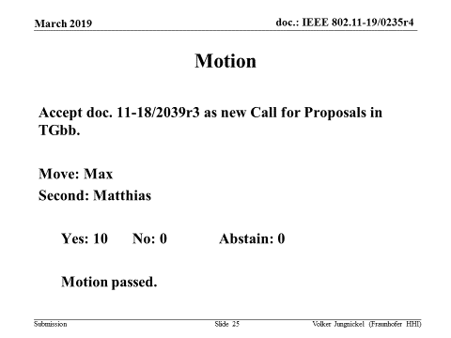
Updated TGbb Call for Proposals in doc. 11-18/2039r3 (PHY: 1-Jul-19)

Slide 87
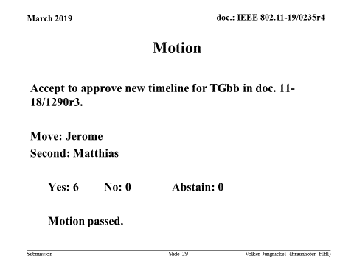
Updated timeline in doc. 11-18/1290r3

Slide 88
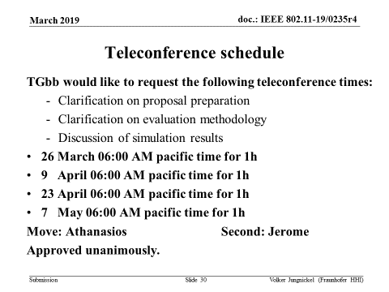
Teleconference schedule request

Slide 89
Plans for TGbb May Meeting
4 slots were requested
Hear further pre-proposals on PHY
Discuss initial evaluation results

Slide 90
TGbc Closing Report
Date: 2019-03-14
Authors:

Slide 91
Abstract
Closing report for IEEE 802.11 TGbc (Broadcast Services) for March 2019, Vancouver, British Colombia, Canada.

Slide 92
Work Completed this week
Technical submissions
Agreed on TGbc Use Case Document
Agreed on update of TGbc Functional Requirements
Discussion on eBCS frame authentication mechanism
Timeline approved

Slide 93
Plans for May 2019
Submissions to populate
the TGbc Use Case Document
the TGbc Functional Requirement Document
Other technical submissions
Find a Technical Editor

Slide 94
Future Session Planning
Teleconferences:
Agreed general time slot: Tuesdays, 10:00h ET
Telco on Apr 9, 2019
12-17 May 2019 F2F meeting, Atlanta, GA:
Meeting time requested: 3 sessions

Slide 95
TGbd Closing Report – Vancouver, Canada
Date: 2019-03-14
Authors:

Slide 96
Abstract
Closing report for Mar 2019 TGbd meeting in Vancouver, Canada

Slide 97
Completed work items in the week
5 meeting slots were allocated in the week.
Meeting agenda: the last revision of 11-19/0237
Work items completed in this week include:
Approve the meeting minutes for Jan meeting and Feb CC
Discuss and approve the selection procedure document
Review and approve the Functional Requirements Document skeleton
Review and approve the Spec Framework Document skeleton
Discuss and approve the liaison response draft corresponding to liaison feedbacks from IEEE VT/ITS 1609 WG.
Appoint John Kenney as the TGbd’s liaison contact with IEEE VT/ITS 1609 WG
Review TGbd timeline, no change
Teleconference plan before Mar meeting was settled
21 tech presentations were submitted for the week and part of them were presented in the week.
Several motions passed for developing FRD and SFD

Slide 98
Motion for Liaison Response
Move to recommend the IEEE 802.11 WG to send 11-19/0437r3 to IEEE VT/ITS 1609 WG and CC as addressed and grant the WG chair editorial privilege
Moved: Joseph Levy
Seconded: John Kenney
Result: 30Y/0N/1A
Motion passed

Slide 99
Tech submissions for the week
11-19/0293, PHY designs for NGV, Yujin Noh (Newracom)
11-19/0310, Considerations on NGV PHY design, Ioannis Sarris (u-blox)
11-19/0311, Simulation of NGV PHY, Ioannis Sarris (u-blox)
11-19/0319, CAM statistics analysis for simulations, Friedbert Berens (FBConsulting)
11-19/0320, Simulation of multi-channel interference, Onn Haran (Autotalks)
11-19/0332, PHY Design for 11bd, Dongguk Lim (LGE)
11-19/0341, NGV Backward Interoperability: Follow-up, Rui Cao (Marvell)
11-19/0342, 11bd Frame Format, Rui Cao (Marvell)
11-19/0343, Modulation Scheme for 11bd Range Extension, Jianhan Liu (Mediatek)
11-19/0346, LDPC Investigation for 11bd, Pashant Sharma, (Marvell)
11-19/0349, NGV indication in legacy unicast PPDU, Liwen Chu (Marvell)
11-19/0364, Performance analysis of outer RS coding scheme, Stephan Sand (German Aerospace Center (DLR))
11-19/0365, Consideration on Positioning with 802.11bd, Stephan Sand (German Aerospace Center (DLR))
11-19/0366, 20MHz Channel Access in 11 bd, Insun Jang (LG Electronics)
11-19/0368, Channel usage in NGV, Hanseul Hong (Yonsei Univ.)
11-19/0082, Interoperable Approach for NGV New Modulations, Michael Fischer (NXP)
11-19/0369, physical-layer-encoding-for-interoperable-ngv-new-modulations, Alessio Filippi (NXP)
11-19/0370, adaptation-mechanisms-for-interoperable-ngv-new-modulations, Alessio Filippi (NXP)
11-19/0371, fading-channel-models-for-6ghz-ngv-simulations, Alessio Filippi (NXP)
11-19/0375, Frame Aggregation, James Lepp (BlackBerry)
11-19/0376, Rate Buckets, James Lepp (BlackBerry)
11-19/0393, simulation of potential PHY technology for NGV, Yonggang Fang (ZTE)

Slide 100
Approved TG Document
TG Document | Baseline Version | Latest Revision
Definition and requirements | 11-19/0202r1 | 11-19/0202r1
Selection Procedure document | 11-19/0030r6 | 11-19/0030r6
Functional Requirement document | 11-19/0440r0 | 11-19/0440r0
Spec Framework document | 11-19/0041r0 | 11-19/0041r0
Liaison response to IEEE VT/ITS 1609 WG | 11-19/0437r3 | 11-19/0437r3

Slide 101
Timeline (unchanged)
PAR approved Dec 2018
First TG meeting Jan 2019
D0.1 Sept 2019
D1.0 Letter Ballot Nov 2019
D2.0 LB recirculation Mar 2020
Form Sponsor Ballot Pool May 2020
D3.0 LB recirculation May 2020
D3.0 unchanged recirculation July 2020
Initial Sponsor Ballot (D4.0) Sept 2020
Final 802.11 WG approval July 2021
802 EC approval July 2021
RevCom and SASB approval Sept 2021

Slide 102
Teleconferences and Goal for May meeting
Teleconferences
Date: Mar 26, Apr 23, May 21
Time: 10:00am ~ 11:59am, ET
Date: Apr 9, May7
Time: 6:00pm ~ 8:00pm, ET
Goal for May meeting
Develop FRD and SFD
Call for technical submissions for FRD and SFD

Slide 103
EHT Closing Report – March 2019
Date: 2019-03-13
Authors:

Slide 104
Work Completed
EHT SG has completed its work.
Thanks to Dennis Sundman for acting as Secretary
Thanks to Laurent Cariou for his help in completed PAR and CSD documents.
Approved PAR and CSD documents submitted to NESCOM and EC for approval
PAR: https://mentor.ieee.org/802.11/dcn/18/11-18-1231-06-0eht-eht-draft-proposed-par.docx
CSD: https://mentor.ieee.org/802.11/dcn/18/11-18-1233-06-0eht-eht-draft-proposed-csd.docx
Responses to EC comments: https://mentor.ieee.org/802.11/dcn/19/11-19-0459-03-0eht-eht-par-and-csd-comments.pptx
Plans for May
Begin work as TGbe
Elect officers
Begin discussion on technical contributions and process.

Slide 105
PAR and CSD Comment Responses
Move to accept https://mentor.ieee.org/802.11/dcn/19/11-19-0459-04-0eht-eht-par-and-csd-comments.pptx as the response to comments received on the EHT PAR and CSD documents received from IEEE 802.
Moved by Michael Montemurro on behalf of EHT SG
EHT SG vote:
Moved: Laurent Cariou, Seconded: Jon Rosdahl - Result: 103-0-0

Slide 106
CSD Approval Motion
Believing that the CSD contained in the document referenced below meets IEEE 802 guidelines,
Request that the CSD contained in 11-18/1233r7 <https://mentor.ieee.org/802.11/dcn/18/11-18-1233-07-0eht-eht-draft-proposed-csd.docx > be posted to the IEEE 802 Executive Committee (EC) agenda for WG 802 preview and EC approval.
Moved by Michael Montemurro on behalf of EHT SG
EHT SG vote:
Moved: Laurent Cariou, Seconded: Allan Jones- Result: 107-0-0

Slide 107
RTA TIG Closing Report
Date: 2019-3-15
Authors:

Slide 108
Abstract
This presentation contains the closing report for the RTA TIG for the March 2019 session.

Slide 109
Work Completed
Approved January Interim minutes
The TIG reviewed 2 presentations
Presented summary of RTA TIG report summary to WG
Adjourned RTA TIG and produced final RTA TIG report to the WG
DCN | Title | Author
11-18-1947 r3 | Performance evaluation of Real Time Communication over Wi-Fi | Evgeny Khorov
11-18-2009 r4 | Changes to the RTA TIG Report | Kate Meng

Slide 110
Reviewed the Timeline in the TIG
July 2018: Formation of the TIG
2 Teleconference
September 2018: Interim Meeting
Assemble a team to develop the initial report
2 teleconferences
Nov. 2018: Plenary Meeting
Post draft TIG report on the RTA TIG
Request informal comments
2 teleconferences
Jan. 2019 Interim Meeting
Continue work on the TIG report and review submissions
Schedule teleconferences (currently planning 2)
March 2019 Plenary Meeting
Final submissions/presentations and submit final report to the working group
Close/Adjourn RTA TIG

Slide 111
802.15 - Chaplin

Slide 112
IEEE 802.18 RR-TAG Vancouver, BC, Canada, Plenary Liaison from 802.18 to 802.11
Dates: 12 Mar 19
14 Mar 19
Authors:

Slide 113
Items Discussed
Welcomed our Fellowship participants this week
EU ETSI and CEPT status in many groups
Including, though not all:
BRAN, ERM, TG-37; ECC CEPT SE24, SE45, FM57
A few highlights:
ECC Report 302 on 6GHz in public consultation thru 01 April
Has important info on RLAN operation at 6GHz for EU.
Also discussion on ECC CEPT FM57 drafting Report A on 6GHz.
Receiver performance in the standards to meet RED still not making it through the process
60 GHZ SR Doc in public consultation, goal to have by WRC-19
2 new Work Items in TG-37, on 5855 – 5925 MHz
1 new Work Item in SE-24 on UWB
See 802.18 agenda/minutes, 18-19-0031/0032, for more details.

Slide 114
Items Discussed – cont.
FCC Open meeting, 15 March, this Friday.
R&O - Spectrum Horizons, > 95 GHz including 300GHz
NPRM Expanding Broadband to the 896 / 935 MHz PLMR Band, Released Thursday, 14 March
FCC NPRM 18-295 6 GHz status
Topics covered in Teleconferences since Jan
US DoT Next phases for DSRC Analysis / testing
Phase 2 is starting, discussed the overall status
IEEE 802’s plan is to ‘Stay Tuned’, many pieces to this puzzle

Slide 115
Items worked on and Action Required from this week.
Ofcom_Enabling-opportunities-for-innovation _ including 2390-2400 MHz for mobile technology
Yes we want to consider some comments on potential interference to license exempt at 2.4GHz
For example we question the interference analysis they are stating.
Will work on comments at next week’s (21 March) .18 teleconference.
FCC NPRM Expanding Broadband to the 896-901/935-940 MHz pair for licensed broadband (e.g. LTE).
Yes, we want to consider if we want to do comments or not, on potential interference to unlicensed in 902-928MHz.

Slide 116
Approved
Documents Approved this week
Agenda for the week, with more detail on topics discussed.
https://mentor.ieee.org/802.18/dcn/19/18-19-0031
January Wireless Interim minutes
https://mentor.ieee.org/802.18/dcn/19/18-19-0009-00-0000-minutes-stl-interim-15-17-jan-2019-rr-tag.docx
Teleconferences moving forward to 05 Sept. 2019.

Slide 117
802.18 Meeting Close
The RR-TAG adjourned AM1 Thursday this week.
Will hold weekly, as needed, teleconferences, 15:00-15:55et Thursdays
Next teleconference planned for 21 March 2019, 1500et/1200pt
Call in information: 18-16/0038-11 (or latest)
All notices are sent through the 802.18 list server reflector.
The next face to face meeting of the 802.18 RR-TAG will be at the IEEE 802 Wireless Interim 14 - 16 May 2019 in the Grand Hyatt Atlanta in Buckhead, Atlanta, GA, USA

Slide 118
Thank You

Slide 119
802.19 - Shellhammer

Slide 120
802.21 - Chaplin

Slide 121
802.24 Vertical Applications Technical Advisory Group Liaison Report
Date: 2019-03-14
Author:

Slide 122
802.24 Vertical Applications TAG
802.24.1 Smart Grid TG
802.24.2 IoT TG
White paper on Low Latency Vertical Applications – expanded draft
Latest version 24-19-0003r1. Call for text contributions remains open.
Started “Network Integration” discussion on the distinguishing characteristics of the IEEE 802 architecture for vertical applications. Key notes from discussion in Closing Report.
Joint session with 802.21 “Network Enablers for Seamless HMD-based VR”. Will continue joint meetings and incorporate into Low Latency White Paper
Completed Liaison Response to ATIS on IoT Characteristics Matrix from ATIS TOPS Council IoT Categorization Focus Group.
Review completed. Comments in 24-19-0004r4. Forwarding back to ATIS.
TSN for Utility Applications white paper updated to D3 – preparing for publication
Agenda 24-19-0007r1
Closing Report 24-19-0009r0
Minutes 24-19-0010r0

Slide 123
IEEE 802.1 OmniRAN TG Status Report to IEEE 802 WGs
Date: 2019-03-14
Authors:

Slide 124
IEEE 802.1 OmniRAN TG Resources
OmniRAN TG page reflecting its status and achievements
https://1.ieee802.org/omniran/
Also showing meeting announcements and conference call dial-in information
OmniRAN filespace on mentor is used for contributions and meeting documents
https://mentor.ieee.org/omniran/documents
Final P802.1CF D3.1 draft is available by
http://www.ieee802.org/1/files/private/cf-drafts/d3/802-1cf-d3-1.pdf
P802.1CQ PAR
https://development.standards.ieee.org/get-file/P802.1CQ.pdf?t=88570100003
No draft yet.

Slide 125
OmniRAN TG Achievements Vancouver, BC meeting, March 11th – 13th
P802.1CF – Forwarded to REVCOM for approval on March 20th
Initial publicity actions planned:
Contribution to the IEEE beyond standards blog
Short notice to IEEE Communications Standards Magazine
Updated introductory slideset on 802.1 website
Full article for IEEE Communications Standards Magazine
P802.1CQ – Local address assignment protocol
Potential alignment with IEEE 1722 MAAP
Considerations of reuse of MAAP concepts for P802.1CQ
Liaison to IEEE 1722 drafted to determine potential cooperation
ToC established
Unicast & multicast, stateful & stateless
Deployment in 802.11
Reviewed proposed additions to PAD

Slide 126
Looking forward to next session
OmniRAN TG will not meet in May, but will progress P802.1CQ through a series of conference calls
Allowing all interested parties to attend and contribute
Interest from TSN participants, P60802 participants, and 802.11 participants
Envisioned topics:
P802.1CQ
Create initial draft specification
Follow up on cooperation with IEEE 1722
Interaction with IEEE 802.11 on solution for WLAN
Upcoming conference calls:
Apr 5th , 2019, 09:00AM ET 1.5hr
Apr 26th , 2019, 09:00AM ET 1.5hr
Mainly covering .1CQ contributions

