Slide 1
How RTA can fit to 802.11
Date: 2019-01-14
Name | Affiliation | Address | Phone | Email
Kazuyuki Sakoda | Sony | 1730 N. First Street, San Jose CA 95112 |  | kazuyuki.sakoda(at)sony.com
William Carney | Sony |  |  | William.Carney(at)sony.com

Slide 2
Introduction
RTA TIG studied applications requiring low latency capability
As presented in [1], it is desirable that this 802.11 amendment should define a technology that is aligned with 802.1 TSN
Some additional APIs might be useful, particularly for 802.11 networks as discussed in [2]
In parallel, we see that EHT TIG/SG is also trying to embrace low latency capability as a part of the project scope [3]
It would be useful to have some discussion regarding the possible approaches for 802.11 to define real time technology as a part of the 802.11 standard

Slide 3
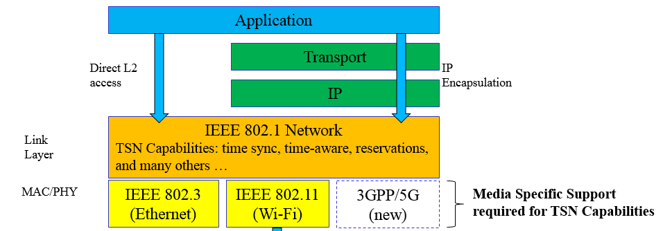
Recap : TSN compatibility
What is suggested by [1]:
802.11 should define compatible features with 802.1 TSN, such as Time-Aware Traffic Shaping
This type of technology should be PHY/Lower MAC independent
RTA technology coverage:
Higher Layer
802.1 Network
SME
Higher MAC
MLME
RTA
802.11 MAC
Lower MAC
802.11 PHY
PHY
PLME

Slide 4
Recap : Additional API?
If we add additional API similar to TSPEC [4],
RTA technology coverage:
Higher Layer
802.1 Network
SME
Higher MAC
MLME
RTA
802.11 MAC
Lower MAC
802.11 PHY
PHY
PLME

Slide 5
Recap: EHT discussion
EHT might be developing real-time technology [3]
However, draft PAR proposal [5] does not include real time capability in its scope…
RTA technology coverage:
Higher Layer
802.1 Network
SME
Higher MAC
MLME
RTA??
802.11 MAC
Lower MAC
802.11 PHY
PHY
PLME

Slide 6
Different approaches potentially exist to achieve similar outcomes regarding RTA
Review and discuss the alternatives

Slide 7
Define real-time technology solely
If RTA becomes solo project:
Pros:
We can secure real-time capability in the specification
The solution could/should be band agnostic
Cons:
The coverage of the technology might be limited in some way, i.e., try to reuse existing components; not requiring hardware changes…
May not deliver best possible latency improvements if not tightly coupled to specific MAC/PHY
802.1 Network
SME
Higher MAC
MLME
RTA
Lower MAC
PHY
PLME

Slide 8
Let EHT work on everything
If it is decided to have EHT work on real time technology
Pros:
We can modify Lower MAC and PHY as needed
Cons:
Not clear if EHT will put emphasis on real time capability
The solution will be operating band specific
Higher Layer
802.1 Network
SME
Higher MAC
MLME
EHT
Real-time feature??
802.11 MAC
Lower MAC
802.11 PHY
PHY
PLME

Slide 9
A more advanced option
We should be able to leverage both RTA focused project deliverable and EHT deliverable
Pros:
Real time technology could be defined as band agnostic framework
We can leverage advanced lower MAC and PHY features if EHT defines such capability
Cons:
Careful RTA/EHT project coordination will be necessary
802.1 Network
SME
Higher MAC
MLME
RTA
EHT
Real-time
Feature ??
Lower MAC
PHY
PLME

Slide 10
Or more challenging goal might help grow the community
If we truly believe that there is a strong need to satisfy challenging low-latency and robustness requirements, it might be better to forget everything about 802.11 backward compatibility…
Pros:
Maybe possible to design truly optimized specification
Cons:
Could be hard to obtain support on this direction from 802.11 community
802.1 Network
SME
Higher MAC
MLME
RTA: Brand new 802.11
Lower MAC
PHY
PLME

Slide 11
Summary
Walked through some options for 802.11 to develop real-time technology
RTA TIG may want to discuss as a group which option would be beneficial to the community while maintaining reasonable/viable project scope

Slide 12
Straw poll (1)
Which option do you think that 802.11 should take?
RTA defines whole real time functionality (forget about EHT)
Let EHT work on the real time capability and do nothing else
RTA defines higher MAC/MLME/SME functionality, whereas soliciting EHT to work on real time lower MAC/PHY technology
Define a whole new MAC/PHY spec from scratch
Need more discussion:

Slide 13
References
[1] IEEE 802.11-18/1542r2, “Time-Aware Traffic Shaping over 802.11,” Dave Cavalcanti, et.al.
[2] IEEE 802.11-18/1972r7, “Thoughts on RTA development,” Kazuyuki Sakoda, et.al.
[3] IEEE 802.11-18/1263r3, “EHT SG formation Motion,” Ron Porat, et.al.
[4] Draft P802.11REVmd D2.0
[5] IEEE 802.11-18/1231r1, “EHT draft proposed PAR,” Laurent Cariou

