Slide 1
Discussion on Multi-Band for EHT
Date: 2019-01-11
Authors:
Name | Affiliation | Address | Email
LiNan | ZTE Corporation | No.9 Wu Xing Section Xi Feng Road Xi’an, Shaanxi Province P.R.China | li.nan25@zte.com.cn
LvKaiying |  |  | lv.kaiying@zte.com.cn
JiaQichen |  |  | Jia.qichen@zte.com.cn
SunBo |  |  | sun.bo1@zte.com.cn

Slide 2
Introduction
Multi-band was initially introduced in IEEE 802.11ad. A multi-band capable device can manage operation over more than one frequency band/channel. The operation across the different frequency bands/channels can be simultaneous or nonsimultaneous[1].
Fast Session Transfer (FST) is a significant feature for Multi-band operation in IEEE 802.11ad . Current FST feature is reviewed and investigated for EHT application in this presentation.

Slide 3
Multi-band Overview
FST provides a mechanism for transfering sessions from one band/channel to another band/channel seamlessly. eg:
Streams on 2.4/5GHz could be transferred to 60GHz for high throughput,or load balancing.
Streams on 60GHz could also be transferred back to 2.4/5GHz for extended range and reliabilty.
Two FST mechanisms are supported :
Nontransparent FST: different bands are identified by different MAC addresses. It is a basic mode for multiband devices
Transparent FST: It needs to virtualize a unique MAC address for multiple bands and present to higher layers, which makes the higher layers unaware of the stream transfer between bands compared with nontransparent FST

Slide 4
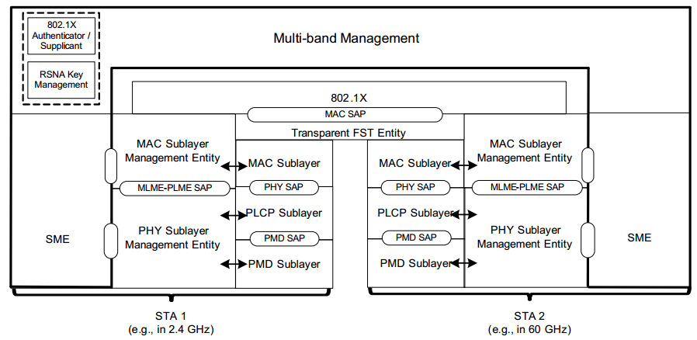
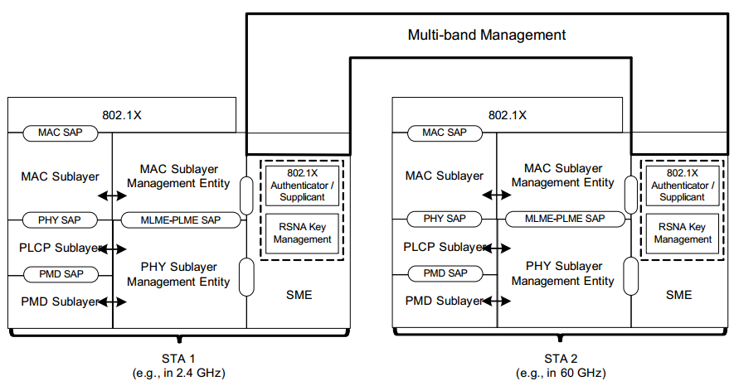
Multi-band Overview
Transparent FST:
One MAC-SAP to highlayer
State information(BA agreements, association state, SNs,etc. )are shared between bands
A Transparent FST Entity manages MSDUs forwarding to related bands.
Nontransparent FST:
Separate MAC-SAPs to highlayer
State information are local
for each band.

Slide 5
Multi-band for EHT
Dual-band or tri-band APs and terminals have been a trend for Wi-Fi equipments nowadays. Multi-band operation is a promising technology for EHT, which could achieve high throughput and flexibility with two or more radios working on different bands.
Both non-transparent and transparent FST prcedure could be reused for EHT in the following scenarios:
Seemless session transfer between bands.This can be supported by the current FST without any change.
Steering data on different bands according to the availability/priority of each band. Prior information about the channel state and pre-defined channel priority are needed.

Slide 6
Multi-band for EHT
Further enhancements could be considered on multi-band operation for EHT, eg:
to enable finer traffic steering
separating MSDUs based on ACs, TIDs, user groups, etc. for better user experience.
to provide more efficient management or control frame transmission
separating mangement and control frames from data frames on different bands.
to facilitate more reliable and lower latency transmission
dynamic duplication of an MPDU on different bands.
to provide flexible DL/UL transmission
flexibe DL/UL configuration or scheduling

Slide 7
Summary
Fast Session Transfer for multiband operation in current IEEE 802.11-2016 and Wi-Fi certification programs is reviewed.
Two modes of Fast Session Transfer should be considered in EHT multiband operation to help efficient use of all bands that the APs/STAs support and optimize the performance of Wi-Fi network in many scenarios.
Further enhancements could be considered.

Slide 8
Reference
[1]IEEE Std 802.11™-2016

