Slide 1
Beamforming Gain for Distributed MIMO
Date: 1/11/2019
Authors:

Slide 2
Introduction
EHT has been discussing various levels of multi-AP coordination
Coordinated vs. joint operation
See [1], [2], [3] for proposed scenarios and terminology
“Joint” operation means that signal intended for a (single) user is transmitted from multiple APs
Signals combine at the receiver
Precoding can be applied over the combined antenna array consisting of the Tx antennas of all distributed APs

Slide 3
Joint Beamforming
Joint Beamforming applies BF precoding using all available antennas as a virtual single antenna array
Possible advantages of joint Beamforming are:
Increased BF gain vs. single AP
Higher total number of antennas available for precoding
Increased (combined) transmit power vs. single AP
Assuming each AP can transmit at the full allowed power level
Depends on regulatory rules for this type of deployment

Slide 4
Distributed BF/power gain
What is the combined BF/power gain of a distributed MIMO system?
Antennas of distributed MIMO system are in physically different locations
Possibly at different distances from the target receiver
Receiver may see unequal power from each of the APs
What is the impact of the antenna separation?
Power gain will no longer be 3 dB
MIMO/BF gain is unknown
No simple model available

Slide 5
Distributed BF/power gain analysis
Purpose of the submission
Analyze combined power gain and BF gain in cases where the distances from the distributed APs to the targeted receiver are different
Simplified analysis based on matrices with complex-valued Gaussian values
Beamforming matrices derived from SVD decomposition
Provides a simple test environment to understand the behavior
Captures the essence of BF (use of dominant singular modes)
Distributed APs are assumed to be 4x4

Slide 6
Simulation approach
4x4 AP to 2x2 client
Model channel as random 2x4 Gaussian matrix
4x2 BF matrix obtained from SVD of channel
Total power normalized to 1
8x8 AP to 2x2 client
Model channel as random 2x8 Gaussian matrix
8x2 BF matrix obtained from SVD of channel
Total power normalized to 1
Two distributed 4x4 APs to 2x2 client
Model channel as random 2x8 Gaussian matrix
8x2 BF matrix obtained from SVD of channel
Total power normalized to 2
Each subset of 4 antennas constrained to power ≤ 1

Slide 7
Modeling different locations
For distributed MIMO, one set of 2x4 channel coefficients is attenuated to model the difference in receive power at the STA

Slide 8
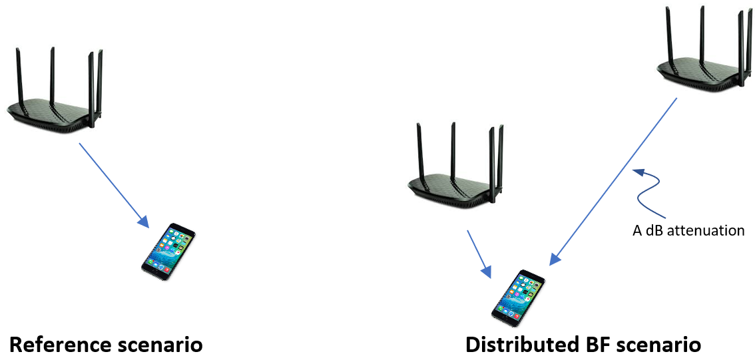
Simulation results
The simulation records the total increase in received power at the target STA
This includes the effects of BF and transmit power level
This level is compared to the received power delivered by a single 4x4 AP with BF

Slide 9
Simulation Results (2)
At equal distance, the gain is ~6 dB as expected
3 dB increased power
3 dB BF gain relative to 4x4
Advantage disappears quickly when distances are unbalanced
Below 3 dB if received powers are unbalanced by 4 dB or more
Very little gain if received powers are unbalanced by 10 dB or more

Slide 10
Simulation Results (3)
If we normalize the received power, we can see the contribution from MIMO BF gain

Slide 11
Distributed MIMO applicability
It appears that maximum power imbalance of 10 dB may be a good rule of thumb for distributed MIMO
Beyond this benefits are minimal
Even without taking into account protocol overhead
This marks areas roughly equidistant from both APs
i.e. “cell edges” in multi-AP deployments
Note that CoMP in LTE is mostly considered in this context as well
See Figures on next slides

Slide 12
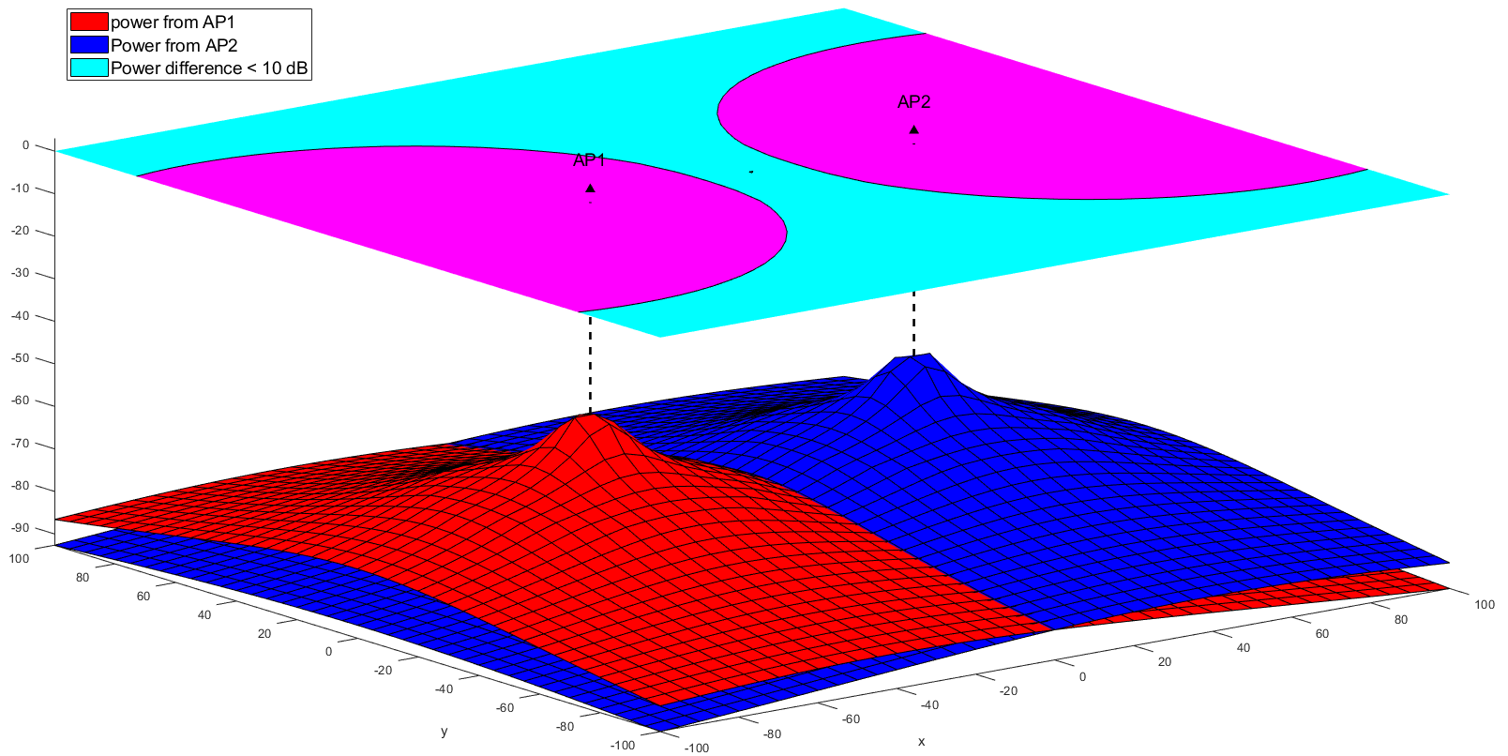
Power imbalance – open space
Channel D propagation loss assumed
Area with power imbalance ≤ 10 dB roughly coincides with cell edge
Little to no gain expected inside the original BSS

Slide 13
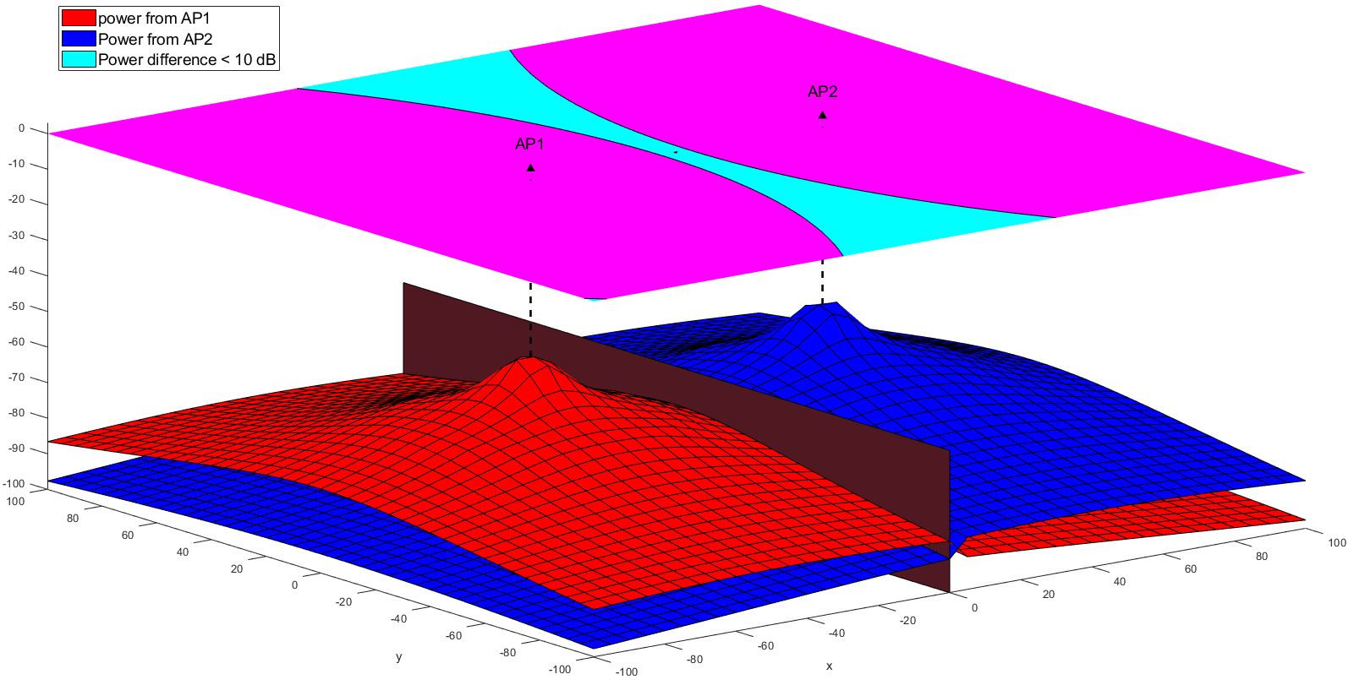
Power imbalance – wall separation
Channel D propagation loss + 1 wall between APs
Area with power imbalance ≤ 10 dB highly affected by in-home obstructions

Slide 14
Conclusion
Joint BF is affected by the separation of the distributed APs
Power and BF gain are a function of the distance from the STA to each of the APs
The power imbalance between the two APs needs to be limited to get power/BF gain
NOTE: this does not guarantee performance gain since MAC overhead needs to be considered as well

Slide 15
Conclusion (2)
Joint BF is most useful for improving “cell edge” performance
It does not provide uniform improvement like a single higher-order MIMO system
Use cases should be defined accordingly
E.g. hot spot
In In-home environments, the areas of improvement are hard to predict
Walls and other obstructions add to the imbalance in received power

Slide 16
Other Questions
How does this affect Distributed MU-MIMO?

Slide 17
References
[1] Discussions on Multi-AP Coordination, 802.11-18/1509
[2] Terminology for AP Coordination, IEEE 802.11-18/1926r2
[3] Considerations on AP Coordination, IEEE 802.11-18/1576r1

