Slide 1
Further discussion for WLAN Radar
Date: 2019-01-03
Name | Affiliation | Address | Phone | Email
Tony Xiao Han | Huawei Technologies |  |  | Tony.hanxiao@huawei.com
Rui Du | Huawei Technologies
Wei Lin | Huawei Technologies
Ross Jian Yu | Huawei Technologies
Yan Xin | Huawei Technologies

Slide 2
Outline
Background and motivation
Opt 1. No change for the Spec
Opt 2. Scheme in [2]
Opt 3. Modified scheme based on [2]
Opt 4. Dedicated explicit indication scheme based on [2]
Summary and comparison
Conclusion

Slide 3
Background and motivation
As described in [1], radar use-case in unlicensed mmWave starts to gain interest in the industry for many applications.
Hence, in [1, 2], radar is proposed as part of the WLAN framework, in order to achieve better Coexistence and sharing between radar function and WLAN function.
In this proposal, we want to summarize and analyze all possible solutions considered so far to include radar function in WLAN, and ask for the feedback from the group.

Slide 4
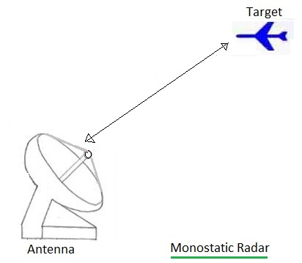
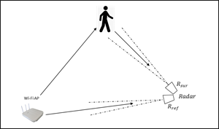
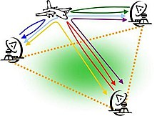
Background and motivation
Monostatic radar is a type of radar in which the transmitter and receiver are collocated.
Bistatic radar is the name given to a radar system comprising a transmitter and receiver that are separated by a distance comparable to the expected target distance.
A system containing multiple spatially diverse Monostatic radar or Bistatic radar components with a shared area of coverage is called Multistatic radar.
The Multistatic radar could be used to do, e.g., target detection, with the following advantages comparing to Monostatic radar:
Multistatic radar is able to localize the target with only a single time radar signal transmission
Multistatic radar system, which include multiple receivers at different locations, is more robust than Monostatic radar on target detection.
Bistatic Radar
Multistatic Radar

Slide 5
Opt 1. No change for the Spec
A possible scheme without changing the Spec
The radar STA (i.e., STA with radar function) could send DMG CTS-to-Self to set the NAV,
Then radar STA could transmit any radar signal during the TXOP.
Pros
No change for the Spec (especially in the late phase of the 11ay project)
Could work for Monostatic radar
Cons
May not robust enough, since the WLAN device may miss the DMG CTS-to-Self and fail to set the NAV, and then only energy detection could be used for the following radar signal.
Does not support Bistatic/Multistatic radar. Since the transmitter and receiver are in different devices for Bistatic/Multistatic radar, so without explicit indication, the receivers do not know the PPDU is for radar, then do not know when to turn on/switch to radar functionality, and do not know when and where to receive the radar signal.

Slide 6
Opt 2. Scheme in [2]
Scheme in [2] including some modification for the Spec, e.g.,
The DMG PHY and EDMG PHY is used to implement radar functionality
Setting RA=TA for some types of frame (e.g., SSW), and this “may” indicate for radar functionality
Adding TRN for some types of frame (e.g., SSW), which is not allowed in the Spec for now
Pros
More robust than Opt 1, since radar signal is included in a DMG/EDMG PPDU.
Could work for Monostatic radar
Cons
EDMG PHY is not a good choice, since 11ad STA cannot understand 11ay preamble and so on (e.g., MAC header including RA, TA, and Duration fields), and cannot set NAV. Hence, 11ad STA may potentially transmit, which could create interference to radar signal.
Receiving a DMG PPDU with RA=TA, the unintended STAs do not explicitly know it’s radar PPDU/TXOP, then the STAs only keep quiet during the TXOP, but cannot go to sleep (or go to sleep with concern/risk), since the TXOP holder (e.g., PCP/AP) may transmit to them. But keeping awake and receiving each following PPDU is wasting the energy of the unintended STAs.
Does not support Bistatic/Multistatic radar. Since the transmitter and receiver are in different devices for Bistatic/Multistatic radar, so without explicit indication, the receivers do not know the PPDU is for radar, then do not know when to turn on/switch to radar functionality, and do not know when and where to receive the radar signal.

Slide 7
Opt 3. Modified scheme based on [2]
Enhanced scheme based on [2]
Only the DMG PHY is used to implement radar functionality
Using RA=TA for few types of frame (e.g., SSW) as explicit indication for radar PPDU/TXOP
Adding TRN for some frames (e.g., SSW)
Pros
More robust than Opt 1&2, since radar signal is included in a DMG PPDU and explicitly indicated.
The unintended EDMG STAs explicitly know it’s radar PPDU/TXOP, then the STAs could go to sleep without any concern/risk, since the TXOP holder (e.g., PCP/AP) will not transmit to them during the TXOP.
Cons
It is a misusing of “RA=TA” and will cause problem in the future. E.g., if we want other function/indication, and together with setting RA=TA at the same time, then it will cause problem for radar functionality (e.g., will cause false alarm for Bistatic/Multistatic radar) and for EDMG STA (will treat it as radar PPDU/TXOP, which is not, and will improperly go to sleep).
Still does not work for Bistatic/Multistatic radar. Since the RA=TA, i.e., RA does not indicate the actual receiver, hence the receiver could not receive this radar PPDU.

Slide 8
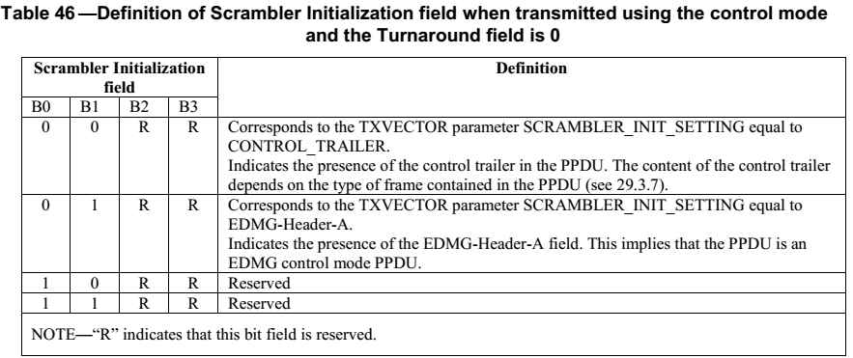
Opt 4. Enhanced scheme based on [2]
Enhanced scheme based on [2]
Only the DMG PHY is used to implement radar functionality
Adding dedicated explicit indication for radar PPDU/TXOP
E.g., 1 reserved value in Scrambler Initialization field
(in Table 46 in [3]) in control mode PPDU
Adding TRN for some frames (e.g., SSW)
Pros
More robust than Opt 1&2&3, since radar signal is included in a DMG PPDU and dedicated explicitly indicated.
The unintended EDMG STAs explicitly know it’s radar PPDU/TXOP, then the STAs could go to sleep without any concern/risk, since the TXOP holder (e.g., PCP/AP) will not transmit to them during the TXOP.
Could work for Monostatic radar and Bistatic/Multistatic radar
Will not cause any further problem in the future
Cons
Need explicit indication (if we call this is Cons/drawback☺)

Slide 9
Summary and comparison
 | Robustness/Coexistence | Monostatic radar | Bistatic/Multistatic radar | Power saving | Spec change
Opt 1. No change for the Spec E.g., DMG CTS-to-Self, then any radar signal | Low. since the WLAN device may miss the DMG CTS-to-Self and fail to set the NAV | Yes (could work) | No | No | No
Opt 2. Scheme in [2] E.g., DMG PHY and EDMG PHY, RA=TA (non explicit indication ), adding TRN | Medium. Better than Opt 1. But EDMG PHY is not a good choice | Yes | No | No | Yes
Opt 3. Modified scheme based on [2] E.g., DMG PHY, explicit indication by setting RA=TA for few types of frame , adding TRN | Medium. Better than Opt 1&2. But it is a misusing of “RA=TA” and will cause problem in the future. | Yes | No | Yes The unintended EDMG STAs explicitly know it’s radar PPDU/TXOP, then the STAs could go to sleep without any concern/risk, | Yes
Opt 4. Dedicated explicit indication scheme based on [2] E.g., DMG PHY, dedicated explicit indication, adding TRN | High. Better than Opt 1&2&3 | Yes | Yes | Yes The unintended EDMG STAs explicitly know it’s radar PPDU/TXOP, then the STAs could go to sleep without any concern/risk, | Yes

Slide 10
Conclusions
This contribution summarizes and analyzes all possible solutions considered so far to include radar functionality in WLAN
After comparison, it seems that the Opt 1 could work without changing the Spec.
If the group agrees to change the Spec, then the Opt 4 is a better solution.

Slide 11
Straw Poll/Motion 1
Which option do you prefer for adding radar functionality?
(The corresponding draft text will be provided if Opt 4 is preferred)
Opt 1. No change for the Spec
E.g., DMG CTS-to-Self, then any radar signal
Opt 2. Scheme in [2]
E.g., DMG PHY and EDMG PHY, RA=TA, adding TRN
Opt 3. Modified scheme based on [2]
E.g., DMG PHY, explicit indication by misusing RA=TA, adding TRN
Opt 4. Dedicated explicit indication scheme based on [2]
E.g., DMG PHY, dedicated explicit indication, adding TRN
Abstain

Slide 12
References
[1] 11-18-2094-00-00ay-wlan-radar.pptx
[2] 11-18-2095-00-00ay-wlan-radar-annex.docx
[3] Draft P802.11ay_D2.1.pdf

