Slide 1
Use cases for RTA in vehicles
Date: 2019-01-14
Authors:

Slide 2
Abstract
This presentation introduces automotive use cases and market/technical requirements for time sensitive and high reliability communications inside a vehicle.

Slide 3
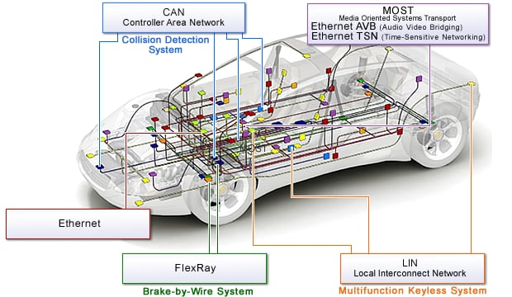
Automotive communication architecture
Multiple protocols
CANBus
LIN
MOST
FlexRay
802.3bp/bw (twisted pair Ethernet)
Varied requirements
AVB/TSN
ASIL/ISO 26262
Wiring harness weight & complexity is a concern
WLAN could possibly reduce weight and complexity, but will need to meet reliability, latency and security requirements

Slide 4
Intra-vehicle Communication Requirements (WLAN)
Robustness
AV: High (users will expect wire-like multimedia QoE)
Actuators: Very high (shouldn’t have to press a button twice)
Sensors: Very high (depending on use case – washer fluid isn’t critical)
Latency requirements (How important is low latency?)
AV: High importance – AVB/TSN/AVnu (802.1BA, 802.1AS…125 μsec interframe, 1 μsec accuracy)
Actuators: Medium-High importance (wire-like response)
Sensors: Medium-High importance (some sensors need very low latency)
Security
AV: Medium (encryption for content protection may be required)
Actuators: Very High
Sensors: Very High (depending on use case)
NOTE: Automotive Safety Integrity Level (ASIL) requirements will be needed for actuator/sensor functional safety. ASIL has its own timing requirements to prevent MITM and other attacks. ISO 26262

Slide 5
Conclusion
Replacing wired connections in a vehicle with wireless LAN could reduce weight and wiring harness complexity
Adding a redundant link via wireless is also useful
Automotive uses place high demands on robustness, latency, and security
AV distribution requires high bandwidth, low latency
802.1BA & 802.1AS + others
802.11ad/ay are excellent candidates – under evaluation by OEMs
Sensors/actuators need high reliability and security
ASIL requirements will also require low latency

Slide 6
References
Standard | Title | Status | Date
IEEE 802.1BA-2011 | Audio Video Bridging Systems | Ratified and published | 30 September 2011
IEEE 802.1Qav | Forwarding and Queuing Enhancements for Time-Sensitive Streams | Ratified and published | 5 January 2010
IEEE 802.1Qat | Stream Reservation Protocol (SRP) | Ratified and published | 30 September 2010
IEEE 802.1Q-2011 | Incorporates IEEE 802.1Qav and IEEE 802.1Qat | Ratified and published | 31 August 2011
IEEE 802.1AS-2011 | Timing and Synchronization for Time-Sensitive Applications in Bridged Local Area Networks | Ratified and published | 30 March 2011
IEEE 1722-2011 | Layer 2 Transport Protocol for Time Sensitive Applications in a Bridged Local Area Network | Ratified and published | 6 May 2011
IEEE 1733-2011 | Layer 3 Transport Protocol for Time Sensitive Applications in Local Area Networks | Ratified and published | 25 April 2011
IEEE 1722.1-2013 | Device Discovery, Enumeration, Connection Management and Control Protocol for 1722-Based Devices | Ratified and published | 23 August 2013
[1] ASIL link on Wikipedia: https://en.wikipedia.org/wiki/Automotive_Safety_Integrity_Level
[2] ISO 26262 link on Wikipedia: https://en.wikipedia.org/wiki/ISO_26262#Automotive_Safety_Integrity_Level_(ASIL)

