Slide 1
RTA report summary
Date: 2019-03-12
Authors:

Slide 2
Abstract
The purpose of this presentation is to provide a summary of RTA discussions and recommendations.

Slide 3
Outline
RTA report summary
RTA recommendations

Slide 4
Missions & Objectives
◆ RTA mission：
  ➣ Investigate latency and stability issues observed with real time applications such as mobile and multiplayer games, robotics and industrial automation
  ➣ Potential mechanisms to address the identified issues
◆ Objectives：
  ➣ Publish an informational report describing use cases, requirements, supporting data (e.g. tests, experiments, simulations results) and potential solution directions to guide the development of 802.11 capabilities to better support the RTA requirements
  ➣ Ensure RTA TIG meet the timeline through group consensus
  ➣ Publish necessary test environment and test plan as needed to validate the requirements stated in usage model

Slide 5

RTA Use Cases
Real-time mobile gaming
Console gaming
Industrial automation
Real-time video
AR/VR
Drone control
Cloud Gaming
RTA TIG report doc.#: 11-18-2009

Slide 6
Use cases and requirements (examples)
Use cases |  | Intra BSS latency/ms | Jitter variance/ms [4] | Packet loss | Data rate/ Mbps
Real-time gaming [2] |  | < 5 | < 2 | < 0.1 % | < 1
Cloud gaming [15] |  | < 10 | < 2 | Near-lossless | <0.1 (Reverse link) >5Mbps (Forward link)
Real-time video [3] |  | < 3 ~ 10 | < 1~ 2.5 | Near-lossless | 100 ~ 28,000
Robotics and industrial automation [1] | Equipment control | < 1 ~ 10 | < 0.2~2 | Near-lossless | < 1
 | Human safety | < 1~ 10 | < 0.2 ~ 2 | Near-lossless | < 1
 | Haptic technology | <1~5 | <0.2~2 | Lossless | <1
 | Drone control | <100 | <10 | Lossless | <1 >100 with video
^{[1]}
The main issue is worst-case latency
Real-time applications need both low latency and low jitter
Higher reliability is also an important new requirement

Slide 7
Challenges and gaps
Although average latency in 802.11 may be low, worst case latency can vary significantly
  Real-time applications are highly sensitive to spikes in latency and jitter
  Although the required latency can vary, a common need for all real-time applications is to control the worst-case latency
  Many applications also need to higher reliability
Existing 802.11 QoS mechanisms (e.g. EDCA priorities) can be used to reduce average latency, but they do not address the worst-case latency, which can still vary significantly [3]

Slide 8
New capabilities needed to support RTA
Extensions of TSN to 802.11 (Wireless TSN)
  802.1 TSN group has been developing capabilities to control latency, jitter, and provide higher reliability over Ethernet and extensions of TSN over 802.11 can help better support RTA
  Potential new TSN features over 802.11 include:
    Time-Aware shaping (802.1Qbv)
    Frame Replication and Elimination (FRE) through dual/multi-link
Multi-band operation is also an important capability to support not only RTA, but to enable coexistence with other high throughput applications through traffic steering/separation
New MAC/PHY enhancements

Slide 9
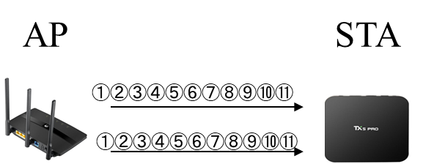
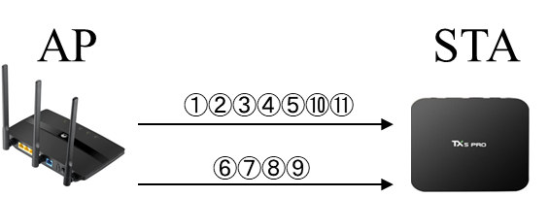
Technical features example (1)
Dual/multiple link[1]
  Duplicated mode: Frame replication and elimination
    Reliability, low latency, low jitter
  Joint mode
    Throughput, low latency

Slide 10
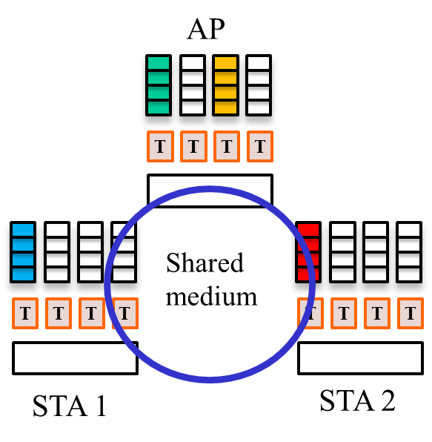
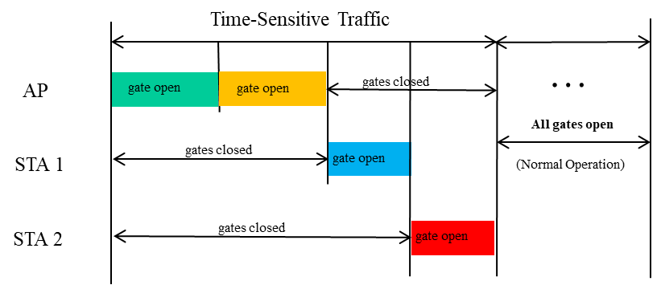
Technical features example (2)
Time-Aware Shaping (802.1Qbv over 802.11 [2]): control queues and access to the medium to ensure time-sensitive traffic is delivered within the required worst-case latency and jitter

Slide 11
Technical features example (3)
AX-like approach. Possible Algorithm
Non-RT RU
RU m
STAs: m, 2m, …
STAs: m
RU m
RT RA RU, idle
…
…
STAs: 2m
…
RT RU, idle
RU 2
STAs: 2, m+2 , …
STAs: m+2
RU 2
RT RU, success
RU 1
STAs: 1, m+1 , …
STAs: 2
RU 1
RT RU Collision
RU 0
RU 0
RU 0
RU 0
STAs 1, 2, m, 2m transmit RT frames
Apart from that, STA m+2 transmits.
Time
By default, the AP allocates 1 RUs for random access
In case of collision, the remaining m RUs are allocated for RA RT uniformly for those STAs, which might participate in the collision
If the number of RT STAs is greater than m, each RU is allocated for several STAs

Slide 12
New MAC/PHY enhancements to support RTA
Predictable and efficient medium access
Reduced PHY overhead and support for time-sensitive small packet transmissions
Improved management and time-sensitive data coexistence
Coordination between APs/BSSs to reduce impact of OBSS on latency/reliability
Dual/Multiple links transmission
  Duplicated mode
  Joint mode

Slide 13
Recommendations & Next Steps
Implement QoS Prioritization for RTA on both Tx and Rx
  Improve average latency with only one direction (uplink)[3]
Refer to RTA requirements metrics as usage model
Develop new MAC/PHY capabilities to address low latency, low jitter and reliability issues to support RTA
EHT has incorporated low latency as part of its PAR and CSD

Slide 14
References
[1] Kate Meng “11-18-1543-04-0rta-rta-report-draft
[2] Dave Cavalcanti et al, “11-18-1892 Time-Aware shaping (802.1Qbv) support in the 802.11 MAC.”
[3] Karthik, Allan Jones, “11-18-2098-01-0rta-packet-prioritization-issues-followup

