Slide 1
Proposed resolution of CID 3518
Date: 2019-01-15
Name | Affiliation | Address | Phone | Email
Mohamed Abouelseoud | Sony | 1730 N. First Street, San Jose CA 95112 |  | Mohamed.Abouelseoud(at)sony.com
Kazuyuki Sakoda |  |  |  | kazuyuki.sakoda(at)sony.com

Slide 2
CID | PP.LL | Comment | Proposed Change
3518 | 11.31.6 | Multi-band discovery assistance allows discovery of an AP or PCP that this STA is connected to however this is not enough. For some use cases, the STA might need to talk to a non-AP/PCP STAs in the same BSS or even in other BSSs . A STA should find other non-AP in that BSS and other BSS | The standard should define a mechanism to allow new STA to find neighbor STAs in an on-demand fashion. Commenter is willing to provide resolution text.

Slide 3
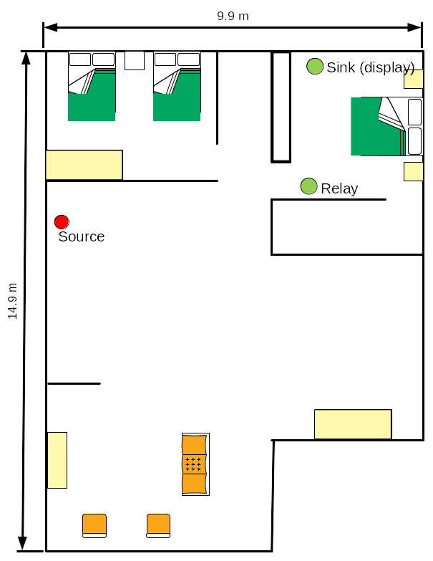
Overview (1)
Multi-band discovery assistance is included in 802.11ay D2.0 to allow a new STA to trigger on-demand sector sweeping instead of the continuous exhaustive sector sweeping all the time by AP
New STA (Sink) can use lower band connection to trigger an AP (Source) mmW beamforming
Source
Sink
Lower band signal
mmW band signal

Slide 4
Overview (2)
New STA (Sink) connects to the Source using lower band
New STA (Sink) might not be in the Source range to form mmW link
If the New STA (Sink) discovers other STAs that is connected to the Source (Relay), L3 routing is used to extend coverage and reach out to the Source
New STA (Sink) needs to find other neighbor DMG STAs (Relay) and beamform with them in an on-demand fashion to reach out to the source
Source
Lower band signal
mmW band signal

Slide 5
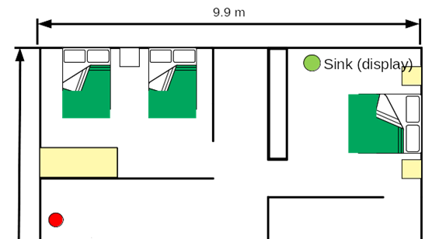
Overview (3)
Relay is a device operates at the same channel with more than one STA
Each STA can have its own MAC and PHY and coordinated by the co-channel coordinated management[*]
BSS2
co-channel coordinated management
Relay
BSS1
STA 1
STA 2
Source
Lower band signal
mmW band signal
* IEEE 802.11-18/1801r0

Slide 6
Example- 1/5
Lower band signal
mmW band signal
New STA establish a link to AP on lower band
New STA sends discovery assistance request to AP on lower band
New STA
Multi-band capable STA
Multi-band Discovery Assistance Procedure
FST Setup Request frame with DMG Discovery Assistance & DMG Capabilities elements
Established sub-6GHz link
(1) Discovery Asst. Req
Co-channel coordinated management
Established mmW link
STA1
PCP 1
AP
Multi-band capable AP

Slide 7
Example- 2/5
Lower band signal
mmW band signal
AP propagates the DMG discovery assistance request to STA 1 on mmW band
STA 1 responds to AP with DMG discovery assistance response if it supports discovery assistance on mmW band
Response include:
  Discovery assistance response (accept/reject)
  PCP1 start time of discovery assistance
  Discovery assistance window length
  MAC address of PCP 1
New STA
Multi-band capable STA
Established sub-6GHz link
(1) Discovery Asst. Req
Co-channel coordinated management
(3) Discovery Asst. Resp.
Established mmW link
STA1
PCP 1
AP
(2) Discovery Asst. Req.
Multi-band capable AP
Information Request frame with DMG Discovery Assistance & DMG Capabilities elements
Information Response frame with DMG Discovery Assistance element

Slide 8
Example- 3/5
Lower band signal
mmW band signal
AP responds to new STA with DMG discovery assistance response on lower band
Response includes:
  Discovery assistance response (accept/reject)
  Scan mode (active/passive)
  MAC address of AP and PCP 1
  Start time of the discovery assistance (including AP and PCP1)
  Discovery assistance window length (including AP and PCP1)
New STA
Multi-band Discovery Assistance Procedure
FST Setup Response frame with DMG Discovery Assistance element
Multi-band capable STA
(4) Discovery Asst. Resp
Established sub-6GHz link
(1) Discovery Asst. Req
Co-channel coordinated management
(3) Discovery Asst. Resp.
Established mmW link
STA1
PCP 1
AP
(2) Discovery Asst. Req.
Multi-band capable AP

Slide 9
Example- 4/5
Lower band signal
mmW band signal
In case of active scanning:
  AP and PCP 1 listen on mmW band at the advertised time
  New STA sweeps Probe Request/Discovery Beacons at the advertised time
  New STA can form mmW link with the STA in range
New STA
Multi-band capable STA
mmW SSW
Potential mmW link
Potential mmW link
Established mmW link
STA1
PCP 1
AP
Multi-band capable AP

Slide 10
Example- 5/5
Lower band signal
mmW band signal
In case of Passive scanning:
  AP and PCP 1 start SSW on mmW band at the advertised time
  New STA can form mmW link with the STA in range
New STA
Multi-band capable STA
Potential mmW link
Potential mmW link
mmW SSW
mmW SSW
Established mmW link
STA1
PCP 1
AP
Multi-band capable AP

Slide 11
How to enable neighbor discovery
DMG Discovery Assistance element is already defined in the 802.11ay D2.0
The Information Request frame is used to propagate the DMG Discovery Assistance element from the STA requesting discovery assistance to other STAs
The Information Response frame can be used to send the DMG Discovery Assistance element including a response to the propagated discovery assistance request
AP processes the responses and sends one response to the STA requesting discovery assistance ( FST Setup Response frame)

Slide 12
DMG discovery assistance request
Information Request frame
New STA DMG Capabilities element
DMG Discovery Assistance element
Discovery Assistance Control
Discovery Assistance Request Status Code
Number of STAs Providing Discovery Assistance
Discovery Assistance Window Length
Sector Sweep Start Time (optional)
Element ID
Length
Element ID Extension
Discovery Assistance Type
Dwelling Time Present
Scan Mode
Reserved

Slide 13
DMG Discovery assistance response
Information Response frame
DMG Discovery Assistance element
Discovery Assistance Control
Discovery Assistance Request Status Code
Number of STAs Providing Discovery Assistance
MAC Address of STA 1
Discovery Assistance Window Length
Sector Sweep Start Time
Element ID
Length
Element ID Extension

Slide 14
Discovery assistance response to new STA
AP sets the discovery assistance response to the new STA as follows:
  Add the MAC Addresses of all STAs providing discovery assistance
  Send the scan mode for the new node
  Send the discovery assistance campaign allocation as one of these options:
    Send the earliest SSW start time of all STAs in the discovery campaign and the period of time where the discovery campaign is active (Sector Sweep Start time and Discovery Assistance Window Length fields in the DMG Discovery Assistance element); or
    Send the Extended Schedule element, each STA providing discovery assistance is mapped to an allocation field in the Extended Schedule element
* Details in document 0020r0

Slide 15
Multi-band Discovery assistance response
FST Setup Response frame
DMG Discovery Assistance element
Other optional elements
Discovery Assistance Control
Discovery Assistance Request Status Code
Number of STAs Providing Discovery Assistance
MAC Address of STA 1
MAC Address of STA N
Discovery Assistance Window Length
Sector Sweep Start Time (optional)
Temporary AID (optional)
Dwelling Time (optional)
Element ID
Length
Element ID Extension
…
Discovery Assistance Type
Dwelling Time Present
Scan Mode
Reserved

Slide 16
Straw Poll
Do you support the proposed resolution of CID 3518?
  Yes
  No
  Abstain

