Slide 1
Simulation of NGV Channel Models
Date: 2019-01-11
Authors:
Name | Affiliations | Address | Phone | email
Prashant Sharma | Marvell | 5488 Marvell Ln, Santa Clara, CA 95054 |  | psharma@marvell.com
Rui Cao |  |  |  | ruicao@marvell.com
Hongyuan Zhang |  |  |  | hongyuan@marvell.com

Slide 2
Introduction
Car-to-Car (C2C) channel models have been proposed for NGV studies [1].
In this contribution, we present a methodology to generate the C2C channels based on the power, delay and doppler parameters as specified in [1].
We also propose the PHY impairment models to be used in the NGV link-level simulations.

Slide 3
C2C Channel Model Recap [1]
Table 1: Rural LOS Parameters
Table 4: Highway LOS Parameters
 | Tap1 | Tap2 | Tap3 |  | Units
Power | 0 | -14 | -17 |  | dB
Delay | 0 | 83 | 183 |  | ns
Doppler | 0 | 90 | -54 |  | Km/h
Profile | Static | HalfBT | HalfBT
 | Tap1 | Tap2 | Tap3 | Tap4 | Units
Power | 0 | -10 | -15 | -20 | dB
Delay | 0 | 100 | 167 | 500 | ns
Doppler | 0 | 126 | -90 | 162 | Km/h
Profile | Static | HalfBT | HalfBT | HalfBT
Table 2: Urban Approaching LOS Parameters
Table 5: Highway NLOS Parameters
 | Tap1 | Tap2 | Tap3 | Tap4 | Units
Power | 0 | -8 | -10 | -15 | dB
Delay | 0 | 117 | 183 | 333 | ns
Doppler | 0 | 43 | -29 | 90 | Km/h
Profile | Static | HalfBT | HalfBT | HalfBT
 | Tap1 | Tap2 | Tap3 | Tap4 | Units
Power | 0 | -2 | -5 | -7 | dB
Delay | 0 | 200 | 433 | 700 | ns
Doppler | 0 | 126 | -90 | 162 | Km/h
Profile | Static | HalfBT | HalfBT | HalfBT
Table 3: Urban Crossing NLOS Parameters
 | Tap1 | Tap2 | Tap3 | Tap4 | Units
Power | 0 | -3 | -5 | -10 | dB
Delay | 0 | 267 | 400 | 533 | ns
Doppler | 0 | 54 | -18 | 108 | Km/h
Profile | Static | HalfBT | HalfBT | HalfBT
Five C2C channel models to cover different scenarios
Main tap (1st tap) always has zero Doppler, and relative Doppler is modeled on other taps.

Slide 4
Delay Model
C2C channel models fixed tap delays at nano-second level.
Sampling rate of 10MHz gives time resolution of 100ns.
Tap delays cannot be modeled accurately at this time resolution.
We suggest the simulation sampling rate to be at least 80MHz.
Provides a resolution of at least 12.5ns.
Good enough to model the tap delay for all C2C models.
Each tap delay will be translated to the nearest resolvable tap index.
The higher sampling rate can also be beneficial for ACI simulations.

Slide 5
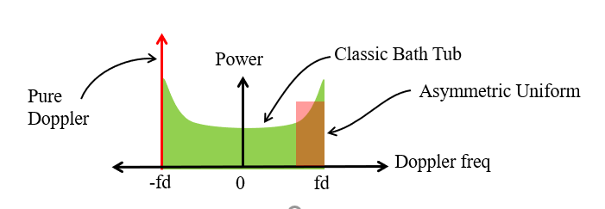
Doppler Model
C2C channels specify biased doppler profile for all channel taps.
There are different ways to model the doppler [2]:
Classic Bathtub using Jakes’ model, Dents’ model, etc.
Offset Classic Bathtub
Asymmetric uniform
Pure doppler
We propose to choose “pure Doppler” method: Doppler shift
Every tap doppler is modeled as a single Doppler shift
Captures the worst case instantaneous Doppler scenario
Helpful in stress testing the performance
Very simple to model, while other models needs to have knowledge on the number of reflectors, reflector phase, and etc.

Slide 6
C2C Channel Model
Channel is modeled as tapped delay line with Doppler shift
$$h\left(t,τ\right)=a_{1}+\sum_{i=2}^{K}{a_{i}exp⁡(j2πf_{i}}t)δ(τ−τ_{i})$$
where,
$a_{i}$ is the channel for each delay tap at time t =0 and modelled as complex Gaussian.
The variance follows the normalized power profile.
$a_{1}$ is static, i.e. no Doppler shift
For all other taps, $exp⁡(j2πf_{i}$t) models Doppler frequency shift of $f_{i}$ Hz for the $ith$tap
Channel evolves on a per sample basis
$t$ has the resolution of sample time (for example, 1/80MHz)

Slide 7
C2C Channel Model (contd.)
Rayleigh fading coefficient $a_{i}$ is generated as:
$$a_{i}=X_{i}+{jY}_{i}$$
where,
$X_{i }\sim N\left(0,{σi}^{2}\right)$ and $Y_{i }\sim N\left(0,{σi}^{2}\right)$are independent normal random variables
${σi}^{2}$ scales according to the power distribution as specified in the channel model with the total power normalized to 1.

Slide 8
PHY Impairments
PHY impairments will affect the performance evaluation of the any future proposals.
We suggest to follow 802.11ac functional requirement document [3] to define the PHY impairments for 802.11bd.
Summary(from [3])
PA Non-linearity
Use RAPP PA model as specified in document 00/294 with p = 3.
Carrier Frequency Offset
Randomly chosen from [-20 , 20] ppm with a uniform distribution.
Phase noise
The phase noise will be specified with a pole-zero model
PSD(0) = -100 dBc/Hz
Pole frequency fp = 250 kHz
Zero frequency fz = 7905.7 kHz

Slide 9
Simulation
Settings
Packet size : 300 bytes
Packet format : 11p – BCC Coding with DFE Channel tracking
Number of channel realizations: 1000
Rx processing:
Ideal timing
CFO estimation and compensation in preamble portion
CPE estimation and compensation in data portion
Impairments: On/Off
CFO
Phase Noise

Slide 10
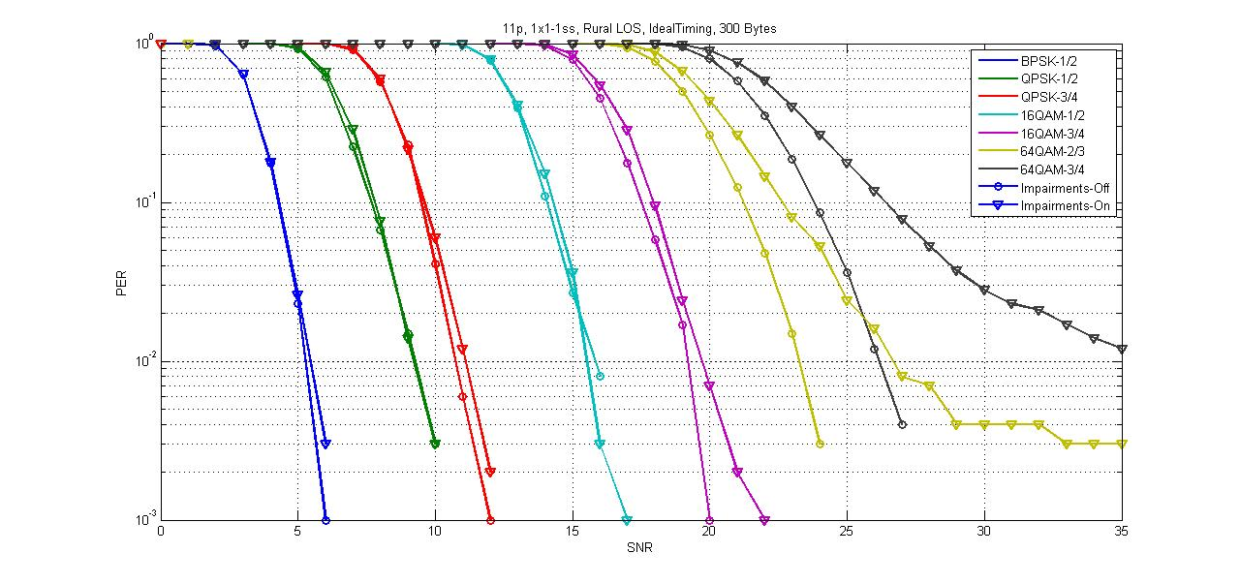
Results: Rural LOS
PHY impairments have a noticeable impact on the performance of higher order QAMs for 11p

Slide 11
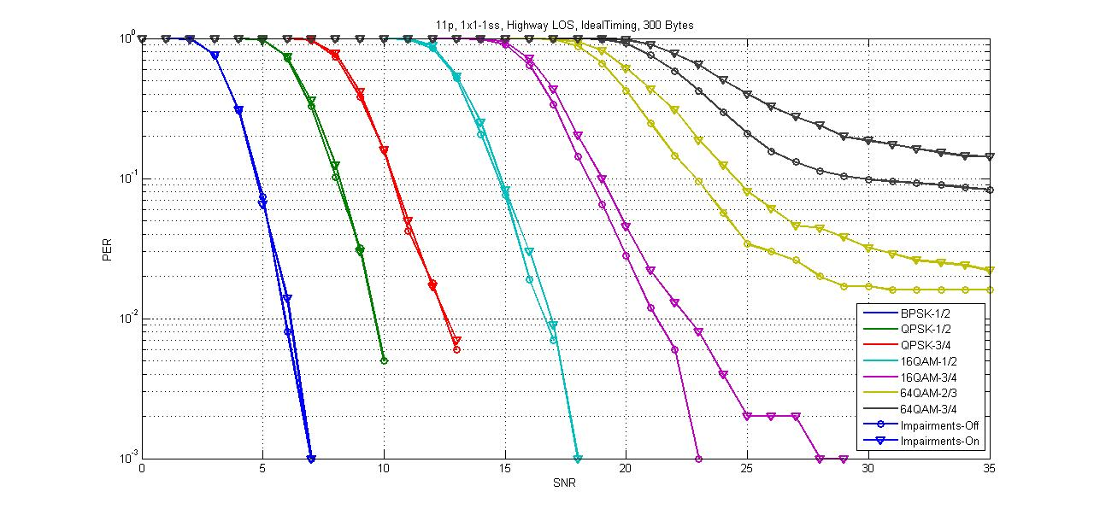
Results: Highway LOS
PHY impairments have a noticeable impact on the performance of higher order QAMs for 11p

Slide 12
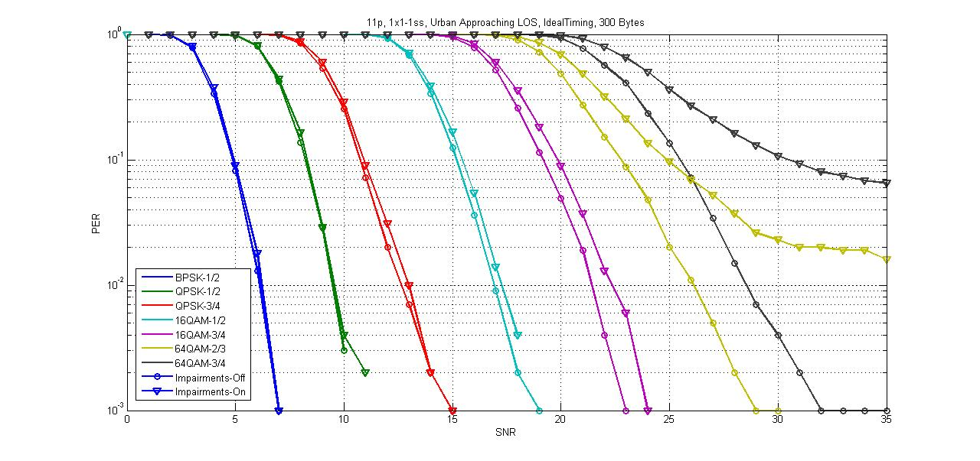
Results: Urban Approaching LOS
PHY impairments have a noticeable impact on the performance of higher order QAMs for 11p

Slide 13
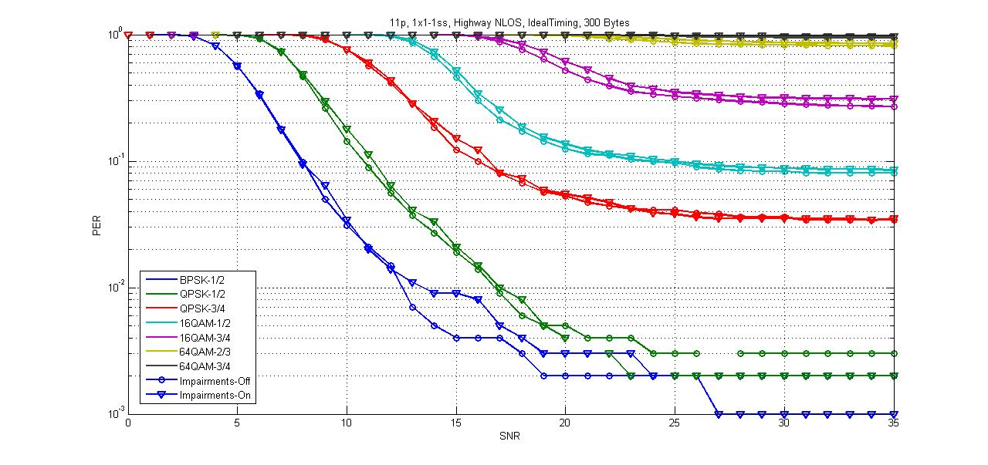
Results: Highway NLOS
Fast channel variation dominates the effect of PHY impairments for high doppler NLOS channel

Slide 14
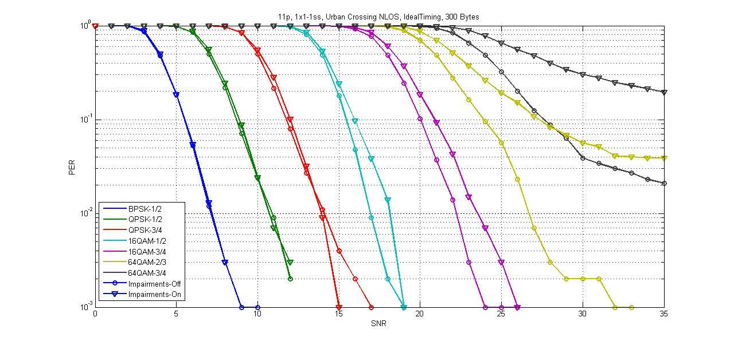
Results: Urban Crossing NLOS
PHY impairments have a noticeable impact on the performance of higher order QAMs for 11p

Slide 15
Summary
Suggested a methodology to generate C2C channels.
Need to oversample in order to model tap delay correctly
Use pure Doppler for each complex Gaussian channel tap
Channel evolves on a per sample basis
Proposed to include PHY impairments based on 11ac in the simulation model for 11bd.
Provided simulation results for 11p under all C2C channels as a benchmark to compare with any future proposals.
Suggest all interested personnel to simulate and calibrate their simulators for future proposals.

Slide 16
Reference
[1] Hongyuan Zhang and etc., “11-18-0858-00-0ngv-c2c-channel-model-overview”
[2] Malik Kahn, “11-14-0259-00-0reg-v2v-radio-channel-models”
[3] Peter Loc, Minho Cheong, “11-09-0451-16-00ac-tgac-functional-requirements-and-evaluation-methodology”

Slide 17
Appendix

Slide 18
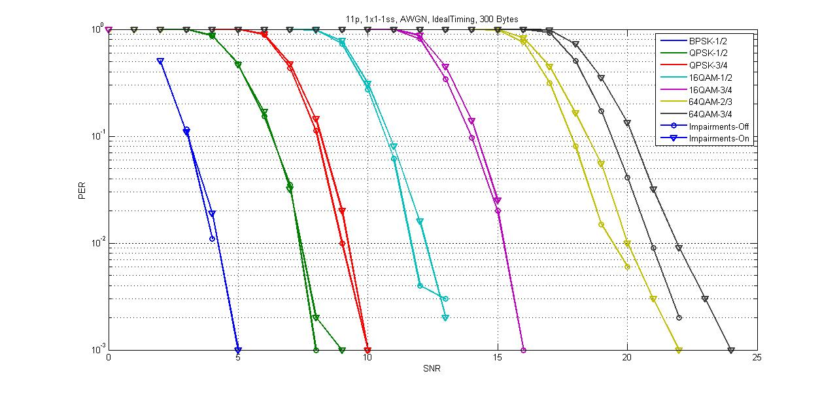
Results: AWGN

