Slide 1
HARQ in EHT
Date: 2018-11-12
Authors:
Name | Affiliation | Address | Email
Imran Latif | Quantenna Communications | 1704 Automation Parkway, 95131, San Jose, CA, USA | ilatif@quantenna.com
Sigurd Schelstraete |  |  | sschelstraete@quantenna.com
Debashis Dash |  |  | ddash@quantenna.com
Huizhao Wang |  |  | hwang@quantenna.com
Ambroise Popper |  |  | apopper@quantenna.com

Slide 2
Background
Hybrid-ARQ is a well-studied and widely used mechanism in wireless, especially cellular communications, to improve link efficiency
For example, LTE, LTE-A, 5G and it has been part of in 802.16
HARQ presentations were made in previous meetings[1][2]
EHT seems to have clear interest in exploring HARQ as a candidate technology

Slide 3
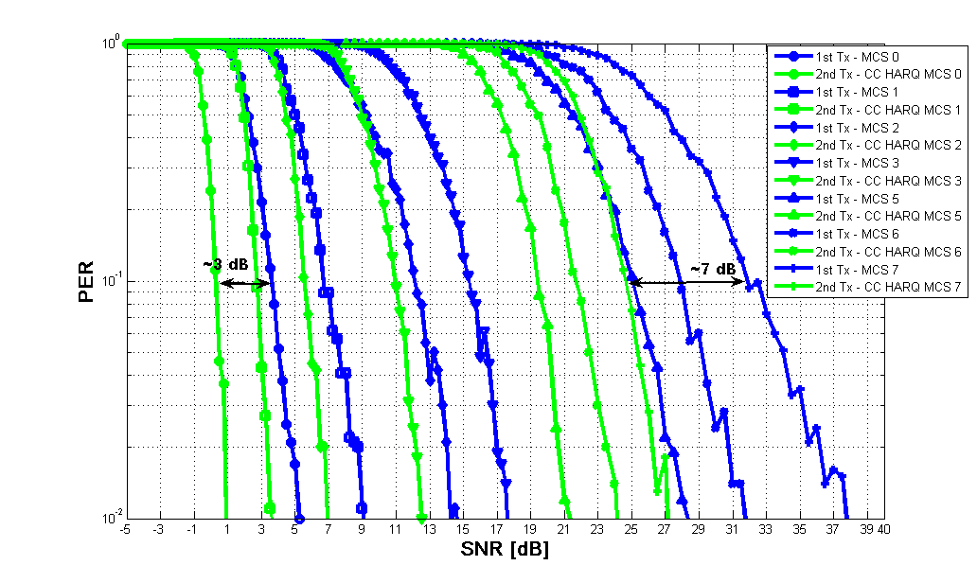
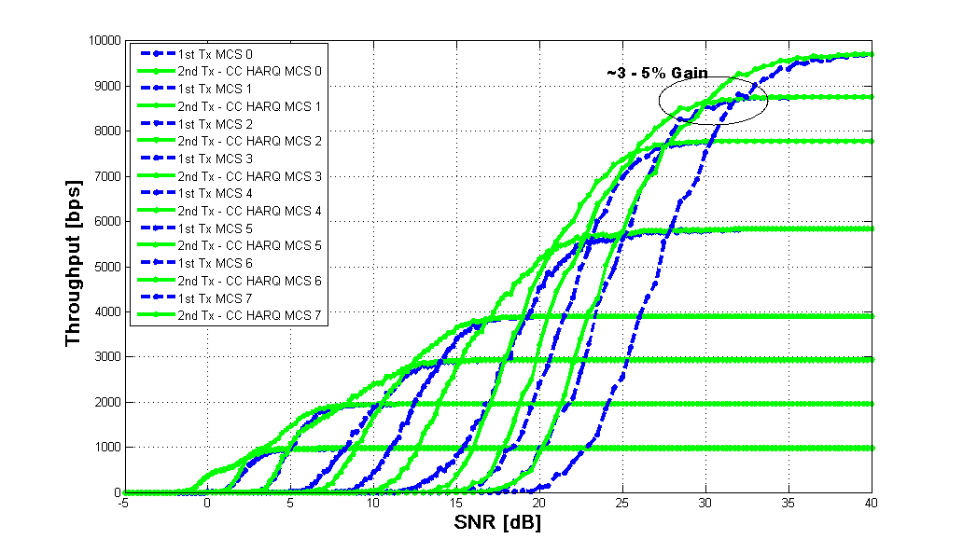
HARQ performance in Wi-Fi
3-4 dB gain was claimed for CC-HARQ lower MCS
PER results shown here confirm this
Results for channel D (iid realizations between retransmissions) are shown below using CC-HARQ
PER results do not translate directly into performance gain when compared as effective throughput (total number of bits/total time)

Slide 4
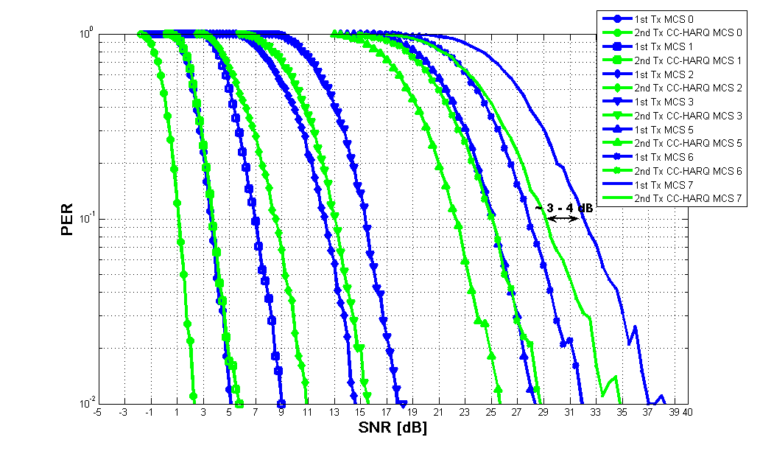
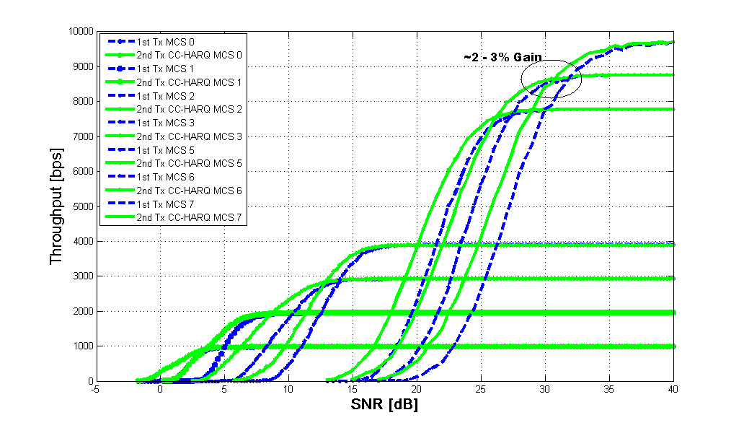
HARQ Performance Review
Results for block channel between retransmissions
Mostly range extension based on throughput
Depending on correlation in channel, throughput even reduces
Fair Link level performance evaluations
Retransmissions consume resources so gains should reflect that, i.e., PER analysis is not fair
Things to consider:
Relatively small gains at high MCS in throughput curves
Growing complexity to accommodate high rates with HARQ
➔ Sweet spot to use HARQ at lower rates for purposes of range extension

Slide 5
What are the Enablers for HARQ in EHT?
MAC level protocol support for HARQ
Simpler techniques of HARQ requiring less memory and low retransmission and acknowledgment overhead
CC Vs. IR-HARQ for LDPC
Complexity Vs. Performance
Transmission of information about corresponding MPDUs and codewords from transmitter to receiver at PHY level
Capability to store and combine MPDUs and codewords until various (2-3) retransmissions
Capability of sending feedback based on codeword and MPDU level
Capability of sending either the failed codewords or failed MPDUs in retransmissions
L-STF
L-LTF
L-SIG
…
HARQ-SIG
DATA
Legacy Preamble

Slide 6
Summary
We present our findings about implementation of simplest HARQ scheme and show that the gains are mainly for range-extension.
Does this fit EHT scope?
If this is to be pursued then we presented the enablers for HARQ in Wi-Fi.
This requires more analysis including MAC overhead and RA gains.

Slide 7
Reference
[1] Shimi Shilo – HARQ for EHT (DCN:1587) – 13 Sep 2018
[2] Ron Porat – Multi-AP-HARQ-for-EHT (DCN: 1116) – 6 July 2018

