Slide 1
Phase-Roll Based ToA for Low Complexity Devices and Immediate Feedback
Date: 2018-11-12
Authors:

Slide 2
What is Phase-Roll
Phase-roll
Commonly used for symbol time tracking
Calculated in frequency domain
$$φ_{lin}=∠\sum_{k}{H\left[k\right]H^{∗}\left[k−1\right]}$$

Slide 3
Phase-Roll Derivation
Assume multi-path channel
$$h\left(τ\right)=\sum_{p}{A_{p}δ\left(τ−τ_{p}\right)},H\left[k\right]=\sum_{p}{A_{p}e^{−j2π\frac{k}{T}τ_{p}}}$$
Subcarrier spacing 1/T
$\sum_{k}{H\left[k\right]H^{∗}\left[k−1\right]}=$
$$\sum_{k}{\left(\sum_{p}{A_{p}e^{−j2π\frac{k}{T}τ_{p}}}\sum_{q}{A_{q}^{∗}e^{j2π\frac{k−1}{T}τ_{q}}}\right)}=\sum_{p}{\sum_{q}{A_{p}A_{q}^{∗}e^{−j2π\frac{τ_{q}}{T}}}}\sum_{k}{e^{j2π\frac{k}{T}\left(τ_{q}−τ_{p}\right)}}$$

Slide 4
More Derivation
Split into same index
$$=\underset{\text{weighted} \text{sum}}{\underbrace{K\sum_{p}{{\left|A_{p}\right|}^{2}e^{−j2π\frac{τ_{p}}{T}}}}}+\sum_{p≠q}{A_{p}A_{q}^{∗}e^{−j2π\frac{τ_{q}}{T}}}\underset{α\frac{\sin\left(πK\left(τ_{q}−τ_{p}\right)/T\right)}{\sin\left(π\left(τ_{q}−τ_{p}\right)/T\right)}}{\underbrace{\sum_{k}{e^{j2π\frac{k}{T}\left(τ_{q}−τ_{p}\right)}}}}$$
Second part, add p-q = (q-p)
=$\sum_{p<q}{\frac{\sin\left(πK\left(τ_{q}−τ_{p}\right)/T\right)}{\sin\left(π\left(τ_{q}−τ_{p}\right)/T\right)}2Re\left\{{A_{p}A}_{q}^{∗}e^{j2π\frac{τ_{p}−τ_{q}}{T}}\right\}}$ $e^{j2π\frac{τ_{p}−τ_{q}}{T}}$

Slide 5
Periodic Sinc Function
$$\sum_{k=0}^{K−1}{e^{j2π\frac{k}{T}τ}}=\frac{1−e^{j2π\frac{K}{T}τ}}{1−e^{j2π\frac{τ}{T}}}=α\frac{\sin\left(πKτ/T\right)}{K\sin\left(πτ/T\right)}$$
Negligible after $\frac{τ}{T}>\frac{3}{K}$
Zero at every $\frac{T}{K}$
Example with K=64

Slide 6
Common Channels
Single Path / AWGN Channel
$h\left(τ\right)=A_{0}δ\left(τ−τ_{0}\right),H\left[k\right]=$ $A_{p}e^{−j2π\frac{k}{T}τ_{0}}$
$φ_{lin}=K$ ${\left|A_{0}\right|}^{2}e^{−j2π\frac{τ_{0}}{T}}=$ $−\frac{2π}{T}τ_{0}$
Equivalent baseband model
Sample spaced delays $\left(τ_{q}−τ_{p}\right)=\left(q−p\right)\frac{T}{K}$
Cross terms cancel
$$φ_{lin}=∠K\sum_{p}{{\left|A_{p}\right|}^{2}e^{−j2π\frac{p}{K}}}$$

Slide 7
Effect of Subcarrier Spacing
Can use adjacent subcarriers or further apart $\frac{1}{T}→\frac{N}{T}$
First part (same bandwidth, so only K/N separate terms)
$$\frac{K}{N}\sum_{p}{{\left|A_{p}\right|}^{2}e^{−j2π\frac{Nτ_{p}}{T}}}$$
Magnifies phase, but can wrap around 2π if delay spread large
Second part not much changed
$\frac{K}{N}\sum_{p<q}{\frac{\sin\left(πK\left(τ_{q}−τ_{p}\right)/T\right)}{K\sin\left(π\left(τ_{q}−τ_{p}\right)/T\right)}2Re\left\{{A_{p}A}_{q}^{∗}e^{j2πN\frac{τ_{p}−τ_{q}}{T}}\right\}}$ $e^{j2πN\frac{τ_{p}−τ_{q}}{T}}$

Slide 8
Proposed Scheme
One side measures Phase-Roll
Report ToA based on Phase-Roll
$$\hat{τ_{0}}=−\frac{T}{2πN}φ_{lin}$$
Indicate that Phase-Roll is used (Negotiation)
Other side applies correction
Calculate both true first-path and Phase-Roll
Use first-path for own ToA
Use difference to correct received ToA
Subcarrier spacing to match GI/delay spread
For VHT, N=4, delay spread up to 0.8 µs
For 2x HE-LTF, N=8, delay spread up to 0.8 µs

Slide 9
Performance Testing
Is the channel really reciprocal?
Only over-the-air testing can tell
Depends on radio front end (filter, etc)
Which channel to use phase-roll on?
Currently FTM, tx from single antenna
In 11az, NDP can transmit multiple streams
Test using 4x4 AP and 1x1 STA
STA calculates phase-roll
AP knows which antenna used to transmit, calculate phase roll on matching received channel, but can calculate ToA with all four

Slide 10
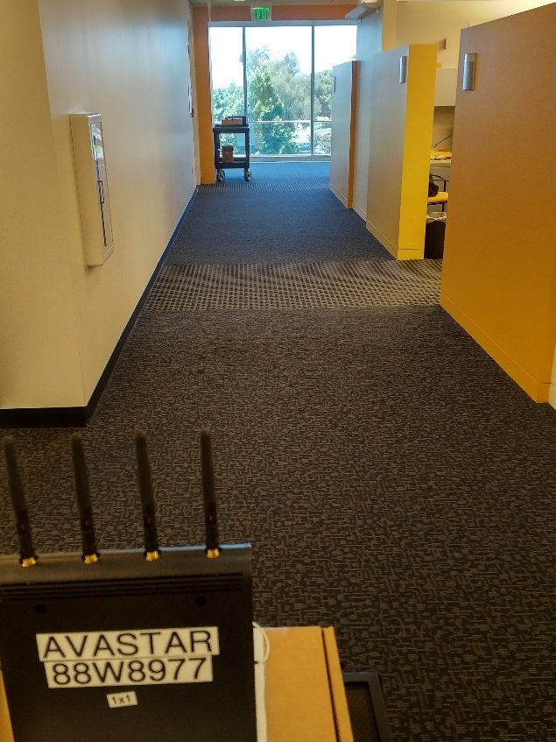
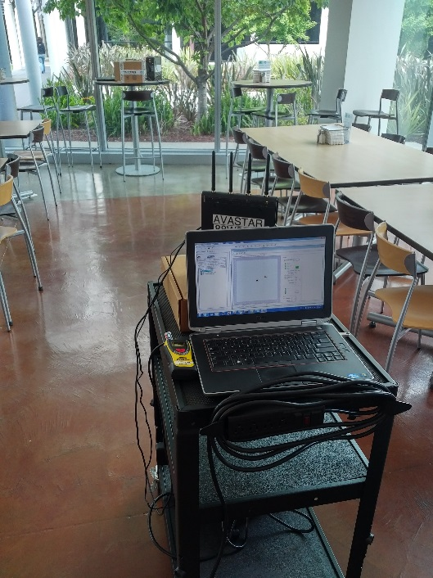
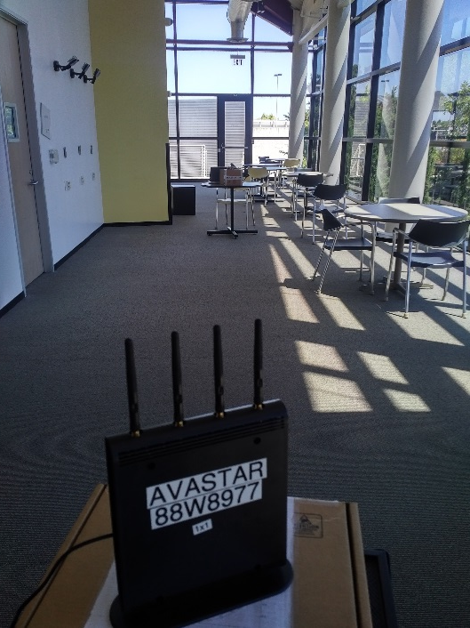
Test Setup
Three locations, six distances
Cafeteria, office space, industrial space
Distances [3 7 10 13 17 20] meters

Slide 11
Test Setup (2)
Signal
VHT80
Channel 36
Histogram
Bursts of 25 FTM packets
Measure ToF/distance per packet, create histogram
Include all distances, all locations
Separate LOS/NLOS results

Slide 12
LOS, VHT80
FFT First-Path (4x4) AP+STA
Error within [0 2]m
Phase-Roll (1x1) at STA
Minimal performance loss

Slide 13
NLOS, VHT80
FFT First-Path (4x4) AP+STA
Error between [1 3]m
Phase-Roll (1x1) at STA
Some performance loss

Slide 14
LOS, VHT80
MUSIC (4x4) AP+STA
Error between [0 1.5]m
Phase-Roll (1x1) at STA
Almost same performance

Slide 15
NLOS, VHT80
MUSIC (4x4) AP+STA
Error between [0 2]m
Phase-Roll (1x1) at STA
Almost same performance

Slide 16
Straw Poll I
Do you support to include a mode in TB and/or non-TB Ranging for ISTA and/or RSTA to report ToA based on phase-roll?
TB Ranging:
Non-TB Ranging:
RSTA side:
ISTA side:
Abstain:
Multiple choices allowed

