Slide 1
Discussion on Target Use Cases of RTA
Date: 2018-11-13
Authors:
Notes:
Hello everyone. I am Akira Kishida from NTT.
I’d like to introduce my presentation entitled as “Discussion on Target Applications of RTA”.
The document number is 1618r2.

Slide 2
Abstract
This presentation introduces key use cases of RTA for industrial business.
Haptic technology, drone control
In these use cases, high stability is required while required data rate is low.
In case of pushing “rich” contents such as video streaming, high data rate is required.
We also discuss use cases that require both low latency and high data rate such as AR/VR, 4K/8K video streaming.
Some of real time gaming would be “rich” contents in the near future.
We should decide whether high data rate RTA (Real Time Applications) should be included in the scope of RTA TIG or not.

Slide 3
Additional use cases for RTA
Real-time gaming, robotics and industrial automation are the targets as use cases of RTA so far [1].
These use cases require low data rate.
Requirements concerning stability such as jitter and packet loss are important for these use cases.
We introduce some additional use cases to robotics and industrial automation.
Haptic technology
Drone control
“Guaranteed” communication might be promising in Wi-Fi systems and will be demanded.

Slide 4
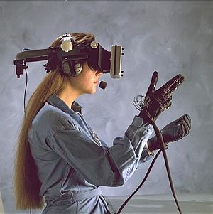
Haptic technology
Haptic technology recreates the sense of touch by applying forces, vibrations, or motions to the user.
If we can replace wired connection from devices to the server, flexibility of application would be expanded.
Low latency, jitter, packet loss will be required.
At least < 5ms latency should be demanded [2].

Slide 5
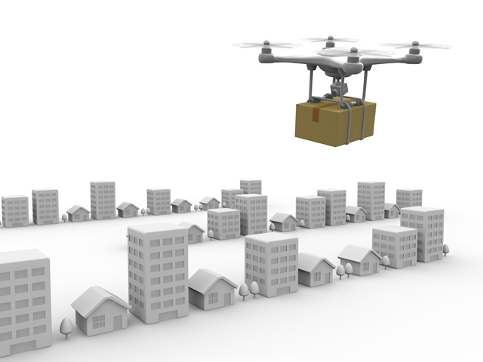
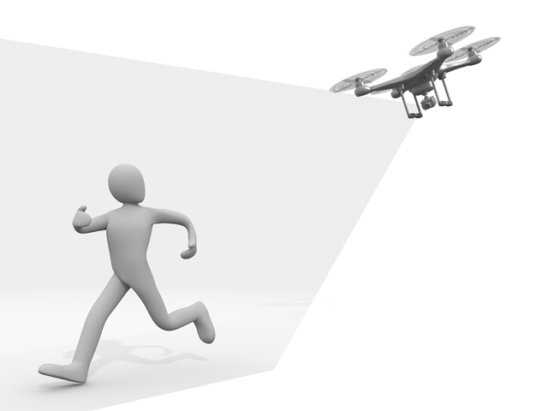
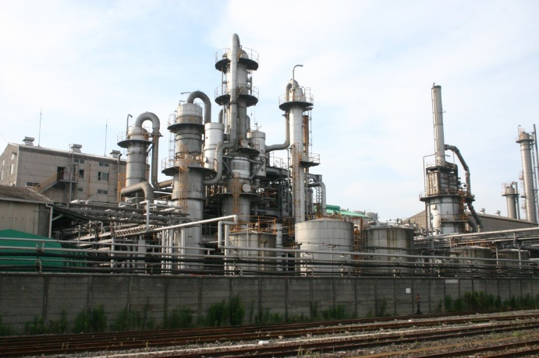
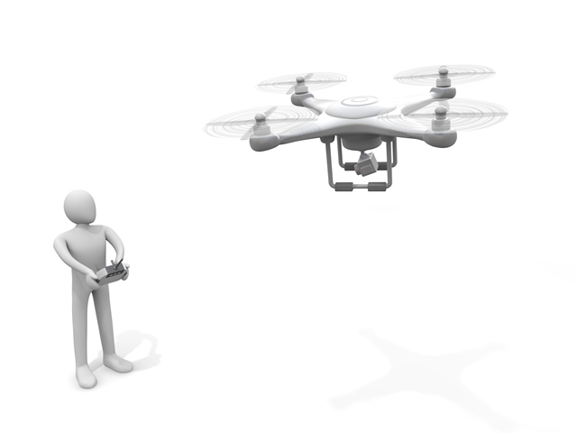
Drone control
Manufacturing and industry
Steamlines inspection, management.
Alternates high-place work.
Logistics
Wi-Fi would be utilized within limited site like warehouse.
Security
Drones equip a camera and take photos and/or videos.
Drone is a key device for several business.
Manufacturing, industry, logistics, security, agriculture and entertainment for example.
Wi-Fi would be suitable wireless system for drone if either of the following requirements is achieved.
Low data rate enough for control signals with low latency and jitter.
High data rate with sufficient capacity for video streaming.

Slide 6
Requirements of the additional use cases
Use cases |  | Latency | Jitter | Packet loss | Data rate
Robotics and industrial automation | Haptic technology | < 1 ms ~ 5 ms | < 0.2 ~ 2 ms | Loss less required | < 1 Mbps
 | Drone control | < 100 ms | < 10 ms | Loss less required | < 1 Mbps > 100 Mbps (with video streaming)
*Detailed numbers of the requirements are further investigation.
Requirements of data rate are low for control signals.
However, required data rate would be high if these cases require “rich” contents such as video streaming.
If 4K/8K video streaming is utilized, data rates of Gbps’ might be required.
Not “best effort”, but “guaranteed” communication is required.

Slide 7
Requirements of use cases on the RTA TIG’s report [1]
Use cases |  | Latency | Jitter* [4] | Packet loss | Data rate
Real-time gaming [1] |  | < 10 ms | < 5 ms | < 0.1 % | < 1 Mbps
Robotics and industrial automation [3] | Equipment control | < 1 ms ~ 10 ms | < 0.2 ~ 2 ms | Near-loss less | < 1 Mbps
 | Quality supervision | > 10’s ms | > 1 ms | Near-loss less | < 1 Mbps
 | Factory resource management | > 100 ms | > 20 ms | Varies | < 1 Mbps
 | Display | > 100 ms | > 20 ms | Varies | < 10’s Mbps
 | Human safety | < 1 ms ~ 10 ms | < 0.2 ~ 2 ms | Near-loss less | < 1 Mbps
*Jitter values are calculated from [3]
Requirements of data rate are low as well.
According to [4], most industrial automations require “loss less” (BLER of 10⁻⁷ % to 10⁻⁵ %).

Slide 8
Real-time gaming in the future
According to the Report of RTA TIG, requirements of data rate is very low because only control signals are considered.
The communication bandwidth a console and a controller (a user equipment device) will be “rich” such as AR/VR application in the real-time gaming in the future.
Approximately 5 Gbps will be required for AR/VR (8K, 90+FPS, HDR, 6 Depth of Field video or free-viewpoint) [2].

Slide 9
Requirements of AR/VR, 4K/8K video [5]
Use cases |  | Latency | Jitter | Packet loss | Data rate
VR | Partial immersion | <10 ms | (not mentioned) |  | > 500 Mbps
 | Deep immersion | < 5 ms |  |  | > 1000 Mbps
Video | 4K (Compressed) | < 20 ms | < 20 ms | 3e-7 | > 100 Mbps
 | 8K (Compressed) | < 20 ms | < 20 ms | 3e-7 | > 200 Mbps
Required data rates are very high.
AR/VR is the one of the target use case of EHT SG.
Development of PHY layer technologies will be demanded.

Slide 10
Wireless VR in EHT [5]
According to the John Son’s contribution [6], latency characteristics of VR contents streaming under various configurations are investigated in EHT SG.
The wireless VR was discussed as one of the main use cases for EHT [5][7][8]
In July meeting, the motion for EHT SG formation was passed as follows: [9]
Approve formation of the 802.11 Extremely High Throughput (EHT) Study Group to consider development of a Project Authorization Request (PAR) and a Criteria for Standards Development (CSD) responses for a new 802.11 amendment for operating in the bands between 1 and 7.125 GHz, with the primary objectives:
To increase peak throughput and improve efficiency
To support high throughput and low latency applications such as video-over-WLAN, gaming, AR and VR

Slide 11
Discussions
RTA missions
Investigate latency and stability issues observed with real time applications such as mobile and multiplayer games, robotics and industrial automation.
Potential mechanisms to address the identified issues.
Use cases that require both low latency and high data rate
Some of industrial automation and robotic that push “rich” contents.
AR/VR.
Future real-time gaming that requires heavy data traffic.
Should we include those use cases or not?
If it is yes, joining EHT SG is one of the options.
If it is no, we should focus on the development of MAC layer and upper solutions, not in PHY layer.

Slide 12
Conclusions
Two additional use cases are introduced.
Haptic technology, drone control .
In these use cases, high stability is required while required data rate is low.
In case of pushing “rich” contents such as video streaming, high data rate is required.
We should decide whether high data rate RTA (Real Time Applications) should be included in the scope of RTA TIG or not.
AR/VR (discussions are in progress in EHT SG).
Future real-time gaming that requires high data rate.
Notes:
Then, we summarize this presentation.
Manufacturing should be one of the target of RTA for broad market potential.
Moreover, we have to define target industries in manufacturing with consideration of possible requirements.
To design target requirement of latency or Jitter, network delay should be considered in addition to inherent issues of IEEE 802.11 WLAN systems.
For example, approximately 4.8 ms or lower latency might be required at the air of WLAN if motion control requires latency of 10 ms.

Slide 13
Straw Polls
[#1] Do you think that applications that require both low latency and high data rate such as AR/VR, 4K/8K video streaming should be included in the scope of RTA TIG?
Y: N: A: Need more further investigations:
[#2] How should we continue our future activity? RTA should be:
(a) A separate SG and amendment and target at both PHY and MAC layer technologies.
(b) A separate SG and amendment and target at only MAC layer technologies and upper layer solutions.
(c) A part of the EHT and follow-on activities and amendmentor self cancellation.
(a): (b): (c): Other:
Notes:
Then, we summarize this presentation.
Manufacturing should be one of the target of RTA for broad market potential.
Moreover, we have to define target industries in manufacturing with consideration of possible requirements.
To design target requirement of latency or Jitter, network delay should be considered in addition to inherent issues of IEEE 802.11 WLAN systems.
For example, approximately 4.8 ms or lower latency might be required at the air of WLAN if motion control requires latency of 10 ms.

Slide 14
References
[1] Kate Meng, “RTA report discussion,” IEEE 802.11-18-1690r0
[2] Qualcomm Technologies, Inc., “VR and AR pushing connectivity limits,”
https://www.qualcomm.com/media/documents/files/vr-and-ar-pushing-connectivity-limits.pdf
[3] Zein Nader, et al., “Wired/Wireless Use Cases and
Communication Requirements for Flexible Factories IoT Bridged
Network,” Nendica Draft Report 802.1-18-0025-06-Icne
[4] Richard Candell, “Reliable, High Performance Wireless System for Factory Automation,” IEEE 802.11-18/1784r0
[5] David Xin Yang, et al., “Next Generation PHY/MAC in Sub-7GHz,” IEEE 802.11-18-0846r2
[6] Jon Son, et al., “Experiments on Wireless VR for EHT,” IEEE 802.11-18-1606r0
[7] Laurent Carou, et al., “EXtreme Throughput (XT) 802.11,” IEEE 802.11-18-0789r10
[8] Dave Cavalcanti, et al., “Controling latency in 802.11,” IEEE 802.11-18/1160r0
[9] Ron Porat, et al., “EHT SG formation Motion,” IEEE 802.11-18-1263r3

