Slide 1
Use Cases for NGV using High Data Rate
Date: 2018-11-12
Authors:

Slide 2
Abstract
This submission proposes use cases for NGV SG, which are utilizing NGV’s high data rate, using mmWave capabilities proposed in [1].
Proposed use cases include:
  IP Traffic Offloading
  Shared Bird’s-Eye View
[1] 11-18/1187r03 mmW for V2X Use Cases

Slide 3
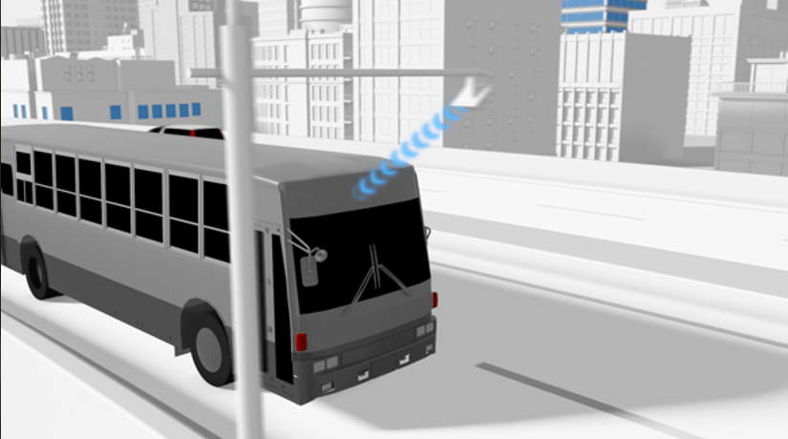
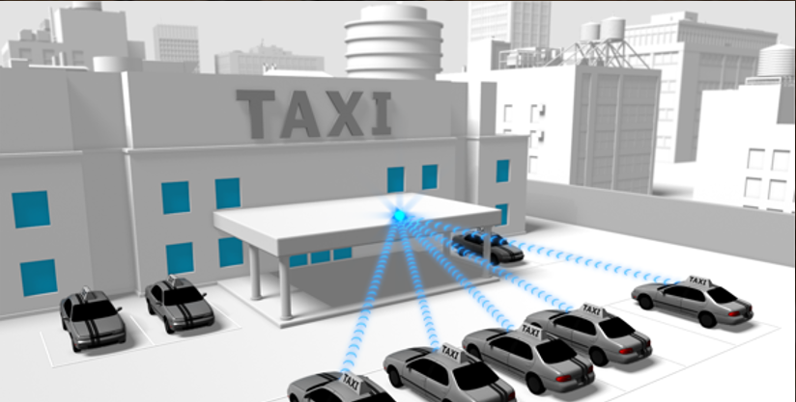
IP Traffic Offloading
Downloading 3D maps
Uploading sensor data
  DSRC/WAVE supports IPv6 over 11p
    Cloud-based applications are expected
Offload IP traffic from 11p to NGV
  distribute location dependent data
    map, advertisement
  download/upload delay tolerant data
    logs, sensor data for non/semi-real time usage, entertainment

Slide 4
IP Traffic Offloading
Overview: Offload IP traffic from 11p to NGV
  distribute location dependent data
  download/upload delay tolerant data
Target performance:
  >1 Gbps max data rate
  Vehicle mobility in a city (~60km/h)

Slide 5
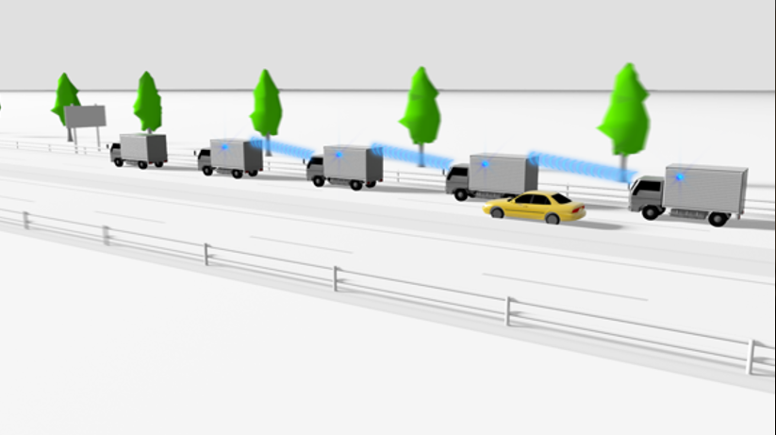
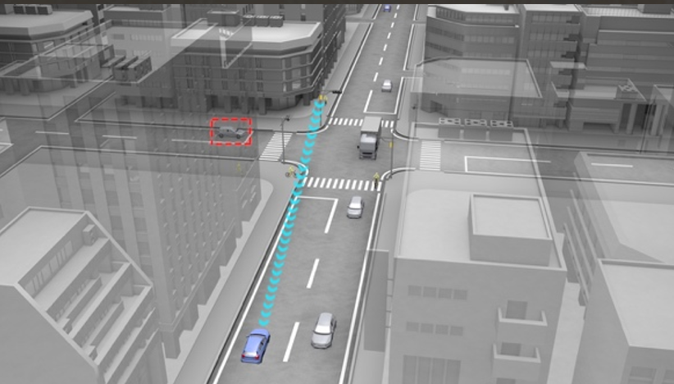
Shared Bird’s-Eye View
Bird’s-Eye View for Platoon (V2V)
Bird’s-Eye View for Intersection (V2I/V2X)
Vehicles and infrastructures share their own views to each other to construct bird’s eye views
  For safety: blind spot monitoring
  For drivers/passengers: navigation, augmented reality

Slide 6
Shared Bird’s-Eye View
Overview: Vehicles and infrastructures share their own views to each other to construct bird’s eye views
  the views are used for safety and driver/passengers usage
  example scenario: (1)around intersection; (2)around platoon
Target performance:
  >1 Gbps max data rate
  <10 ms delay
  Vehicle mobility in a city (~60km/h)

Slide 7
References
[1] 11-18/1187r03 mmW for V2X Use Cases
[2] 11-18/0861r08 802.11 NGV Proposed PAR
[3] 11-18/1323r01 NGV SG Use Cases

Slide 8
Straw Poll
Do you agree to adopt each of the use cases on slide 4 and 6 as one of NGV use cases?
Y/N/A

