Slide 1
Old and new latency requirements
Date: 2018-11-15
Name | Affiliation | Address | Phone | Email
Kazuyuki Sakoda | Sony | 1730 N. First Street, San Jose CA 95112 |  | kazuyuki.sakoda(at)sony.com
William Carney | Sony |  |  | William.Carney(at)sony.com

Slide 2
Introduction
Today, many devices handle video streaming via 802.11 WLAN. Most of them are not latency sensitive
However, interactive video applications require low latency capability
This submission explains the rationale of the interactive video latency requirements
In many of these case, the latency requirements are derived from the video frame rate
60Hz framerate is commonly used, i.e., 16.7[msec] per frame
To accommodate end-end signal processing in a video frame, we need to make sure that the signal processing delay plus transmission latency is less than 16.7 [msec]
For these applications, ideally, 10[msec] one-way or roundtrip delay should be considered as a targeted specification

Slide 3
Interactive Experience Requires Low Latency Capability
In general, low latency requirements will arise when there is a control loop in the system
Case A: video subscription
Case B: interactive video
Video content
Renderer
Video server
AP
Smartphone,
TV (dongle)
Feedback input
Human
Human
This case, latency should be
constrained by video frame rate

Slide 4


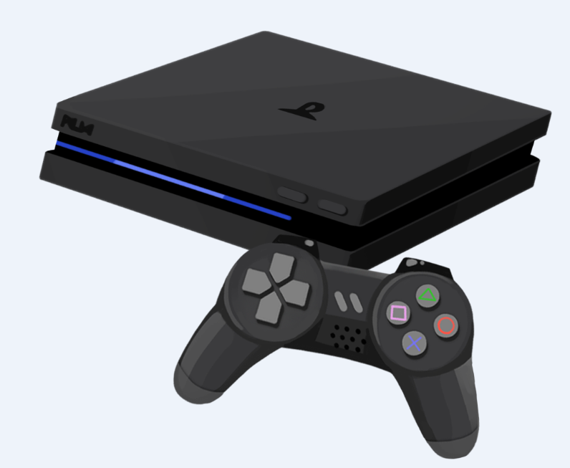
Why does the video frame rate matter? (1)
High quality VR headset
60Hz/16.7msec
Renderer
Feedback input
= Head tracker
Human
= Move
Video content

Slide 5


Why does the video frame rate matter? (2)
HDMI cable replacement
Video content
Renderer
Feedback input
= game commander
Human

Slide 6
Why does the video frame rate matter? (3)
The interactive video application requires low latency transmission capability
The video contents needs to be updated per feedback from the user reaction. This is the source of the latency requirement
As of today, we should target 60Hz video frame rate
(1 video picture per 16.7msec)
Transmission needs to be completed in 5msec or 10msec, depending on the applications

Slide 7
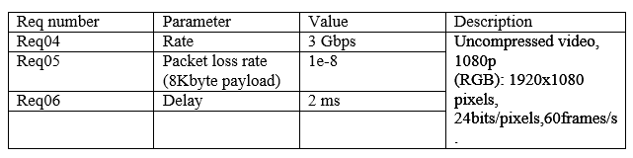
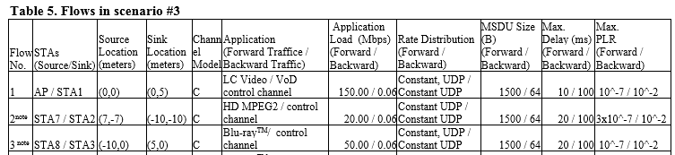
The requirement has been there…
802.11ad functional requirements [1]
802.11ac functional requirements and evaluation methodology [2]

Slide 8
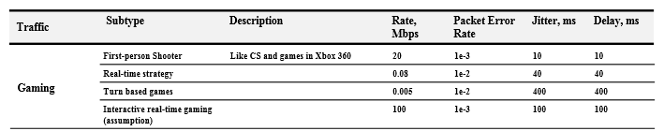
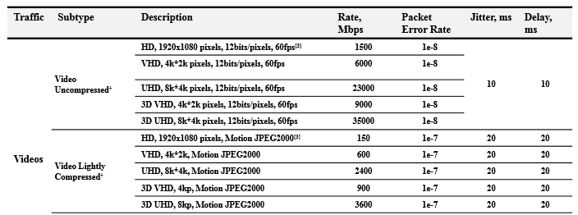
The requirement has been there…
802.11ax usage models [3]

Slide 9
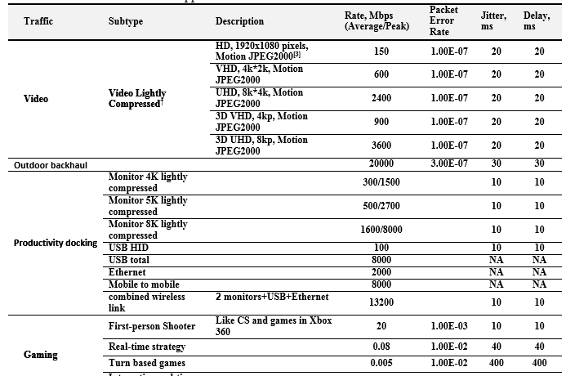
The requirement has been there…
802.11ay evaluation methodology [4]

Slide 10
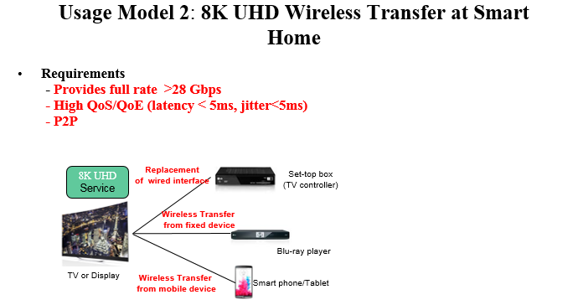
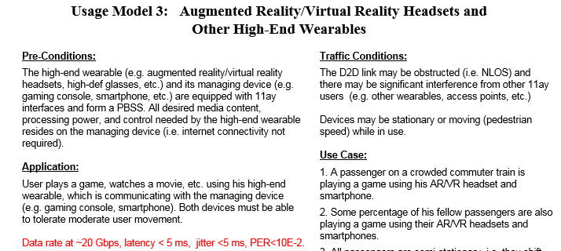
The requirement has been there…
802.11ay use case [5]

Slide 11
The requirement has been there…
These requirements are well known in the 802.11 community, but there has not been much effort to take these requirements seriously until RTA discussions

Slide 12
Summary
It is recommended that RTA considers real time video application as a part of the target applications
The target latency requirement for the real time video application is derived from video frame rate of 60Hz
It is further recommended to define latency target to be 10 [msec] roundtrip or 5 [msec] one way for these applications

Slide 13
Strawpoll (1)
Do you think it is reasonable to include high data rate (>1Gbps) real time video application as a part of the target applications of the RTA?
  Yes: 17
  No:7
  Abstain: 4

Slide 14
Strawpoll (2)
Do you think it is reasonable to include real time video application requirement to the IEEE 802.11 Real Time Applications TIG Report [6] (11-18/2009r0)?
  i.e., 5[msec] or 10[msec] latency together with high bandwidth (>1Gbps) streaming capability
  Yes: 14
  No: 6
  Abstain: 5

Slide 15
References
[1] 11-09/0094r0, “TGad Functional Requirements,” Eldad Perahia
[2] 11-09/0451r16, “TGac Functional Requirements and Evaluation Methodology,” Peter Loc, et.al.
[3] 11-13/0657r6, “Usage models for IEEE 802.11 High Efficiency WLAN study group (HEW SG) – Liaison with WFA,” Laurent Cariou
[4] 11-15-0866r2, “TGay Evaluation Methodology,” Laurent Cariou, et.al.
[5] 11-15/0625r7, “IEEE 802.11 TGay Use Cases,” Rob Sun, et.al.
[6] 11-18/2009r0, “IEEE 802.11 Real Time Applications TIG Report,” Kate Meng

