Slide 1
Thoughts on RTA Development
Date: 2018-11-15
Name | Affiliation | Address | Phone | Email
Kazuyuki Sakoda | Sony | 1730 N. First Street, San Jose CA 95112 |  | kazuyuki.sakoda(at)sony.com
William Carney | Sony |  |  | William.Carney(at)sony.com

Slide 2
Table of Contents
Brief recap on the applications that drive interest in a RTA spec
Possible categorization of the targeted improvements
Application requirements: Is “Real Time” the only consideration?
Operating band of the RTA network
sHow can we create innovation spaces for better implementation?

Slide 3
Brief recap on applications (1)
On-line gaming [1], [2], [3]:

Slide 4
Brief recap on applications (2)
Real time video [4], [5]:

Slide 5
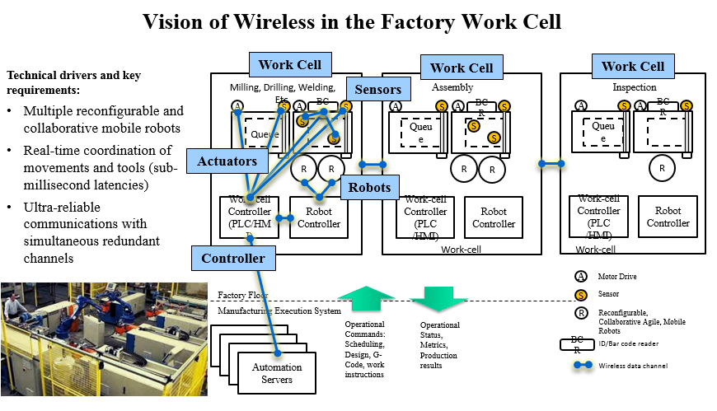
Brief recap on applications (3)
Automated control systems [6]:

Slide 6
Comparison of the Requirements per Apps
Application | Intra-BSS target latency | Bandwidth | Packet size | Robustness
On-line gaming [1], [2], [3] | 10[msec] | 0.2~1.0Mbps | 100~200 octet | < 3 consecutive packet loss, PER < 0.1%
Real time video [4], [5] | 3~10 [msec] | 0.1~20Gbps | >4000 octet | Must
Control System Class 0 [6], [8], [9] | 1-3 [msec] | 10~100kbps | < 100 octet | BLER < 10e-9
Control System Class 1 [6] | 10 [msec] | 10~100kbps | < 100 octet | BLER < 10e-9
Control System Class 2-3 [6], [7] | 10~100 [msec] | 1~10kbps | < 100 octet | BLER < 10e-9
Control system class 0 : emergency / force control
Control system class 1 : regulatory control / camera input
Control system class 2 : supervisory / no physical interaction
It may be useful to define categories that each application falls into

Slide 7
How Other Technologies Consider RTA
For instance, 3GPP defines 3 device categories: eMBB, mMTC, and URLLC [10]
eMBB: enhanced Mobile BroadBand
mMTC: massive Machine Type Communication
URLLC: Ultra-Reliable and Low Latency Communications
Different user plane latency requirements are defined for each of the devices
eMBB: 4msec for UL, and 4msec for DL
mMTC: N/A
URLLC: 0.5msec for UL, and 0.5msec for DL
Should we define similar categories for 802.11 RTA devices?

Slide 8
Is Low Latency the Only Consideration for a Potential RTA Specification?
Many of the applications benefit real time capability also require high-level robustness
None of these applications appreciates real time capability with large frame loss ratio
Do we want to bundle latency requirement together with reliability and/or robustness criteria?

Slide 9
RTA: Band Specific or Band Agnostic?
802.11 network can be deployed in many frequency bands, i.e., ~800MHz, 900MHz, 2.4GHz, 3.5GHz, 5GHz, and >40GHz
The operating frequency band is selected to meet application requirements
Looking through applications in the previous slides, it is possible that applications that appreciate RTA technology can be accommodated in any 802.11 frequency bands
Should we consider RTA to be band specific technology or band agnostic technology?
802.11ax and EHT are for 2.4GHz, 5GHz, and 6GHz only

Slide 10
How does the RTA technology fit with 802.11 specification?
802.11 MSDU transport is on a best-effort basis. However, the spec defined some schemes to allow cross-layer operation, i.e., TSPEC [11]

Slide 11
RTA: A Tool for Cross-Layer Design?
Layering model makes system design easier. However, when the target requirements are extremely precise, a cross-layer design approach is often useful.
Should RTA define APIs for cross-layer operation beyond just defining a latency framework?
It may complicate the end specification, but could allow a more innovative implementation of RTA systems leveraging 802.11

Slide 12
Discussion/Questions
Develop a categorization schema of RTA types to guide specification development?
Low Latency focus only, or also include Robustness and Reliability?
Band Specific or Band Agnostic?
Also consider informative content and APIs to facilitate cross-layer system design?

Slide 13
Straw poll (1)
Do you think it is reasonable to develop a categorization schema of RTA types to guide specification development?
Yes
No
Need more information/discussion
Don’t know

Slide 14
Straw poll (2)
Should RTA consider robustness/reliability metric together with latency requirements?
Yes
No
Need more information/discussion
Don’t know

Slide 15
Straw poll (3)
Should RTA capability be available with multiple 802.11 PHY technologies?
Yes
No
Need more information/discussion
Don’t know

Slide 16
Straw poll (4)
Should RTA define APIs for cross-layer operation beyond just defining a latency framework?
Yes
No
Need more information/discussion
Don’t know

Slide 17
References
[1] IEEE 802.11-18/1234r0, “Real-time Mobile game vs Wi-Fi,” Kate Meng
[2] IEEE 802.11-18/1499r0, “Real-time Console Game Network Profile,” Karthik Iyer, et.al.
[3] IEEE 802.11-18/1542r2, “Time-Aware Traffic Shaping over 802.11,” Dave Cavalcanti, et.al.
[4] IEEE 802.21-18/0059r1, “Introduction to Concept of the ‘Network Enablers for seamless HMD based VR Content Service’ IG,” Dong-Il Dillon Seo, et.al.
[5] IEEE 802.11-18/1970r, “Old and new latency requirements,” Kazuyuki Sakoda
[6] IEEE 802.11-18/1784r0, “Reliable, High Performance Wireless Systems for Factory Automation,” Richard Candell

Slide 18
References
[7] IEEE 802.11-18/1618r0, “Discussion on Target Applications of RTA,” Akira Kishida, et.al.
[8] “Momentum Control with Hierarchical Inverse Dynamics on a Torque-Controlled Humanoid,” Alexander Hrzog, et.al, Journal on Autonomous Robots, Vol. 40 Issue 3, March 2016
[9] “An autonomous manipulation system based on force control and optimization,” Ludovic Righetti, et.al., Autonomous Robots, January 2014, Volume 36, Issue 1–2
[10] 3GPP TR 38.913 V15.0.0 (2018-06), “Study on Scenarios and Requirements for Next Generation Access Technologies”, Release 15
[11] Draft P802.11REVmd_D1.4.

