Slide 1
Simulation of LTE-V and WAVE
Date: 2018-11-07
Authors:
Name | Affiliation | Address | Email
Li Nan | ZTE Corporation | No.9 Wu Xing Section Xi Feng Road Xi’an, Shaanxi Province P.R.China | li.nan25@zte.com.cn
Sun Bo |  |  | sun.bo1@zte.com.cn
HanZhiqiang |  |  | han.zhiqiang1@zte.com.cn
Wei Ning |  |  | wei.ning@zte.com.cn
Lv Kaiying |  |  | lv.kaiying@zte.com.cn

Slide 2
Abstract
This proposal introduces performance metrics for LTE V2X, and provide PRR simulation results of LTE V2X and WAVE in similar conditions.
The simulation result indicates the necessity of improving WAVE in typical scenarios.

Slide 3
LTE V2X
In LTE V2X, PRR and latency are used to evaluate system performance[1].
  Packet Reception Ratio (PRR):
    For one Tx packet, the PRR is calculated by X/Y, where Y is the number of UE/vehicles that located in the range (a, b) from the TX, and X is the number of UE/vehicles with successful reception among Y.
    Average PRR, calculated as (X1+X2+X3….+Xn)/(Y1+Y2+Y3…+Yn) where n denotes the number of generated messages in simulation. with a = i*20 meters, b = (i+1)*20 meters for i=0, 1, …, 25
  Latency:
    latency components include: L-RRC,L-paging, L-SL_config, L-UL,L-RSU, ... etc.. And the overall latency of each scenario can be decomposed into selective combination of the latency components.
This proposal focuses on PRR simulation result comparation between LTE V2X and WAVE.

Slide 4

Simulation Assumptions (LTE V2X)
LTE V2X Parameter | Assumption
Carrier frequency | 5.9GHz
Bandwidth | 10MHz
eNB transmit power | 46dBm
SPS period | 100ms
Time gap between Tx and ReTx | 1~15ms
Tx antenna gain | 3dBi
Rx antenna gain | 3dBi
Noise figure | 9dB
Pathloss model | Urban:WINNER+ B1 Manhattan grid layout Freeway: LOS in WINNER+ B1
UE Maximum transmit power | 23dBm
scenario | Freeway , Urban
mobility model | Freeway:3 in each direction ,Lane width:4m Urban:2 in each direction，Lane width:3.5 m
 | Resource reselection counter，random value
numSubchannel | 6
Resource reservation | 1
thresPSSCH-RSRP | -128dBm
restrictResourceReservationPeriod | 1

Slide 5
Simulation Assumptions (WAVE)
WAVE Parameter | Assumption
Carrier frequency | 5.9GHz
Bandwidth | 10MHz
CCAThreshold | -85dBm
channel access mode | default(channel access on CCH)
EnergyDetectionThreshold | -65dBm
Tx antenna gain | 3dBi
Rx antenna gain | 3dBi
Noise figure | 9dB
Pathloss model | Urban:WINNER+ B1 Manhattan grid layout Freeway: LOS in WINNER+ B1
Maximum transmit power | 23dBm
scenario | Freeway , Urban
mobility model | Freeway:3 in each direction ,Lane width:4m Urban:2 in each direction，Lane width:3.5 m

Slide 6

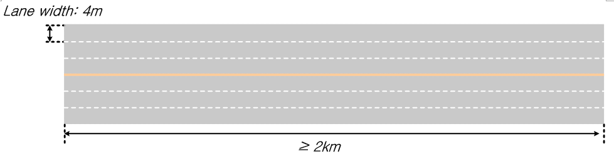
Mobility Model
Freeway
urban
ISD=1732m
Wrapping around region
Simulation region=2ISD=3464m
Wrapping around region

Slide 7
Traffic Model
Two traffic models exist in LTE V2X :
  Periodic traffic
    This traffic model is used in our simulation.
  Event-triggered :event arrival follows Poisson process with the arrival rate X per second for each vehicle. Once event triggered, 6 messages are generated with space of 100ms. Working assumption of message size for Event-trigger traffic at L1 is 800bytes.
Index | Vehicle dropping scenarios | Absolute vehicle speed (km/h) | Message generation period (ms)
1 | Freeway | 140 | 100
2 | Freeway | 70 | 100
3 | Urban | 60 | 100

Slide 8
Channel Model
LTE V2X UE to UE,WAVE
LTE V2X UE to eNB
 | Urban case | Freeway case
Pathloss model | WINNER+ B1 Manhattan grid layout (note that the antenna height should be set to 1.5 m.). Pathloss at 3 m is used if the distance is less than 3 m. | LOS in WINNER+ B1 (note that the antenna height should be set to 1.5 m.). Pathloss at 3 m is used if the distance is less than 3 m.
Small Scale Parameters Model | IMT-A UMi NLOS clustered delay line models (CDL) model
 | Urban case | Freeway case
Pathloss model | 128.1 + 37.6log10(R), R in kilometers
Small Scale Parameters Model | UMi NLOS

Slide 9
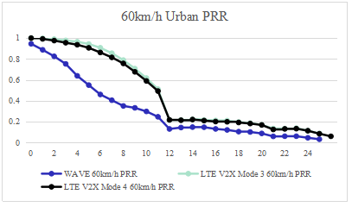
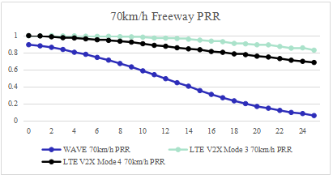
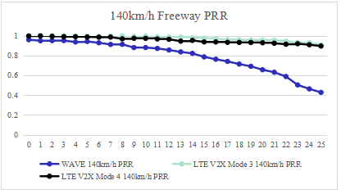
Simulations
  Y axis: Packet Reception Ratio (PRR)
  X axis: i
  a = i*20 meters, b = (i+1)*20 meters,i=0~25,see slide 3.

Slide 10
Observations
Both in LTE V2X mode3 and mode4 ,a packet goes through initial transmission and one time retransmission.Thus in the simulation , one time retransmission is also added to WAVE for fairness.
The simulation results shows that in each scenario, mode3 performs better than mode4.This because UEs in mode4 select resources by performing channel sensing like WLAN,whereas UEs in mode3 depend on eNB resource scheduling ,which avoids collision between UEs in the same cell.
The results also shows that LTE V2X's PRR performance is better than WAVE' s under same mobility model ,traffic model and channel model. The reasons may lie in :
  The difference of channel sensing mechnism: in WAVE system, STAs do channel sensing on a bandwidth of 10MHz,where in LTE V2X ,the 10MHz channel is divided into subchannels,and UEs do channel sensing on each subchannel for channel access opportunity.
  In mode4 resource selection procedure , if the number of candidate single-subframe resources is smaller than 20% of the total number of the candidate single-subframe resources, then thresPSSCH-RSRP is increased by 3 dB and this can be repeated till the number of candidate single-subframe resources is >=20% of total. This makes sure mode 4 UE can always select available RBs once it contends for channel access.

Slide 11
Conclusion
PRR simulation results for WAVE and LTE V2X under same simulation assumption are shown in this proposal,including two scenarios(Urban and Freeway) of different speeds.
By the observation of the curves, PRR for LTE V2X is bettter than that of WAVE under specific scenarios.
WAVE should improve its performance for better collision avoidence and transmission reliability for V2X traffic.

Slide 12
Reference
[1]36885-e00,3rd Generation Partnership Project;Technical Specification Group Radio Access Network;Study on LTE-based V2X Services;(Release 14)
[2]36.213 V14.0.0
[3]36.211 V14.0.0
[4]36.212 V14.0.0

