Slide 1
Use Cases, Requirements and Potential Wireless Approaches for Industrial Automation Applications
Date: 2018-11-01
Author:

Slide 2
Abstract
This presentation addresses requirements and use cases commonly experienced by R3 Communications in the industrial automation sector. Apart from discussing these use cases and their requirement implications, we also address potential approaches to realize the latency requirements typically seen in industrial automation use cases. We finally present some results of measurement campaigns that highlight the potential of the discussed approaches.

Slide 3
Shift to Smart Factory
Product 1
Product 2
Product 2
Product 1
TODAY:
STATIC PRODUCTION SETUP
TOMORROW:
SMART MANUFACTURING SYSTEMS
Inflexible, centralized production flow,
labor intensive processes.
Flexible, smart, mobile and adapting
systems that support even lot size “1”

Slide 4
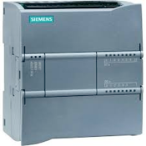
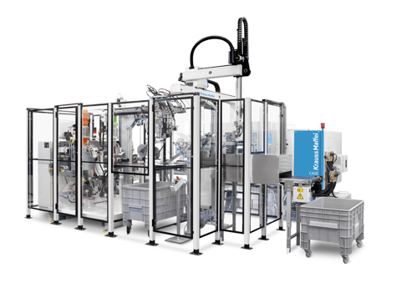
Architecture of Industrial Automation Systems
Master PLC
Module
Control Level
Unit Control
(PLCs)
Module
Production Cell
Field
Level
Module
Devices (Sensors, Actuators, Primary Technology )

Slide 5
Relevant Performance Metrics in Industrial Automation Systems
Cycle time: Elapsed time from writing of sensor reading into memory until reading actuation command from memory.
Reliability: Packet error rate per individual communication component in the loop.
Coverage: Range spanned between loop components.
Density: Amount of loops per unit (production cell).
Raw payload: Size of the sensor reading or actuation command (additional protocol overhead might apply).
Roaming: Necessity for handover functionality.

Slide 6
Illustration Cycle Time and Components
T_{transfer}
T_{wireless}
T_{transfer}
Sensor
Tx
Rx
PLC
T_{compute}
Actuator
Rx
Tx
T_{transfer}
T_{wireless}
T_{transfer}

Slide 7
Typical Use Cases
LOGISTICS
(LAM)
automation of transport (AGVs, monorails, AS/RS)
MACHINE
TOOLS
Instantaneous adaptation of shop floor machinery
COORDINATED
ROBOTS
wireless edge control of / collaboration between robots
PLC-2-PLC
COMMUNICATION
fixed-group PLC master/slave set-up (multiple hierarchies)
FIELD-LEVEL
CONTROL
closed loop control between PLC and field devices (I/Os)
SAFE FIELD-
LEVEL CONTROL
same as field-level control, but safety-oriented
SAFETY
HUMAN IN THE
LOOP (HMI)
wireless control for humans (integrated in safety control)
HUMAN-ROBOT
COEXISTENCE
wireless control / worker safety in dynamic production cells

Slide 8
Use Case Requirements
Use cases with large packet size (> 50 Byte)
Use cases with small packet size (< 50 Byte)
Cycle Time
Cycle Time
PLC-2-PLC Communication
<1 ms
Field-Level Control
Logistics (LAM)
Human-Robot Coexistence
<1 ms
Machine Tools
Safe Field-Level Control
Coordinated Robots
10 ms
Human in the Loop (HMI)
10 ms
<50 ms
<50 ms
Coverage
100 m
10 m
Coverage
100 m
10 m
10⁻³
Reliability
10⁻³
10⁻⁶
10⁻⁹
10⁻⁶
10⁻⁹
< 5
< 5
Reliability
10-20
10-20
> 50
> 50
Density
Density

Slide 9
Contemporary Wireless Capabilities
10⁻⁹
Remote
Control
DETERMINISTIC
REQUIRMENTS
10⁻⁶
Wireless
HART
Reliability (error/success transmission ratio)¹
SIEMENS IWLAN
LTE/4G
10⁻³
Standard
WLAN
Bluetooth
ZigBee
802.11p
100ms
50ms
20ms
10ms
1ms
Latency (sensor-to-controller-to-actor)

Slide 10

Token-Passing Principle & Cooperation
ARCHITECTURE
COOPERATION
physical token ring
fault
tolerance
logical token ring
transmission failure
fault
reaction
immediate relaying
cable based
wireless channel
wireless channel
wireless channel
IEEE 802.5 Token
Ring Standard as
basis for EchoRing
deterministic
behavior with
low latencies
failure recogni-
tion and auto-
matic reaction
cooperative re-
transmission of
lost data packets

Slide 11
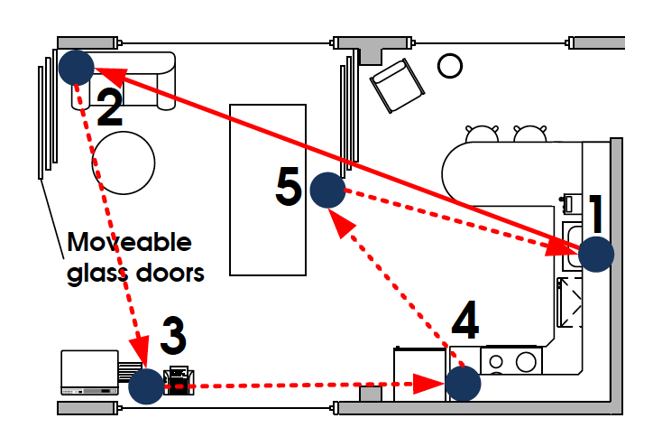
Performance Studies
Scenario:
5 stations
Indoor, low mobility
5 GHz band, no interference
.11g physical layer (10 MHz)
100 Byte packet size
~10⁸ transmitted packets
Schemes:
  Basic ring
  CSMA
  Recovery ring
  EchoRing (token-passing + cooperative communications)
~10 x 20 meters

Slide 12
Experimental Evaluation
OVERALL PERFORMANCE
LATENCY BEHAVIOUR
COOPERATION GAIN
Data Packet Loss Rate above layer 2 for all stations
Packet Delay Distribution at Station
Station 2’s PLRs for various ring sizes

Slide 13
Conclusions
Low-latency, low-rate requirements generally encountered in industrial automation applications
Useful categorization along safety/non-safety applications and/or payload sizes.
R3 Communications observes somewhat similar requirements for automation applications as Intel (Ref Missing) and NIST (IEEE 802.11-14/1784r0) – difference mainly with our emphasis on cycle times.
Token-passing is a powerful approach to guaranteeing low latencies

Slide 14
References
C. Dombrowski and J. Gross (R3 Communications) “EchoRing: A Low-Latency, Reliable Token-passing MAC Protocol for Wireless Industrial Networks” European Wireless Conference, 2015 .
Richard Candell (NIST), “Reliable, High Performance Wireless System for Factory Automation,” IEEE 802.11 RTA TIG contribution, IEEE 802.11-14/1784r0, October 2018.

