Slide 1
6 GHz operation for 11ax follow up
Date: 2019-01-14
Name | Affiliation | Address | Phone | Email
Wook Bong Lee | Samsung |  |  | wookbong.lee@samsung.com
Ravi Gidvani | Samsung |  |  | ravi.gidvani@samsung.com
Sharan Naribole | Samsung |  |  | n.sharan@samsung.com
Tianyu Wu | Samsung |  |  | tianyu.wu@samsung.com
Shailender Karmuchi | Samsung |  |  | karmuchi.s@samsung.com

Slide 2
Introduction
In [1], we proposed two step behavior in 6GHz which will bridge the gap between current implementations and proposed complete scheduled access
In this presentation, we follow up on this item
And address the two CIDs listed below
CID | Commenter | P.L | Comment | Propose Change
16444 | Matthew Fischer | 579.17 | Given that a new protocol might be defined for the 5.940 band, it would be good to have some way to disable EDCA access by Tgax devices in this band to allow most efficient use of this new spectrum. | Add a signaling mechanism that allows future devices to disable EDCA in Tgax devices operating in channels referenced to 5.940 GHz
15178 | Alfred Asterjadhi | 27.2 | A STA that operates in the 6 GHz band cannot do EDCA whenever it wants. Ensure that the STA can do EDCA only if it is explicitly allowed by the AP. | Will submit a proposal.

Slide 3
Discussions
Why we need new operation mode?
There are benefit of restricted EDCA + Triggered access, and there are problems of EDCA + Scheduled network (see slide 4-5)
In 2.4 or 5GHz band, there is legacy STA, so proposed operation may not help much
Can we just not do complete scheduling mode?
There are problem with pure scheduling mode (see slide 6)
What is solution?
Allowing EDCA only when it is necessary
Specification text proposal can be found in appendix

Slide 4
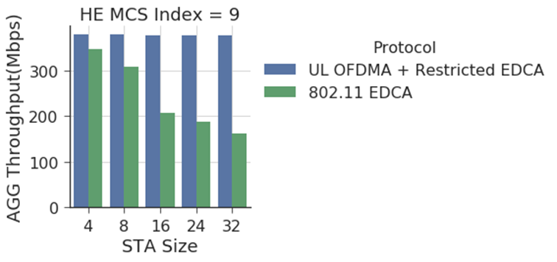
Comparison of Triggered access Versus EDCA (aggregate)
Scheduled Access shows higher network throughput
EDCA suffers from collision with increased congestion
Even without UL OFDMA power benefit, UL OFDMA provides more than 2x gain

Slide 5
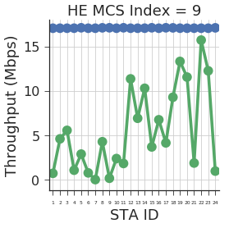
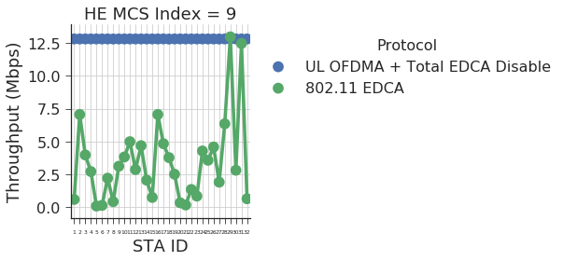
Comparison of Triggered access Versus EDCA (instantaneous)
Scheduled Access shows stable throughput under fair AP
Fair RU allocation significantly improves network fairness
Following figure shows some instance of 10s evaluation
24 STA network
32 STA network

Slide 6
Problem of Fully Scheduled Network
Some of uplink traffic may affected by long latency under maximum 2040 TU MUEDCATimer
STA may not be able to send QoS data using scheduled RU when size of scheduled RU is too small
STA may want to send “QoS Null frame with PM bit set to 1” or “OM Control subfield” immediately, e.g. power saving, operation mode change, coexistence
Schedule of BSS is decided by one central entity can act as a single point of failure

Slide 7
Proposed Enhanced MU EDCA Operation
Optional Enhanced MU EDCA Operation
Count down of MUEDCATimer
Starts/continues after sending BSR only when STA has data to send
Resets after sending QoS data
This gives AP time to prepare schedule for STA
Smaller max MUEDCATimer
To minimize initial UL latency
Exceptions: we want to transmit following frames immediately
QoS Null frame containing BSR, PM=1, OM Control subfield
Advertisement for Mode Of Operation
A 6 GHz HE AP may set the Enhanced MU EDCA Operation subfield to 1 in HE Operation elements it transmits only if it is co-located with at least one other HE AP that operates in the 5 GHz or 6 GHz band that has set the Enhanced MU EDCA Operation subfield to 0 in the HE Operation element it transmits. .
STA can choose whether it moves to the AP set enhanced MU EDCA=1

Slide 8
Example
STA1 BSR
Ack
Data using EDCA
TBTT
TBTT
TBTT
TBTT
MUEDCATimer Period
After sending BSR, if AP does not allocate RU(s) to the STA, then the STA will access channel using EDCA

Slide 9
Why Counting Down MUEDCATimer only after BSR?
This is to prevent doze STA from sending EDCA data immediately after waking up
Basically if there is no data, STA shall not count down
STA needs to inform AP its intention, then the MUEDCATimer is serving as timer for AP to schedule STA
Longer MUEDCATimer can’t solve this problem
Also, when STA runs VoIP kind of application, STA needs to send data within small amount of time, and thus it needs small MUEDCATimer

Slide 10
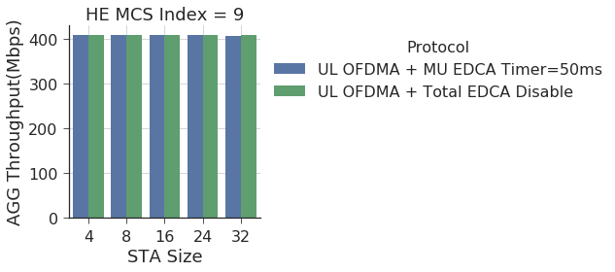
Requirements of Max MUEDCATimer
Since EDCA is restricted, to solve latency problem, we want to restrict MUEDCATimer smaller than 200TU
Certain VOIP application can tolerate maximum latency of 200TU for call setup/initialization
Performance of scheduled access won’t be affected too much with 200 TU

Slide 11
Why Smaller Max MUEDCATimer?
With a fair scheduling, AP can serve more than 200 active STA (MCS0) or ~ 2000 (MCS9) “active” STAs with maximum MUEDCATimer = 200TU
Assuming 1 DL and 1 UL 1500B packet per STA
Assumed frame exchange is in appendix

Slide 12
Why We Need Exceptions?
We want to send QoS Null frame immediately
BSR
Coexistence
Power saving
Operation mode change
These kind of frames requires even smaller latency than 200 TU
Limiting to small number of small size packet won’t disturb system operation
Proposal to send QoS Null using EDCA

Slide 13
Reference
[1] 11-18/1607r1, “6 GHz operation for 11ax”
[2] 11-18/1828r2, “D3.0 CR for 6GHz Post Association”

Slide 14
Appendix- Frame Exchange Assumption
Basic trigger frame, M-BACK, MU BAR, UL MU Block ACK: MCS0
BASIC
TRIGGER
UL OFDMA
M-BACK
DL OFDMA
MU
BAR
UL MU
Block ACK
HE TB PPDU
HE TB PPDU
HE MU PPDU
HE TB PPDU
HE TB PPDU

Slide 15
Problem of Mixed Network (EDCA and Scheduled)
Performance of UL OFDMA STAs are affected by trigger frame Queue
MU EDCA STAs will have quite different performance depending on which Queue AP choose for trigger frame
Following simulation shows average throughput of EDCA STAs and scheduled STAs
There are 4 or 8 EDCA STAs and 4 Scheduled STAs
All EDCA STAs has AC_BE packets only
 |  | AC_BE | AC_VO
4 EDCA STAs + 4 Scheduled STAs | Scheduled STAs | 26.25 Mbps | 42.53 Mbps
 | EDCA STAs | 58.77 Mbps | 44.50 Mbps
8 EDCA STAs + 4 Scheduled STAs | Scheduled STAs | 15.17 Mbps | 25.99 Mbps
 | EDCA STAs | 31.74 Mbps | 25.90 Mbps

