Slide 1
Packet Prioritization Issues
Date: 2018-10-24
Authors:

Slide 2
Abstract
The purpose of this presentation is a follow up on the previous presentation[1]. It discusses a few simulation results that were suggested during the last RTA TIG meeting.

Slide 3
Preface:
Video streaming compromises Real Time application performance
Suggestions were to change packet type to voice for better performance
Refer to IEEE 802.11-18/1499r0 for more details[1]

Slide 4
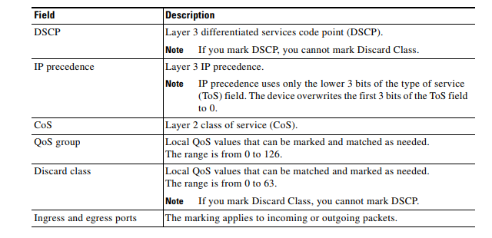
Types of QoS
[2]

Slide 5
Simulation with DSCP modification
Client
AP
Internet
Server
DSCP values used:
EF – Voice
AF41 – Video
Default – Best Effort

Slide 6
Simulation with DSCP modification
Client
AP
Internet
Server
Latency | Client to AP |  |  | AP to Server |  |  | Total
 | Avg | Min | Max | Avg | Min | Max | Avg | Min | Max
Packets as voice | 26ms | 25ms | 29ms | 33ms | 30ms | 67ms | 59ms | 56ms | 93ms
Packets as video | 30ms | 30ms | 35ms | 35ms | 33ms | 52ms | 65ms | 64ms | 83ms
Packets as Best-effort | 14ms | 11ms | 23ms | 34ms | 33ms | 52ms | 48ms | 44ms | 68ms

Slide 7
Simulation with Streaming
Client
AP
Internet
Server
Video
Latency | Client to AP |  |  | AP to Server |  |  | Total
 | Avg | Min | Max | Avg | Min | Max | Avg | Min | Max
Packets as voice | 33ms | 29ms | 65ms | 32ms | 30ms | 53ms | 65ms | 60ms | 97ms
Packets as video | 17ms | 14ms | 64ms | 35ms | 33ms | 50ms | 52ms | 47ms | 102ms
Packets as Best-effort | 14ms | 12ms | 53ms | 35ms | 33ms | 51ms | 49ms | 45ms | 96ms

Slide 8
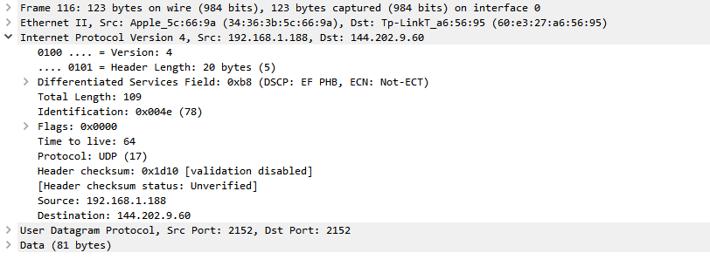
DSCP value client side

Slide 9
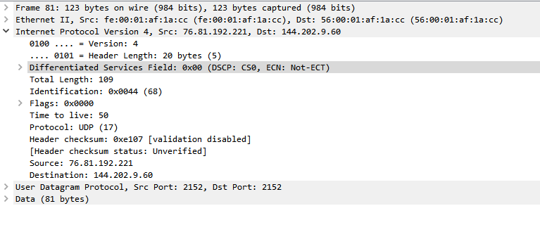
DSCP value Server side

Slide 10
VoIP call Wi-Fi capture

Slide 11
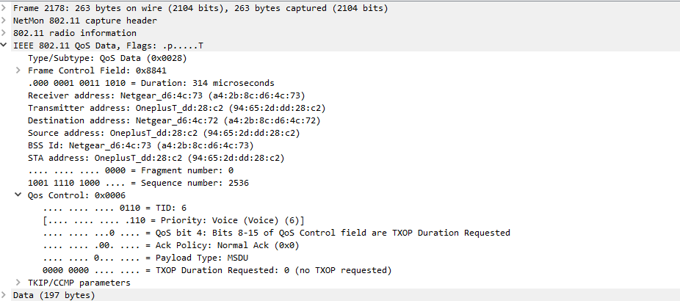
802.11e QoS Client side

Slide 12
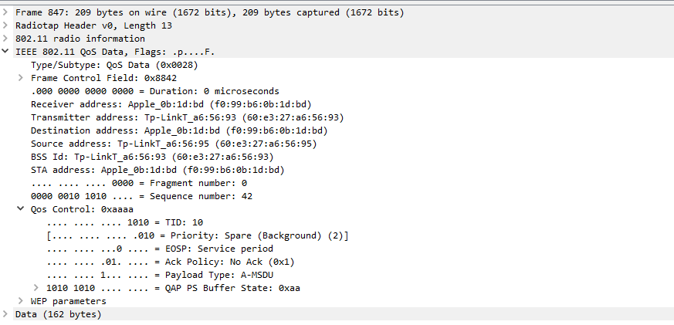
802.11e QoS Server side

Slide 13
Doesn’t make sense

Slide 14
Observation & Summary
Changing the priority level doesn’t help in reducing latency
DSCP value is not preserved in the packets once it is out in the internet
AP to Server latency remains constant irrespective of changing the DSCP value
Packet loss is less when DSCP is set as video than in Best-effort
Priority can only be preserved in local network if configured in controller or Edge router.

Slide 15
References
[1] Karthik, Allan Jones, “Real-time Console Game Network Profile” – September 2018; https://mentor.ieee.org/802.11/dcn/18/11-18-1499-00-0000-real-time-console-game-network-profile.pptx
[2] Cisco, “Cisco Nexus 1000V Quality of Service Configuration Guide, Release 4.2(1)SV1(4)”; https://www.cisco.com/c/en/us/td/docs/switches/datacenter/nexus1000/sw/4_2_1_s_v_1_4/qos/configuration/guide/n1000v_qos/n1000v_qos_3marking.pdf

