Slide 1
Discussion on Target Applications of RTA
Date: 2018-09-13
Authors:

Slide 2
Abstract
This presentation raises discussion about applications that should be focused by RTA.
Gaming is one of the most promised application for RTA [1] so far, but more kinds of applications or use cases should be considered for RTA.
Manufacturing is also promised industry from potential market perspective.
When we decide PAR/5C, latency and jitter requirement for manufacturing should be considered.
To realize RTA WLAN, we have to consider network delay in addition to inherent issues of IEEE 802.11 WLAN systems.
[1] Kate Meng, “Real-time Mobile Game vs Wi-Fi,” IEEE 802.11-18-1234r0

Slide 3
IEEE 802 criteria for standards development (CSD)
RTA should fulfill 5C (five criteria) to promote to TG.
We have to define the Functional Requirements.
For one of 5C, Broad Market Potential should be considered.
Broad sets of applicability.
Multiple vendors and numerous users.
We should define the requirement for PAR/5C to include more broad markets.

Slide 4
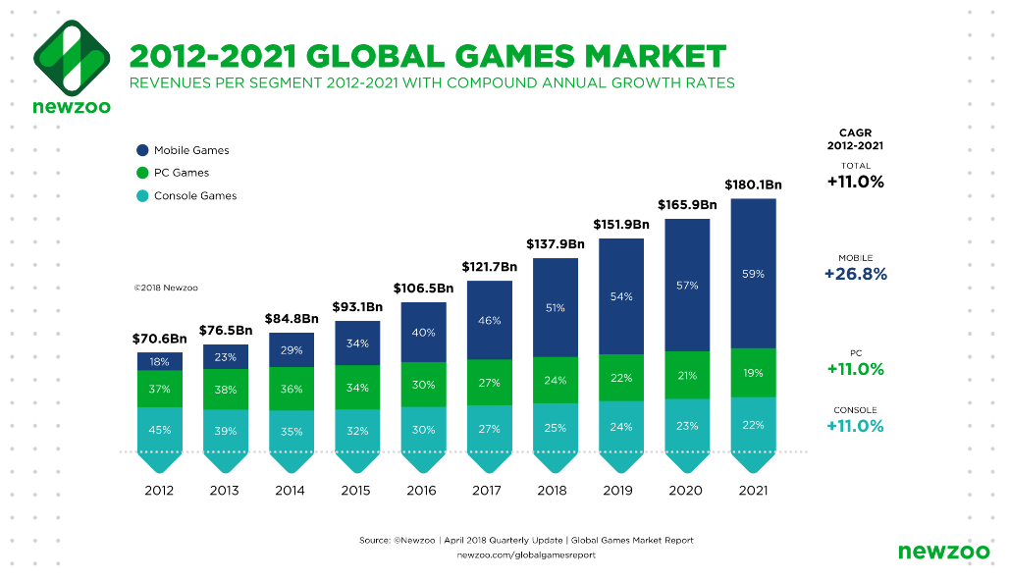
Potential Market of RTA [1]
Global games market would be the 180 billion dollar industry in 2021.
59 % of the market segment (106 billion dollar) will be occupied by mobile games.
[1] Kate Meng, “Real-time Mobile Game vs Wi-Fi,” IEEE 802.11-18-1234r0

Slide 5
Potential Market of RTA [2]
Industry | Applications | Market Segment (billion dollar)
Healthcare | Digital health | 37
 | Tele-healthcare | 10
 | Mobile health | 20
Automotive | Driver assistance | 54
 | Safety Technologies | 36
 | Safty and autonomous driving | 89
Entertainment | AR and VR | 153
Manufacturing | ICT sector in manufacturing (EU) | 974
[2] Maria A. Lema, et a1, “Business Case and Technology Analysis for 5G Low Latency Applications,” IEEE Access, Vol.5, Apr. 2017

Slide 6
What applications should we assume?
All industries shown in previous slide can be target application of RTA.
Each industry has broad market potential.
In particular, manufacturing has a large scale of market segment.
However, there is a variety of industries in manufacturing.
We have to consider which industry can be the target of RTA WLAN.
Required latency and jitter vary by each industry.

Slide 7
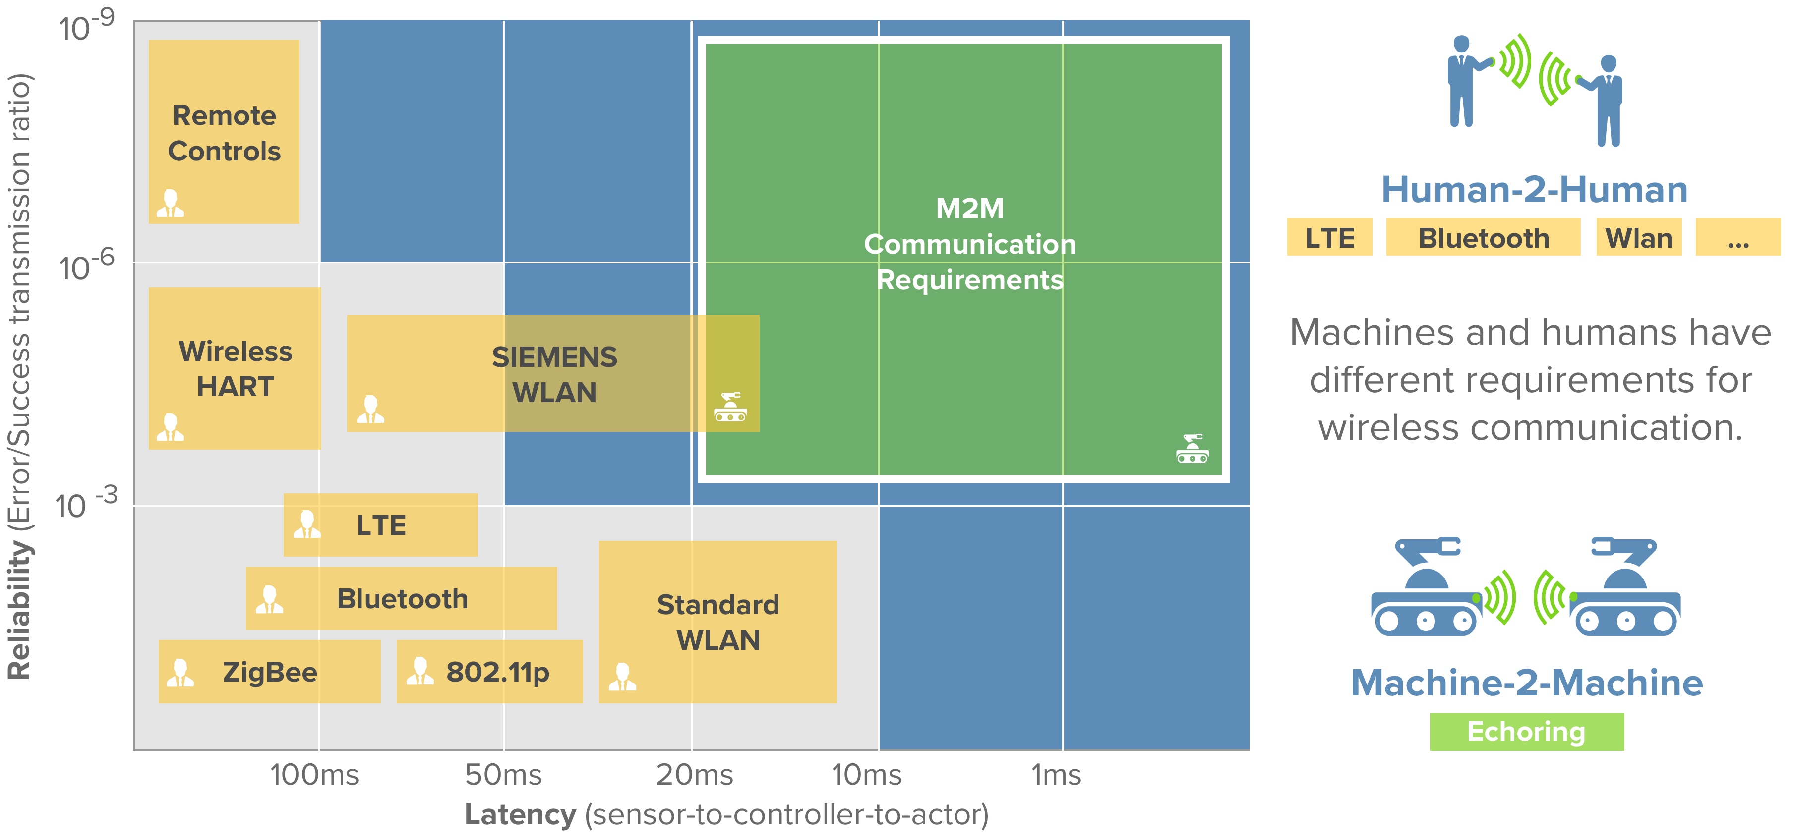
Proposed Target Region of RTA Manufacturing[3]
Target region of RTA
(We are here)
[3] Texas Instruments, “The gap in wireless communications: ultra-reliability and low latency”
https://e2e.ti.com/blogs_/b/industrial_strength/archive/2018/06/12/the-gap-in-wireless-communications-ultra-reliability-and-low-latency

Slide 8
Rquirements of RTA Manufacturing
If we assume manufacturing as one of the target industry of RTA, we have to define suitable targets of latency and jitter requirements.
Major inherent problems of WLAN should be solved.
Example: Interferences / Retransmissions / Consecutive transmissions
Network delay should be considered too.

Slide 9
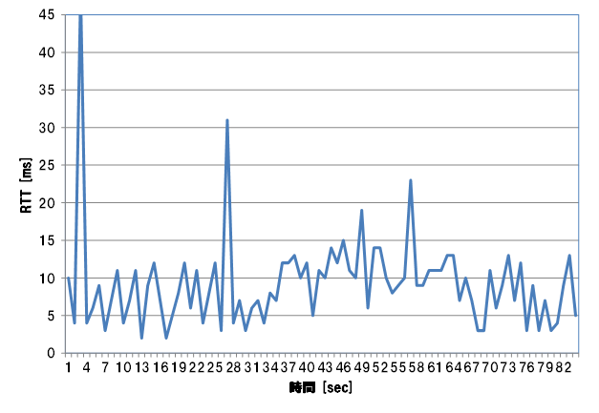
Inherent Problems of WLAN
Interferences
Time for refraining transmission according to CSMA/CA generates substantial delay.
Retransmissions
Retransmissions due to error of transmission lead fatal degradation of latency characteristics.
Hidden / expose node problems are still serious issues.
Consecutive Transmissions
Jitter and latency might get worse if there is burst transmissions by aggregated frames.
An example of measured delay
at NTT lab
RTT fluctuates dynamically!!
-> Features that can realize stable low-latency environment are required for RTA.
Time

Slide 10
Network Delay Consideration
Requirement of WLAN Manufacturing [4]
Example of latency estimation
Latency=10ms
2.5ms
Server
Scenarios | Latency
Automation | < 50ms
Monitoring | < 100ms
Mechanical Control | < 10-50ms
Motion Control | < 10ms
Transfer node
Broad Intensive Point (Shirahige, Japan)
1ms
Tokyo Ring (Prox.100km)
Transfer node
Dispersed Intensive Point
(Tachikawa, Japan)
Latency=10ms
0.4ms
Tama Ring (Prox.30km)
Server
2.5ms
Transfer node
Local Building
Transfer node
0.3ms
0.3ms
Approximately 4.8 ms or lower latency might be needed at the air of WLAN for Motion Control.
WLAN AP
<4.8ms
<6.2ms
[4] David Xin Yang, “Next Generation PHY/MAC in Sub-7GHz,” IEEE 802.11-18-0846r2
1ms
1ms

Slide 11
Summary
Manufacturing should be one of the target of RTA for broad market potential.
Moreover, we have to define target industries in manufacturing with consideration of possible requirements.
To design target requirement of latency or Jitter, network delay should be considered in addition to inherent issues of IEEE 802.11 WLAN systems.
For example, approximately 4.8 ms or lower latency might be required at the air of WLAN if motion control requires latency of 10 ms.

Slide 12
References
[1]Kate Meng, “Real-time Mobile Game vs Wi-Fi,” IEEE 802.11-18-1234r0
[2]Maria A. Lema, et a1, “Business Case and Technology Analysis for 5G Low Latency Applications,” IEEE Access, Vol.5, Apr. 2017
[3]Texas Instruments, “The gap in wireless communications: ultra-reliability and low latency”
https://e2e.ti.com/blogs_/b/industrial_strength/archive/2018/06/12/the-gap-in-wireless-communications-ultra-reliability-and-low-latency
[4]David Xin Yang, “Next Generation PHY/MAC in Sub-7GHz,” IEEE 802.11-18-0846r2

