Slide 1
Experiments on Wireless VR for EHT
Date: 2018-09-13
Authors:

Slide 2
Introduction
In July meeting, the motion for EHT SG formation was passed as follows: [1]
Approve formation of the 802.11 Extremely High Throughput (EHT) Study Group to consider development of a Project Authorization Request (PAR) and a Criteria for Standards Development (CSD) responses for a new 802.11 amendment for operating in the bands between 1 and 7.125 GHz, with the primary objectives:
To increase peak throughput and improve efficiency
To support high throughput and low latency applications such as video-over-WLAN, gaming, AR and VR
The wireless VR was discussed as one of the main use cases for EHT [2][3][4]
In order to support wireless VR transmissions in EHT, the network requirements of VR contents should be investigated.
In this submission, we evaluate latency characteristics of VR contents streaming under various configurations.

Slide 3
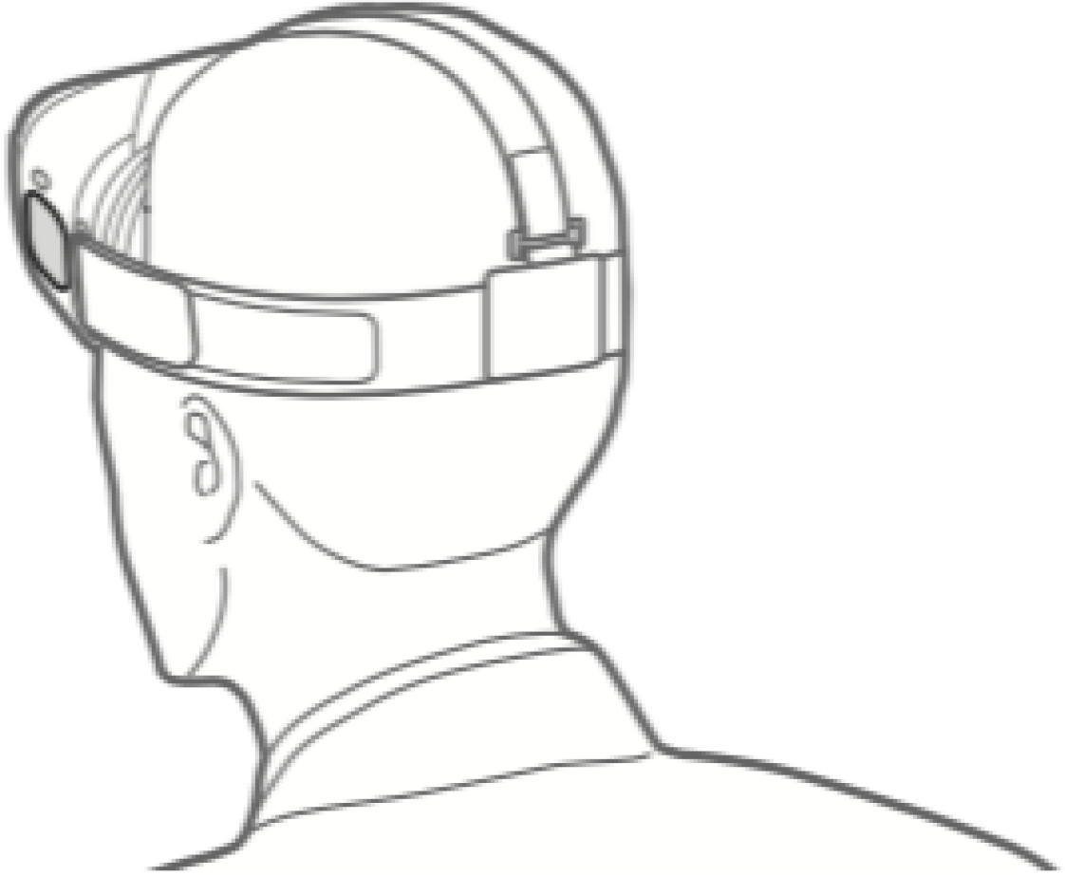
Wireless VR system
Host PC
Audio/Video
Rendering
Audio/Video Capturer
HMD Sensor Data
(uplink)
Audio/Video Encoder
Depacketizing
motion data
RTSP/RTP/
RTCP
WLAN
STA
WLAN
AP
UDP
UDP
Motion data
Packetizing
RTSP/RTP/
RTCP
Audio/Video
Decoder
VR Contents
(downlink)
Motion data
Acquisition
VR HMD
Host PC
Audio/Video
Player
VR HMD
VR requires a local (or cloud) host PC for real-time rendering of a virtual image based on the user’s latest head direction measured from HMD internal sensors
Wireless VR replaces HDMI and USB cables with wireless link which delivers the VR contents (downlink) and HMD sensor data (uplink)
Without video compression, the data rate requirements for VR contents will be in the order of tens of Gbps [3]
However, with video compression, we observed the data rate requirements reduce to the order of tens of Mbps which can be delivered in 11n or 11ac networks
In this submission, we mainly investigate network latency characteristics when streaming compressed VR contents

Slide 4
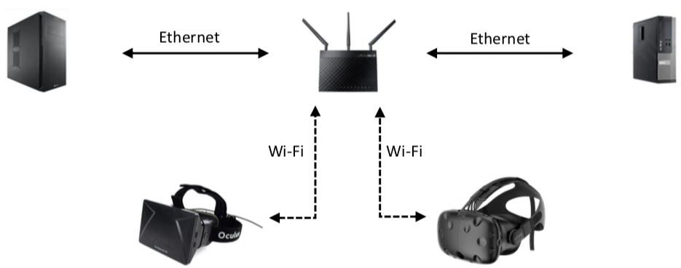
Wireless VR streaming experiments setup
VR Frame Rate: 30 or 60 FPS
VR Resolution: 1280x800 or 1600x900
Video Capturing/Streaming Engine: GamingAnywhere [5]
Video Codec: FFmpeg H.264 (AVC) (options: Ultrafast, IntraRefresh=ON/OFF)
AP: ASUS RT-ac66 (11n, 11ac)
STA: ASUS USB-AC56 Dual-band AC1300 (11n, 11ac)
11n BSS setting: 11n@2.4GHz (1STA Iperf avg: 25Mbps)
11ac BSS setting: 11ac@5GHz (1STA Iperf avg: 290Mbps)

Slide 5
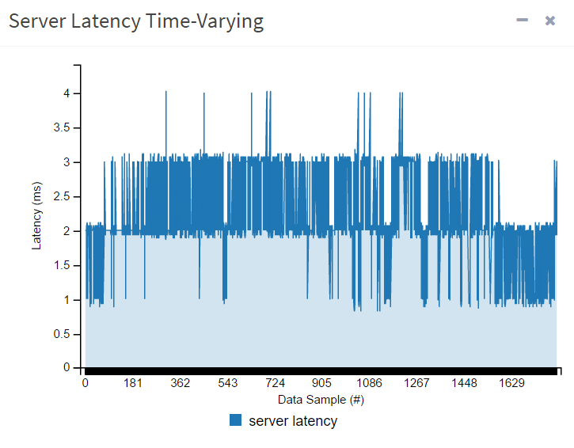
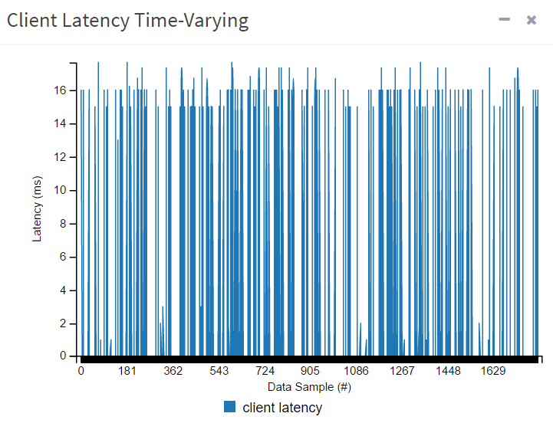
Video encoding/decoding processing latencies
Encoding processing latency
Host PC: Intel i7 4.0GHz CPU, NVIDIA GTX 1080 GPU
FFmpeg SW library or GPU acceleration (NVENC)
Encoding latency was stable at around 2ms on both SW/HW settings
Further applied IntraRefresh=ON option to avoid the video frame size variations
Decoding processing latency
Client PC: Intel i7 2.4GHz CPU, Intel HD Graphics 3000 GPU
FFmpeg SW library only
Decoding latency fluctuates according to video content variations
With the decoding acceleration, we assume that the total encoding/decoding latency would be limited to under 10 msec in total

Slide 6
Frame size variation vs. Network latency (11n, 11ac) (1/2)
Encoded Video
Frame
Size
IntraRefresh
=OFF
11n
Network Latency
11ac
Network
Latency
After video compression, we observed periodic big size keyframe (I-frame) which makes network latency increasing very much
Important to regulate the frame sizes to have constant network latency

Slide 7
Frame size variation vs. Network latency (11n, 11ac) (2/2)
Encoded Video
Frame
Size
IntraRefresh
=ON
11n
Network Latency
11ac
Network
Latency
Tried to regulate video frame sizes with IntraRefresh=ON (no I-frame) encoding option in which the keyframe is "spread" over many frames.
Still observed 11n have latency spikes, while the large network bandwidth of 11ac makes the latency low

Slide 8
Multi-STA Contention vs. Network latency (11ac)
Experimented one vs. two pairs of VR server-client sets in the same 11ac network
11n network had much steeper latency increase when there is contention
Even the large bandwidth of 11ac suffers from the latency increase, mainly from the frame buffering at sender side from channel contention
All the subsequent frames will suffer from the increased network latency as well, from the constantly generating video frames and the Head of Line Blocking effect

Slide 9
Uplink/Downlink Contention vs. Network latency (11n)
VR requires very frequent (but small size) uplink data transmission to deliver the current user’s motion data
Measured the effects on the downlink video latency when there is also the uplink motion data transmission in the same network or not
For comparison, we delivered the motion data through the same WLAN (Wireless) or Ethernet (Wired)
Video downlink latency fluctuates very much from the uplink contention in the same network

Slide 10
Discussions
High throughput would be beneficial for reducing the network latency spikes when transmitting large video frames
However, for the multi-STA contentions and uplink/downlink contentions, we need additional methods to minimize the latency
11ax’s OFDMA may be beneficial for multi-STA contentions
11ax’s Cascading or TWT may be beneficial for uplink/downlink contentions
Needs more study whether 11ax would provide enough means for reducing latencies under contention environments
Recommend EHT SG to investigate further whether additional mechanisms are required to support latency critical applications such as wireless VR transmission
Multi band operation for downlink/uplink separation [6]
Scheduling for extremely frequent traffic flows

Slide 11
Conclusions
We experimented compressed VR contents streaming
Video compression would reduce the huge data rate requirements of VR contents which makes it feasible to stream those in WLAN networks
However, we observed network latency fluctuations under different network settings
Regular/Irregular video frame sizes
Multi-STA contentions
Uplink/downlink contentions
Increasing the network throughput would be beneficial for the latency reduction of the transmission of high resolution video frames
EHT SG should investigate additional methods to minimize latency fluctuations when there are contentions from multiple uplink/downlink flows

Slide 12
References
[1] 11-18-1263-03-0eht-eht-subgroup-formation-motion
[2] 11-18-0789-10-0wng-extreme-throughput-802-11
[3] 11-18-0846-02-0wng-next-generation-phy-mac-in-sub-7ghz
[4] 11-18-1160-00-0wng-controlling-latency-in-802-11
[5] http://www.gaminganywhere.org
[6] 11-18-1518-00-0eht-eht-multi-channel-operation

