Slide 1
Use case for Aerial Vehicle ITS
Date: 2018-09-10
Authors:

Slide 2
Introduction
NGV has adopted several use cases and requirements
  BSM, Sensor Sharing, Multi-channel operation, Infrastructure application, Vehicular positioning & Location, Automated driving assistance
Currently, Aerial Vehicles are being used to regulate traffic
  Speed violation
  HOV lane violation
  etc
Aerial Vehicles are anticipated to play an important role in ITS
  Traffic regulation
  Accident report
  Virtual V2X path
  etc

Slide 3
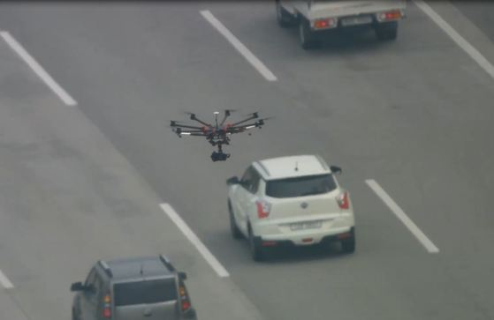
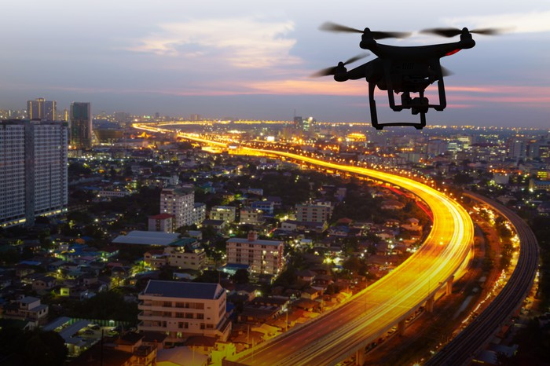
Drones are used and being studied for traffic regulation
Korea[1]
  2 drones have been deployed to help police officers to expose traffic violations in the Ho-nam Highway during the holiday season
  2 drones, a helicopter and police cars cooperated for the mission
Canada[2]
  Drone traffic cop: New research project in Ontario to develop drones as carpooling-lane traffic cop since Nov. 2017
Qatar[3]
  Drone ITS: a three years R&D project funded by the Qatar National Research Fund (QNRF) since Oct. 2016

Slide 4
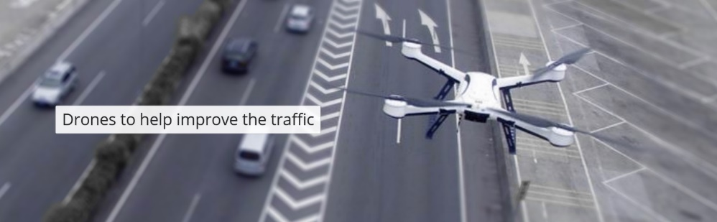
Aerial Vehicle Applications in ITS[4][5]
Flying Accident Report Agent:
  One or more UAVs fly to the accident’s location to get a detailed report about the accident and send the report in real time and over multi-hop communications to the related authorities.
Flying Road-Side Unit
  Enabled with DSRC, the ITS UAV will be used as a Flying Road Side Unit (FRSU) that can be used to support V2X communications on the ground.
Flying Speed Camera
  The ITS UAVs will be equipped with a miniature speed camera to detect over-speeding vehicles.

Slide 5
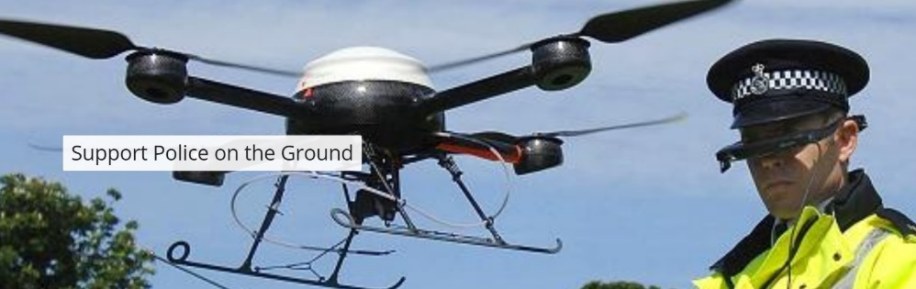
Aerial Vehicle Applications in ITS
Flying Police Eye
  This application enables a direct communication with a DSRC-enabled police car on the ground to provide the police agent with a top view video streaming to better assess traffic violations.
Flying Dynamic Traffic Signal
  A set of UAVs can be quickly deployed at a congested intersection to organize the traffic.

Slide 6
Aerial Vehicle ITS Communication with NGV
Limit the scope of Aerial Vehicle
  Special Aerial Vehicle used for law enforcement or public safety: e.g., Police Drones
NGV communication
  Flying Accident Report Agent: Information relay to other vehicles and data center

Slide 7
Aerial Vehicle ITS Communication with NGV
  Flying Road-Side Unit: Coverage extension of RSU
  Flying Speed Camera: Speed information can be gathered by flying over vehicles

Slide 8
Aerial Vehicle ITS Communication with NGV
  Flying Police Eye
  Flying Dynamic Traffic Signal

Slide 9
7. Aerial Vehicle ITS Application
Overview:
  Aerial Vehicles provide road safety and traffic violation monitoring functions with LoS connectivity
  Aerial Vehicles can be deployed flexibly and dynamically to control heavy traffic congestion
Requirements:
  Vehicle to X communication includes Aerial Vehicle to X
  High Throughput to provide traffic video information from Aerial Vehicles to Authorities (police officers)
  Multi-Channel operation
  Short packet transmission latency
Limitations:
  Maintaining channel load
  Priority control

Slide 10
Straw Poll
Question: Do you agree to adopt the Aerial Vehicle ITS use case on slide 9 as one of NGV use cases?
Y/N/A:

Slide 11
References
[1] https://www.koreatimes.co.kr/www/tech/2018/05/133_248268.html
[2] https://www.fool.com/investing/2017/12/13/nvidias-artificial-intelligence-to-power-a-drone-t.aspx?source=iedfolrf0000001
[3] https://www.qmic.com/solutions/drone-its/
[4] H. Menouar, I. Guvenc, K. Akkaya, A. S. Uluagac, A. Kadri and A. Tuncer, "UAV-Enabled Intelligent Transportation Systems for the Smart City: Applications and Challenges," in IEEE Communications Magazine, March 2017.
[5] drone ITS - http://droneits.com/

