Slide 1
Prototype of Full Duplex for 802.11
Date: 2018-09-11
Authors:
Name | Affiliations | Address | Phone | email
James Gary Griffiths | Huawei Canada | 303 Terry Fox Drive, Suite 400 Kanata, Ontario Canada K2K 3J1 |  | james.griffiths@huawei.com
Peiwei Wang |  |  |  | peiwei.wang@huawei.com
Philippe Wu |  |  |  | Philippe.Wu@huawei.com
Yan Xin |  |  |  | Yan.Xin@huawei.com
Edward Au |  |  |  | edward.ks.au@huawei.com
Baojian Zhou |  |  |  | zhoubaojian@huawei.com
Tho Le-Ngoc | McGill University | Room 633, McConnell Engineering Building 3480 University Street Montreal, Quebec, Canada H3A 0E9 |  | tho.le-ngoc@mcgill.ca
Robert Morawski |  |  |  | robert.morawski@mcgill.ca
Harry Lee |  |  |  | hakhyun.lee@mail.mcgill.ca

Slide 2
Full Duplex (FD) – Potential Solution for Next Generation of 802.11
Successful Market - WLANs are extensively deployed worldwide. According to Wi-Fi Alliance [1], the cumulative Wi-Fi device shipments will be over 20-billion units in 2018. Large quantities of Wi-Fi devices are used in dense environments demanding advanced technologies to improve the spectrum efficiency in WLANs. FD technology allows simultaneous transmission and reception of signals over the same bandwidth.
Various self-interference cancellation (SIC) techniques available – Challenges in applications of FD have been discussed in [2]-[4]. Various techniques, such as shared (SISO) or separated (MIMO) antenna configurations, passive or active cancellations, RF or digital cancellations, have been proposed to reduce significant self-interference in FD.
Proposed Enabling Technique - This contribution analyzes the components of SI and the requirements for a FD-capable receiver to cancel the SI, overviews several self-cancellation techniques potentially to be considered in FD for 802.11. In addition to digital cancellation, a cost-effective solution by using high Tx/Rx isolation MIMO antenna sub-system with SI cancellation capability to enable full duplex for 802.11 is proposed. Separating multiple antennas into Rx & Tx yields high isolation, however this may limit the MIMO capabilities.

Slide 3
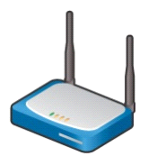

802.11 Full-Duplex Challenges
Self Interference
Sources
Self Interference
Components
0
Direct Path from other Transmit Antenna
-10
Tx to Rx in Antenna
Multipath Echoes
Self-interference Power (dB)
-20
Tx to Rx in Same Antenna
-30
-40
Leakage in RF Circuit
-50
Direct Path from other Transmit Antenna
-60
Tx
RF Canceller
-70
Near-end multipath echoes
Far-end multipath echoes
-80
Leakage in
RF Circuit
-90
Time
Sub
nsec
Tens of nsec
(Tens of meters)
Hundreds of nsec
(Hundreds of meters)
Rx

Slide 4
802.11 FD Link Budget [4]
System: Carrier Frequency: 2.45GHz, BW: 20MHz
Desired received signal power: Pr = Pt + Gt + Gr – Lp, where:
  Pt (transmitter output power) = 20 dBm
    Gt (transmitter antenna gain) = 6 dBi, Gr (receiver antenna gain) = 6 dBi
    Lp (path loss) (note: channel model-D for Typical Office [5] is considered)
  Lp(d) = L_{FS}(d_{BP})+35*log10(d/d_{BP}) for d > d_{BP} (breakpoint distance =10m)
  L_{FS}(d_{BP}) is free space path loss at d_{BP} ; d is Tx-Rx separation distance (m)
Noise floor: N_{floor} = -90dBm, for BW=20MHz; receiver NF: 6dB; margin (I_{o}): 5dB
With SIC=95dB sufficient for range of 40m and SINR= 26dB (for MCS7, i.e., rate-3/4 coded 64-QAM)
SIC (dB) | d = 40 m |  |  |  | d = 80 m
 | Pr = -49dBm |  | SNR=41dB |  | Pr = -59.7dBm |  | SNR=30.3dB
 | Residual SI (dBm) | SINR(dB) |  | data rate (Mbps) / 11ax MCSs | Residual SI (dBm) | SINR(dB) |  | data rate (Mbps) / 11ax MCS
90 | -70 | 21 |  | 43.9 / MCS4 | -70 | 10 |  | 7.3 / MCS0
95 | -75 | 26 |  | 73.1 / MCS7 | -75 | 15 |  | 21.9 / MCS2
100 | -80 | 31 |  | 87.8 / MCS8 | -80 | 20 |  | 43.9 / MCS4
105 | -85 | 35 |  | 97.5 / MCS9 | -85 | 24 |  | 58.5 / MCS5
110 | -90 | 38 |  | 121.9 / MCS11 | -90 | 27 |  | 73.1 / MCS7

Slide 5
Prototype of SIC in 802.11 FD
Antenna isolation
Tx1
Tx2
Rx1
Rx2
45-50dB antenna isolation
d₁
a₁
…
…
Variable
delays
Variable
attenuators
∑
15-20dB Analogue SIC
Analogue / Analogue SIC
…
…
d_{n}
a_{n}
DAC
&
UC
ADC
&
DC
30-35dB Digital SIC
Digital /Digital SIC
Digital BB

Slide 6
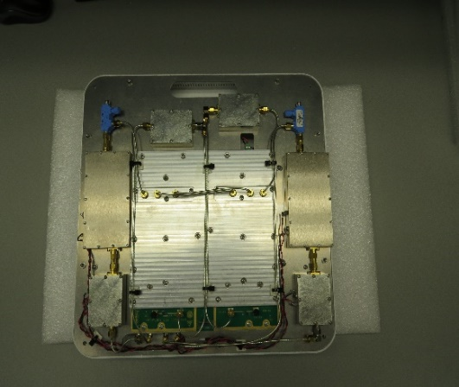
Antenna Isolation and Analogue SIC in 802.11 FD
  2x2 array with dual-polarized elements
  Use EBG (Electromagnetic Band Gap) technologies to reduce size and enhance inter-element isolation
  Multi-layer structures
  Wideband, high Tx/Rx isolations
  45-50dB antenna isolation
  High Tx/Rx isolation MIMO antenna sub-system with SI cancellation capability
2x2 MIMO FD Antenna Assembly
Analogue SI Canceller

Slide 7
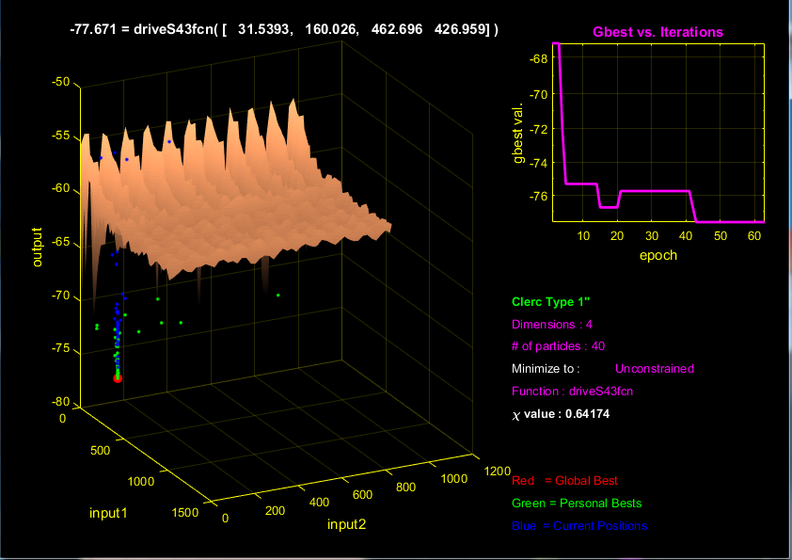
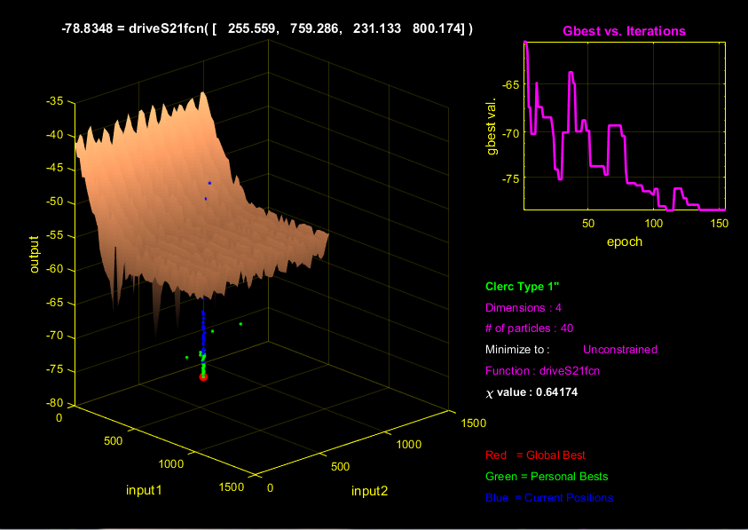
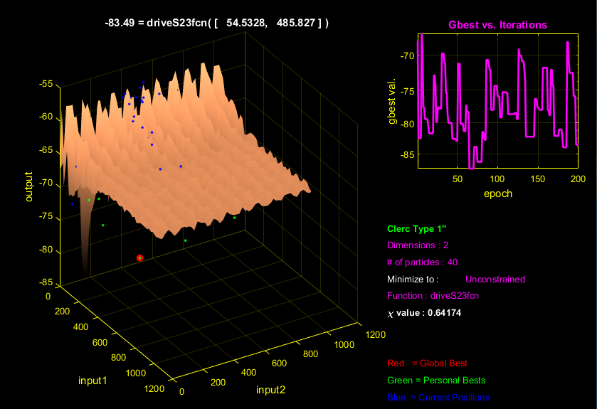
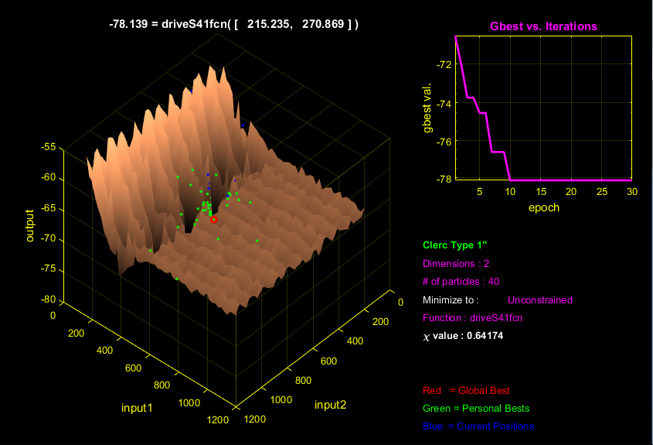
Typical Standalone Cancellation Surface for Analogue Canceller + High Isolation Antenna
Analogue SI Canceller
For 2x2 MIMO; 4 Cancellation Paths, S21, S43, S23, S41 ranging from -77 to -83 dB

Slide 8
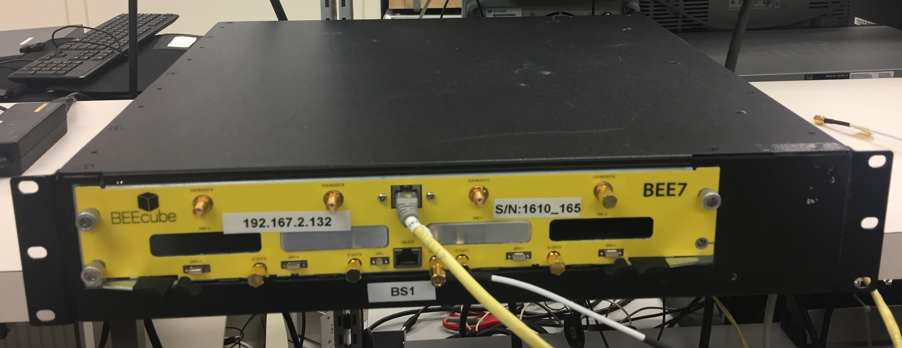
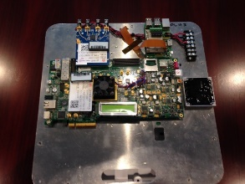
Prototype of Digital SIC in FD
DAC
&
UC
ADC
&
DC
Tx1, Tx2
MIMO Side B Cancellation
Direct Chan Est.
Rx1, Rx2 + SIC
Cross Chan. Est
CancA1 Gen.
MIMO Side A Cancellation
Direct Chan Est.
Cross Chan. Est
Tx1, Tx2 Ref
S3 Cancel Signal Gen.
CancA1 Gen.
30-35dB SIC
S3 Cancel Signal Gen.
CancA2 Gen.
Rx1, Rx2 After Digital SIC
CancA2 Gen.
Digital SIC
Digital BB

Slide 9
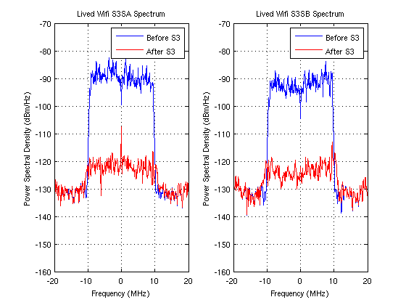
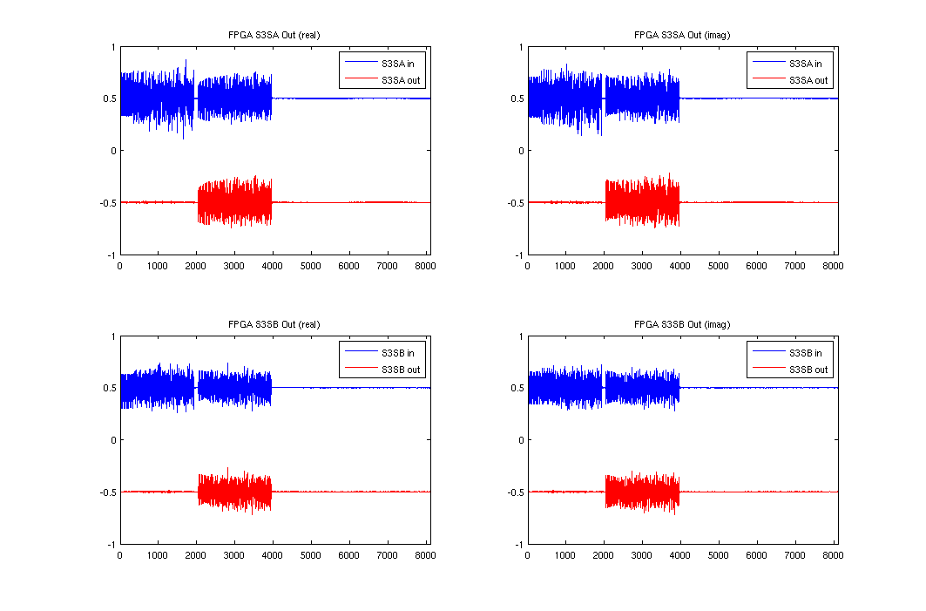
Digital SI Cancellation – AP without Data Traffic

Slide 10
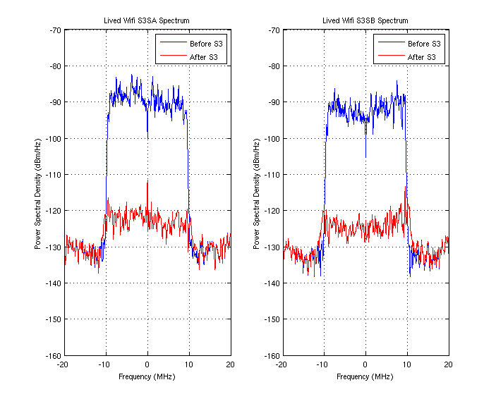
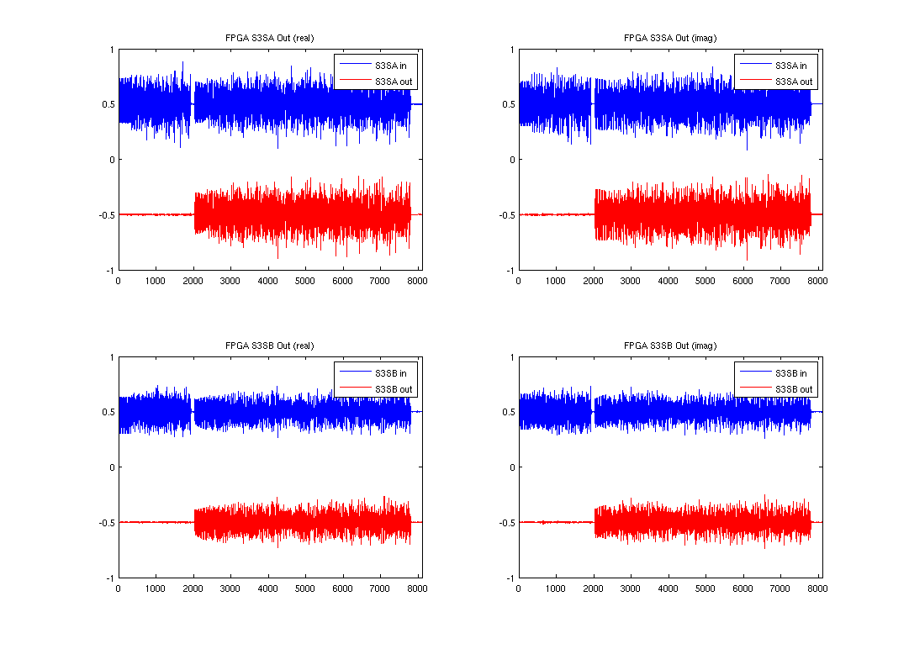
Digital SI Cancellation – AP with Data Traffic

Slide 11
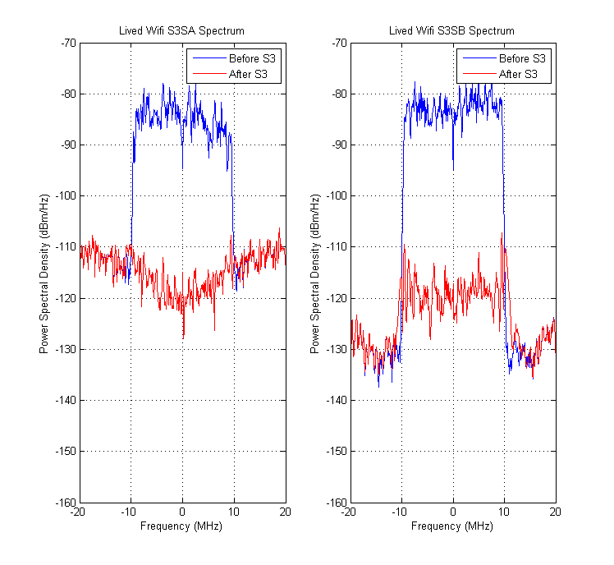
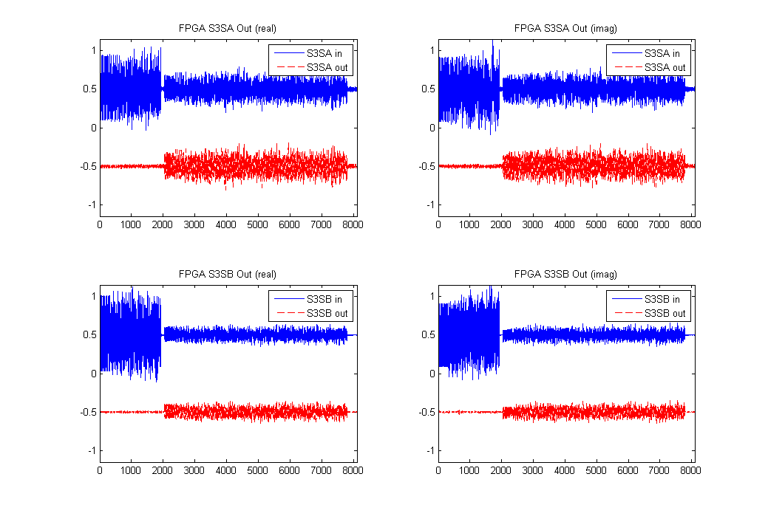
Digital SI Cancellation – STA with Data Traffic

Slide 12
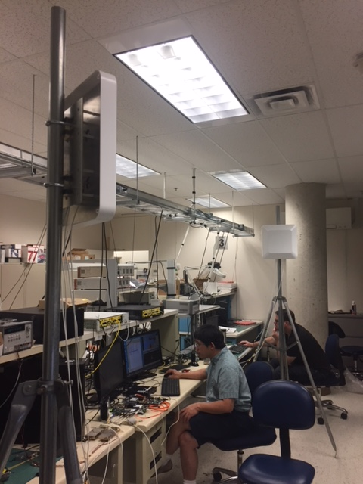
Prototype Configuration Setup
 | FD-AP | FD-STA
Operating channel | 2.45GHz | 2.45GH
Band Width | 20MHz | 20MGHz
Number of transmit antennas | 2 | 2
Number of receive antennas | 2 | 2
Modulation used for the demo | 64 QAM | 64 QAM
Code rate | 2/3 | 2/3
Standards Compatible | IEEE 802.11ax PHY compliance with fixed HE-MCS index in operation and without MAC support | IEEE 802.11ax PHY compliance with fixed HE-MCS index in operation and without MAC support
Tx Power | 20dBm | 20dBm
ANT Gain | 6dBi | 6dBi
Analog Cancellation(including ANT isolation) | >65dB (Goal) >45dB (Current) | >65dB (Goal) >45dB (Current)
Digital Cancellation | >30dB | >30dB
Self-Interference
TX
RX
Self-Interference
TX/RX
Full duplex
Full duplex
STA
AP
Symmetric FD

Slide 13
Summary
A symmetric Full-Duplex (FD) architectures have been shown.
Self-interference channel impulse response has been performed and the measurement results show external reflections exist in the indoor environment.
Link budget has shown that FD can achieve high data rate transmission for mid-range communications in WLAN.
We have shown the current SIC capability for a full duplex MIMO (2x2) prototype using a Wi-Fi compatible frame structure in an indoor environment.

Slide 14
Appendix – Full Duplex Demonstration Video
Link for the video play:
https://drive.google.com/file/d/1LyqrXOCHe2bXAxPmEhCeki_WkvMDcS1e/view?ts=5b9875bf
This presentation and the demo are not intended to sell you on a
particular full duplex implementation

Slide 15
References
[1] https://www.wi-fi.org/news-events/newsroom/wi-fi-alliance-publishes-2018-wi-fi-predictions
[2] 11-18-0549-00-00fd-full-duplex-for-802-11.
[3] 11-18-0448-01-00fd-full-duplex-benefits-and-challenges.
[4] 11-18-0880-00-00fd-self-interference-cancellation-in-full-duplex-for-802-11
[5] IEEE 802.11-03/940r1.
[6] Fei Chen, Robert Morawski, Tho Le-Ngoc, “Self-Interference Channel Characterization for Wideband 2x2 MIMO Full-Duplex Transceivers using Dual-Polarized Antennas”, IEEE Transactions on Antennas & Propagation, Vol. 66, No. 4, April 2018.
[7] IEEE 802.11-03/940r1.
[8] D. Bharadia, E. McMilin and S. Katti, “Full Duplex Radios”, Proc. of the ACM SIGCOMM 2013, Hong Kong, China, Aug. 2013.
[9] https://www.design-reuse.com/umc/adc-c-78/
[10] T. Zhang et al, “A 1.7-to-2.2GHz Full-Duplex Transceiver System with >50dB Self-Interference Cancellation over 42MHz Bandwidth”, ISSCC 2017.
[11] D. Regev et al, “Modified Re-Configurable Quadrature Balanced Power Amplifiers
for Half and Full Duplex RF Front Ends”, Wireless and Microwave Circuits and Systems (WMCS), 2018 Texas
[12] T. Huusari et al, “Wideband Self-Adaptive RF Cancellation Circuit for Full-Duplex Radio: Operating Principle and Measurements”, 2015 IEEE 81st Vehicular Technology Conference (VTC Spring)

