Slide 1
Performance Simulations
Date: 2018-09-10
Authors:

Slide 2
Abstract
This presentation describes the stadium video distribution simulations.
Especially the point of view of:
How many device can be covered by a single AP?

Slide 3
Assumptions
Tens of thousands of spectators in a stadium
Each spectator occupies 1m² (1m * 1m)
All spectators watch the same video stream on their own devices.
A video stream consumes 2Mbps
1m
1m

Slide 4
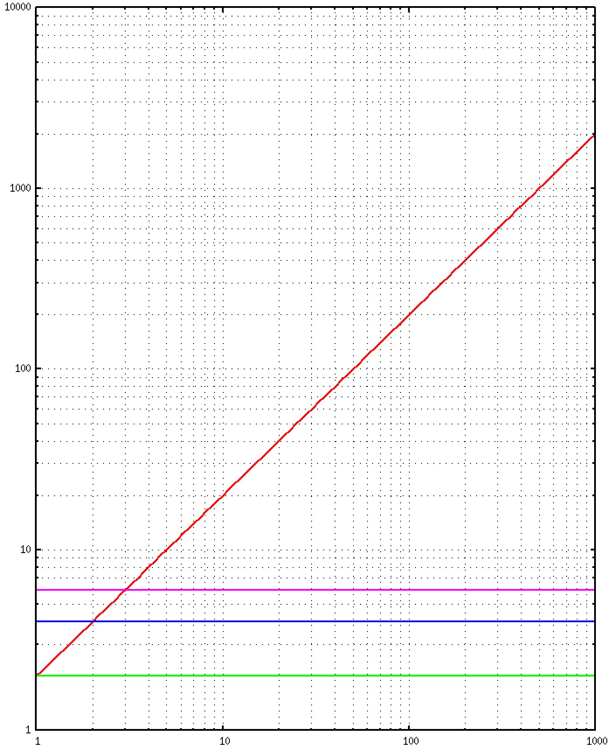
Unicast vs Broadcast
Unicast traffic is proportional to the number of users
Broadcast does not have ACK mechanism.
  A kind of inter-packet error correction will be used to reduce packet losses. e.g. transmitting the same packet multiple times.
Unicast (2Mbps/user)
traffic (Mbps)
Broadcast (3 times)
Broadcast (2 times)
Broadcast (1 time)
number of users

Slide 5
Cell Size Estimation
To specify the practical cell size,
  Measured error rate
  Calculated cell size

Slide 6
Error Rate Measurement
Host A and Host B exchange packets.
  Payload: 1408 byte
Host C captures packets.
  If FCS is incorrect, the frame is considered as error.
Not in a shielded room, just in a general office building.
  Much interference
Host A
AP
Host B
Stable Communication
Capture
Host C
Move

Slide 7
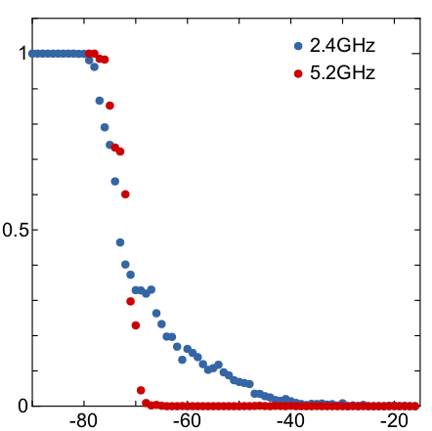

Result
N > 1000 for each point
2.4GHz
  MCS 7 (n)
  ShortGI
  20MHz Bandwidth
  72.2 Mbps
  The result may be affected by interference from environment.
5.2 GHz
  MCS 7 (ac)
  ShortGI
  80MHz Bandwidth
  325.0 Mbps
Error Rate 0
when RX Power > -67dBm
Error Rate
$$\sim$$
RX Power (dBm)

Slide 8
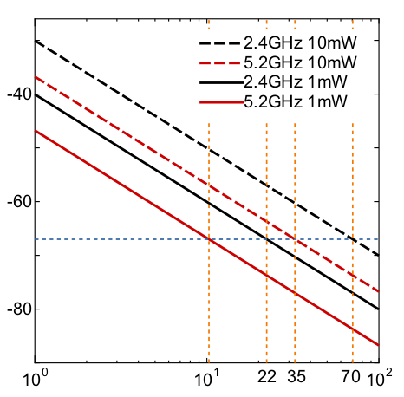
Cell Size
Assumptions
  TX power: 1mW or 10mW
  Antenna Gain: 0dBi
  Free Space (Friis transmission equation)
Frequency (GHz) | 2.4 |  | 5.2
TX Power (mW) | 1 | 10 | 1 | 10
Distance (m) when RX Power = -67dBm | 22 | 70 | 10 | 35
Area (m²) = Number of Users | 1558 | 15579 | 332 | 3319
RX Power (dBm)
-67
An AP can cover > 3000 users while existing IEEE 802.11 AP can associate with 2007 STAs.
Distance (m)

Slide 9
Conclusion
Broadcast can reduce traffic when many users access to the same contents.
Broadcast without association can reduce the number of APs for Broadcast Service.

