Slide 1
Symbol Randomization Simulations
Date: 2018-09-10
Authors:

Slide 2
Introduction
At the July meeting several presentations [1-3] were made on symbol randomization to eliminate spectral lines as well as addressing FCC and ETSI Regulations
Since no consensus emerged at the July meeting several people worked offline on a Spec Text proposal [4] for consideration at this meeting
Here we provide simulation results in support of that proposal

Slide 3
Executive Summary
The Spec Text [4] proposal implements symbol randomization within the MC-OOK On Waveform Generator
  The cyclic shift is applied before appending the GI so the natural place to put this is inside the On Waveform Generator
The symbol randomization combines both phase and cyclic shift randomization
  Binary phase randomization
  Cyclic shift randomization from a set of eight cyclic shifts
A linear feedback shift register (LFSR) is used to generate the required random numbers
This is a low complexity design and is simple to implement in the WUR transmitter
This fully eliminates spectral lines and address FCC regulations. It also increases allowed transmit power according to ETSI regulations

Slide 4
Block Diagram

Slide 5
Simulation Methodology
Generate LDR Data Field with 50k random bits
Binary Phase Randomization & Cyclic Shift Randomization
  Cyclic shift randomly selected from the following set [3]
    {0, -400, -800, -1200, -1600, -2000, -2400, -2800} ns
Calculate PSD
  5 kHz resolution for Plot and for calculating power in 1 MHz
  300 Hz resolution for calculating power in 3 kHz
Calculate Maximum Allowed Transmit power based on FCC Rule of 8 dBm in 3 kHz bandwidth
Calculate Maximum Allowed Transmit power based on ETSI Rule of 10 dBm in 1 MHz bandwidth

Slide 6
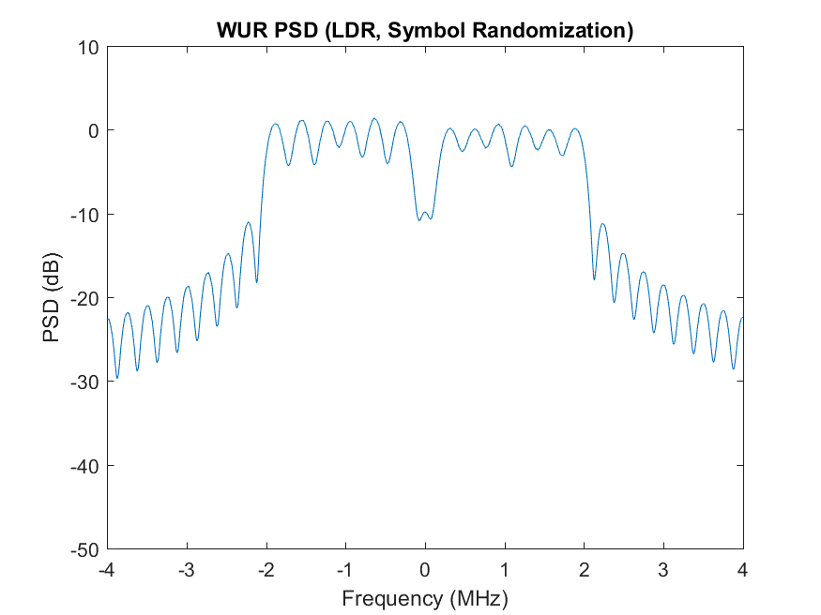
Example 1 – Symbol Randomization – Power Spectral Density
No Spectral Lines and symmetric spectrum

Slide 7
Maximum Allowed Transmit Power
MC-OOK Symbol (Annex AB) |  | Maximum Allowed Transmit Power according to FCC 3 kHz Rule (dBm) | Maximum Allowed Transmit Power according to ETSI 1 MHz Rule (dBm)
Example 1 | Original | 20.0 | 14.5
 | Symbol Randomization | 36.7 | 15.4
Example 2 | Original | 18.6 | 13.8
 | Symbol Randomization | 34.5 | 14.4
Example 3 | Original | 19.1 | 14.4
 | Symbol Randomization | 36.7 | 15.4
Completely eliminates any spectral lines
Fully addresses the FCC 3 kHz rule
Increases the maximum allowed transmit power (allowed by ETSI) by between 0.6 and 1 dB

Slide 8
References
Vinod Kristem, Shahrnaz Azizi, and Thomas Kenney, “WUR PSD Studies,” IEEE 802.11-1165r1, July 2018
Steve Shellhammer and Bin Tian, “Comparison of Symbol Randomization Techniques,” IEEE 802.11-1200r0, July 2018
Miguel Lopez, Dennis Sundman, and Leif Wilhelmsson, “Spectral line suppression for MC-OOK,” IEEE 802.11-1179r1, July 2018
Spec Text document …

Slide 9
Summary
Demonstrated the effectiveness of symbol randomization in addressing both the FCC and ETSI regulations, as well as fully eliminating any spectral lines
The symbol randomizer is a low complexity design and easy to implement in the WUR transmitter

Slide 10
Backup

Slide 11
Phase Randomization Only
If only one form of symbol randomization is to be utilized then phase randomization works well on its own
  Very simple implementation
  Phase randomization has been shown in [2] to eliminate spectral lines in all example symbols
It was pointed out in [3] that phase randomization alone may lead to slightly lower TX power in PSD-limited regions
This issue can be easily overcome by simply boosting some of the tones
Preliminary results are shown in the following slides
  No optimization has been performed, so better results may be possible
  Specific power boosting can be a vendor specific implementation

Slide 12
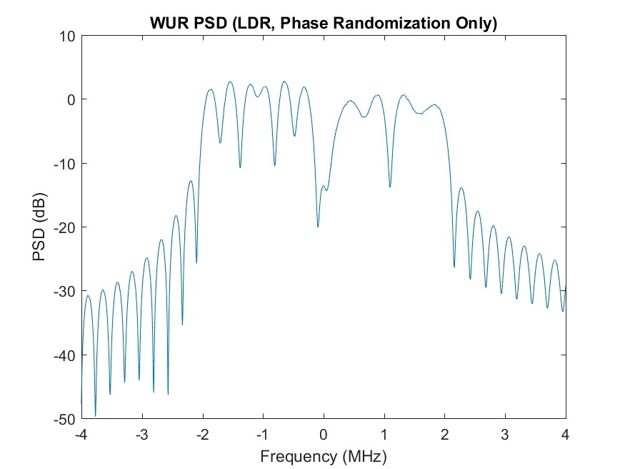
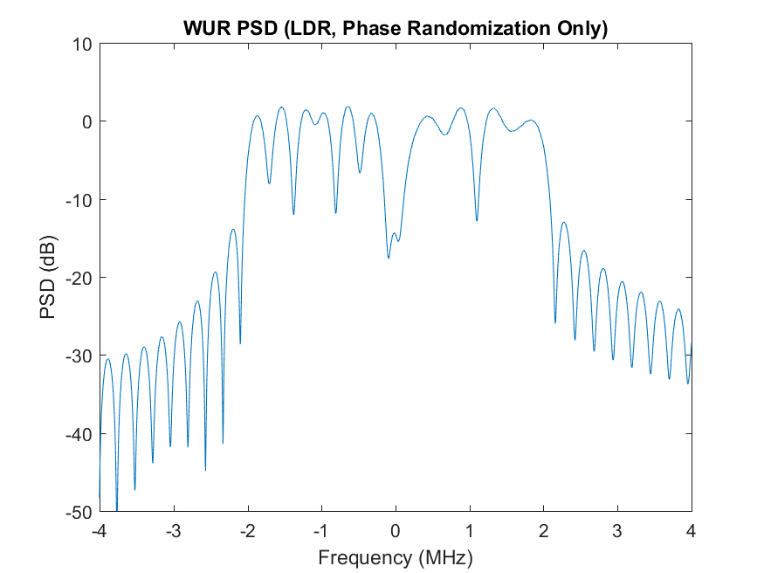
Example 1 Symbol in Annex AB – PSD
Original PSD
Tone Boosted PSD
Simple power boosting of positive frequency tones, flattens spectrum and enables higher allowed transmit power

Slide 13
Summary – Max Allowed Power per ETSI Rule
Symbol (From Annex AB) | Original | Phase Randomization and Tone Boosting
Example 1 | 14.5 | 15.4
Example 2 | 13.8 | 14.8
Example 3 | 14.4 | 15.3
Phase randomization with tone boosting
  Preliminary tone boosting already enables increases in maximum allowed power
    Further optimization may be possible
  Increases the maximum allowed transmit power (allowed by ETSI) by 0.9 to 1 dB

Slide 14
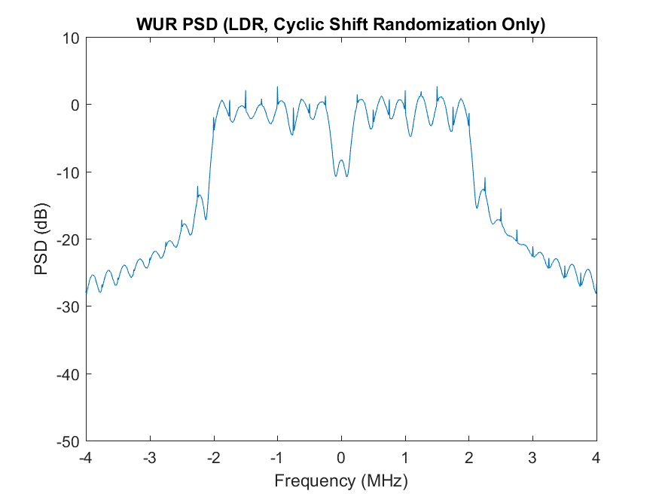
Example 2 – Cyclic Shift Randomization Only
CS randomization alone may not always eliminate all the spectral lines

