Slide 1
Time-Aware Traffic Shaping over 802.11
Date: 2018-09-10
Authors:

Slide 2
Abstract
In a previous presentation (doc#: 802.11-18/1160r0) we showed that 802.11 latency can be very low, but predictability (reliability) can be improved
  - This would enable 802.11 to address many time sensitive applications (gaming, robotics, industrial automation, etc.)
Many issues raised with current products can be resolved with optimized implementations, or by implementing features already defined in 802.11.
802.11 could go further on congestion control solutions to address worst cast latency predictability to ensure 802.11 competitiveness
  Extend 802.1 TSN features: Time-Aware shaping (802.1Qbv) over 802.11
In this presentation we discuss the Time-Aware shaping (802.1Qbv) concept and how it can be used to control congestion in 802.11
We also provide preliminary performance results in a single BSS case

Slide 3
Outline
Time sensitive application examples
Latency challenges
802.1 TSN overview
Time-Aware (802.1Qbv) traffic shaping
Time-Aware traffic shaping over 802.11
Performance evaluation
Conclusions

Slide 4
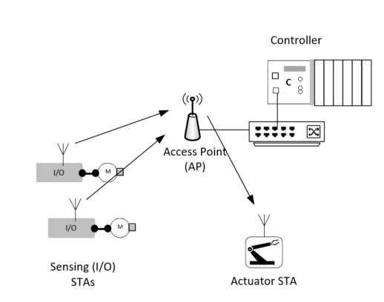
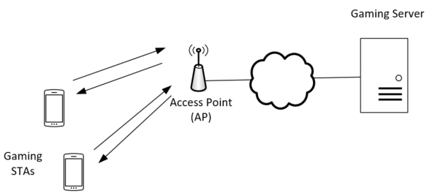
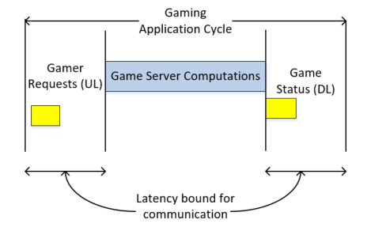
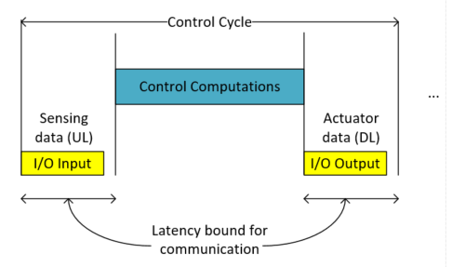
Time Sensitive Applications Examples
Limiting worst case latency (also over the Wi-Fi link) is the main issue
Real-time mobile gaming
Wireless control system
Latency/jitter cause lagging/bad user experience
Latency/jitter may cause instability of the system

Slide 5
Requirements for the Wi-Fi Network
Application | Worst Case Latency | Application PER | Throughput Requirement
*Mobile gaming | 10 ms | 0.1% | Low (0.5-1Mbps)
**Wireless control, robotics, AGVs | Class A: 10-50ms Class B: 1-10ms Class C: <1ms | 0.1 – 0.0001% (depend on specific application) | Low
Wireless VR | 5 ms | 0.1% | High
Predictable worst case latency with high probability is major improvement area for Wi-Fi.
*Doc#: 802.11-18/1419r4
**Doc#: 802.11-18/1160r0

Slide 6
Latency Challenges
802.11 latency can be very low without congestion
  Basic sequence: EDCA+DATA+ACK (~100’s µs for 100 bytes)
  This enables a wider range of very low latency use cases (mobile gaming, industrial Class A/B under managed networks)
Congestion is the main challenge in enabling more predictability of worst case latency
  Congestion within BSS is easier to address with congestion control solutions
  Congestion with managed OBSSs can also be addressed
  Congestion with unmanaged OBSSs is very hard to control
Time-aware traffic shaping can enable better congestion control
  802.1Qbv defines a solution for Ethernet-based TSN (Time-Sensitive Networking)
  As with other 802.1 capabilities, similar concept can be extended to 802.11
  This also enables better integration of 802.11 with Ethernet-based TSN

Slide 7
IEEE 802.1 Time-Sensitive Networking (TSN)
Standard Ethernet with Synchronization, small and/or fixed latency, and extremely low packet loss
TSN Components
Common Standards
Time synchronization:
Time Synchronization (802.1AS)
Ultra reliability:
Frame Replication and Elimination (P802.1CB)
Path Control and Reservation (802.1Qca)
Per-Stream Filtering and Policing (802.1Qci)
Reliability for time sync (P802.1AS-Rev)
Synchronization
√ 802.1AS over 802.11
Timing Measurement (TM)
Fine Timing Measurements (FTM)
Reliability
Reliability
Latency
Bounded low latency:
Time-Aware traffic shaping (802.1Qbv)
Preemption (802.1Qbu/802.3br)
Cyclic Scheduling (802.1Qch)
Asynchronous Scheduling (802.1Qcr)
Resource Mgmt
Dedicated resources & API
Stream Reservation Protocol (802.1Qat)
TSN configuration (P802.1Qcc)
YANG (P802.1Qcp)
Link-local Registration Protocol (P802.1CS)
Zero congestion loss
Time-Aware shaping (802.1qbv) over 802.11 (extension to address latency)
√ 802.11aa (SRP over 802.11 for AV)
√ 802.11ak (802.11 links in an 802.1Q network)
Credit: János Farkas, Ericsson
TSNA Conference 2017, http://www.tsnaconference.com/

Slide 8
Time-Aware Traffic Shaping
Scheduling time-critical frame transmissions while avoiding contention with lower priority frames can give low jitter and guarantee worst case latency
  802.1Qbv defines Time-Aware shaper for Ethernet switches
Queues/Traffic classes
Multiple queues are controlled based on a repeating schedule (time, gate open/closed), time reference is provided by 802.1AS
T
T
T
T
T
T
T
T
Qbv can be very effective, especially for predictable, periodic traffic
frame selection
Transmission time
gate open
gate open
gate closed
gate open
gate closed

Slide 9
Time-Aware Shaping over Wireless
Time-Aware shaping sitting on top of 802.11 MAC can resolve contention within each device and across multiple STAs/AP that share the medium
  Within the BSS, existing 802.11 MAC/PHY protocols can be used to ensure that the STAs will have time to complete their transmission during the period when the gate is open: EDCA, UL OFDMA, TWT, …
AP
Example Scenario
Time-Sensitive Traffic
Other Traffic
…
AP
gate open
gate open
gates closed
T
T
T
T
All gates open
STA 1
gates closed
gate open
(Normal Operation)
Shared medium
STA 2
gates closed
gate open
T
T
T
T
T
T
T
T
The Qbv schedule defines when the gates open/close (implementation specific)
The schedule can take into account the 802.11 MAC/PHY mode (e.g. EDCA, 11ax DL/UL OFDMA, TWT, …)
STA 1
STA 2

Slide 10
Simplified TSN Reference Stack
Application
Transport
Direct L2 access
IP Encapsulation
IP
IEEE 802.1 Network
TSN Capabilities: time sync, time-aware, reservations, and many others …
Link Layer
MAC/PHY
IEEE 802.3
(Ethernet)
IEEE 802.11
(Wi-Fi)
3GPP/5G
(new)
Media Specific Support required for TSN Capabilities
802.11 requirements for Time-Aware (Qbv) capability:
  Exchange the 802.1Qbv schedule between managed STAs
  Rules to certify the release of frames from the 802.11 queues according to the 802.1Qbv defined times

Slide 11
Performance Evaluation
Single BSS gaming scenario
  Single AP, 80 MHz channel BW, 2 NSS
  16 Gaming STAs: Time-Sensitive traffic
    Bi-directional periodic streams: 500B UDP packets (worst case packet size according to 802.11-18/1419r4) every 30ms;
    DL and UL streams are independent
  20 Video STAs: BE traffic
    DL traffic: ~6MB DL packets generated periodically every 4s (models 1080P DASH video streaming application)
Goal: evaluate the latency performance of with and without Qbv over different access mechanisms

Slide 12
Simulation configurations
With Qbv:
AP and STAs know the Qbv schedule
Gaming traffic is prioritized
Other traffic is blocked before and within the period
Access within the period:
  DL: MU OFDMA
  UL: EDCA, Trigger-Based, or TB (no gaming) + EDCA (gaming)
Without Qbv: no prioritization and no reserved period (gaming uses VO, and Video uses VI)
EDCA access:
Trigger-based access:

Slide 13
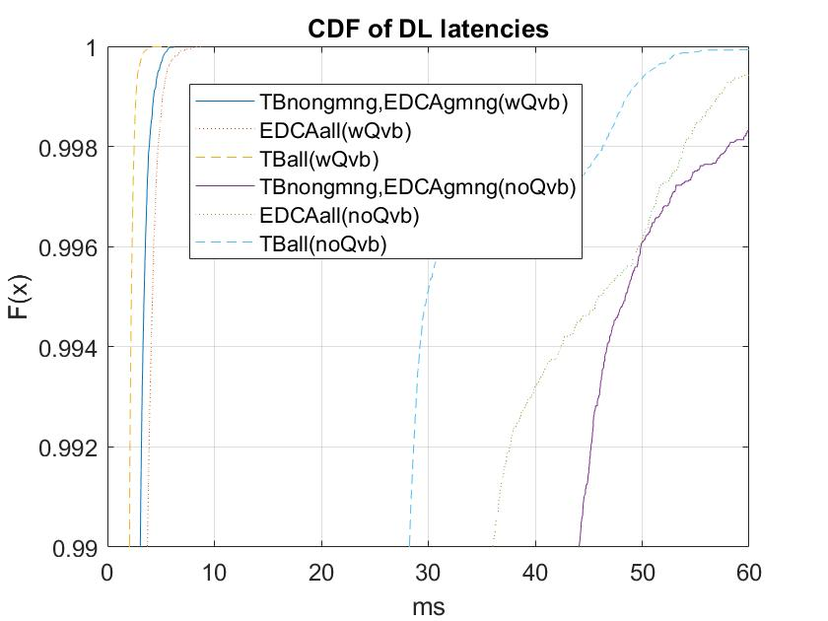
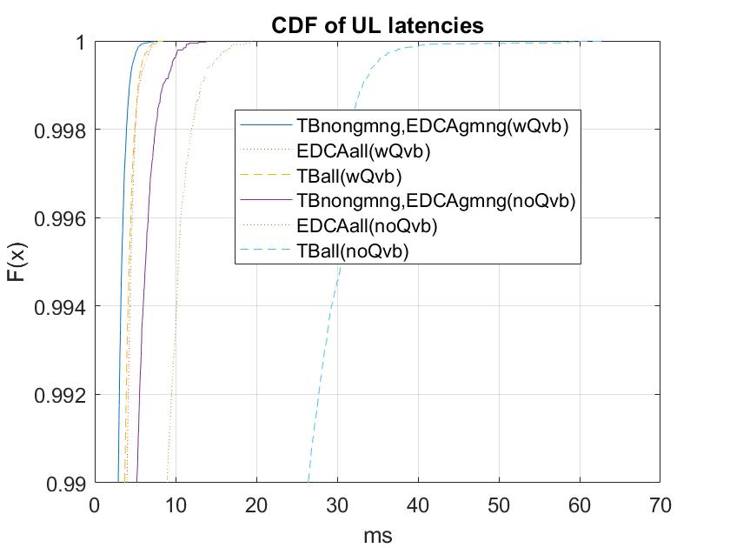
Results
Worst case latency is under 10ms with high reliability with Qbv in this scenario

Slide 14
Conclusions
Worst case latency is an important requirement for many time-sensitive applications (gaming, automation, robotics, …)
The Time-Aware traffic shaping concept (802.1Qbv) has been used to control congestion and worst case latency in 802.1 TSN over Ethernet
Extending Qbv over 802.11 can help control congestion in managed networks and improve latency for time-sensitive traffic
  Few MAC changes are required to enable the exchange of the Qbv schedule within a BSS and rules to ensure interfering traffic can be blocked during certain periods

Slide 15
References
Doc#: 802.11-18/1419r4
Doc#: 802.11-18/1160r0

Slide 16
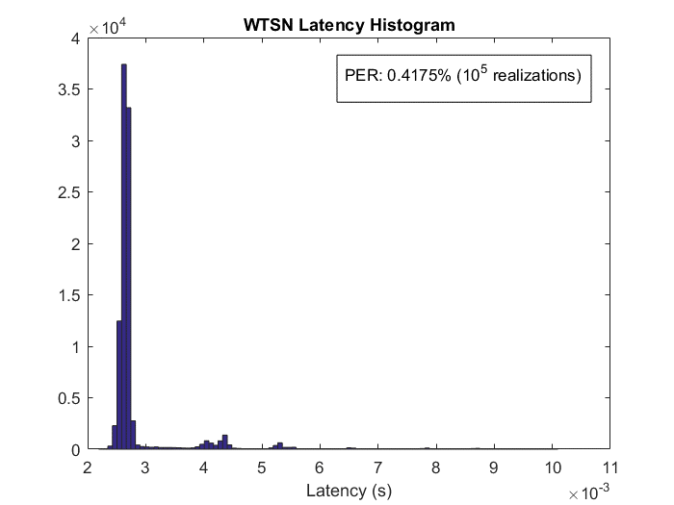
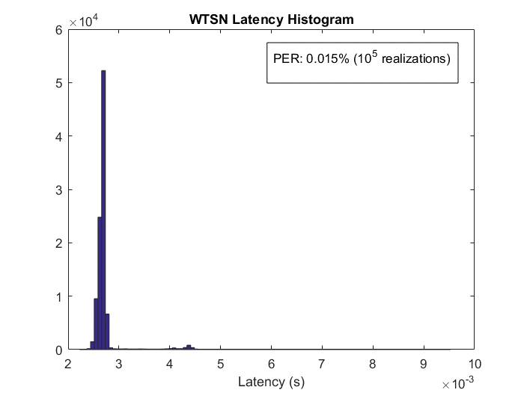
Simple Experiment: Admission control and Time-Aware Scheduling over the 802.11 MAC
STA and AP are time synchronized through 802.1AS over 802.11
Time-Aware Schedule: STA and AP hold the packet into the application queue until the scheduled release time (same concept as in 802.1Qbv)
Application layer latency and PER (office environment)
d
Busy/Office hours
Overnight hours
STA
AP
Packet arrivals according to a schedule
DL
UL
DL
…
Slot Duration = 10 ms
802.11ac 2.4 GHz, d=10 m range (NLOS)
Application packet size = 100 Bytes
PER= Packet is considered lost if not delivered within the slot duration (10 ms)
Dave Cavalcanti, Intel

Slide 17
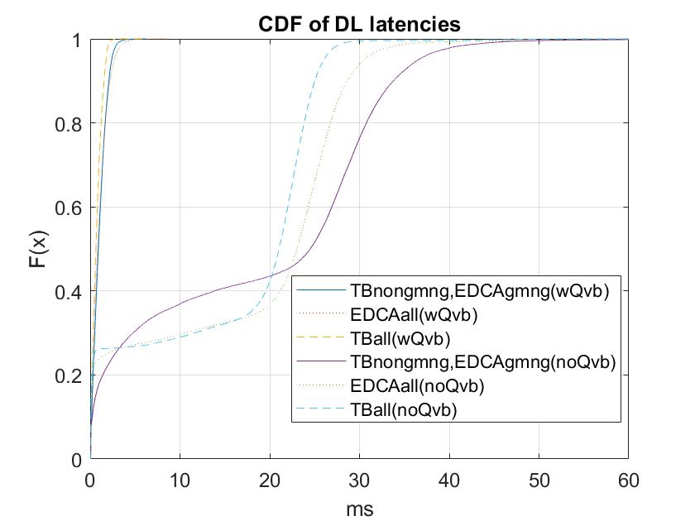
DL latency results

