Slide 1
Tuning Symbol Randomization
Date: 2018-09-10
Authors:

Slide 2
Abstract
In [1], [2], [3] it is shown that binary phase randomization and cyclic shift randomization are effective means to suppress spectral lines and flatten the spectrum
In this presentation we investigate the choice of delay values for cyclic shift randomization and give recommendations

Slide 3
Symbol randomization by concatenation of phase and cyclic shift randomization
Phase randomization suppresses spectral lines but can’t flatten the PSD
Cyclic shift randomization flattens the PSD but does not remove spectral lines arising from DC
  The draft spec [4] states that the DC subcarrier can be null. Hence, it is beneficial to ensure that the spectral lines are suppressed even if the DC subcarrier is not null.
By concatenating the phase randomizer and the cyclic shift randomizer the spectral lines are suppressed and the PSD is flattened

Slide 4
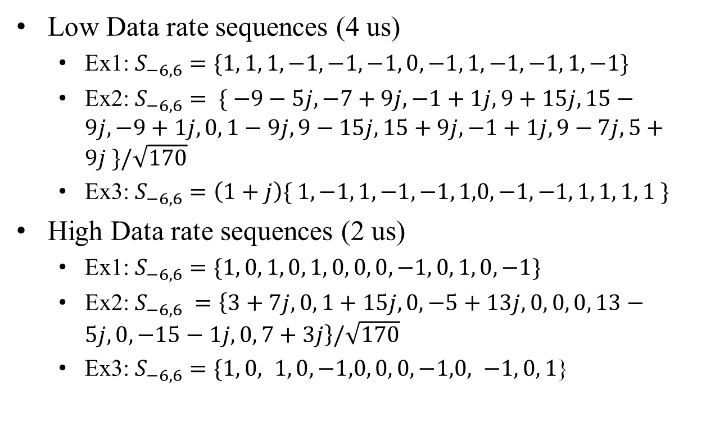
Recap – recommended examples
Low Data rate sequences (4 us)
  Ex1: $S_{−6,6}=\{1, 1, 1, −1, −1, −1, 0, −1, 1, −1, −1, 1, −1\}$
  Ex2: $S_{−6,6}= \{ −9−5j, −7+9j, −1+1j, 9+15j, 15−9j, −9+1j,0, 1−9j, 9−15j, 15+9j, −1+1j, 9−7j, 5+9j \}/\sqrt{170}$
  Ex3: $S_{−6,6}=\left(1+j\right)\{ 1, −1, 1, −1, −1, 1,0, −1, −1, 1, 1, 1, 1 \}$
High Data rate sequences (2 us)
  Ex1: $S_{−6,6}=\{1, 0, 1, 0, 1, 0, 0, 0, −1, 0, 1, 0, −1\}$
  Ex2: $S_{−6,6} =\left\{3+7j, 0, 1+15j,0, −5+13j,0, 0, 0, 13−5j,0, −15−1j,0, 7+3j\right\}/\sqrt{170}$
  Ex3: $S_{−6,6}=\{1, 0, 1, 0, −1,0, 0, 0, −1,0, −1, 0, 1$}

Slide 5
Simulation assumptions
8K data bits
PSD computed using the Welch method (Matlab’s dsp.SpectrumAnalyzer)
  Sampling rate 160 MHz

Slide 6
Combined binary phase and cyclic shift randomization
The On waveforms have been generated according to the following block diagram:

Slide 7
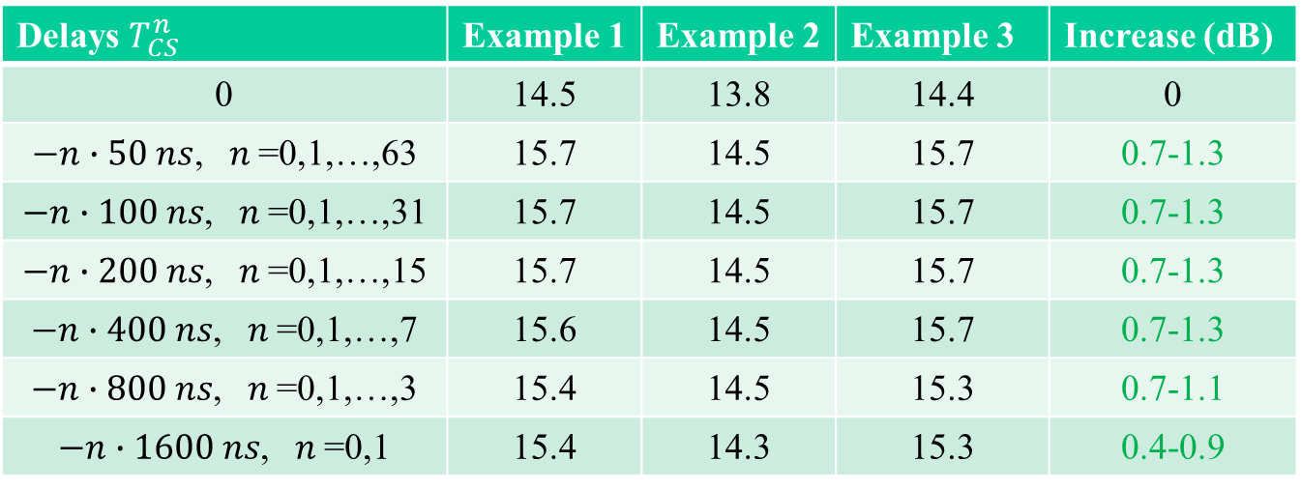
Phase randomization + cyclic shift randomization (ETSI, 10 dBm/MHz)
LDR – Tx Power (dBm)
Delays $T_{CS}^{n}$ | Example 1 | Example 2 | Example 3 | Increase (dB)
0 | 14.5 | 13.8 | 14.4 | 0
$−n∙50 ns$, $n$=0,1,…,63 | 15.7 | 14.5 | 15.7 | 0.7-1.3
$−n∙100 ns$, $n$=0,1,…,31 | 15.7 | 14.5 | 15.7 | 0.7-1.3
$−n∙200 ns$, $n$=0,1,…,15 | 15.7 | 14.5 | 15.7 | 0.7-1.3
$−n∙400 ns$, $n$=0,1,…,7 | 15.6 | 14.5 | 15.7 | 0.7-1.3
$−n∙800 ns$, $n$=0,1,…,3 | 15.4 | 14.5 | 15.3 | 0.7-1.1
$−n∙1600 ns$, $n$=0,1 | 15.4 | 14.3 | 15.3 | 0.4-0.9

Slide 8
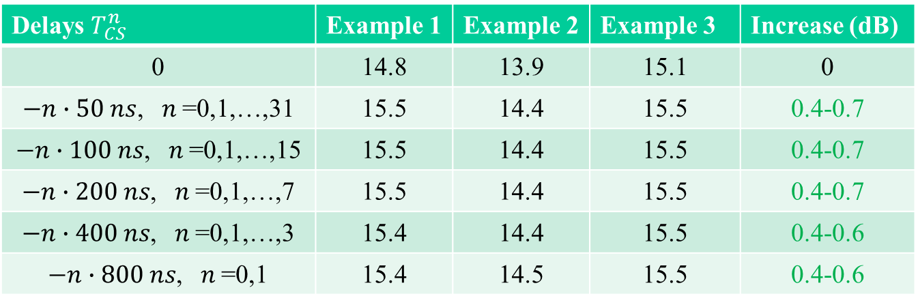
Phase randomization + cyclic shift randomization (ETSI, 10 dBm/MHz)
HDR – Tx Power (dBm)
Delays $T_{CS}^{n}$ | Example 1 | Example 2 | Example 3 | Increase (dB)
0 | 14.8 | 13.9 | 15.1 | 0
$−n∙50 ns$, $n$=0,1,…,31 | 15.5 | 14.4 | 15.5 | 0.4-0.7
$−n∙100 ns$, $n$=0,1,…,15 | 15.5 | 14.4 | 15.5 | 0.4-0.7
$−n∙200 ns$, $n$=0,1,…,7 | 15.5 | 14.4 | 15.5 | 0.4-0.7
$−n∙400 ns$, $n$=0,1,…,3 | 15.4 | 14.4 | 15.5 | 0.4-0.6
$−n∙800 ns$, $n$=0,1 | 15.4 | 14.5 | 15.5 | 0.4-0.6

Slide 9
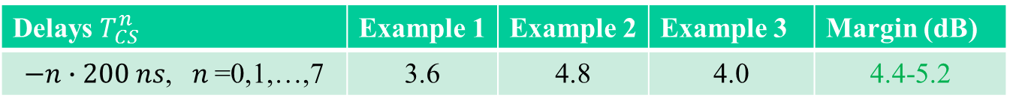
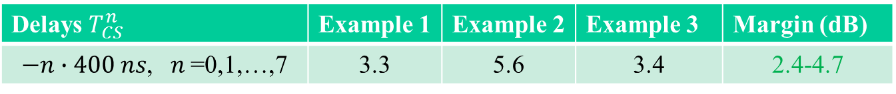
Phase randomization + cyclic shift randomization (FCC, 8 dBm/3kHz)
LDR – Max power in 3 kHz sub-band (dBm)
Delays $T_{CS}^{n}$ | Example 1 | Example 2 | Example 3 | Margin (dB)
$−n∙400 ns$, $n$=0,1,…,7 | 3.3 | 5.6 | 3.4 | 2.4-4.7
HDR – Max power in 3 kHz sub-band (dBm)
Delays $T_{CS}^{n}$ | Example 1 | Example 2 | Example 3 | Margin (dB)
$−n∙200 ns$, $n$=0,1,…,7 | 3.6 | 4.8 | 4.0 | 4.4-5.2

Slide 10
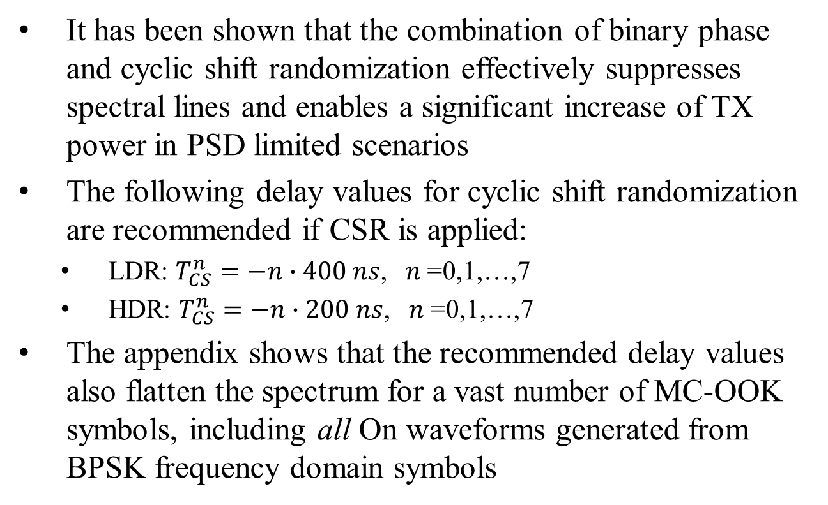
Conclusions
It has been shown that the combination of binary phase and cyclic shift randomization effectively suppresses spectral lines and enables a significant increase of TX power in PSD limited scenarios
The following delay values for cyclic shift randomization are recommended if CSR is applied:
  LDR: $T_{CS}^{n}=−n∙400 ns$, $n$=0,1,…,7
  HDR: $T_{CS}^{n}=−n∙200 ns$, $n$=0,1,…,7
The appendix shows that the recommended delay values also flatten the spectrum for a vast number of MC-OOK symbols, including all On waveforms generated from BPSK frequency domain symbols

Slide 11
Straw poll
Do you agree that the delays applied by Cyclic Shift Randomization take on the values recommended for HDR and LDR in slide 10?
Y
N
A

Slide 12
References
[1] Spectral line suppression for MC-OOK, IEEE 802.11-18/1179r1, M. López et al.
[2] WUR Power Spectral Density, IEEE 802.11-18/0824r1, S. Shellhammer et al.
[3] WUR PSD Studies, IEEE 802.11-18/1165r1, V. Kristem et al.
[4] Draft P802.11ba D0.4

Slide 13
Appendix
The delay values suggested in slide 10 have been evaluated in slides 7 – 9 for the example symbols
In this appendix it is shown that these delay values flatten the spectrum not only for the examples but also for a wide choice of MC-OOK symbols. In particular,
  LDR: CSR flattens the spectrum for all possible combinations of BPSK frequency domain symbols
  HDR: CSR flattens the spectrum for all possible combinations of QPSK frequency domain symbols

Slide 14
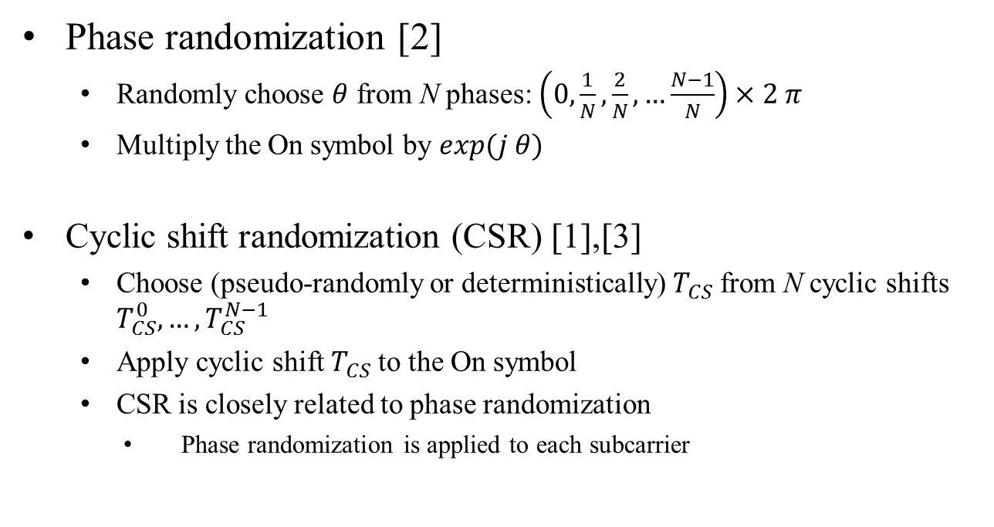
Recap - symbol randomization techniques
Phase randomization [2]
  Randomly choose $θ$ from N phases: $\left(0,\frac{1}{N},\frac{2}{N}, …\frac{N−1}{N}\right)×2 π$
  Multiply the On symbol by $exp⁡(j θ)$
Cyclic shift randomization (CSR) [1],[3]
  Choose (pseudo-randomly or deterministically) $T_{CS}$from N cyclic shifts $T_{CS}^{0},…,T_{CS}^{N−1}$
  Apply cyclic shift${ T}_{CS}$ to the On symbol
  CSR is closely related to phase randomization
    Phase randomization is applied to each subcarrier

Slide 15
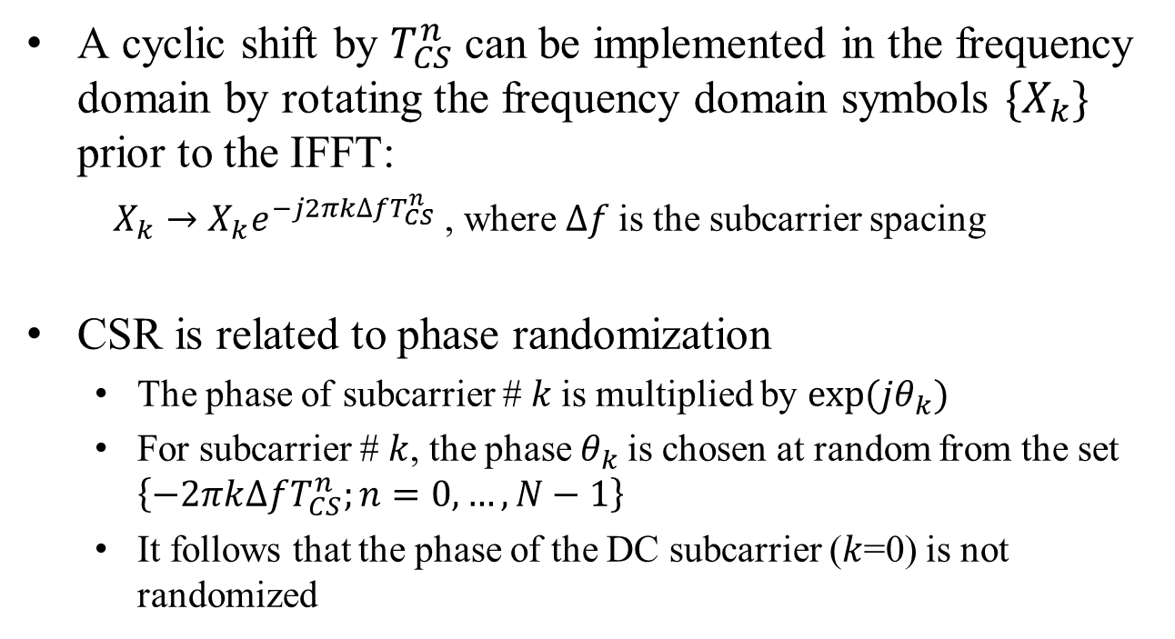
Cyclic shift randomization
A cyclic shift by $T_{CS}^{n}$ can be implemented in the frequency domain by rotating the frequency domain symbols ${\{X}_{k}\}$ prior to the IFFT:
  $X_{k}→X_{k}e^{−j2πk∆fT_{CS}^{n}}$ , where $∆f$is the subcarrier spacing
CSR is related to phase randomization
  The phase of subcarrier # $k$is multiplied by ${exp⁡(jθ}_{k})$
  For subcarrier # $k$, the phase$θ_{k}$ is chosen at random from the set $\left\{−2πk∆fT_{CS}^{n};n=0,…,N−1\right\}$
  It follows that the phase of the DC subcarrier ($k$=0) is not randomized

Slide 16
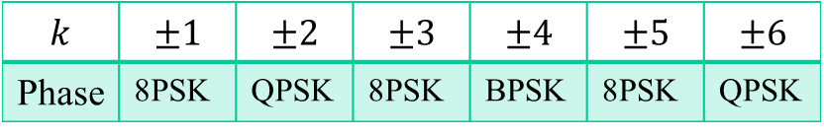
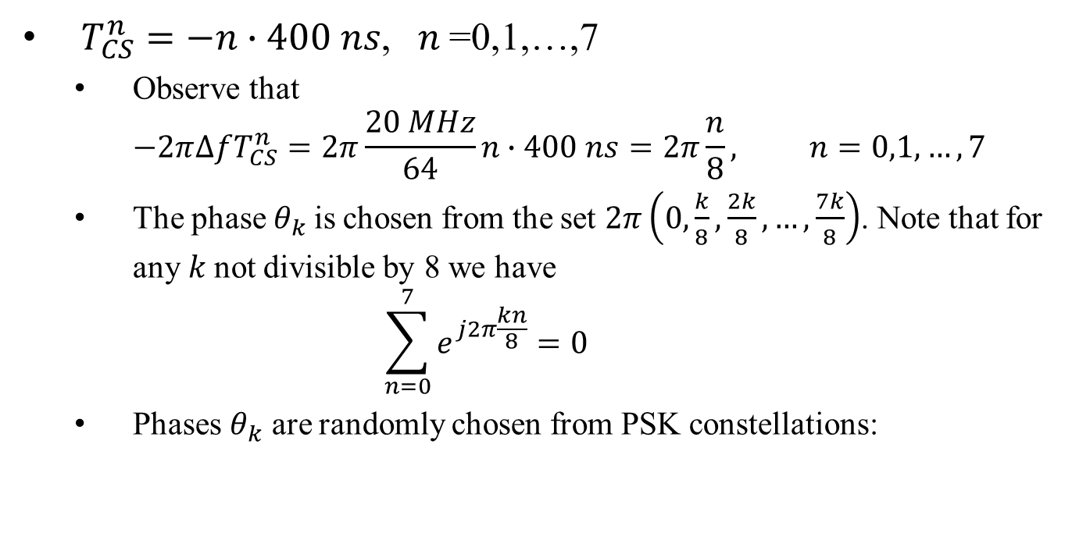
Suggested cyclic shifts, 4 us symbols
$T_{CS}^{n}=−n∙400 ns$, $n$=0,1,…,7
  Observe that
  $−2π∆fT_{CS}^{n}=2π\frac{20 MHz}{64}n∙400 ns=2π\frac{n}{8}, n=0,1,…,7$
  The phase$θ_{k}$is chosen from the set $2π\left(0,\frac{k}{8},\frac{2k}{8},…,\frac{7k}{8}\right)$. Note that for any $k$not divisible by 8 we have
  $\sum_{n=0}^{7}{e^{j2π\frac{kn}{8}}}=0$
  Phases $θ_{k}$ are randomly chosen from PSK constellations:
$$k$$ | $$±1$$ | $$±2$$ | $$±3$$ | $$±4$$ | $$±5$$ | $$±6$$
Phase | 8PSK | QPSK | 8PSK | BPSK | 8PSK | QPSK

Slide 17

Suggested cyclic shifts, 2 us symbols
$T_{CS}^{n}=−n∙200 ns$, $n$=0,1,…,7
  Observe that
  $−2π∆fT_{CS}^{n}=2π\frac{20 MHz}{32}n∙200 ns=2π\frac{n}{8}, n=0,1,…,7$
  The phase$θ_{k}$is chosen from the set $2π\left(0,\frac{k}{8},\frac{2k}{8},…,\frac{7k}{8}\right)$, as in the previous slide

Slide 18
Metric for spectrum flattening (1)
To evaluate the effectiveness of CSR when applied to arbitrary MC-OOK symbols, we propose a simple metric to measure the amount of PSD flattening, which we call LeftRightImbalance.
  Without CSR: LeftRightImbalance is the ratio of the baseband signal power over the negative frequencies to the baseband signal power over the positive frequencies
  With CSR: LeftRightImbalance is the ratio of the average over all the cyclic shifts of the baseband signal power over the negative frequencies to the average over all the cyclic shifts of baseband signal power over the positive frequencies
The extent of PSD flattening can be measured as the difference between LeftRightImbalance without CSR and with CSR

Slide 19
Metric for spectrum flattening (2)
Without CSR
LeftRightImbalance can be computed directly by numerical integration (as opposed to simulation)

Slide 20
Metric for spectrum flattening (3)
With CSR

Slide 21
Example calculation of LeftRightImbalance HDR without CSR
LeftRightImbalance = 1.2 dB

Slide 22
Example calculation of LeftRightImbalance HDR with CSR
LeftRightImbalance = 0 dB

Slide 23
Left-Right Imbalance LDR
LeftRightImbalance for example symbols
LeftRightImbalance=0.0 dB with CSR, computed for all possible combinations of BPSK frequency domain symbols
|LeftRightImbalance| < 0.2 dB with CSR, computed for 10K random choices of QPSK frequency domain symbols
Freq domain symbols | LeftRightImbalance (dB) without CSR | LeftRightImbalance (dB) with CSR
Ex1 | 1.5 | 0.0
Ex2 | -1.0 | 0.0
Ex3 | -1.1 | 0.0

Slide 24
Left-Right Imbalance HDR
LeftRightImbalance for example symbols
LeftRightImbalance = 0.0 dB with CSR, computed for all possible combinations of QPSK frequency domain symbols
Freq domain symbols | LeftRightImbalance (dB) without CSR | LeftRightImbalance (dB) with CSR
Ex1 | 1.2 | 0.0
Ex2 | 1.5 | 0.0
Ex3 | 0.2 | 0.0

