Slide 1
NGSM Next Generation Spectrum Management
Date: 2018-07-06
Authors:

Slide 2
Introduction
In San Diego I introduced the need for a change in the way spectrum is managed
Straw polls indicated interest and the need for more information
This presentation provides additional information and a plan for working with regulators to progress the initiative
Agenda

Slide 3
Background
Document 11-18/1055r3 was presented at the 802.11 WNG SC meeting in San Diego
The following three slides show the results of the strawpolls conducted
There is general agreement that the work should be conducted within 802; not necessarily 802.11
Although the vote on 802 regulator advocacy was negative, the vast majority wanted more information

Slide 4
Straw Poll
Do you believe that a group or groups within IEEE 802 should investigate the feasibility of Multi-band White Space?
YES - 49
NO - 13
More information required to make a decision? - 53

Slide 5
Straw Poll
Which group(s) should do this work?
802.11? - 31
802.22? - 0
Both - 2
Other - 24

Slide 6
Straw Poll
Should IEEE 802 advocate to regulators, for an AI managed database for spectrum management?
YES - 6
NO - 15
More information required to make a decision? - 76
Paul Nikolich: There is another IEEE project about AI that Rich may want to co-ordinate with.

Slide 7
General White Spaces
DARPA Project XG tried to take advantage of unused spectrum
www.daml.org/meetings/2005/04/pi/DARPA_XG.pdf
Sensing across a range of frequencies could locate unused segments for a specific location and time, i.e. White Spaces
Perfect identification of unused spectrum is required, and very difficult using only sensing
In 2006, the FCC looked at this WRT the TV bands
The digital transition could make a lot of spectrum available for unlicensed use
However, the decision to auction the 600 MHz band severely limited the number of available channels

Slide 8
Multi-Band White Spaces
The limited success of TVWS technology resulted in a loss of interest in all White Spaces
The TV bands were a choice of opportunity
Based on location and time, there are still vast amounts of White Space, but with technical challenges
Meeting technical and regulatory challenges has always been an IEEE 802 focus
The key to rethinking White Spaces is identifying the challenges and meeting them
The key to success of MBWS is a revamp of the way spectrum is allocated

Slide 9
Spectrum Management Future
The NTIA spectrum map on the following slide looks very complex, but it represents an aggregation of all US spectrum allocations
It does not represent any specific location or time of day
A nearly infinite set of maps would be needed to show the available spectrum at any location in the U.S.
This problem is the perfect example of how AI can manage the unmanageable
To avoid a spectrum deadlock in the next 20 years, we must first convince regulators that this is a requirement and need action now

Slide 10
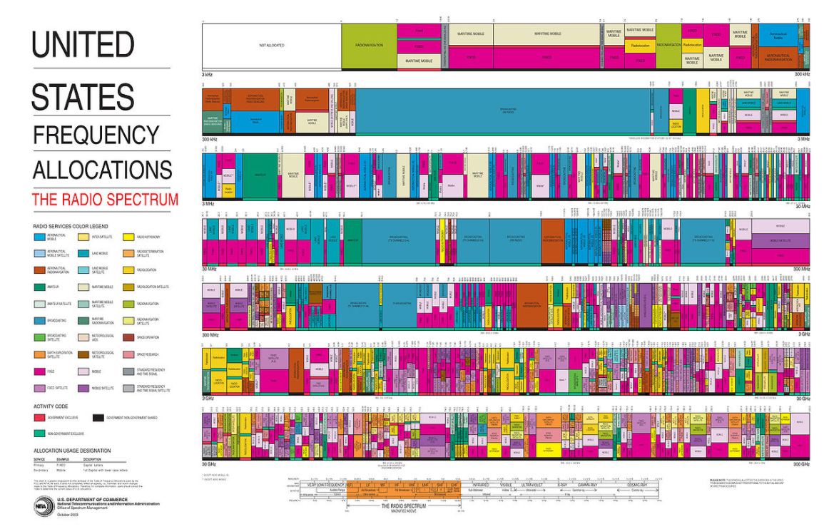
The U.S. Spectrum Map

Slide 11
Advantages of AI Managed Spectrum
Any location within the managed borders will have its own map and timetable showing frequencies available during all 24 hours of a day
Make better use of current unlicensed bands
Interference can be better managed
Mobile devices can know what frequencies are available where they are AND where they are going
Changes, corrections and fine tuning can be done nearly instantaneously
Regulatory changes can be incorporated rapidly
New technologies can be assured of available spectrum for testing and use

Slide 12
Plan for Regulatory Action
Begin with the US FCC and NTIA
Emails have been sent, but f2f meetings are a must
Full industry support will force regulators to take a hard look at it
The 6 GHz band sharing initiative is a good example
We should ask for a study, which industry will support
We need credible projections for spectrum congestion 5, 10, 15 and 20 years in the future
Based primarily on urban areas, where spectrum is most needed and in shortest supply

Slide 13
Questions?

Slide 14
References
FCC
https://www.fcc.gov/general/white-space
Ofcom
https://www.ofcom.org.uk/consultations-and-statements/category-1/white-space-coexistence
Microsoft
http://whitespaces.microsoftspectrum.com/
My documents
https://www.linkedin.com/pulse/multi-band-white-space-spectrum-access-rich-kennedy/
https://mentor.ieee.org/802.18/dcn/18/18-18-0060-02-0000-a-future-for-unlicensed-spectrum.pptx

